Slide 1
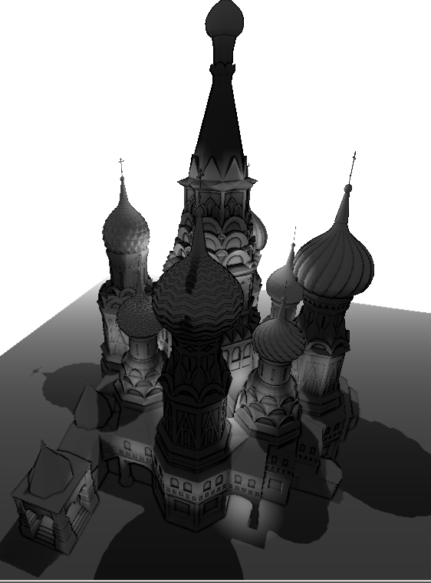
Deferred Shading

Slide 2
Introduction
Deferred shading is the rendering technique of writing scene information to a set of intermediate buffers – the “G buffer” - before calculating other effects such as lighting
Uses MRT (Multiple Render Targets) – writing to multiple buffers in one pass
All the lighting is now done by the programmer instead of the graphics API.

Slide 3
Popular Deferred Shading
Some well-known games which use DS:
  Grand Theft Auto 4
  Killzone 2
  Little Big Planet
  inFamous
  Dead Space

Slide 4
Pros and Cons
Pros:
  Managing massive amounts of different types of lights is possible
  Complimentary to many other effects such as Depth of Field, shadows, etc
  Faster in scenes with many lights
  Early Z-culling

Slide 5
Cons
Massive memory usage
Lack of transparency support
Lack of built-in anti-aliasing

Slide 6
G-Buffer
So what goes in a g-buffer?
  The g-buffer stores all the information you need to make lighting calculations
  For instance:
    Diffuse Color
    Specular Color
    Normal information
  This all would normally be passed to the graphics card via glMaterialf() – now we do the work.

Slide 7
G-Buffer implementation
The format of the G-Buffer can vary extensively, but here is mine:
  Diffuse – GL_RGBA
  Normal – GL_RGBA16 (also stores linear depth)
  Specular – GL_RGBA
Some people store worldspace position, but that takes GL_RGBA32 and is generally discouraged
The following slides will show typical content:

Slide 8

Diffuse buffer:

Slide 9
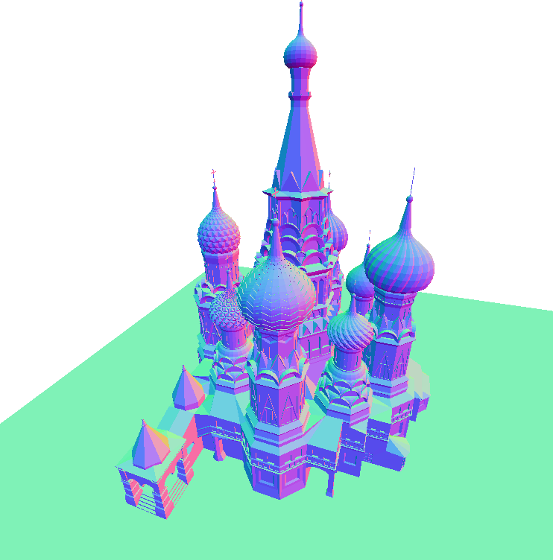
Normal Buffer:

Slide 10

Specular Buffer:

Slide 11
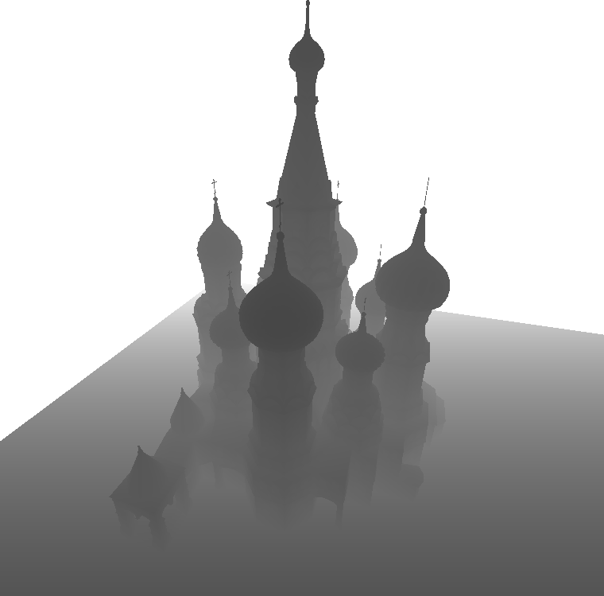
Linear Depth:

Slide 12
Lighting
So now that the g-buffer is populated, you can use that information to do lighting.
Phong lighting is seperable – you can do diffuse calculations, then specular calculations, and combine the results
A light accumulation buffer (similar to OpenGL’s accumulation buffer), stores the contribution from all lights before calculating the final scene

Slide 13
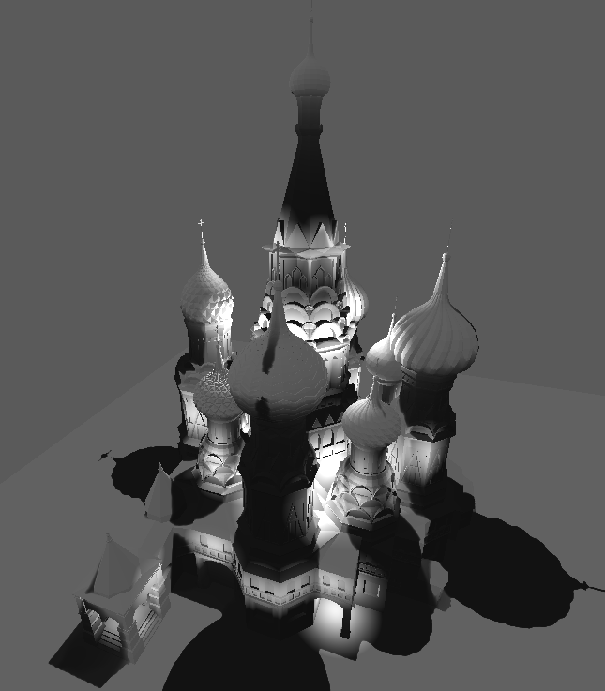
Light buffer:

Slide 14
Optimizations
You don’t want to calculate lighting for pixels which will receive no light.
Performance can be dramatically improved if you use scissor or stencil testing per light
“Light volumes”

Slide 15
Screen Space Ambient-Occlusion
In a realistic lighting model, light bounces many times around the scene.
There will be areas which receive very little of this ambient light – cracks, corners, wrinkles, etc.
This is a technique solely popularized by Crysis - emulates a global lighting model using nothing but a linear depth buffer

Slide 16
Depth Darkening
SSAO is very GPU demanding because it requires around 16 texture lookups per pixel to get a good “feel” for the neighboring geometry + a blur afterwards
“Depth Darkening” is a technique to emulate SSAO.
Darkens depth discontinuities cheaply

Slide 17
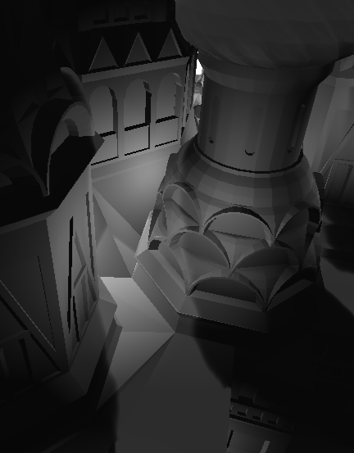
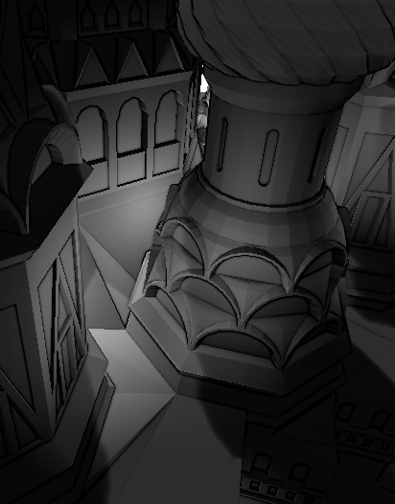
On/Off

Slide 18
Shadowmapping
Shadows are done almost exclusively using shadowmapping these days
1.) Take a picture of the depth buffer from the lights position
2.) Project this lights depth buffer onto the scene, and compare the projected lights depth for that pixel & the real distance to the light
If the true distance is greater, you know something is in the way and that pixel is shadowed

Slide 19
Exponential Shadows
Realtime shadowing is a big area of research
There are probably about 10 different ways to achieve nice looking shadows
Performance/quality tradeoff
Exponential shadows uses a probability distribution rather than a step-function to determine whether a pixel is lit.
Cheap + nice looking

Slide 20
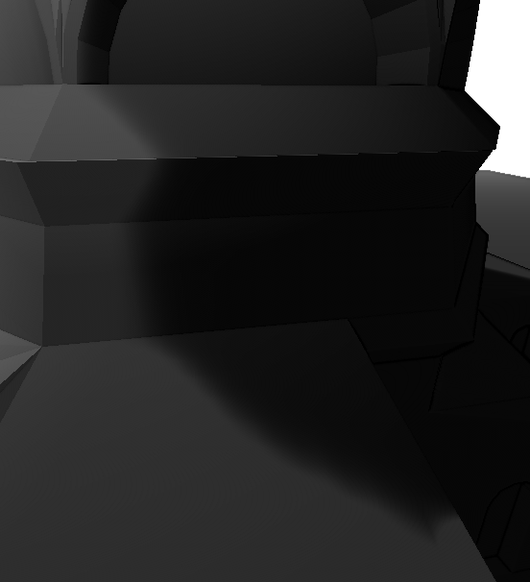
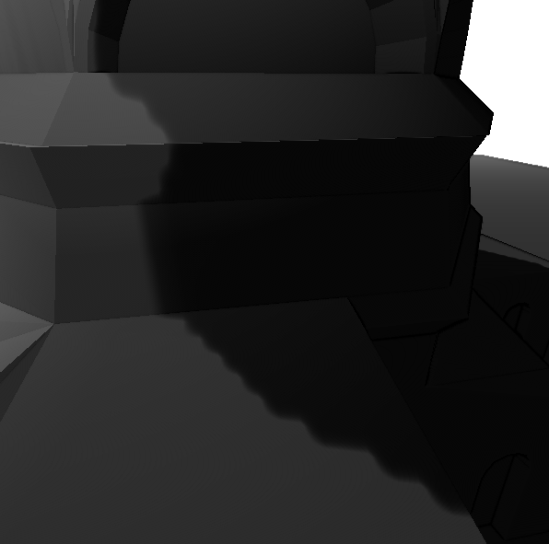
On / Off

Slide 21
Motion Blur
A traditional way to motion blur uses the accumulation buffer
This frame = (last frame + this frame)/2
Slow and not too realistic

Slide 22
Motion Blur
I used a technique from “GPU Gems 3” that looks at the last frames modelview matrix and compares it to this frames
Using a shader and these matrices, you can determine the velocity of any given pixel.
You can then do a directional blur

Slide 23
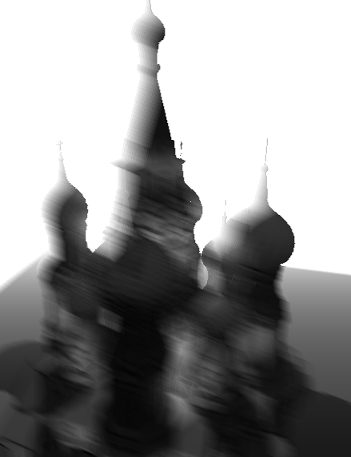

Slide 24
Depth of Field
Lots of games use this – Call of Duty: MW2
Simulates eye focus
I compared the depth of the center of the screen to the depth of the current pixel being rendered. If this depth was great, a more aggressive gaussian blur was applied.

Slide 25
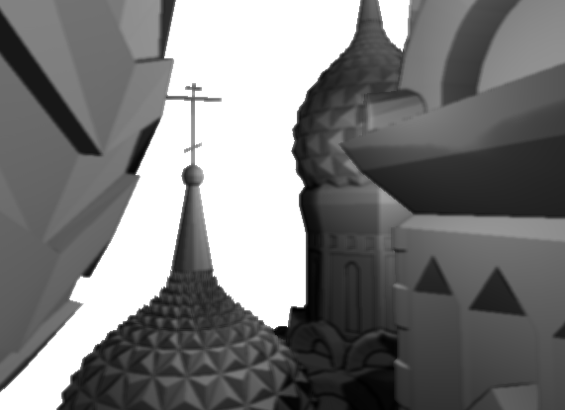
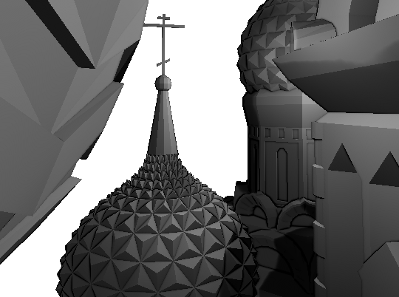
On / Off

Slide 26
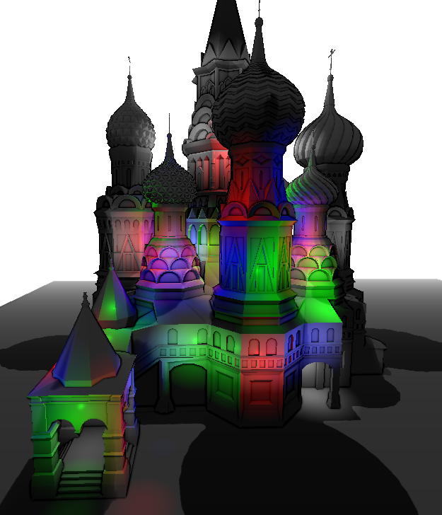
Thank you! Merry Christmas!

Slide 27
Sources:
Depth Darkening:
http://graphics.uni-konstanz.de/publikationen/2006/unsharp_masking/Luft%20et%20al.%20--%20Image%20Enhancement%20by%20Unsharp%20Masking%20the%20Depth%20Buffer.pdf

Slide 28
Exponential Shadows
http://research.edm.uhasselt.be/~tmertens/papers/gi_08_esm.pdf

Slide 29
Motion Blur
http://http.developer.nvidia.com/GPUGems3/gpugems3_ch27.html

