Slide 1
Fusion Style Restaurants
Expansion Analysis

Slide 2
Fusion Restaurants
Combine two cuisines into one
Most often quick service
Any combination of style is possible
Theoretically combine German and Latin:
Empanadas filled with Bratwurt

Slide 3

Burrigato
Founded in 2017
Two former students, Korra and Daniel
University of Minnesota
Asian
Mexican
Note: Burrigato is a real world restaurant, but for the purposes of this presentation should be considered a fictional example.

Slide 4
University Locations
Student bodies have diverse tastes
Students often dine in groups
Fusion restaurants satisfy multiple tastes in a single venue

Slide 5
The Question:
If the Burrigato owners desired to open a franchise near another Big Ten Conference University, which of the thirteen schools has the highest concentration of Asian and Mexican restaurants and would therefore be considered the optimal expansion candidate?

Slide 6
Data acquisition
University locations from wikipedia
University coordinates from Fourquare
Restaurant locations and counts from Foursquare
Limit the anlaysis to a 10Km radius

Slide 7
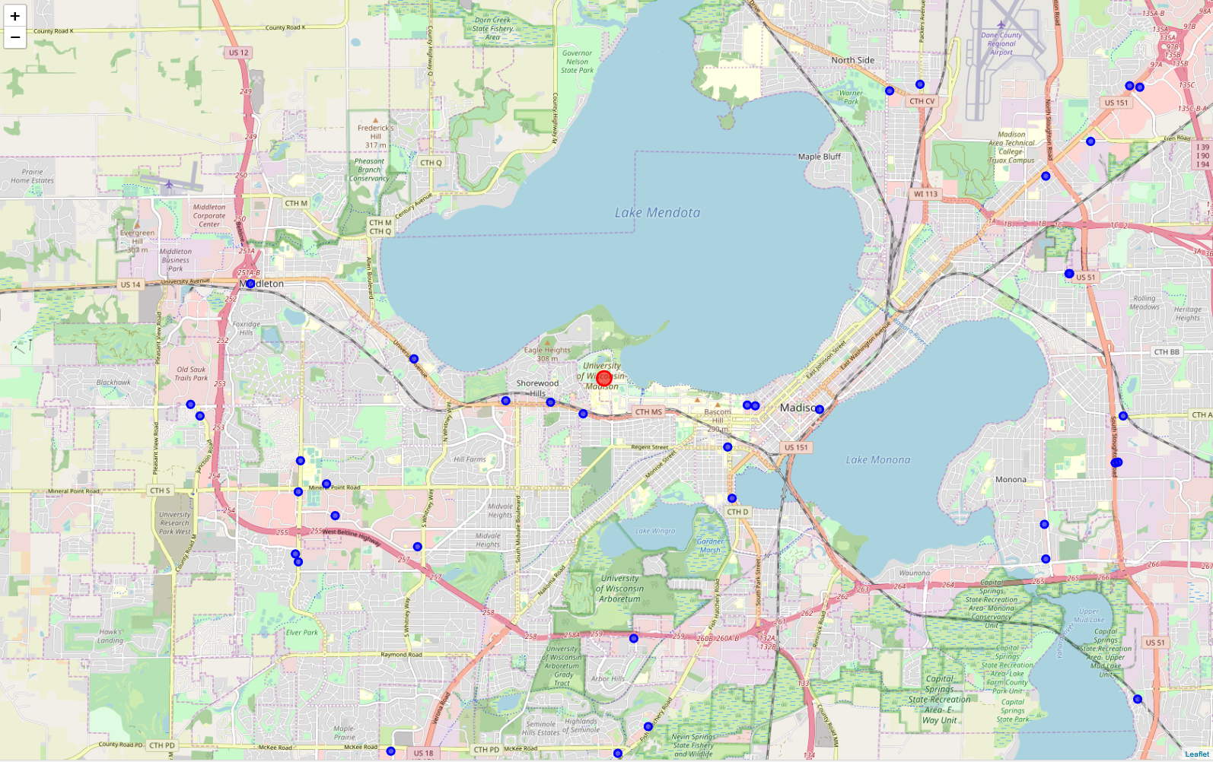
Example – Mexican Restaurants by the University of Wisconsin - Madison

Slide 8
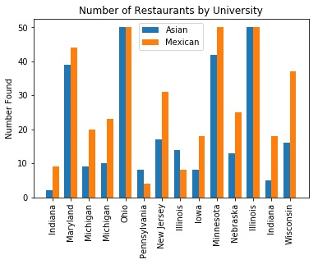
Number of Restaurants by Unversity

Slide 9
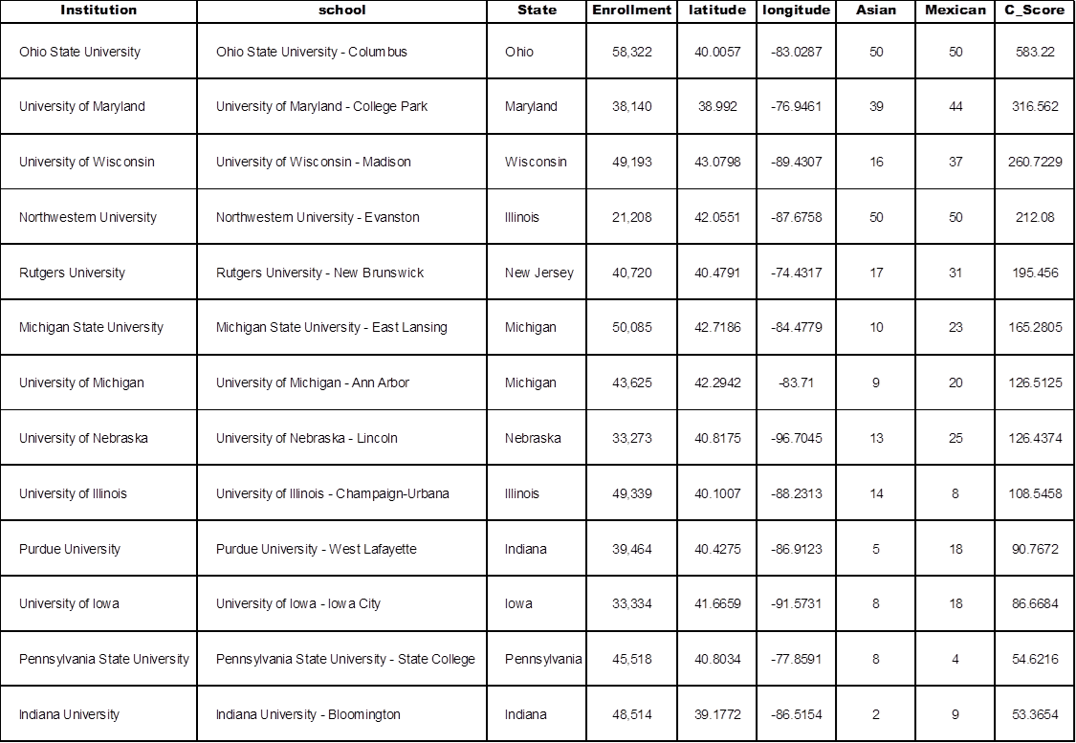
Results Table

Slide 10

Recommendation
Ohio State
Score = 583.22
Northwestern has equal number but lower concentration

Slide 11
Summary and Conclusion
Basic in nature but rigorous enough to produce accurate, viable, and actionable rankings
Scale to four or more cuisine types
Use alternate population centers
Use machine learning (e.g. K-means) for a weighted similarity factor
Target new styles rather than existing

