Slide 1

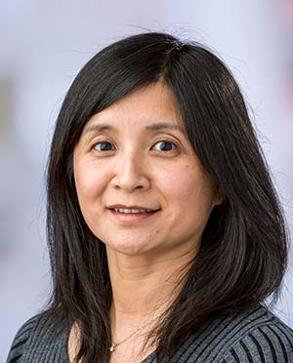

Ying Huang

Slide 2
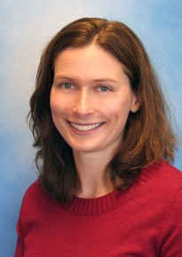
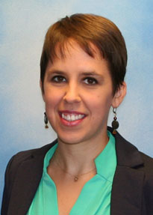
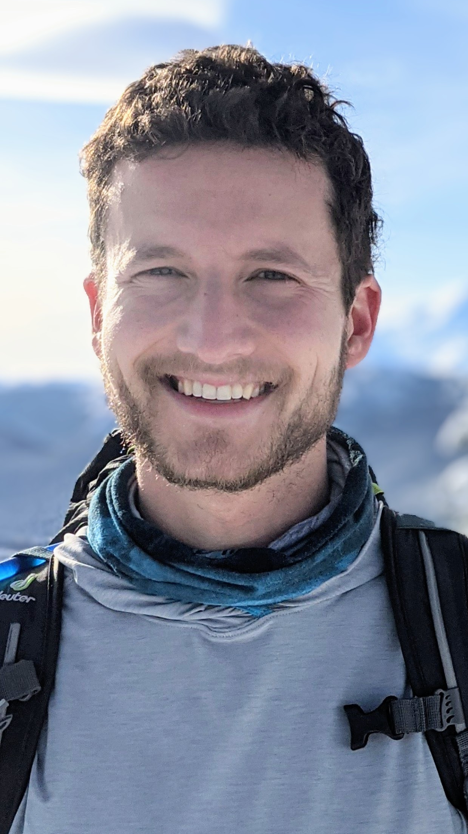


Susan Shortreed
Yates Coley
Charlie Wolock

Slide 3
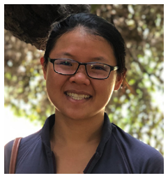

Susan Shortreed
Jean Feng

Slide 4
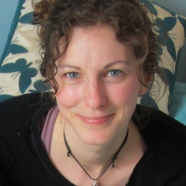

Susan Shortreed
Erica Moodie

Slide 5
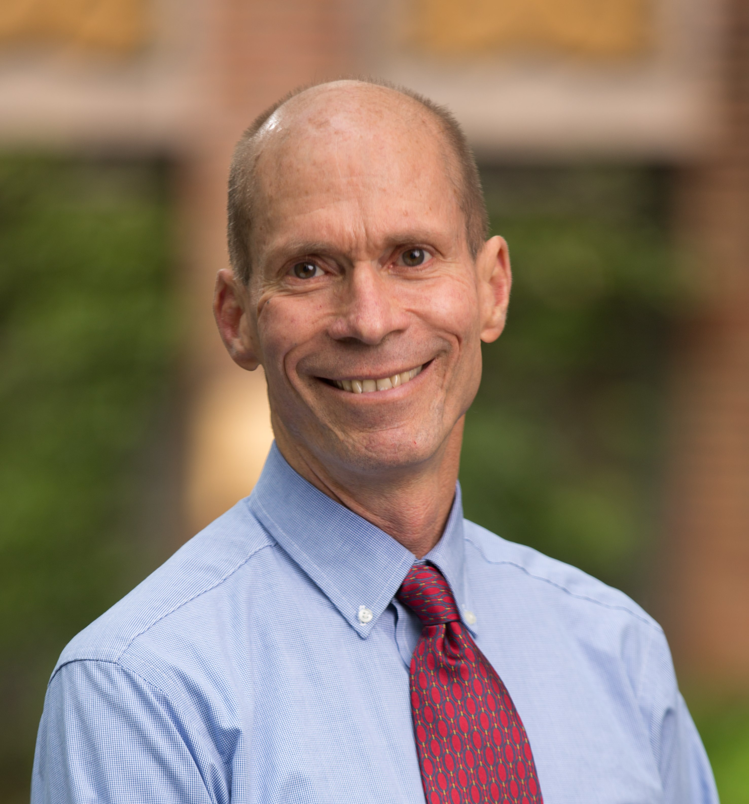
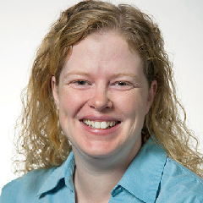

Greg Simon
Rebecca Rossom

Slide 6
Susan Shortreed
Erica Moodie
Greg Simon
Rebecca Rossom

