Slide 1
YouTube Trending Study
Berkeley Willis

Slide 2
Introduction
YouTube Trending
Question
Hypothesis
YouTube Trending is a tab that shows popular videos that are recommended due to their popularity in a certain area or country.
My initial question was, is it possible to predict what videos go into the trending tab? But this had limitations, and so instead I found a different analysis possible, can we predict number of views for a trending video.
I think that it is possible to predict the number of views for a trending video based on the number of likes, dislikes, comment counts, and age of the video.

Slide 3
Data Used
The data used in this project originated from kaggle: https://www.kaggle.com/datasnaek/youtube-new
What is contained is some basic statistical data on videos that appeared in a country’s trending tab everyday for about 6 months.

Slide 4
Variables Outline
Likes - the number of registered YouTube users that have clicked the like button for a trending video.
Dislikes - the number of registered YouTube users that have clicked the dislike button for a trending video.
Comments Count - the number of registered YouTube users that have written a comment for a trending video.
Video Age - the age of a video from the date of upload to a day of it being in the trending tab.
Trending date - the date a video appears in trending

Slide 5
Data Cleaning
The YouTube trending data is fairly clean but there are some issues of duplicates, and very large outliers. The primary reason for these outliers would be certain viral videos that get large number of views and other indicators of those views such as likes and comment counts.
The outliers will be dealt with by calculating the z-score for each of the columns and filtering those that have an absolute value of greater than 3.
z-score = y - mean(y) - std(y)
clean_pd = clean_pd [ abs(z-score) < 3 ]

Slide 6
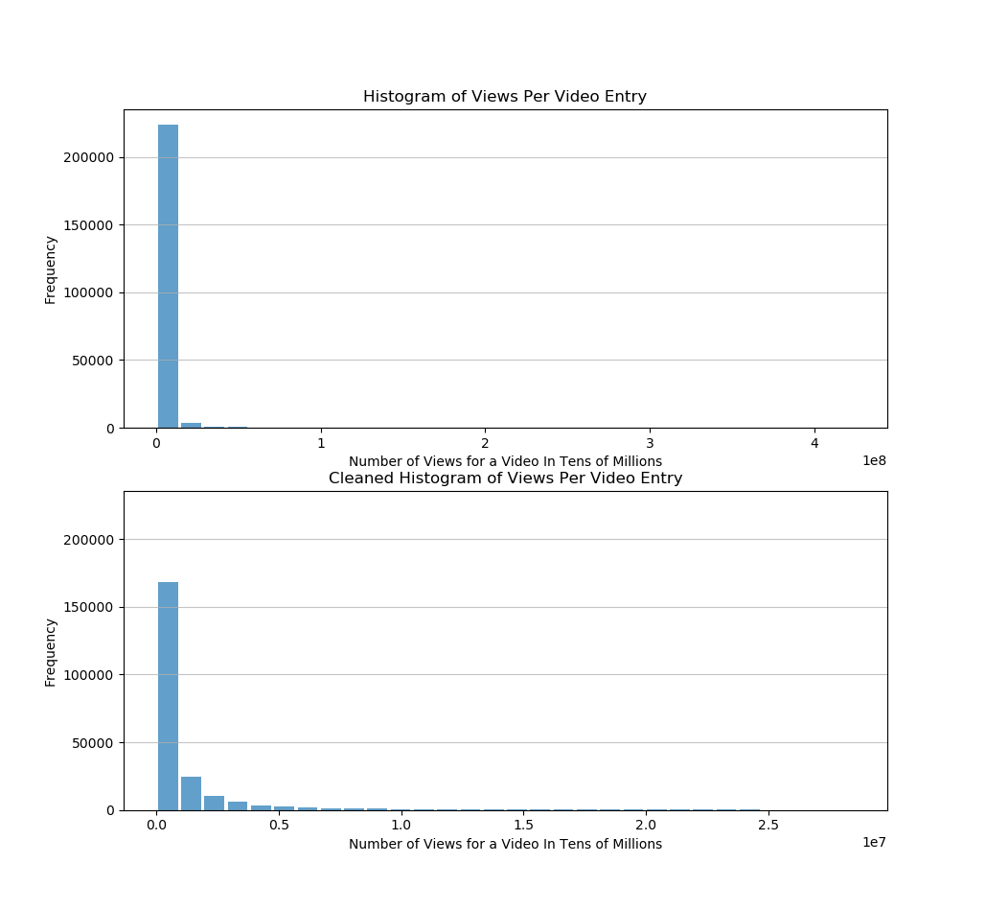
Views
Number of times that a video was viewed by a user, including anonymous users
Mean | 1.897883e+06
Mode | 6573
Std. Dev. | 8.876277e+06
Spread | This is not evenly distributed and still varies quite widely for trending videos.
Outliers | Outliers will far more views, likely due to viral videos.

Slide 7
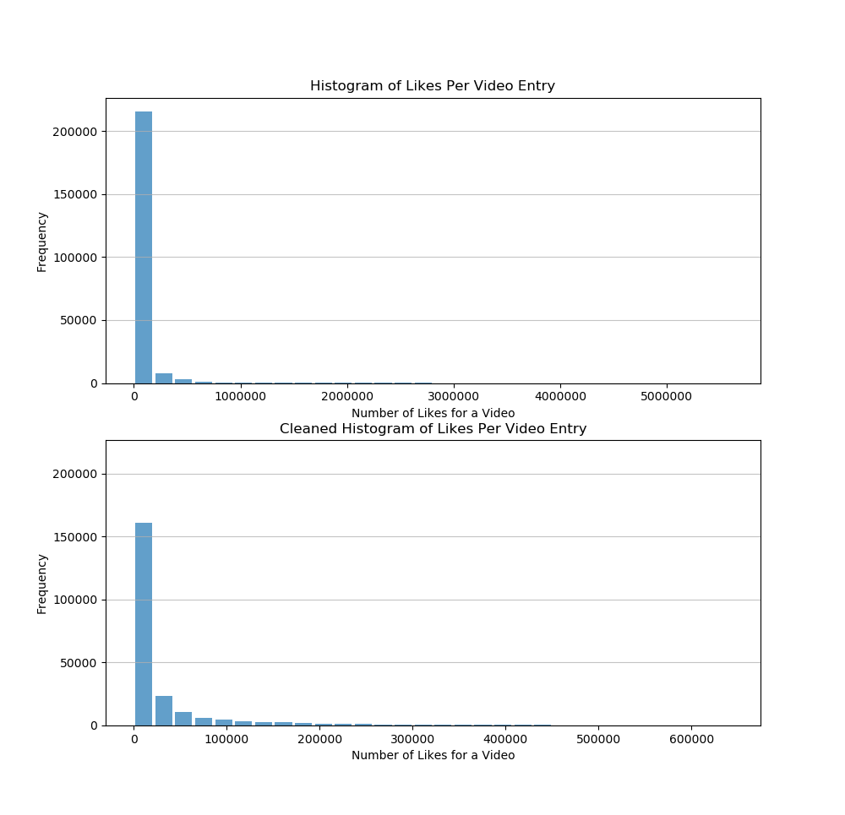
Likes
The number of registered YouTube users that clicked the like button on a video
Mean | 5.225978e+04
Mode | 0
Std. Dev. | 1.971921e+05
Spread | This is not evenly distributed and still varies quite widely for trending videos.
Outliers | Outliers will far more likes, likely due to popular viral videos.

Slide 8
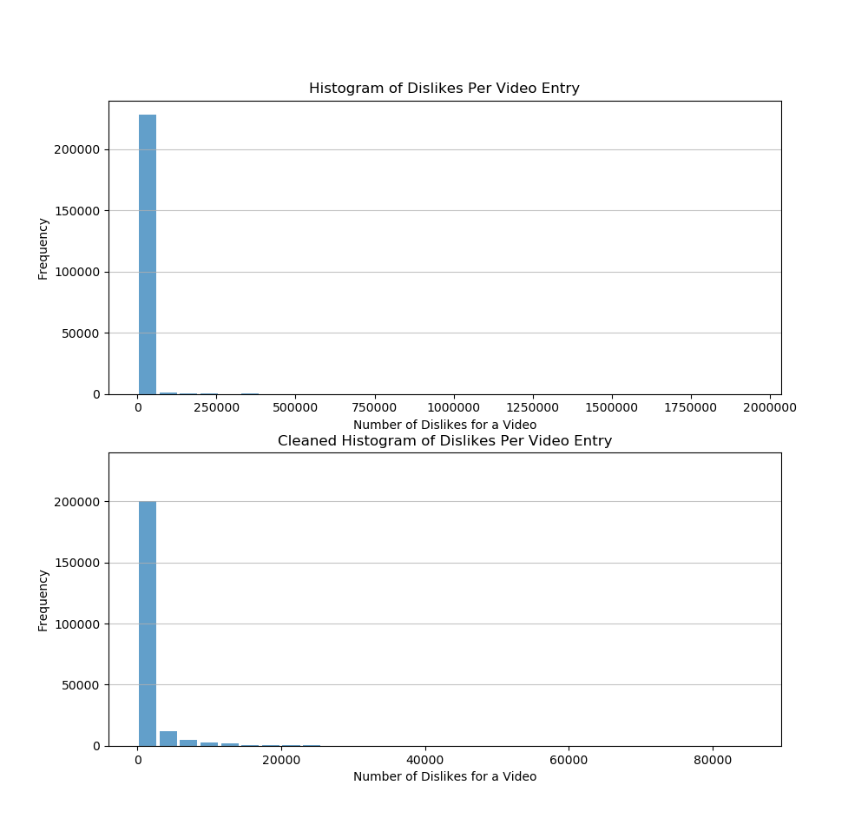
Dislikes
The number of registered YouTube users that clicked the dislike button on a video
Mean | 2.297060e+05
Mode | 0
Std. Dev. | 2.756118e+04
Spread | This is not evenly distributed and still varies quite widely for trending videos.
Outliers | Outliers will far more dislikes, likely due to viral videos with a lot of hate.

Slide 9
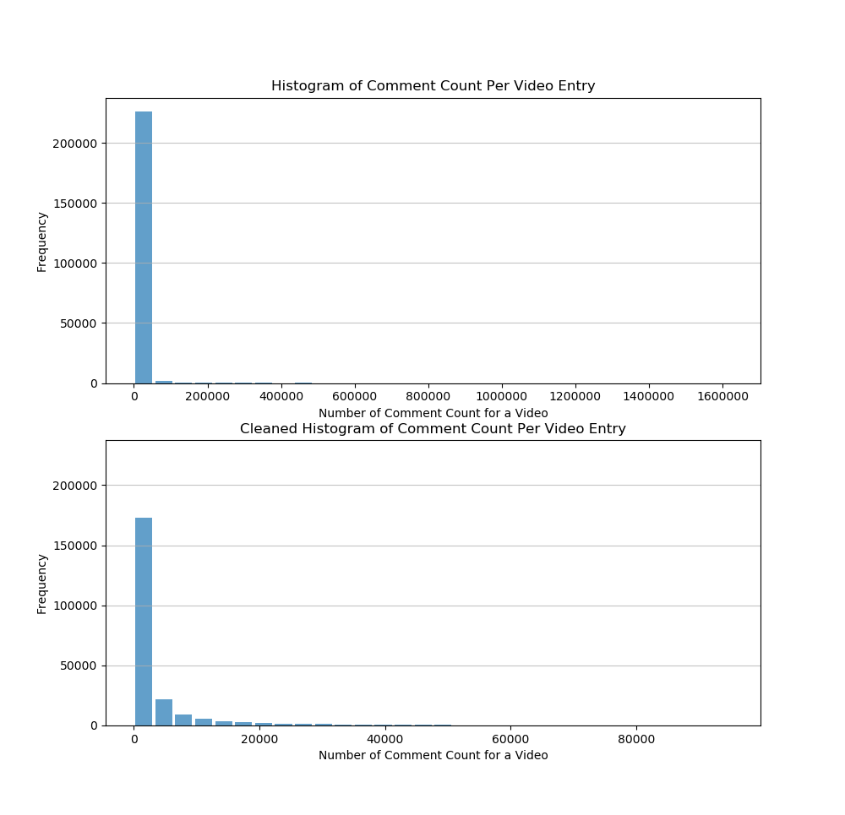
Comment Count
￼
The number of registered YouTube users that left a comment on a video
Mean | 5.664155e+03
Mode | 0
Std. Dev. | 2.992399e+04
Spread | This is not evenly distributed and still varies quite widely for trending videos.
Outliers | Outliers will far more views, likely due to viral videos that garner comments.

Slide 10
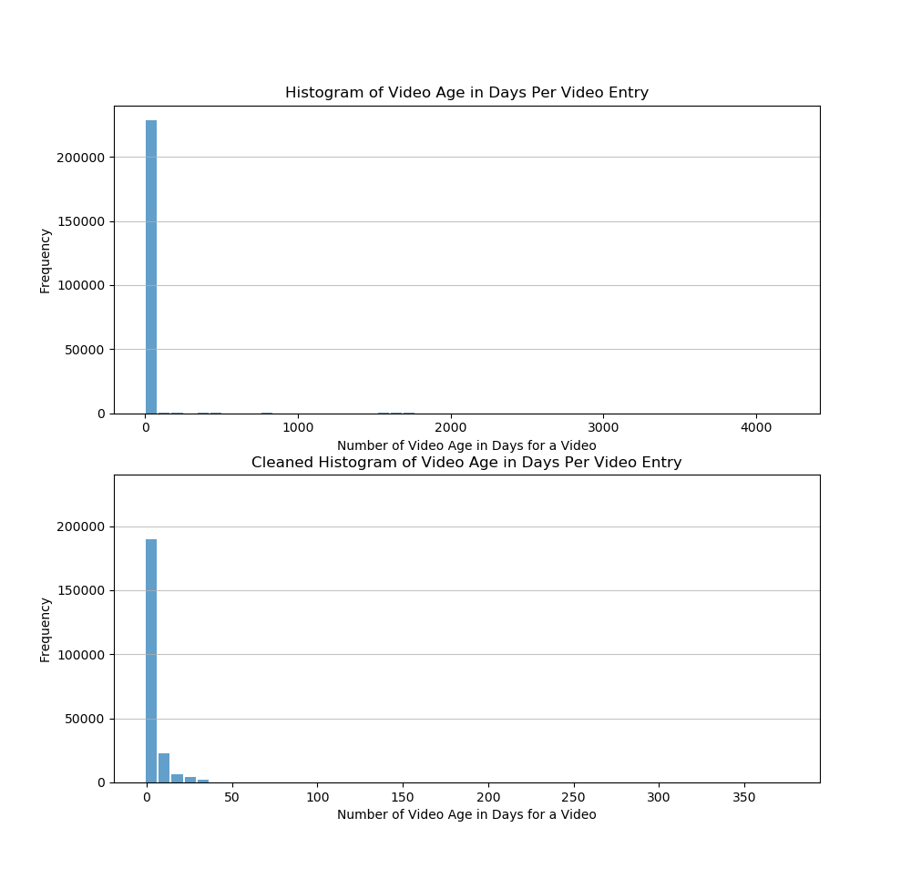
Video Age
The number of days that a trending video is on the platform at the time of trending
Mean | 9.915418
Mode | 0
Std. Dev. | 122.153945
Spread | This is not evenly distributed and still varies quite widely for trending videos.
Outliers | Outliers will far more views, likely due to viral videos.

Slide 11
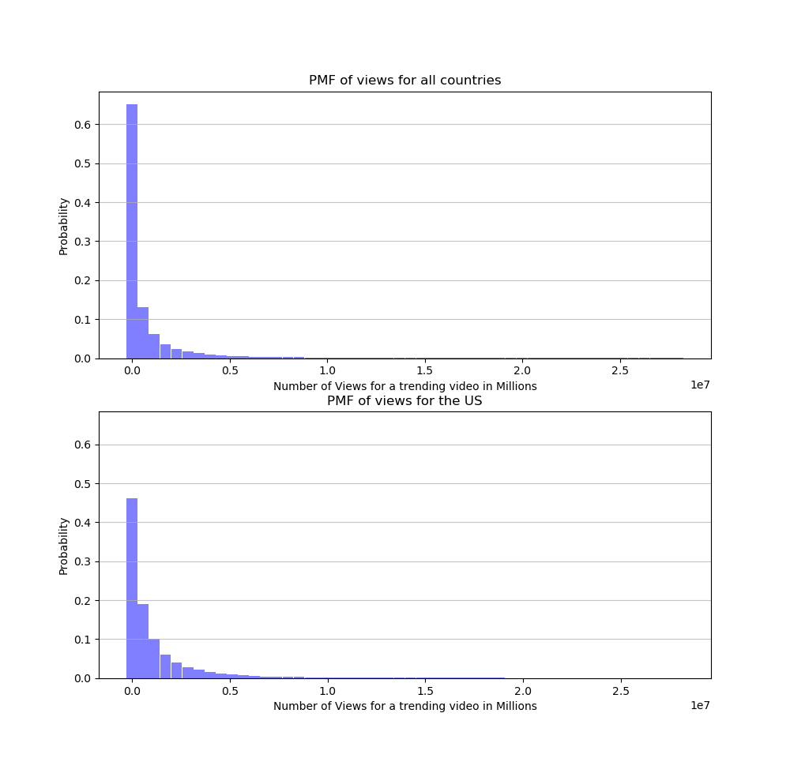
PMF of Views from World vs US Views
PMF of the number of views a video has for all countries, and then narrowed down to the US.
What we can see here is interesting, across the world there is likely a country that is pushing the distribution further to the left, because we see a somewhat more even distribution of views for trending videos in the US.

Slide 12
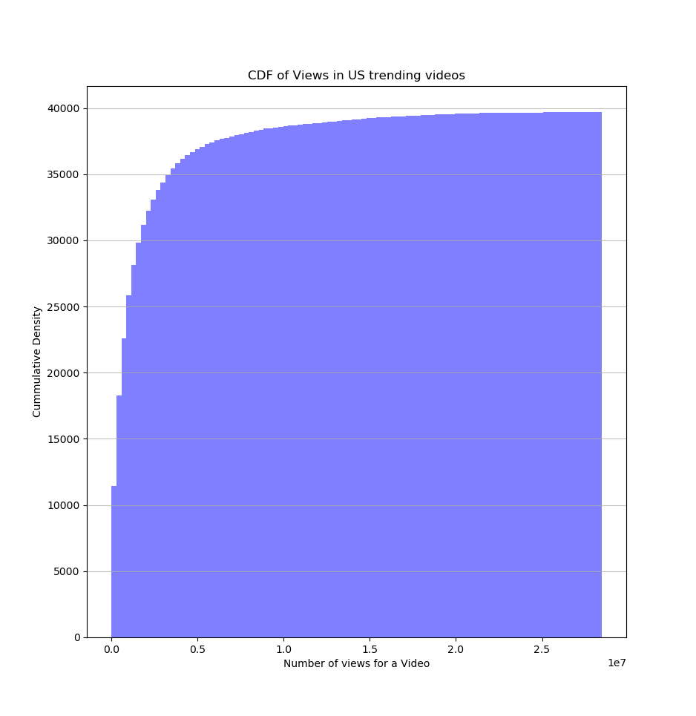
CDF for Views in the US
What does a CDF of likes look like and what does it reveal?

Slide 13
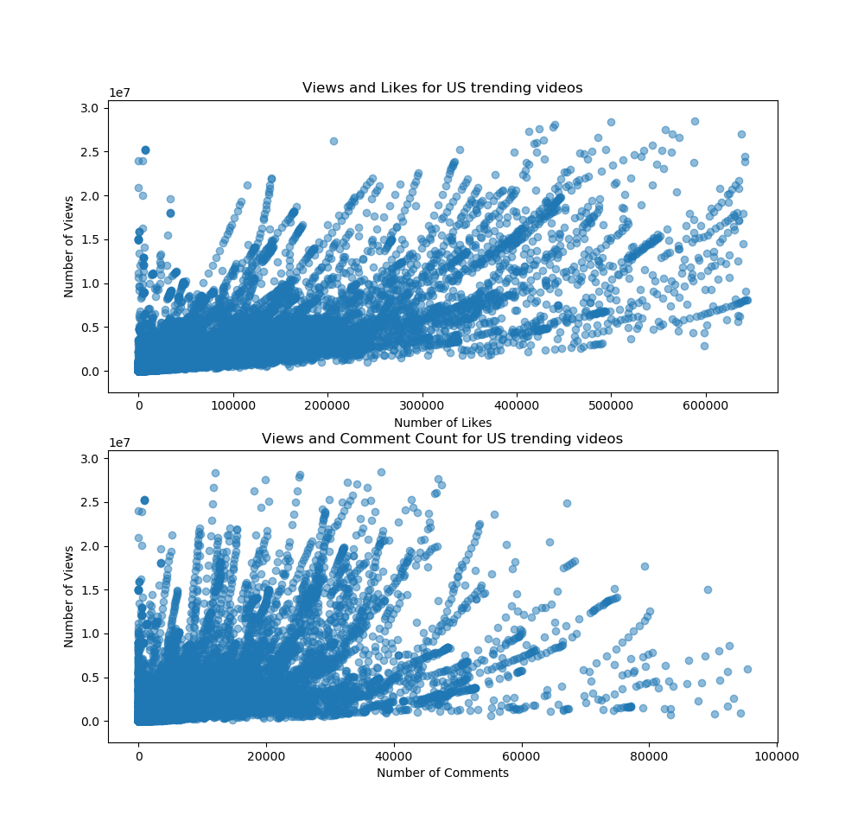
Views and Likes
The scatter plots on the right illustrate two relationships US trending videos:
Views and Likes
Views and Comment Count
What we can see there seems to be very strong correlative relationship with views and likes, and that there might be some relationship between views and the number of comments.
However the relationship for views and comments seems a little more skewed with some oddities, due to some outliers I may not have caught.

Slide 14
Relationship between Views and Likes
 | views | likes | comments
views | 1.0 | 0.789743 | 0.620483
likes | 0.789743 | 1.0 | 0.810042
comments | 0.620483 | 0.810042 | 1.0
I ran a correlation test between the three variables of interest thus far, and it does seem to illustrate a fairly strong and correlative relationships between views and the number of likes or comments.
Some thing of possible concern here is that likes and comment do have a very high relationship, even possibly showing some causality which in turn may interfere with the model.

Slide 15
Modeling for Views
Model Summary
Dep.Variable | views
Model | OLS
Method | Least Squares
No. Observations | 224788
Df Residuals | 224783
R-squared | 0.681
Adj. R-squared | 0.681
F-statistic | 1.197e+05
A model was then created to multivariate linear regression to predict how many views that a trending video would get based on several factors.
Formula: views ~ likes + dislikes + comment_count + video_age
From the R-squared values given, it seems the model isn’t very the most accurate, with the model explaining the variance in ~68% for the actual view counts.
Variable | coef | std_err | P > | t |
Intercept | 1.126e+05 | 3544.719 | 0.000
likes | 26.2963 | 0.073 | 0.000
dislikes | 159.8984 | 0.914 | 0.000
comment_count | -60.1904 | 0.720 | 0.000
video_age | 3.206e+04 | 365.585 | 0.000

Slide 16
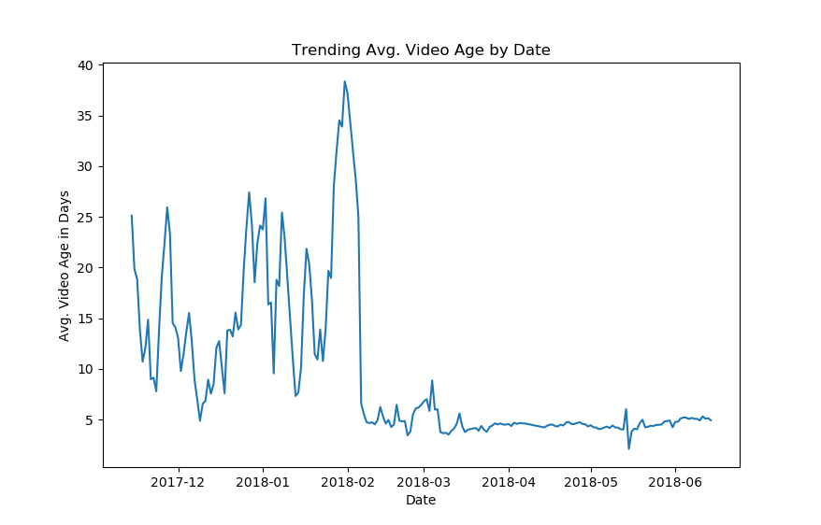
Other Exploration
This led me to want to explore some time series views of this and found some very interesting patterns that I explore in the code and figures I created in the GitHub project.
An example of this would be the mean in the change in video age between days. There is the fascinating drop off in video age that would indicate to me a change in either the trending algorithm or user behavior.

Slide 17
Conclusions
There is certainly a relationships between the number of views and the number of likes, dislikes, couodel I think maybe limited, and that there are likely other data points or more complex models that maybe better suited to predict the number of views. nt of comments, and video age. However, using only those in an analysis and creation of a m
There is also much more that can be done with this dataset, I ended up spending a considerable amount of time doing some basic time series exploration but was limited by the constraints of the data.

