Slide 1
Is Air Travel More Dangerous?
Berkeley D. Willis

Slide 2
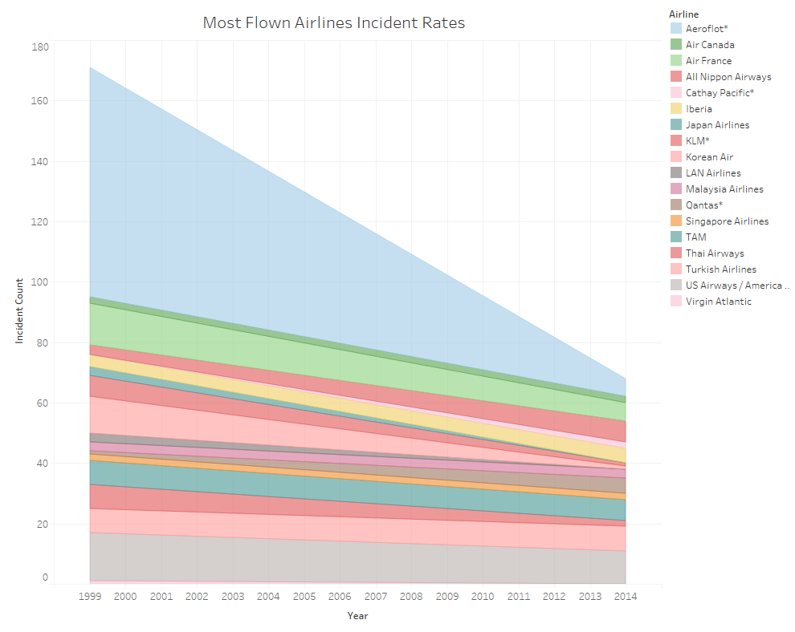
Incidents per Airline
Despite recent incidents with air travel, air travel has been getting safer over time.
The figure to the right shows the most flown airlines, and even with those that had many incidents in the past have drastically approved.

Slide 3
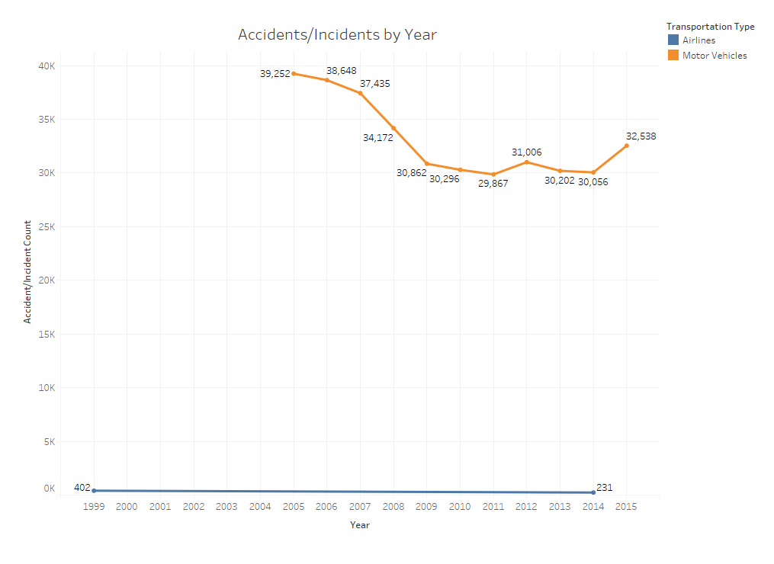
Incident Comparison
Though incidents of course occur, data collected from NHTSA Motor Vehicle Crash Data and the Aviation Safety Network there are far more motor vehicle incidents. Showing that traveling by motor vehicles like cars, trucks, buses, etc. are much more likely to have incidents.

Slide 4
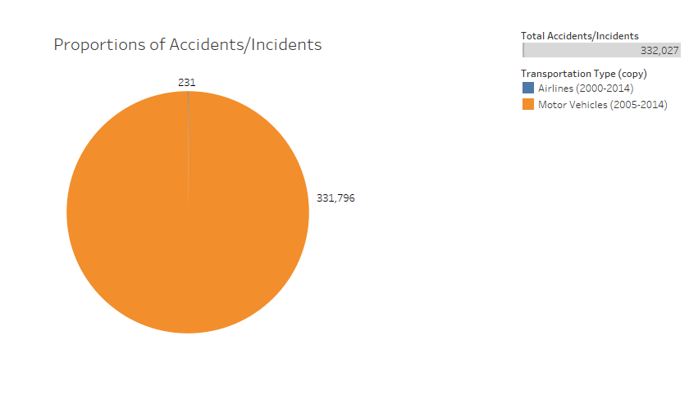
Incident Pie Chart
The figure to the right shows some of that same data, looking at counts that were available after 2000.
Even if we consider data from 2000-2014 for airlines and 2005-2014, despite data 4 years of data not being included, motor vehicles have many times more incidents.

Slide 5
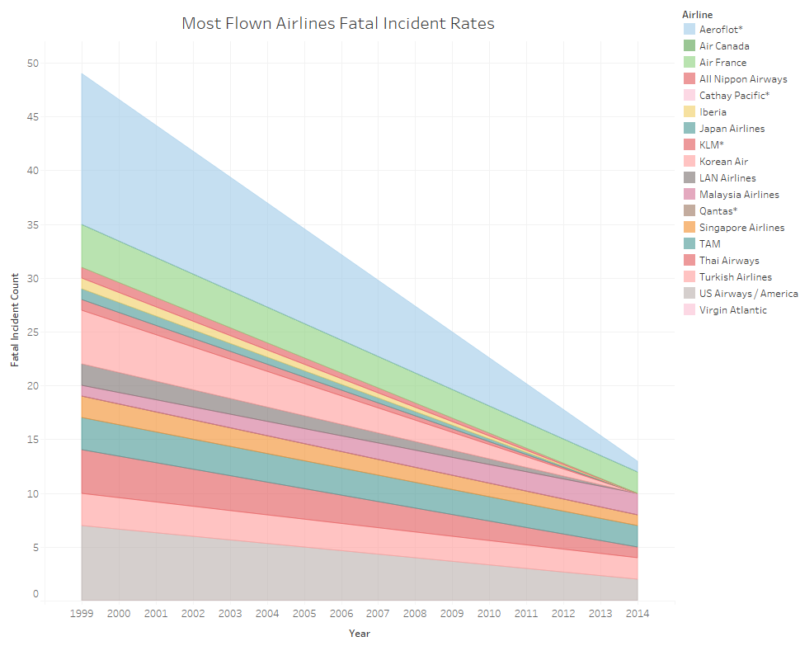
Fatal Incidents for Airlines
Furthermore, most of these incidents do not end in fatalities.
The figure on the right shows the distribution of the most traveled airlines, and whether or not they had a fatal incident. Again, the number of fatal incidents were low to begin with but decreased with time and air travel becoming safer.

Slide 6
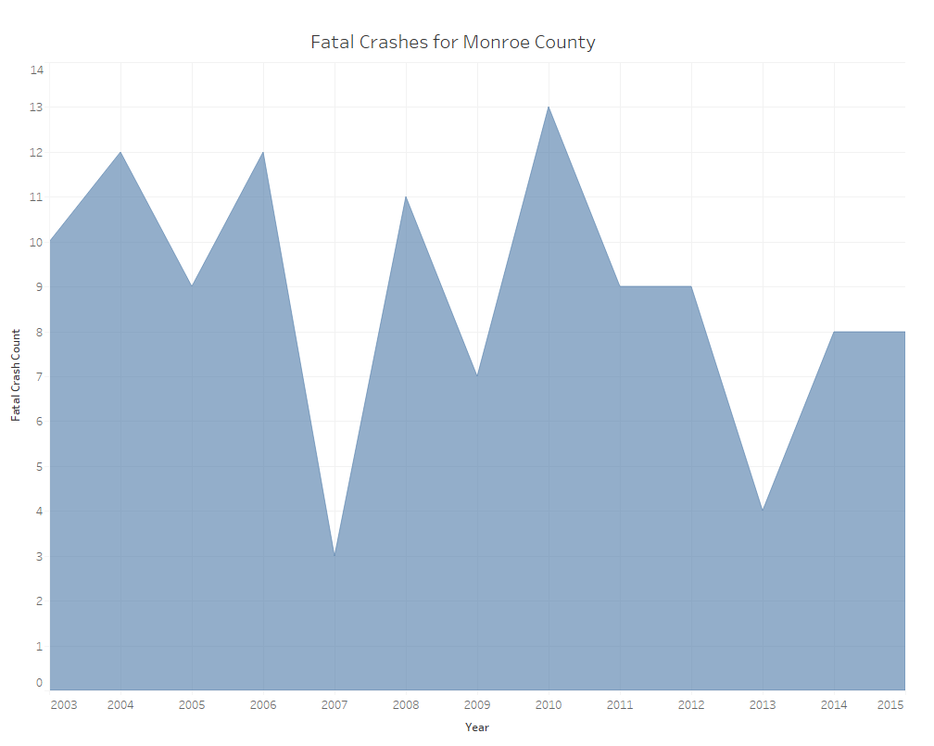
Fatal Crashes for Motor Vehicles
When viewing incidents for motor cars in just Monroe County Indiana over this time period, we can see that the number is pretty high with counts for this time period. There is also no easy to show improvement over this time period that is clear.

Slide 7

When directly compared there are almost just as many fatal incidents in a single U.S. county versus all airlines combined.
With more safety improvements, airlines will continue to be the safest method of travel.

Slide 8
Thank you

