Slide 1
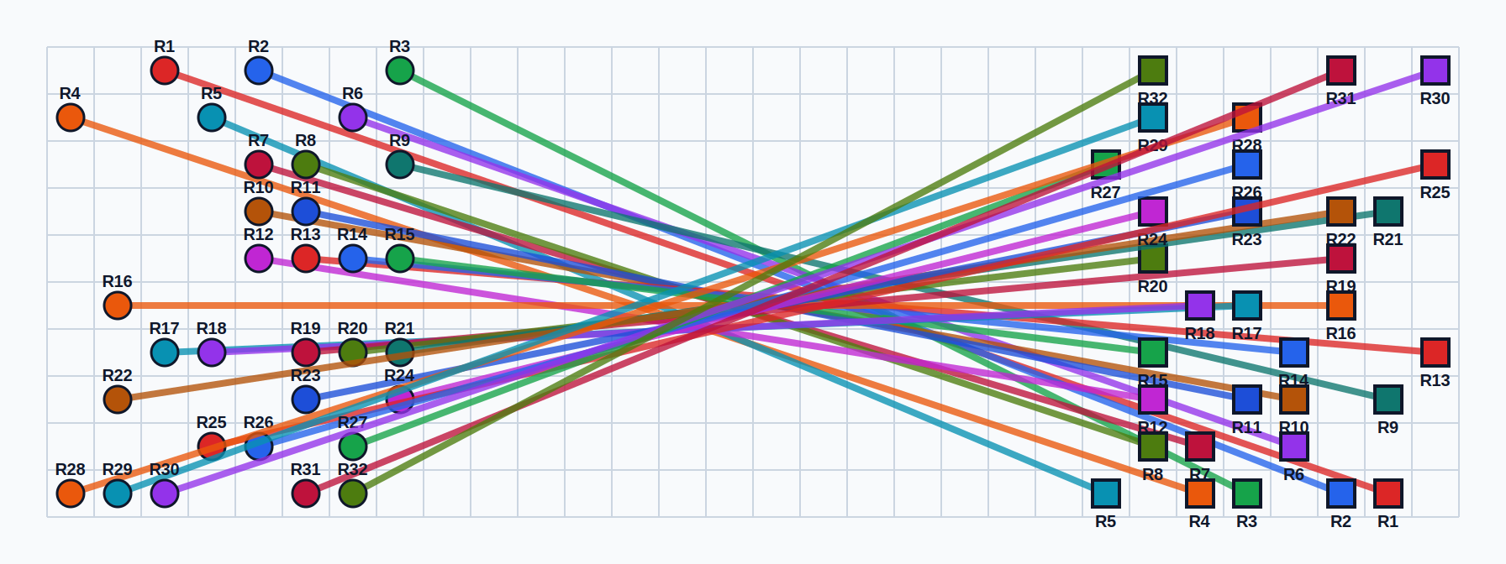
CMU
Carnegie Mellon University
15-418: Parallel Computer Architecture
& Programming – Spring 2026
Parallel
Multi-Agent
Path Planning
32
10×30
3
Batched Repair · Speculative Search · Bitset Wavefront
Robots
Grid
Planners
Dylan Sun (bdsun)
Jongsun Park (jongsunp)
github.com/bdyldo/418-final-project
small_32 benchmark · PSC Bridges-2 · April 2026

Slide 2
Problem: Multi-Agent Path Finding (MAPF)
Why is collision-free multi-robot planning hard to parallelize?
What is MAPF?
Benchmark Map: small_32
32 robots on a shared 10×30 grid must each travel from a start cell to a goal cell. Every timestep, a robot may move to an adjacent cell or wait. No two robots may occupy the same cell (vertex conflict) or swap along the same edge (edge conflict) simultaneously.
Why Not Exact CBS?
Conflict-Based Search (CBS) is optimal but exponentially expensive. It explores a binary constraint tree that branches on every pairwise conflict. For 32 dense robots, the branching factor makes CBS completely intractable – confirmed in our Stage 0 experiments (only worked for ≤8 robots).
Our Solution: Greedy Iterative Repair
Keep MAPF collision semantics but avoid the full CBS tree. Instead: detect conflicts, select robot-disjoint conflict subsets, generate repair candidates, score, and apply. This exposes a natural parallel loop over candidate repairs while preserving collision-free solutions.
● = start ■ = goal each color = one robot
10 × 30
32
Vertex + Edge
Intractable
Grid
Robots
Conflicts
CBS Result

Slide 3
Implementation Journey: Three Stages
Each stage targeted a different bottleneck in search performance
00
01
02
03
CBS Baseline
Greedy Batch Repair
Speculative Beam Planner
Bitset Wavefront Planner
Standard CBS + A*
OpenMP parallel repair candidates
Beam width=8, conflict pool=128
BFS with packed uint64 bitmasks
Exact optimal. Works for ≤8 robots. Constraint tree explodes with 32 dense robots – completely intractable. Established A* as the low-level single-agent planner interface.
Select top-K robot-disjoint conflicts per iteration. Parallelize repair scoring with OpenMP. Achieved 4.7 speedup at N=16. Plateaued because 32 robots -> at most 16 disjoint pairs/round.
Wider conflict pool + beam of top-8 candidates. Reduced repair iterations from 4,914 to 1,628. Better solution quality (cost 1019 vs 1109). But OpenMP sync dominated: <1 CPU utilized at N=16.
Replace hash-table A* with dense BFS over bitsets. Pack 64 cells/uint64 word. Bit-shift frontier propagation, O(1) constraint lookup, no heap allocation. 10.1x single-thread speedup over greedy baseline.
Abandoned due to Exponential Branching
4.69x speedup at N=16
Better quality, negative scaling
10.1× faster at N=1
Profiling (perf record/stat on PSC Bridges-2) informed decisions at each stage transition.

Slide 4
Stage 1: Greedy Batch Repair – Algorithm & Scaling
OpenMP parallel repair candidates · Top-K disjoint conflict selection
Algorithm
Runtime vs. Thread Count — Greedy Batch (small_32)
1
Plan initial paths for all robots independently using A*.
2
Detect all vertex & edge collisions; sort by earliest timestep.
3
Select top-K robot-disjoint conflicts (max K=32). Disjoint = independently parallelizable.
4
For each conflict, generate 2 candidate repairs (one constraint per robot). Score with A*.
5
#pragma omp parallel for over repair tasks – workers evaluate candidates concurrently.
6
Merge best repairs; validate merged state doesn't introduce new collisions. Repeat.
Key insight: Robot-disjoint conflict selection ensures repair tasks are truly independent – no shared robot state → safe OpenMP parallel execution.
156.3s
33.3s
4.69x
Plateau
N=1
N=16
Speedup
N>16

Slide 5
Stage 2: Parallel Speculative Repair (Beam-8)
Wider conflict pool + beam search for better quality, but OpenMP overhead kills scaling
Design Changes from Stage 1
Runtime vs. Threads — Speculative Beam-8 (small_32)
Conflict pool:
128 (was 32)
More candidates to explore speculatively
Beam width:
8 candidates
Keep top-8 repair solutions across iterations
Lookahead:
Depth 1
Evaluate repair quality one step ahead
Merge logic:
No duplicate constraints, skip already-changed robots
Algorithmic Improvement (at N=1)
−67%
−64%
−8.1%
−7.7%
4,914 → 1,628
58,760 → 21,124
1,109 → 1,019
39 → 36
Repair iterations
A* calls
Solution cost
Solution makespan
38.4s
81.9s
0.468x
Despite better quality, N=1 (single thread) is the fastest run.
N=16 is 2.13x slower than N=1. Extra threads sit idle in OpenMP barriers – exposed by profiling (see Slide 6).
N=1
N=16
Speedup

Slide 6
Profiling: Why Doesn't It Scale?
perf record/stat on PSC Bridges-2 — parallel beam-8, N=16
perf stat Highlights (N=16, beam-8)
perf report — Top Sampled Hotspots
CPUs utilized (avg)
0.935 / 16 requested
Backend stalled cycles
63.71%
Frontend stalled cycles
0.93%
IPC (instr/cycle)
0.79
Branch misses
1.88%
time elapsed
90.5 s
Root Cause: OpenMP Spin-Wait
The hottest libgomp addresses were inspected with objdump — they land in a pause/compare spin loop. The thread team is mostly waiting in barriers, not doing useful computation.
Each repair iteration exposes too few independent tasks for 16 workers. Once the conflict-disjoint tasks are claimed by a few threads, the rest spin idle until the next iteration's barrier.
Take-away: The dominant cost is not a serial merge or collision-detection function. Over 51% of cycles are in libgomp synchronization. The largest useful application hotspot is A* search — specifically its unordered_map lookups, heap allocations, and priority-queue operations. This motivated Stage 3: replace A* with a data-parallel bitset BFS.

Slide 7
Stage 3: Bitset Wavefront Low-Level Planner
Replace irregular A* with dense bitwise BFS – 10.1x constant-factor speedup at N=1
Design: Bitwise BFS over Packed Words
N=1 Runtime Comparison (small_32)
Pack cells:
Pack up to 64 grid cells into one uint64_t word (1 word/row for 10-row grid).
Frontier prop.:
Propagate reachable frontier using bitwise shifts, AND, OR – no heap, no hash table.
Constraints:
Pre-index vertex/edge constraints into bitmasks → O(1) constraint lookup per timestep.
Path recon.:
Compact parent-move table for path reconstruction after BFS completes.
Bit parallelism:
Machine-word SIMD-friendly; row-parallel on wide grids (>64 cols).
Bitset Runtime vs. Threads (small_32) — Negative Scaling
A* (before): unordered_map/set for visited states, priority queue (heap), dynamic allocation per node, irregular memory access pattern. Bitset BFS (after): dense uint64 arrays, bit-parallel frontier expansion, pre-allocated fixed arrays, regular sequential memory access.
10-row grid = 1 uint64/row. No coarse work to distribute. OpenMP overhead grows with N → negative scaling.

Slide 8
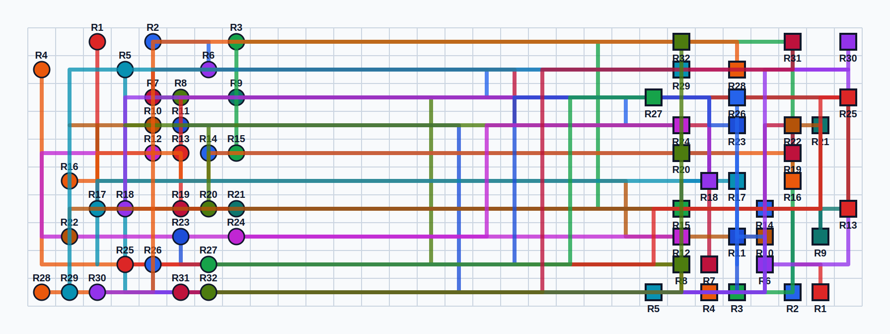
Results, Key Findings & Future Work
What we learned from parallel MAPF on PSC Bridges-2
Benchmark Summary — small_32
Key Findings
Planner | N | Runtime | Cost | Speedup
Greedy Batch | 1 | 156.3 s | 1109 | baseline
Greedy Batch | 16 | 33.3 s | 1109 | 4.69x
Greedy Batch | 128 | 34.6 s | 1109 | plateau
Speculative Beam-8 | 1 | 38.4 s | 1019 | baseline
Speculative Beam-8 | 16 | 81.9 s | 1019 | 0.47x
Bitset Wavefront | 1 | 15.5 s | 1060 | 10.1x*
Bitset Wavefront | 8 | 76.0 s | 1060 | 0.20x
4.69x
Greedy batch scales to N=16, then plateaus. Disjoint-conflict ceiling: 32 robots → max 16 pairs/round → parallelism saturates before 128 cores.
0.47x
Speculative beam-8 improved search quality by 67% (fewer iterations) but OpenMP synchronization dominated at all N>1. <1 CPU utilized on average at N=16.
10.1x
Bitset wavefront: largest win of the project. Dense BFS over packed uint64 eliminated A*'s hash-table/heap overhead — best single-thread result at N=1.
0.20x
Bitset scales negatively on small_32: 10-row grid → 1 uint64/row, no coarse-grained row parallelism. Confirms granularity matters as much as algorithm.
Future Work
* vs. Greedy-Batch N=1
→ Test bitset MAPF on wider grids (>64 cols) where multiple uint64 chunks enable real row-level parallelism.
Solved Paths (small_32)
→ GPU implementation: BFS wavefront is data-parallel → CUDA block/warp mapping.
→ Combine beam-search quality (Stage 2) with bitset low-level planner (Stage 3).

