Slide 1


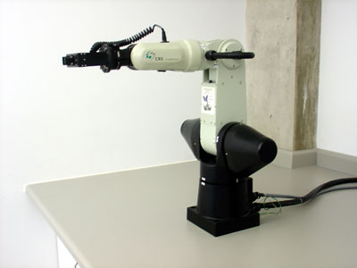
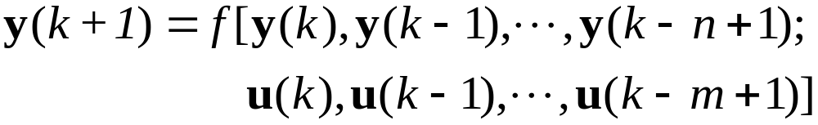
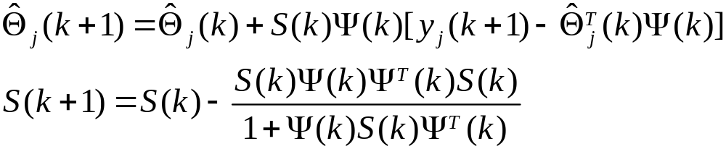

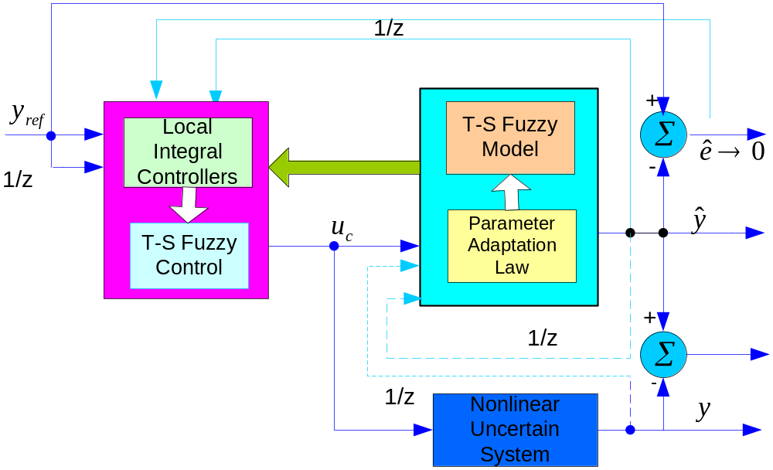


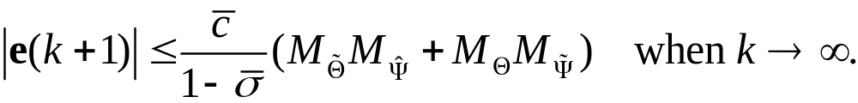




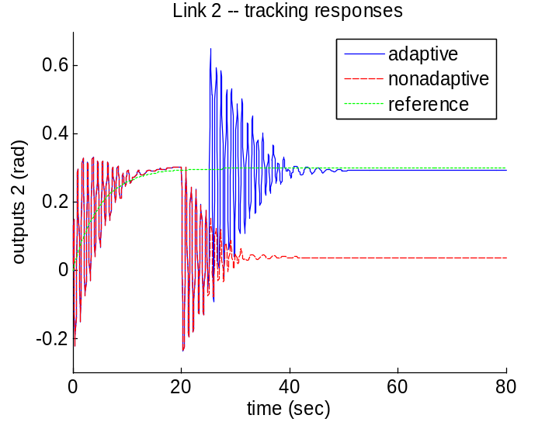
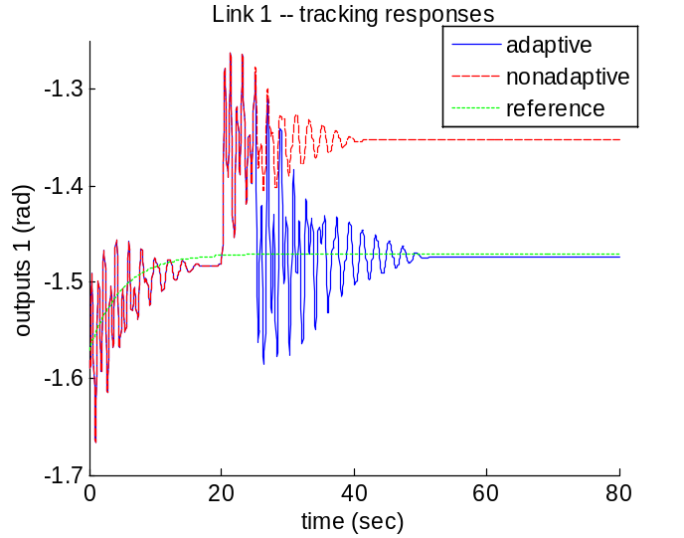










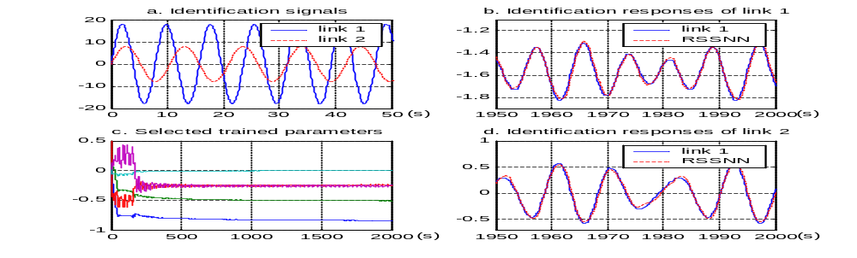
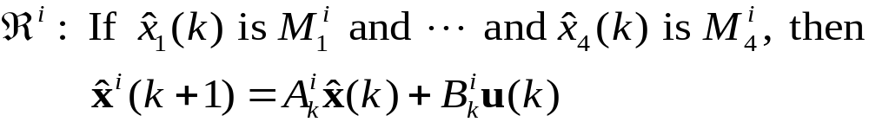




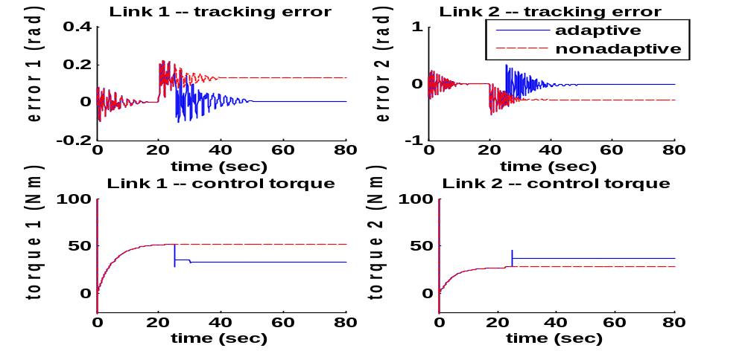



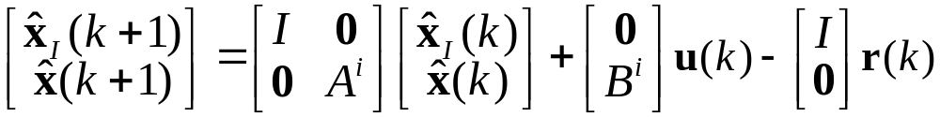

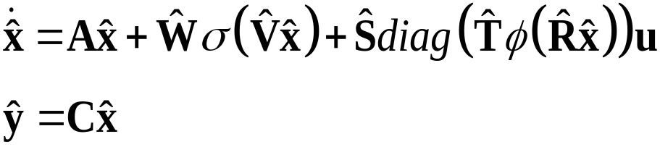
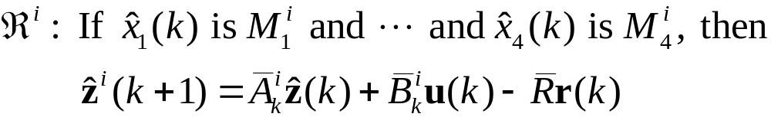
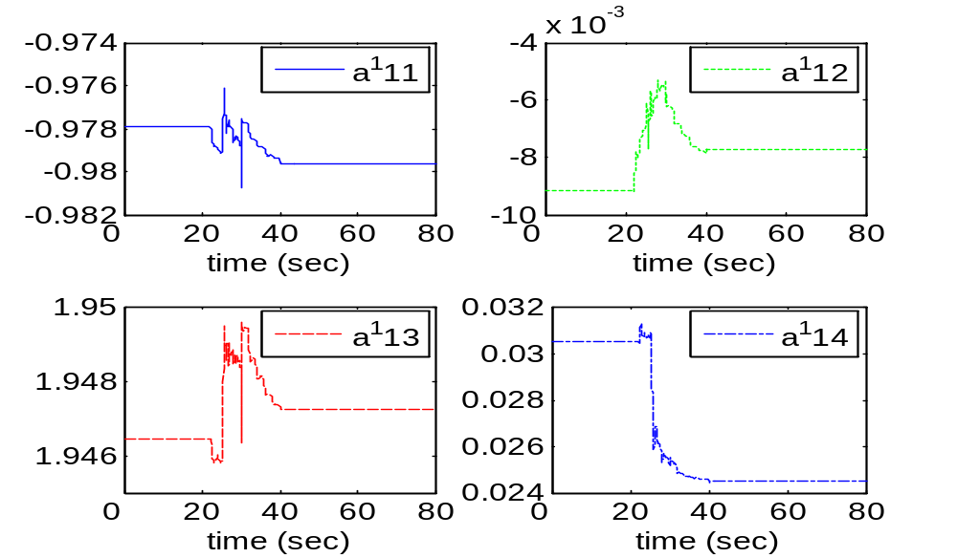




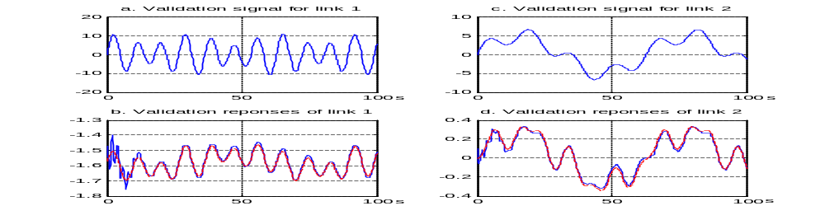
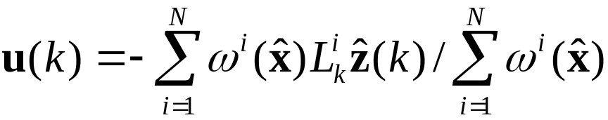
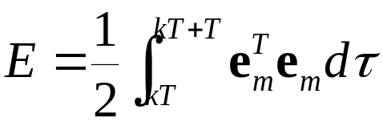
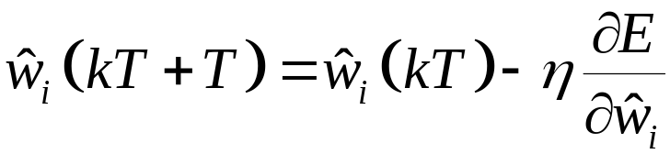
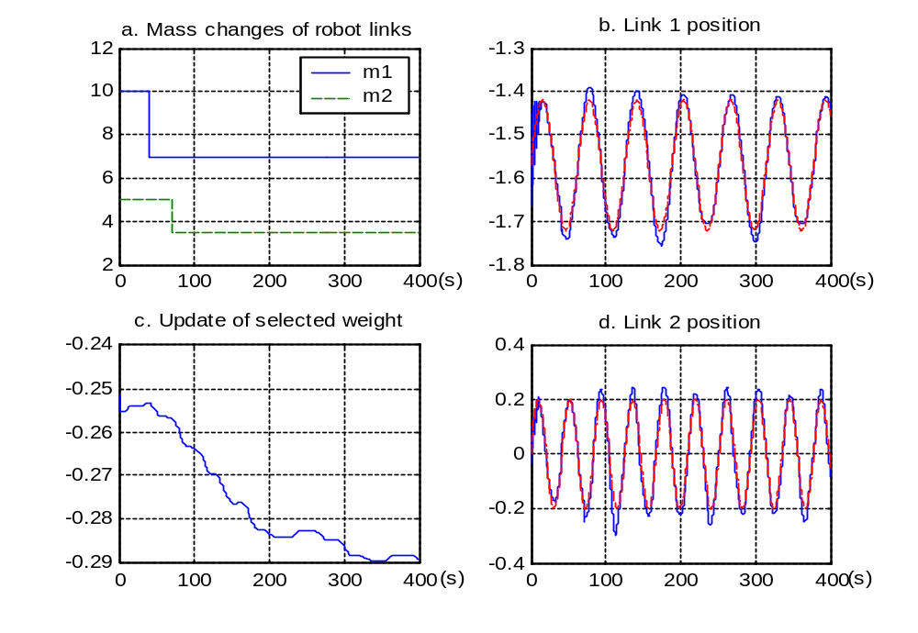
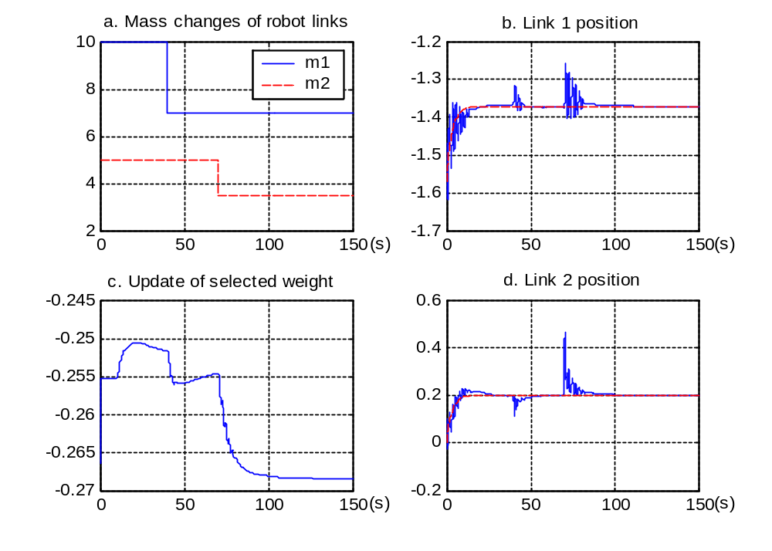


THE UNIVERSITY
OF BIRMINGHAM
RESEARCHERS
Mietek A. Brdys (Prof. Tech. Sci., PhD, DSc, CEng, MIEE, SMIEEE, FIMA)
Duc Thang Nguyen (PhD Student)
Ruiyun Qi (PhD Student)
Introduction
Indirect Adaptive Fuzzy T-S Control for Nonlinear Systems
In the last few decades, nonlinear control using neural networks and fuzzy logic has undergone rapid development. Neural networks offer exciting advantages such as adaptive learning, parallelism, fault tolerance and generalization. Fuzzy logic systems provide human reasoning capabilities to capture uncertainties that cannot be described by precise mathematical models.
Based on Local Linear Integral Controllers
Consider a nonlinear system that can be represented by the following discrete nonlinear different equation model
The control objective is to make the system output track a vector of specified bounded trajectories .
A diagram of the overall control system structure is shown in Fig. 1. A T-S fuzzy model is used as a design model of the nonlinear system. Local integral controllers are designed for each local linear model of the T-S fuzzy model. Then a T-S fuzzy controller is generated by weighted integration of all the local integral controllers. The parameters of the T-S fuzzy model can be adapted on-line when the nonlinear system varies due to external disturbances or parameter perturbations.
The rule of T-S fuzzy model is described as follows:
For each local model, if ( ) is controllable, a state feedback controller can be designed. Here we design the controller by using integral control technique in augmented state space.
Define , then the local model in the augmented state space becomes
The local integral controller for the local linear model can be designed as
where is the feedback gain which is obtained by pole
placement. The overall T-S controller is obtained as
Recursive least square estimation (RLSE) can be applied here to find optimal parameters on-line.
The plant tracking error
Since the model tracking error converges quickly to the reference trajectory due to the control law. Thus, after some fast transient when the algorithm is initialized, the tracking error is directly related to the state error:
Therefore, we have there following boundedness of tracking error
Thus, all the signals in the closed-loop are bounded.
Example: Tracking control of a two-link robot manipulator
Control Objective
Online Parameter Adaptation
Our recent research includes:
Neural network modelling and control of an unknown nonlinear continuous-time MIMO plant with unmeasurable states.
T-S fuzzy model based indirect adaptive control for discrete-time MIMO nonlinear systems.
Stability Analysis
Dynamic neural network identification and control
Fig. 5 Control Structure
under unmeasurable plant states
Control Structure
The study focuses on identification and control of a dynamic nonlinear MIMO system without plant state measurements using a new dynamic neural network.
Adaptive model-based control agorithm
Motivation
+
Simulation Results
Dynamic neural network (DNN)
Feedback linearization controller
u
DNN model
-
+
σ₁
A
Plant
-
T-S Model based Control Design
σ₂
∫
C
Fig. 2 The control diagram
Fig. 6 Tracking responses with disturbance
σ_{m}
u₁
u_{q}
Fig. 1 The dynamic neural network architecture
Mathematically, the DNN can be explained by following matrix form equation:
where and are sigmoid functions.
In our work, since the updating is only based on the tracking error, we use gradient descent algorithm for training the model. Following the algorithm, (k+1)th update is in the opposite direction to the gradient of the following error criterion
Each parameter of the DNN is calculated from previous value as:
where T is the length of the moving window, η is the learning rate and is the updated weight.
The nonlinear MIMO system to be controlled is a double link manipulator with its dynamics described as
Identification inputs are chosen as sine waves. Identification results and the validation are shown in Fig. 3 and Fig. 4.
In this study, feedback linearization control is applied to the DNN model. During control, the control signal is fed to both model and plant. The difference between the model and the plant outputs is used to calculate the updating gradient.
Fig. 7 Tracking error and control torques
Learning algorithm
Fig. 3 Double link manipulator identification: 20 nonlinear neurons, b and d: last 50sec.
Fig. 8 Parameter adaptation of Rule 1
Tracking responses of DNN Model Based Adaptive Control with disturbances as changes of link masses
Identification results and validation
Fig. 4 The validation: red dashed lines: model outputs, blue solid lines: link outputs
The DNN is powerful in capturing the plant dynamics without a priori information about them and the algorithm promises good tracking error convergence.
The control system has been proved to be stable through ultimate bounds of all signals and the convergence of the updating parameters.
Conclusion
DNN model based adaptive control
Fig. 9 Sine references (red: model, blue: plant)
Fig. 10 Constant references (red: model, blue: plant)
Control System Group, Department of Electronic, Electrical and
Computer Engineering, University of Birmingham, B15 2TT, UK
Tel: +44 (0)121 414 4354; Fax: +44 (0)121 414 4291
Emails: m.brdys@bham.ac.uk;
Poster designed by Duc Thang Nguyen and Ruiyun Qi

