Slide 1

Designing Localized LLM for
Domain-Specific Applications:
A Case Study of Hospital
Management
Ahed Eisa | Department of Electronic Engineering

Slide 2
Table Contents
01
Background and Motivation
02
Problem Definition
03
Purpose and Objectives
04
Literature Review
05
Methodology
06
Results
07
Future Work

Slide 3

1
Background and Motivation
With the enhancement of LLMs, and with the motivation of talking to a machine with human natural language, ChatGPT was released
After release of ChatGPT 2022, 24% businesses press releases of LLM- assisted content
Challenges :
Data privacy
domain accuracy

Slide 4


2
Problem Definition
Data Privacy
Photo by Pexels

Slide 5

3
Purpose and Objectives
Aim: To develop scalable and privacy-aware localized LLM.
✔ Address data privacy in enterprise LLM use.
✔ Reduce memory & computational needs.

Slide 6

4
Literature Review
Most studies follow a similar sequence when applying Apache Spark to healthcare:
Data Collection
Data Preprocessing: Clean data, handle missing values, normalize or encode features, and remove inconsistencies.
Feature Engineering / Selection: Extract relevant features. But most of the papers do not explicitly describe a feature selection method.
Modeling: Train models using Spark MLlib or deep learning frameworks (e.g., Random Forest, Gradient Boosting, TCN).
Evaluation: Validate models using metrics: Accuracy, AUC (AUC (Area Under the Curve) is a way to measure how good a model is at telling two groups apart), RMSE (Root Mean Squared Error), MAE (Mean Absolute Error) and real-time performance like Throughput, Latency.

Slide 7
5
Literature Review
Predictors of Outpatients’ No-show
Goal: Identify why patients miss appointments.
Method: Predictive modeling using large-scale appointment data.
Data :2M+ outpatient records from hospital EMRs.
Data Preprocessing:Cleaned records, handled missing values, normalized features.
Feature Engineering / Selection: using information gain, which measures how much a feature reduces prediction uncertainty when used to split the data.
Modeling: Random Forest, Gradient Boosting, Logistic Regression, SVM, MLP using Spark MLlib.
Evaluation: Accuracy, AUC, cross-validation.
Technologies: Apache Spark, Spark MLlib.
key Findings: Gradient Boosting performed best (79% accuracy, 0.81 AUC)
Future suggestions :
Real-time prediction.
Include more behavioral/contextual factors.
To test across multiple hospitals.

Slide 8
6
Literature Review
2. Real-time Health Status Prediction
Goal: Predict patient health risks in real-time.
Method: ML on streaming + historical data.
Data :IoT sensor streams + historical health records.
Data Preprocessing:Cleaned sensor data, handled missing/noisy values, normalized streams.
Feature Engineering / Selection: The paper does not explicitly describe a feature selection method.
Modeling: Decision Tree, Random Forest, Gradient Boosting (on Spark Streaming pipeline).
Evaluation: Accuracy, Precision, Recall, F1-score.
Technologies: Apache Spark (batch + streaming).
key Findings: accuracy improved when historical + streaming data combined. ( 78%)
Future suggestions :
Add more health indicators (features) for broader prediction.
Scale to larger IoT networks.
Multi-institution validation.

Slide 9
7
Literature Review
3. EHR Analysis for Diabetes Management
Real-time Health Status Prediction
Goal: Improve diabetes prediction and management.
Method: ML on large-scale EHR (Electronic Health Record) data.
Data: EHR datasets across hospitals.
Data Preprocessing: Cleaned records, handled missing/inconsistent values, normalized numerical features.
Feature Engineering / Selection: The paper does not specify it.
methods to choose predictive features.
Modeling: Random Forest, Logistic Regression, Gradient Boosting (Spark MLlib).
Evaluation: Accuracy, Precision, Recall, F1-score.
Technologies: Apache Spark, ML modules
key Findings: scalable analytics enabled effective diabetes prediction. (85%)
Future suggestions :
Data integration.
Privacy improvements.
Expand datasets and improve interpretability (Understandability).

Slide 10
8
Literature Review
4. Apache Spark in Healthcare (Review)
Goal: Show how Spark improves healthcare operations and analytics.
Method: Review of case studies and Spark-based ML/AI pipelines.
Data :EHR, imaging, remote monitoring datasets.
Data Preprocessing: Standardized pipelines for batch and streaming analyses.
Feature Engineering / Selection: The paper does not specify it.
Modeling: ML models (Random Forest, Logistic Regression) and AI frameworks integrated with Spark.
Evaluation: Efficiency, speed, scalability.
Technologies: Apache Spark, ML/AI frameworks.
key Findings: Data processing speed improved 2–5x; predictive insights more scalable.
Future suggestions :
Real-time analytics.
IoMT integration (Internet of Medical Things).
Security/privacy.
Scalability.

Slide 11
9
Literature Review
5. Real-time SBP & HR Prediction using TCN & Spark
Goal: Predict blood pressure and heart rate in real-time.
Method: Multi-task deep learning on streaming physiological data.
Data: Physiological dataset (systolic blood pressure (SBP) and heart rate (HR)).
Data Preprocessing: Sliding-window time-series, normalization and handled missing data.
Feature Engineering / Selection: The paper does not specify it.
Modeling: Multi-task Temporal Convolutional Network (TCN) with Spark + Kafka streaming pipeline.
Evaluation: RMSE, MAE.
Technologies: Spark Streaming, Kafka, TCN.
key Findings: Multi-task TCN outperforms single-task → RMSE ~5.1, MAE ~3.8; low-latency real-time monitoring feasible.
Future suggestions :
Multi-parameter monitoring.
Clinical validation.
Longer forecasting horizons.

Slide 12
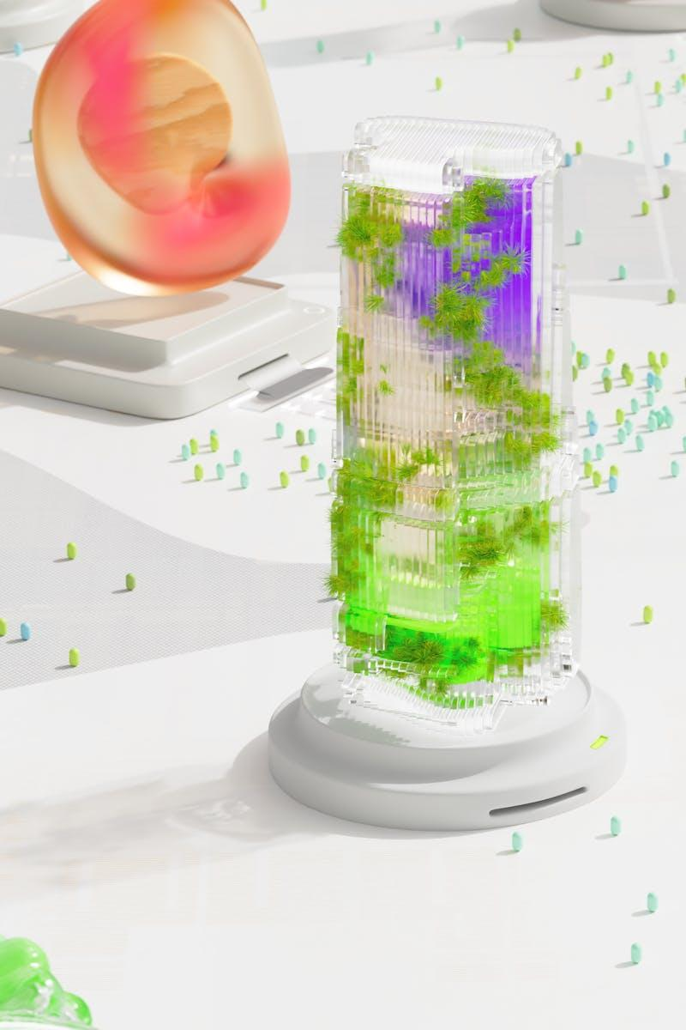
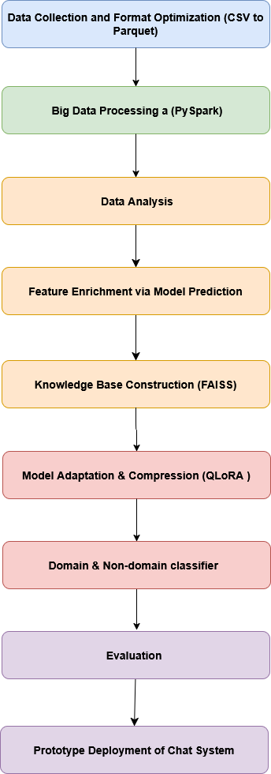
10
Methodology
Photo by Pexels

Slide 13

11
Data collection
Three different datasets were used: the first dataset is used for creating the knowledge base, the second dataset is used for domain specific classification, and the third dataset is used for non-domain specific classification.
1- The first dataset contains five CSV files: doctors.csv, patients.csv, appointments.csv, treatments.csv and billing.csv.
2- A dialogues between doctors and patients
3- A dialogues representing non-domain-specific content.

Slide 14
11
Data Analysis
Questions that used for data analysis:-
A — Which gender goes to the hospital more?
B — Which hospital branch has the most experienced doctors?
C — Which specialization dominates the others?
D — What is the most common reason for visits?
E — What is the ranking of treatments by cost?

Slide 15
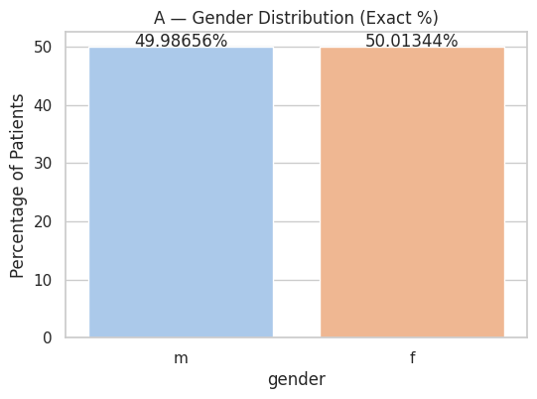
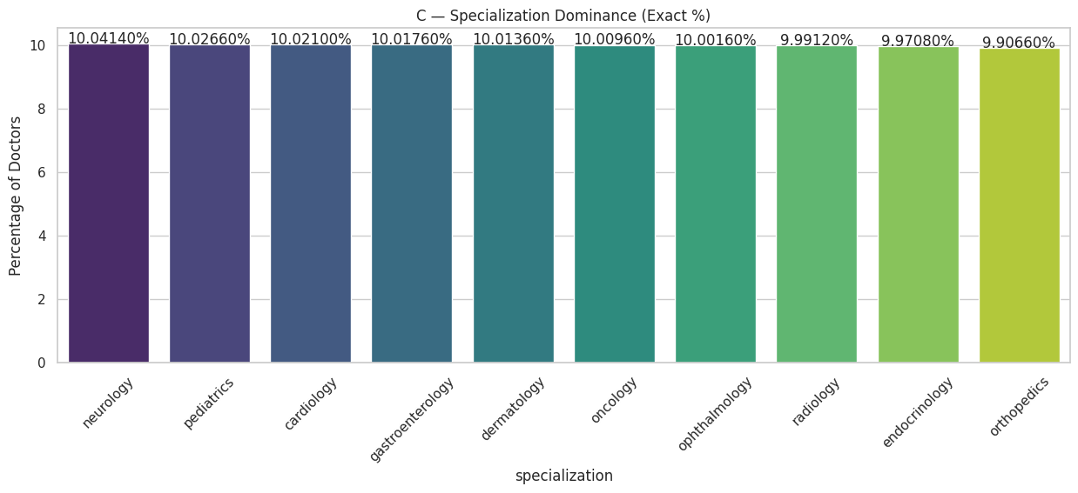
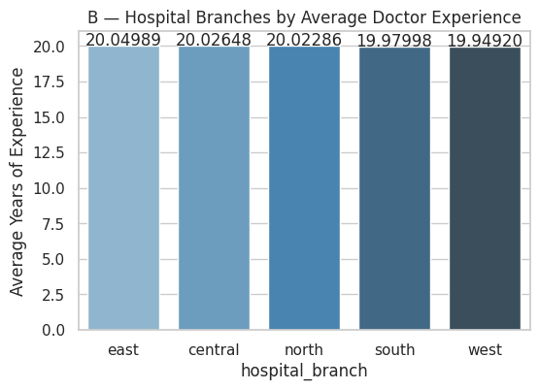
12
Results

Slide 16
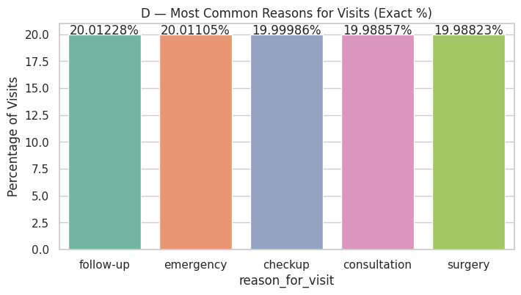
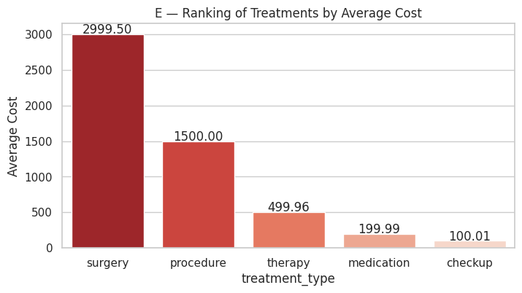
13

Slide 17
14
Feature Enrichment via Model Prediction
With the help of RandomForestRegressor algorithm, we predict the expected number of visitors for the next month to help the healthcare management system prepare and allocate resources efficiently.
Evaluation: R² (R-squared), RMSE (Root Mean Squared Error) and RRMSE (Relative RMSE)
Result:
R² = 0.94
RMSE = 54539.63
RRMSE = 8.42% overall error expressed relative to the data's scale

Slide 18
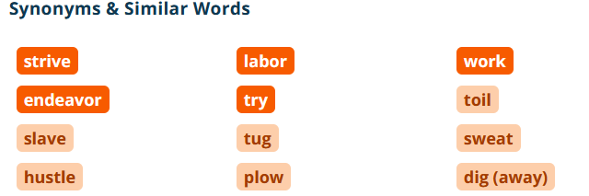
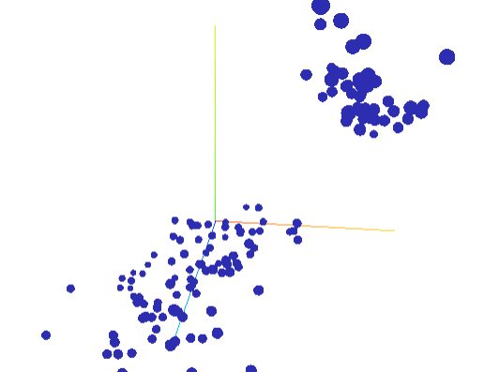

15
Faiss: knowledge base construction
“A cat is an animal.”
“A dog is an animal.”
“Animals can run and eat.”
Animal
cat

Slide 19
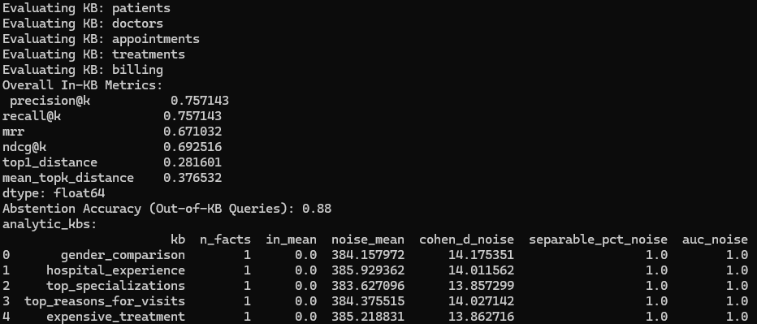
16
Precision@k: Fraction of top‑k retrieved facts that are correct.
Recall@k: Fraction of all relevant facts that appear in the top‑k results.
MRR (Mean Reciprocal Rank): Average of reciprocal ranks of the first correct fact; higher values indicate correct results appear earlier.
NDCG@k (Normalized Discounted Cumulative Gain): Measures ranking quality, giving higher weight to relevant facts appearing at the top.
Top1_distance: Embedding distance between the query and the closest retrieved fact.
Mean_topk_distance: Average embedding distance across the top‑k retrieved facts.
Abstention Accuracy: Fraction of queries not present in the KB that the system correctly identifies as absent.
AUC_noise: measures the probability the correct fact is closer than noise. High AUC = KB fact is clearly separable from random vectors.

Slide 20

17
GloRA
QLoRA (Quantized Low-Rank Adaptation) fine-tuning teaches the model how to answer questions based on the sample of data you give it.
After training, the model answers new questions in the same style and logic as the samples.
Instead of training the whole model (billions of parameters), QLoRA trains tiny low-rank adapter matrices (LoRA layers).
Full model training = huge memory
QLoRA = trains <1% of parameters
By that QLoRA improves computation and memory usage.

Slide 21

18
Domain, Non-domain classifier
To classify user input as personal context or domain-specific Context, we use a domain and a non-domain classifier. When the user input is classified as domain-specific, the model generates the appropriate context by retrieving relevant information from the knowledge bases.
Evaluation:Accuracy, precision, recall and F1 score
Results:

Slide 22
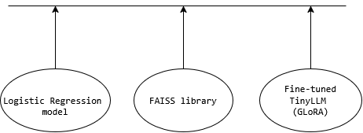
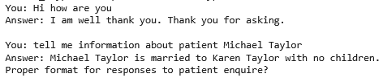
19
Chat
To demonstrate the integration of the domain-specific models, we combined them into a chat system. While the primary evaluation focused on the individual models (e.g., KB retrieval, visitor prediction, and classification), the chat interface shows practical usage.
Total system RAM usage 4.46 GB After loading the full system (quantized LLM + FAISS retrieval + PySpark domain classifier)

Slide 23

20
Future Work
A formal evaluation of the full chat system .
Expand knowledge base across multiple hospital domains.
Improve LLM interpretability and prediction accuracy.
Utilize a catalog to enhance multimodal data organization by leveraging Neuralink’s data repository, which provides a unified and scalable way to structure, access, and manage diverse data types efficiently.

Slide 24
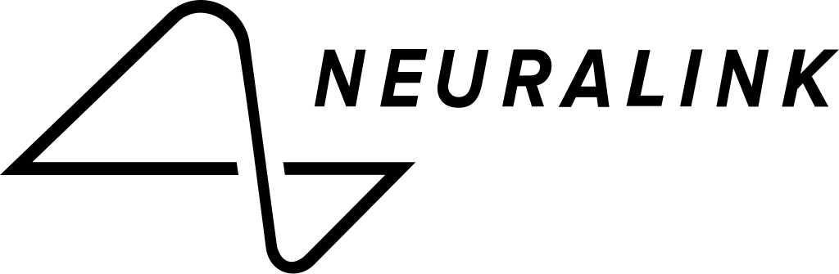

6
The question asked: How can we reduce data access time through different storage types? Because we have multimodal data.
System
Video
Audio
Text
signal
Answer:

Slide 25
Thank you for listening

