Slide 1

Project Ultron

Slide 2
Project Ultron
Introduction
Q/A
Jarvis
Workload Placement
Ultron
Architecture
Algorithm

Slide 3
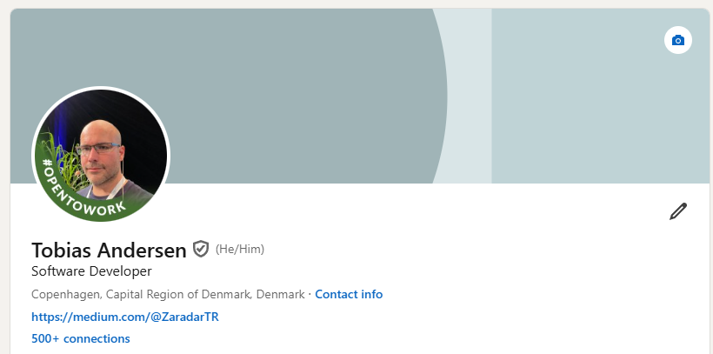
Project Ultron > Introduction

Slide 4
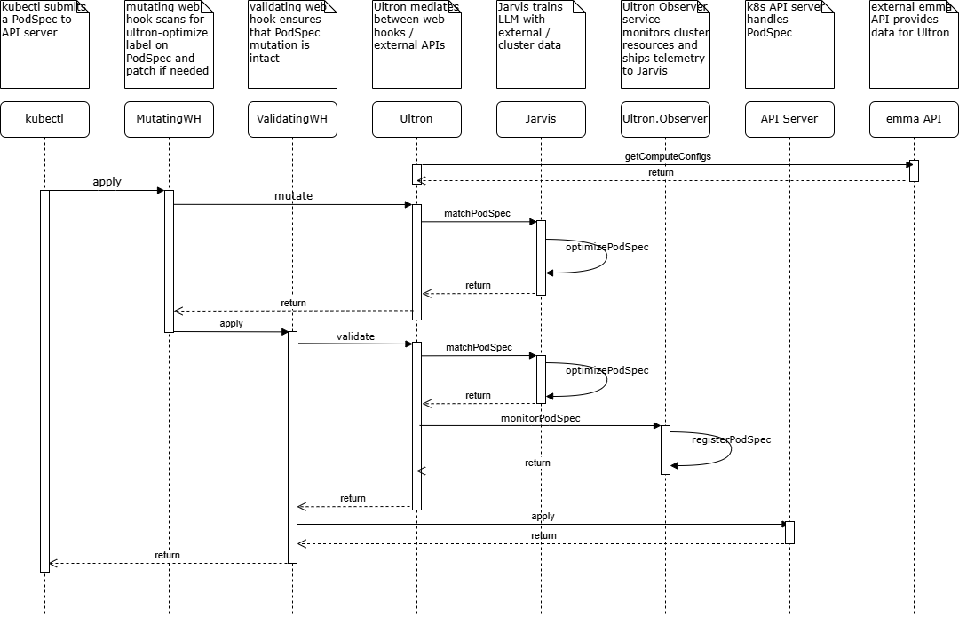
Project Ultron > Introduction

Slide 5
Project Ultron > Workload Placement
Workload Placement is the strategic process of determining the best location for running applications, balancing factors like performance, cost and compliance to maximize efficiency and minimize expenses.

Slide 6
Project Ultron > Workload Placement > Factors
Factor | Single Cloud | Multi-Cloud | Trade-Off Summary
Cost | Lower complexity, potential for discounts with single provider | Higher costs due to inter-cloud data transfer and management | Single cloud is cost-effective, multi-cloud offers flexibility but at added cost.
Reliability | Dependent on a single provider's availability and uptime | Redundant infrastructure across multiple providers enhances reliability | Multi-cloud enhances resilience against single provider failures.
Data Residency & Compliance | Limited flexibility, may require local regions of the single provider | Enhanced compliance flexibility by leveraging multiple regions/providers | Multi-cloud offers more control over data residency for compliance.
Performance | Generally optimized within a single cloud's infrastructure | Variable performance due to data transfer between clouds | Single cloud offers consistency, while multi-cloud can introduce latency.
Scalability | Easy to scale within one provider's ecosystem | Greater resource access but complex to manage across clouds | Multi-cloud offers scalability across providers but adds management complexity.

Slide 7
Project Ultron > Workload Placement > Factors
Factor | Single Cloud | Multi-Cloud | Trade-Off Summary
Vendor Lock-In | High risk of dependency on one provider | Reduced vendor lock-in, flexibility to switch providers | Multi-cloud reduces dependency on a single provider but adds complexity.
Security & Compliance | Consistent security policies and tools available | Varying security tools and policies across providers, increasing complexity | Single cloud simplifies security management; multi-cloud adds flexibility but complexity.
Management Complexity | Easier to manage, with a unified set of tools and processes | Higher complexity due to managing multiple tools and providers | Single cloud has simpler management; multi-cloud adds operational burden.
Innovation & Service Options | Limited to one provider’s service portfolio | Access to a diverse range of services across providers | Multi-cloud offers diverse innovation but may require integration efforts.
Disaster Recovery | Limited if single provider fails | Enhanced with failover across clouds | Multi-cloud improves resilience but adds complexity in DR planning.

Slide 8
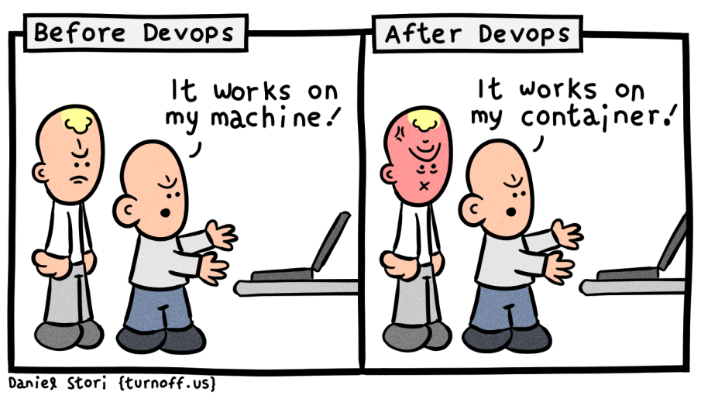
Project Ultron > Workload Placement > Challenges
Identifiability
Attestability
Connectability
Observability
Hostability

Slide 9
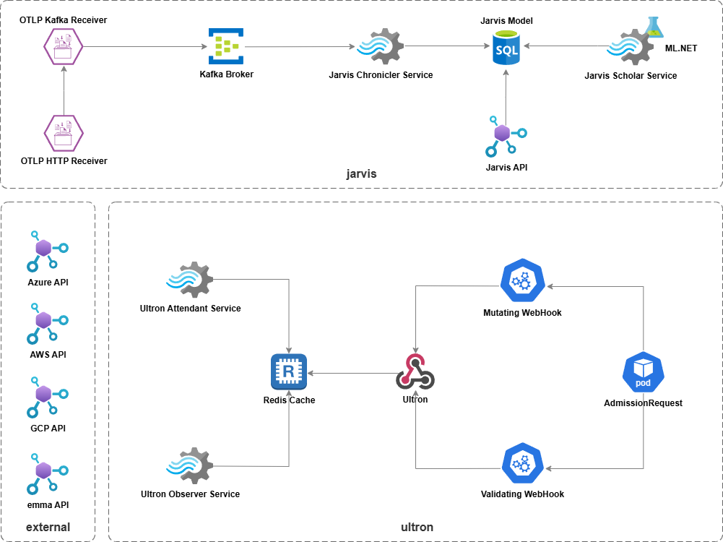
Project Ultron > Architecture

Slide 10
Project Ultron > Algorithm
`α` * ResourceFitScore + `β` * DiskTypeScore + `γ` * NetworkTypeScore + `δ` * PriceScore -
`ε` * NodeStabilityScore +
`ζ` * WorkloadPriorityScore

Slide 11
Project Ultron > Ultron
Ultron
Ultron Attendant
Ultron Observer
Ultron Operator

Slide 12
Project Ultron > Jarvis
Jarvis Model
Jarvis API
Jarvis Chronicler Service
Jarvis Scholar Service

Slide 13

Project Ultron > Q&A

Slide 14
Project Ultron > Q&A > Literature
https://medium.com/@ZaradarTR/unpacking-ultron-a-deep-dive-1bfabb6a81e5
https://medium.com/@ZaradarTR/meet-ultron-observer-966d154822f0
https://www.virtana.com/glossary/what-is-workload-placement/
https://www.apiculus.com/blog/optimising-multicloud-workload-placement-with-ai-and-machine-learning/
https://www.youtube.com/watch?v=fJiuqRY5Oi4
https://github.com/be-heroes/ultron/blob/main/docs

