Slide 1
Ruadhán Ó Nidh
Performance Tuning & Antipatterns
Coding Club

Slide 2
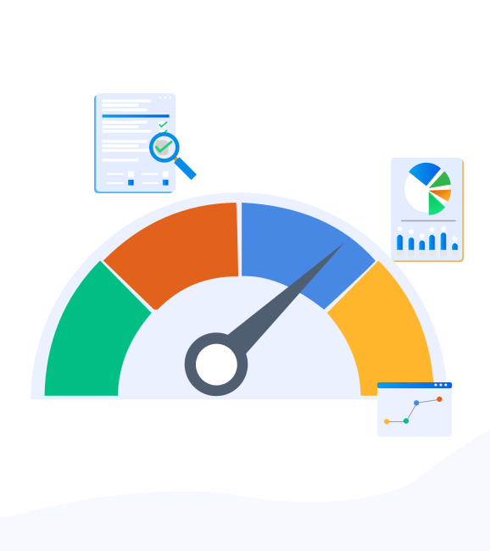
Introduction
Optimisations done in project work in 2018:
DSP – profiling user actions in the application
Execution Time
CPU Usage
Memory Usage
Main take-aways
Database indexes
Using IEnumerable instead of IQueryable
N+1 problem
Caching
Session outline
Outline of antipattern
Antipattern example
Code sample
Performance profiling of code
Code fix & profiling of said fix

Slide 3
Chatty I/O
Synchronous I/O
Extraneous Fetching
Retry Storm
Antipatterns
No Caching
Busy Database
Busy Front End

Slide 4
Chatty I/O
Continually sending many small network requests.
Problem:
Network calls and other I/O operations are inherently slow compared to compute tasks. Each I/O request typically has significant overhead, and the cumulative effect of numerous I/O operations can slow down the system.
Solution:
Reduce the number of I/O requests by packaging the data into larger, fewer requests.
Fetch data from a database as a single query, instead of several smaller queries.

Slide 5
N+1 Problem
Example Scenario:
1. Initial Query: Retrieve a list of customers from the database.
2. N Additional Queries: For each customer, an additional query is executed to retrieve their orders.
Why It's a Problem:
Performance: Instead of retrieving all the needed data in a single query (e.g., using a join), the application makes multiple round trips to the database.
Latency: Each query incurs network latency and processing time, significantly slowing down the application.
Solutions:
Eager Loading: Fetch related data along with the main entity in a single query using techniques like joins.
Batching: Group multiple queries into a single database call when possible.
Caching: Cache the related data to avoid repeated queries.

Slide 6
Extraneous Fetching
Retrieving more data than is needed, resulting in unnecessary I/O.
Problem:
When more data than is needed is retrieved for a business operation resulting in unnecessary I/O overhead
Solution:
Avoid fetching large volumes of data that may quickly become outdated or might be discarded, and only fetch the data needed for the operation being performed.
Instead of getting every column from a table and then filtering them, select the columns that you need from the database.

Slide 7
IQueryable
IEnumerable
Namespace: System.Collections
Purpose: Used for iterating over a collection.
Execution: Immediate; all operations are performed in memory.
Use Case: Suitable for querying in-memory collections like lists or arrays.
Methods: Extension methods like Where, Select, Sum, etc., are executed locally.
Namespace: System.Linq
Purpose: Used for querying data from external sources like databases.
Execution: Deferred; query execution is translated to the underlying data source's query language (e.g., SQL for databases).
Use Case: Suitable for querying remote data sources where execution can be optimized by the data provider.
Methods: Extension methods build an expression tree, which is later executed by the data provider.
In summary, use IEnumerable for in-memory collections and IQueryable for querying data from external sources efficiently.

Slide 8
No Caching
Failing to cache data.
Problem:
A no caching antipattern occurs when an application that handles many concurrent requests, repeatedly fetches the same data. This can reduce performance and scalability.
Solution:
The most popular caching strategy is the on-demand or cache-aside strategy.
On read, the application tries to read the data from the cache. If the data isn't in the cache, the application retrieves it from the data source and adds it to the cache.
On write, the application writes the change directly to the data source and removes the old value from the cache. It will be retrieved and added to the cache the next time it is required.
This approach is suitable for data that changes frequently.

Slide 9
Retry Storm
Retrying failed requests to a server too often.
Problem:
When a service is unavailable or busy, having clients retry their connections too frequently can cause the service to struggle to recover, and can make the problem worse. It also doesn't make sense to retry forever, since requests are typically only valid for a defined period of time.
Solution:
Use the Circuit Breaker pattern, which is designed specifically to help avoid retry storms.

Slide 10
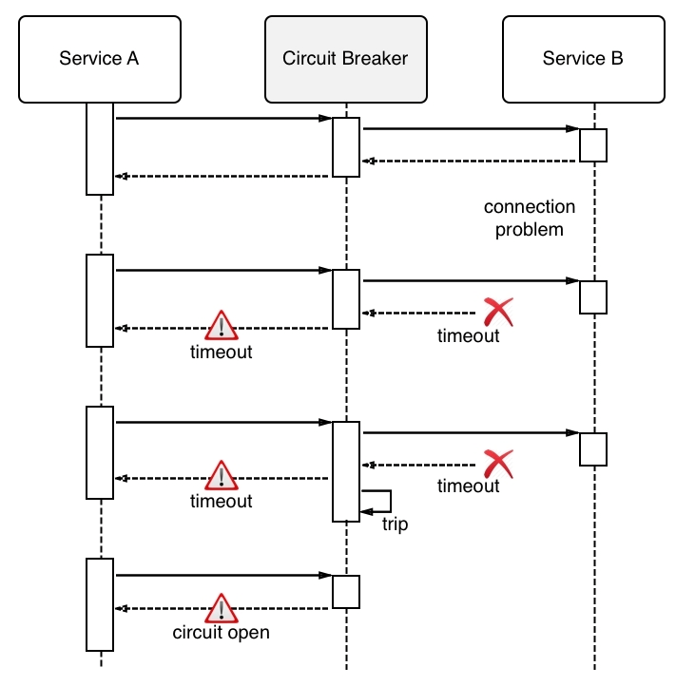

Slide 11
Busy Database
Offloading too much processing to a data store.
Problem:
Offloading processing to a database server can cause it to spend a significant proportion of time running code, rather than responding to requests to store and retrieve data.
Solution:
Move processing from the database server into other application tiers. Ideally, you should limit the database to performing data access operations, using only the capabilities that the database is optimized for, such as aggregation in a relational database management system.

Slide 12
Synchronous I/O
Blocking the calling thread while I/O completes.
Problem:
A synchronous I/O operation blocks the calling thread while the I/O completes. The calling thread enters a wait state and is unable to perform useful work during this interval, wasting processing resources.
Solution:
Replace synchronous I/O operations with asynchronous operations. This frees the current thread to continue performing meaningful work rather than blocking, and helps improve the utilization of compute resources. Performing I/O asynchronously is particularly efficient for handling an unexpected surge in requests from client applications.

Slide 13
Busy Front End
Moving resource-intensive tasks onto background threads.
Problem:
Resource-intensive tasks can increase the response times for user requests and cause high latency. One way to improve response times is to offload a resource-intensive task to a separate thread. This approach lets the application stay responsive while processing happens in the background. However, tasks that run on a background thread still consume resources. If there are too many of them, they can starve the threads that are handling requests.
Solution:
Move processes that consume significant resources to a separate back end.
With this approach, the front end puts resource-intensive tasks onto a message queue. The back end picks up the tasks for asynchronous processing. The queue also acts as a load leveler, buffering requests for the back end. If the queue length becomes too long, you can configure autoscaling to scale out the back end.

Slide 14
Questions

Slide 15

Further Reading
Performance tuning a distributed application
https://learn.microsoft.com/en-us/azure/architecture/performance/
Performance tuning scenarios
Other antipatterns: Noisy Neighbour, Monolithic Persistence, Improper Instantiation
Entity Framework 6 Database Performance Anti-patterns
https://app.pluralsight.com/library/courses/entity-framework-database-performance-anti-patterns/table-of-contents

