Slide 1
Prepared By:
Sharleen Bang
Coding Club – November Session
Prepared For:
BE Coding Club
Design Patterns – Composite (Structural) & Chain of Responsibility (Behavioural)
Notes:
For November’s coding club session,
We will be taking a look at the Composite Design pattern from the Structural group and the Chain of Responsibility from the behavioural group.

Slide 2
Composite
Chain of Responsibility
What is the Composite Design Pattern?
What is the Chain of Responsibility Design Pattern?
Content
How do we use it?
How do we use it?
Coding Demo
Coding Demo
Advantages/Disadvantages
Advantages/Disadvantages
Notes:
We will be covering the patterns by going through:
What the pattern is?
How it’s used?
Coding demo of the pattern in action.
Advantages and disadvantages of the patterns.

Slide 3
Composite
Notes:
We’ll be taking a look at the Composite Design Pattern first.

Slide 4
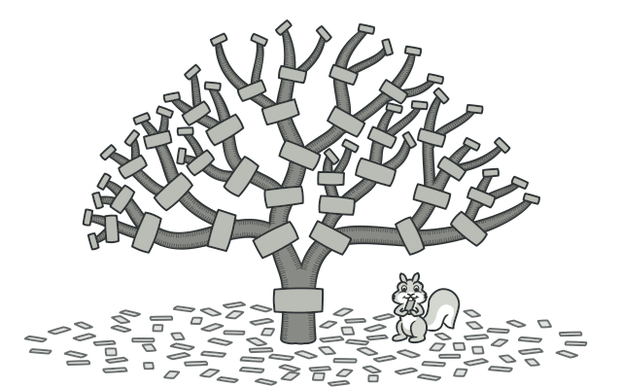
What is the Composite Design Pattern?
Objects are structured into a Tree-like arrangement.
Individual objects are treated the same way as any compositions of those objects.
1-to-Many (Has-A relationship) between the objects.
Example:
Directories & Entries.
Use:
Dealing with tree-structured data.
Notes:
Objects are placed in a tree-like structure.
A single instance of an object of a certain type would be treated the same way as a group of that object.
Grouping of these objects would be represented as part-whole hierarchies. (Any object in the hierarchy is a part of the whole composition; the composition as a whole is a collection of hierarchies)
This is our 1-To-Many (Has-A relationship) between the objects in the Tree-like structure.
Objects & Composites would be inheriting a base type (generally done by an Interface class) -> exhibiting similar functionalities.
Example (Directories & Entries) :
Directories can contain Entries (Files/Folders).
Each Entry could be a directory.
Use (Tree-Structured Data) :
Generally, developer needs to discriminate between a leaf-node and a branch in the structure.
Which means -> Processing of the primitive object (leaf) is handled in one way.
Processing of the composite object (branch) is handled in a different way.
The underlying issue would be the ‘querying’ of the type of each object before trying to process.
Make it more error-prone & complex than it needs to be.

Slide 5
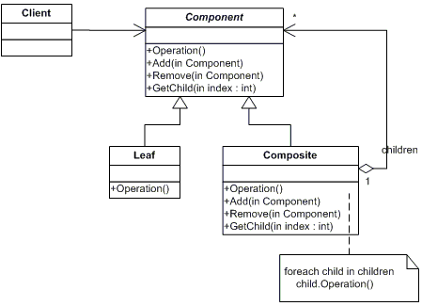
Participants in a Composite Design Pattern
Component
Declares interface for objects in composition.
Implements common behaviour.
Implements interface for accessing & managing child components.
Leaf
Represents the objects in composition.
Has no children.
Implements the behaviour for the base component.
Composite
Consists of Leaf elements.
Implements the behaviour for the base component.
Defines child-related operations.
Client
Manipulates the objects in the composition through the Base Component object.
Notes:
In terms of designing the code under this pattern, there’s 4 necessary participants that needs to be added:
Component
This class declares the interface for the objects in the composition.
The methods declared will be common to all simple/complex elements of the tree.
The methods will include functionality such as accessing & managing the child components.
Leaf
Object in the compositions.
They don’t have reference to any child objects.
Implement the methods declared by the Base Component.
Composite
Grouping of the Leaf elements.
Implements the methods declared by the Base Component.
Also, the methods defined by the Child objects.
Client
Interacts with the objects in the composition through the component interface.
If the recipient is a leaf, then the interaction/event would be handled directly by the leaf.
If the recipient is a composite, then the interaction/event is forward to its child components.

Slide 6
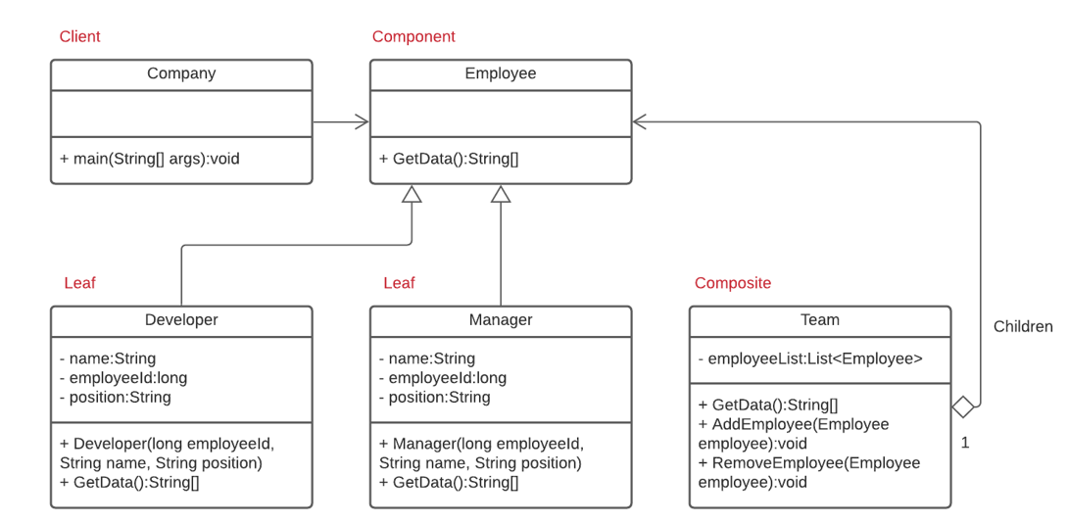
Context
Notes:
Putting the Composite Design Pattern into Context:
-> Component -> Employee
-> Our function common to all the employees, is retrieving their data.
-> We know that an Employee can have different roles but in this scenario; we’ll be using Developer and Manager which are our Leaf Nodes.
-> Composite -> Team
-> Grouping of the various employees (Developers/Managers)
-> It will inherit the GetData() method as a Team will have their own data.
-> Client -> Company
-> Which will be interacting with the Team; but more specifically the members of the team. So, either a developer or a manager.

Slide 7
Coding Demo
Notes:
Starting of we have a common interface which is our Employee and a GetData() method declared.
Then we create a Developer & Manager class which implements our Employee interface.
Developer & Manager class will have its own private variables like name, employeeId and position
The getData() implementation will just print out those details
Then we have our Team class which also inherits our employee interface. Because it’s a composite were going to keep a list of objects which is our employee.
We’ll be interacting with each of those objects when getting its Data.
And there’s functionality added, to add or remove nodes from the composite.
Our client is the company class which will be interacting with the objects in the tree.
We’re going to create two developers and they will be put in a composite called DevTeam
We’re also going to create two managers and they will be put in a composite called ManagementTeam
Then we’ll have another composite which is just a group of those two teams called DevOps team.
Running this code, should give us an output for the two managers and developers in the DevOps team.

Slide 8


Advantages & Disadvantages
Good for dealing with complex Tree structures; using Recursion & Polymorphism.
Supports the Open/Closed principle. You can introduce new elements without breaking existing code.
If functionality varies greatly between classes, then it would be difficult to provide a common interface to all.
Notes:
Advantages:
Composite Design pattern is good for dealing with tree structure data.
It provides you with two element types; simple leaves and complex containers of those leaves or other containers.
But you are able to recurse around the object structure.
Achieving uniformity across the object hierarchy.
Supports the open/closed principle
You can add new components into the code without breaking the existing code because of the uniformity of the hierarchy.
Disadvantages
If the functionality varies greatly between the classes, it would be difficult to provide a common interface to all the classes.
Over-generalising the component can lead to issues in understand the role that class.
This makes it difficult to restrict objects that can be included in the composite if it’s too general.
The client also needs to be able to distinguish between the composites and non-composites object. The idea of the composite class is provide extended access to individual group members in the hierarchy.

Slide 9
Chain of Responsibility

Slide 10
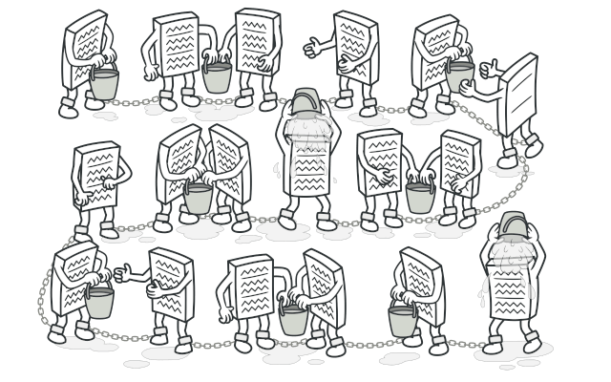
What is the Chain of Responsibility Design Pattern?
Requests are passed along a chain of handlers.
Avoids coupling the sender of a request to its receiver.
Request is received by a handler.
Objects in the chain decides who will process that request.
Example:
User Authentication & Authorization.
Use:
Efficient processing of requests without hard-wiring request-to-handler mappings.
Unknown types of requests and sequence.
Essential to execute several handlers in a particular order.
Set of handlers & their order changes at run time.
Notes:
There’s a chain of receiver objects for a request.
The idea is to decouple the sender and receiver of a request.
Sender does not know who the receiver is, and the receiver doesn’t know who the sender is.
So that if a particular object can’t handle the request, it will freely pass the request to the next object in the chain.
Example (User Authentication & Authorization) :
Requests with user’s credentials are transferred between the sender to the receiver.
A series of checks needs to be performed to authenticate the user.
If the user is existing, levels of permissions etc.
Use :
When the types of the incoming requests and the sequence of when they come in are unknown;
The pattern gives all the handlers a chance to process the request
If there is a need to execute the handlers in a specific order, you can use this pattern to chain the handlers in any order you want and have the request pass through them in that order.
If there’s a need to change the set of handler or their order during run time, the pattern allows you to put setters inside the handler classes where you’ll be able to insert, remove or reorder the handlers dynamically.

Slide 11
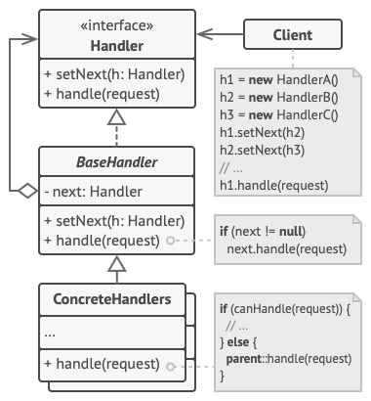
Participants in a Chain of Responsibility Design Pattern
Handler
Interface which primarily receives the request and dispatches it to the chain of handlers.
Methods declared are common to all handlers.
References only the first handler of chain.
No knowledge of the rest of the handlers.
Concrete Handlers
Actual handlers of request chained in some sequential order.
Implements the processing code.
Self-contained and immutable.
Base Handler (Optional)
May contain boilerplate code common to all handler classes.
Client
Source of request.
Access the handler to handle the request.
Notes:
Handler
Defines the interface for handling the requests.
It can also be an abstract class.
It’s role is to primarily receive the request and forwards it to the chain of handlers
The Handler is only aware of the existence of the first handler of the chain. The rest of them are unknown to the handler.
Concrete Handlers
These are responsible for handling the requests they receive.
If a particular handler can’t handle the request, it passes it to its successor.
These handlers are usually self-contained (can be independent from the system) and immutable (unchangeable after it’s created).
Base Handler
This is an optional class that may contain boilerplate code common to all the handler classes.
Client
Sends the requests to the first object in the chain.
Can be used to compose the chains once or dynamically.

Slide 12
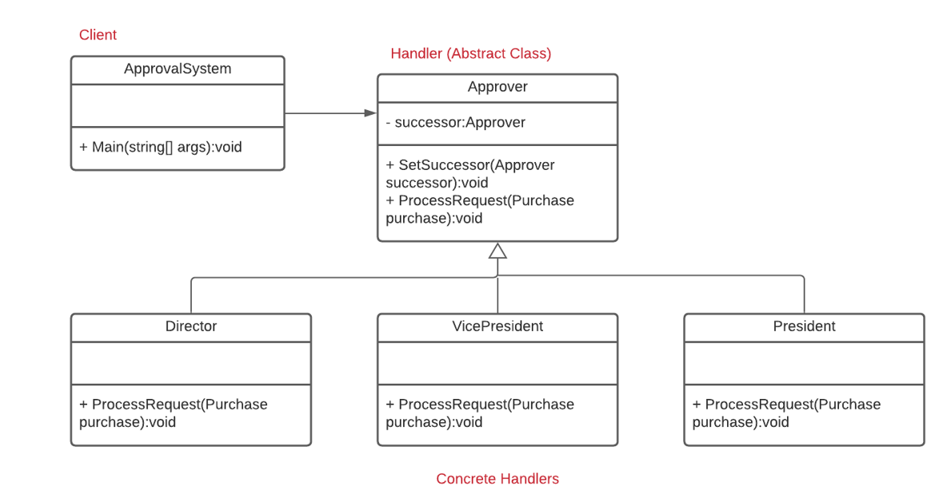
Context
Notes:
Giving the Chain of Responsibility more context:
In this scenario, we have some sort of approval system for a purchase of an asset.
We have our Handler which is a generic Approver abstract class.
This class will declare methods for setting the next handler and the processing of the request.
2. Then we have our concrete handlers;
1. Which is our Director, VicePresident and President.
2. These handlers will implement the method of processing the request.
3. They will also have a reference to the next handler in the chain.
3. Our client is the approval system.
In this class, we can declare the order of the handlers that the request will be passing through.
It will also pass the request to the first handler of the chain.

Slide 13
Coding Demo
Notes:
We’re going to define a purchase class, that has details such as id, quantity and the description.
We’re going to have an approver abstract class, that will contain a reference to the next handler in the chain. A method to set the next handler and a declaration of the processRequest method.
Then we’re going to create a Director, VicePresident and President class which will implement the approver class and their variation of the processRequest method.
In this scenario, the director can only approve of purchases of quantity that is less than 10000, VicePresident can only approve of purchases of quantity that are less than 25000 and the president can approve of purchases that are less than 100, 000. Anything more than 100,000 would require a board meeting to discuss the purchase.
We have our client which is the approval system that sets the chain of handlers which is the approvers in this case.
We create our director, vicepresident and president objects.
Director sets the vicepresident as its next handler, and the vicepresident will set the president as its next handler.
We’re going to have a couple of purchase instances, one of quantity 300 which will be approved by the director, one of 50000 which will be approved by the president and then lastly one of quantity 200,000 where it will reach the end of the handler chain and a meeting would need to be held to discuss that purchase.
Running the code, we get the output that I’ve mentioned.

Slide 14
Advantages & Disadvantages
The order of request handling can be controlled.
Supports the following principles:
Single responsibility
Decoupling of classes that invoke operations from classes that perform operations.
Open/Closed Principle
Introduce new handlers without breaking existing code.
Some requests may go unhandled.
Notes:
Advantages:
Order of the request handler can be controlled.
You can have it declared in the client or changed the order during run time through the setters of the handlers.
Supports the following principles:
Single responsibility
Through the decoupling of the sender and the receivers.
We know already that all the concrete handlers are self contained.
Open/Closed Principle
Because the concrete handlers are self-contained we can add new handlers to the chain without breaking the existing code.
Disadvantage:
Some requests may go unhandled.
If one of the handlers fails to call the next one, then the request is dropped.
It can also lead to deep stack traces with the passing around of the request. That can affect performance.

Slide 15
Thank you for listening!
Any Questions?

