Slide 1
Observer Pattern
BE Coding Club

Slide 2
What is it?
Observer is a behavioral design pattern. It specifies communication between objects: observable and observers. An observable is an object which notifies observers about the changes in its state.
For example, a news agency can notify channels when it receives news. Receiving news is what changes the state of the news agency, and it causes the channels to be notified.

Slide 3
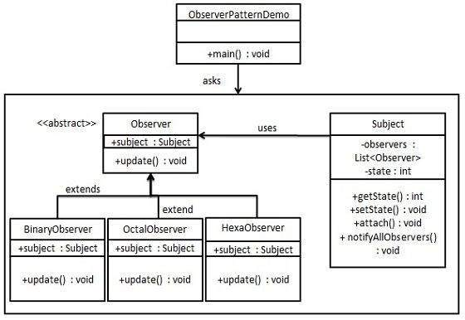

Slide 4
News Agency Example
Abstract Channel
News Agency
Uses
Extends
RTE News
ABC News
BBC News

Slide 5
DEMO

