Slide 1
GF22FDX_SC8T_104CPP_BASE_CSC28L_DRC_SUMMARY
Version: 6.00
Notes:
<number>

Slide 2
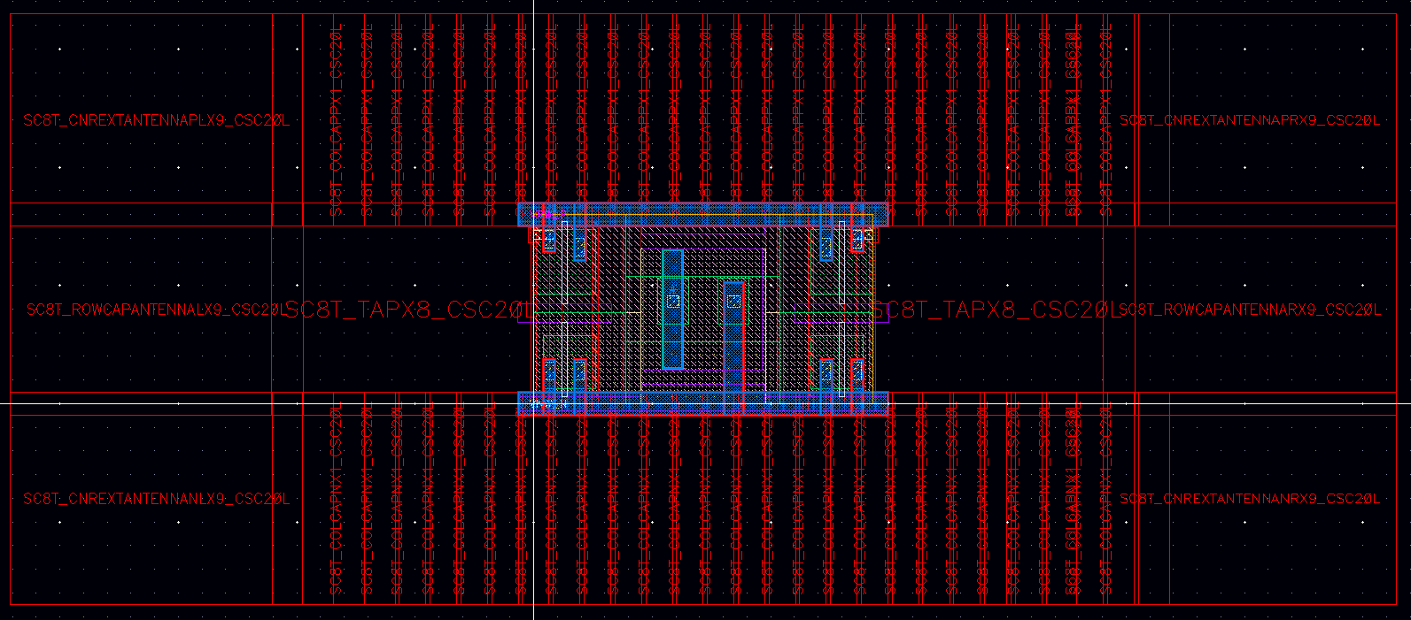
Context Used For DRC Checks
An original cell along with physical cells is used for DRC checks.
COLCAPPX1
CNREXTPRX9
CNREXTPLX9
ROWCAPANTENNALX9
TAPX8
TAPX8
ROWCAPANTENNARX9
CNREXTNLX9
COLCAPNX1
CNREXTNRX9
07/04/17
INVECAS CONFIDENTIAL
<number>
Notes:
<number>

Slide 3
Waivers & Known Violations

Slide 4
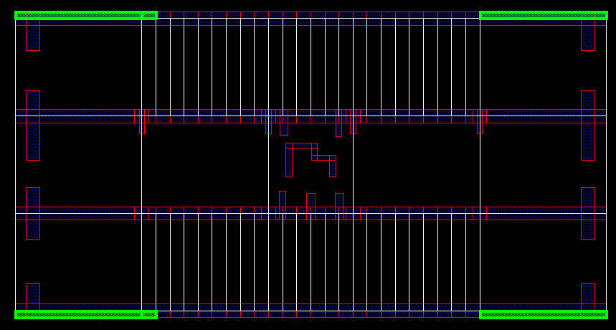
GRCLC.OUTLINE.C.2_M1_U_cfill_all
Rule:
M1_U_cfill_all must be within OUTLINE >= 0
Description/Location:
Known Violation at cell Level. Will be cleaned at Design Level.
07/04/17
INVECAS CONFIDENTIAL
<number>

Slide 5
Thank You
<number>

