Slide 1
Excel Functions

Slide 2

HELLO!
I am Arpit Jain
I am here because Data Science is my passion and I love sharing my expertise with people.

Slide 3
Agenda
1
Text Functions
Date Functions
Math Functions
Vlookup

Slide 4
Text Functions
Text functions in Excel are a set of powerful tools that enable users to manipulate and transform text data within spreadsheets.
These functions are designed to perform various tasks such as extracting specific characters from text strings, changing text case (e.g., converting to uppercase or lowercase), concatenating strings, searching for and replacing text, and more.
They are essential for data cleansing, formatting, and analysis, making it easier to work with textual information in Excel.
By utilizing these functions, users can efficiently process and transform text data to meet specific requirements for reporting, calculations, and data presentation, thereby enhancing the flexibility and utility of Excel in handling a wide range of text-related tasks.

Slide 5
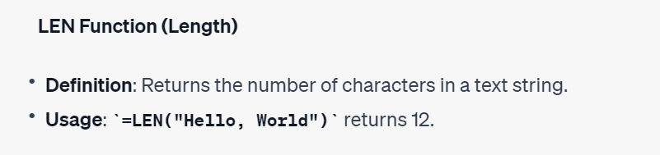
Text Functions

Slide 6
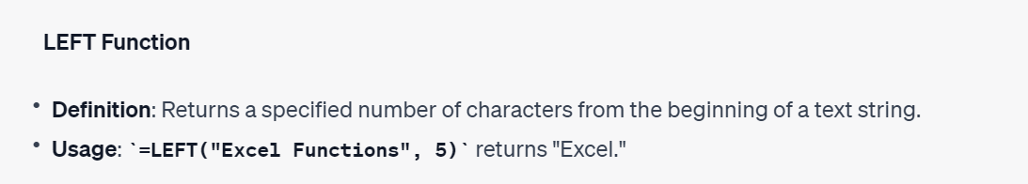
Text Functions
Right → Similar Function

Slide 7
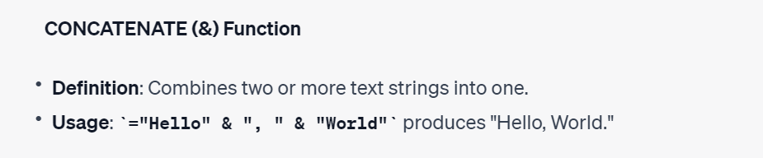
Text Functions

Slide 8
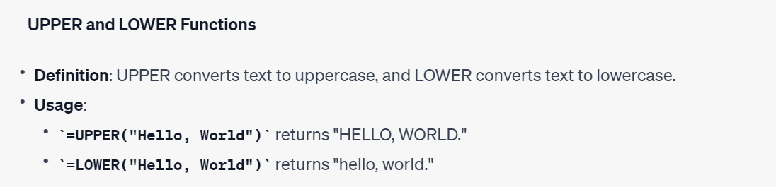
Text Functions

Slide 9

Text Functions

Slide 10
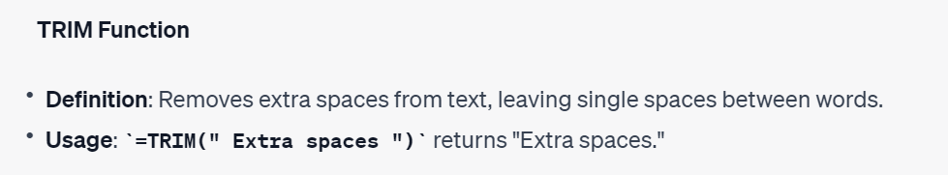
Text Functions

Slide 11
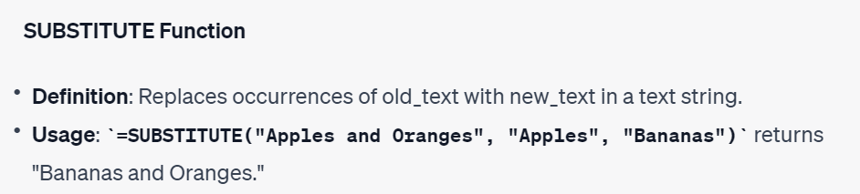
Text Functions

Slide 12
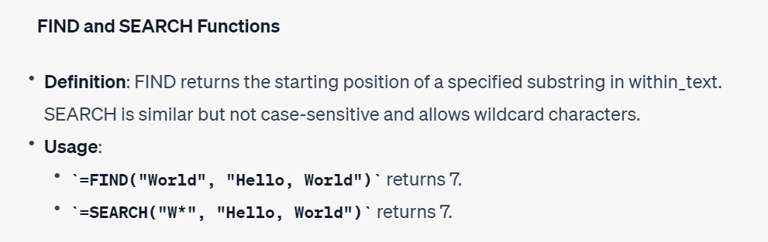
Text Functions

Slide 13
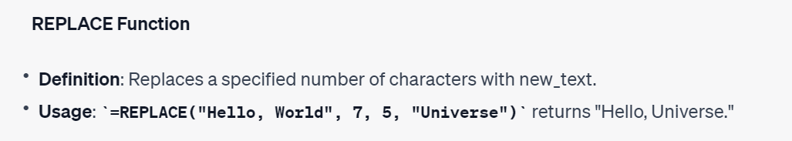
Text Functions

Slide 14
Date Functions
Date functions in Excel are essential tools for working with date and time data.
They serve various purposes, such as calculating durations between dates, extracting specific components of date and time, and performing complex date-related operations.
These functions are especially valuable in tasks like financial modeling, project management, and record-keeping, where accurate date and time calculations are crucial for decision-making, analysis, and reporting.

Slide 15
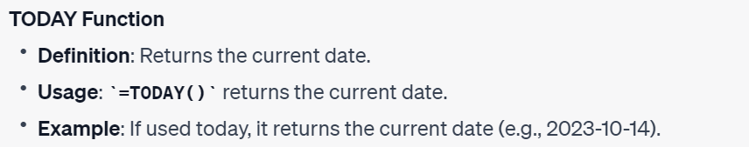
Date Functions

Slide 16
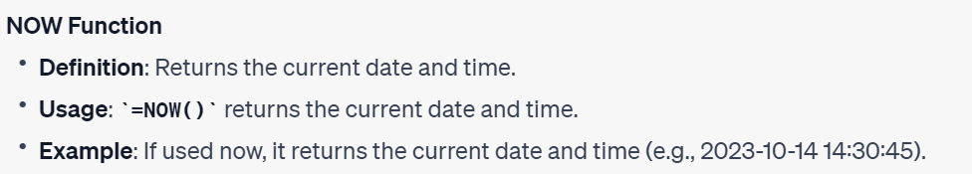
Date Functions

Slide 17
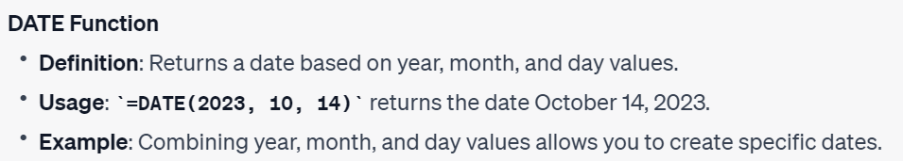
Date Functions

Slide 18
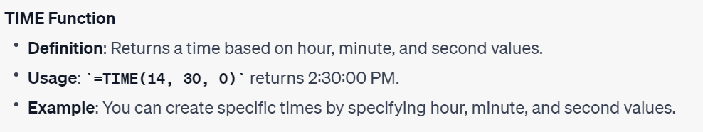
Date Functions

Slide 19
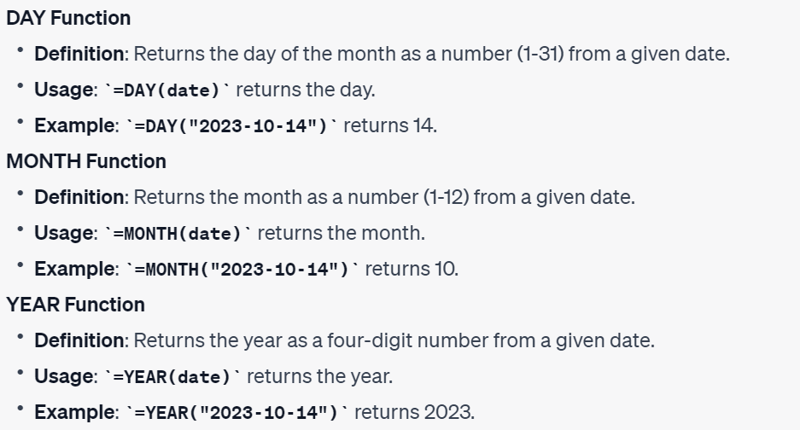
Date Functions

Slide 20
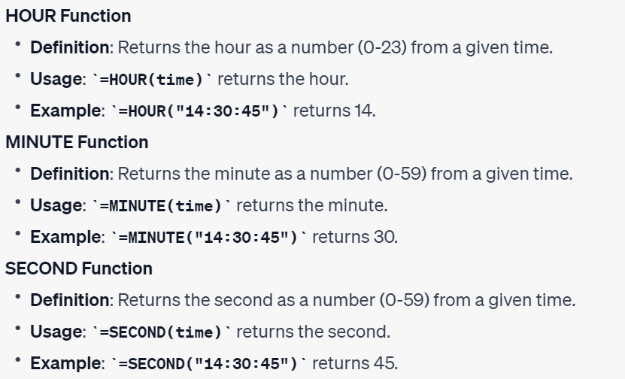
Date Functions

Slide 21
Math Functions
Math functions in Excel are essential tools for performing various mathematical operations and calculations within spreadsheets.
These functions allow users to manipulate numeric data, perform calculations, and analyze numerical information efficiently.
They are particularly valuable for financial modeling, engineering, scientific analysis, and a wide range of quantitative tasks, enabling users to work with numbers, perform complex calculations, and generate numeric results for informed decision-making.

Slide 22
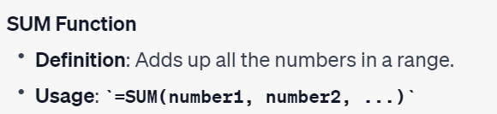
Math Functions

Slide 23
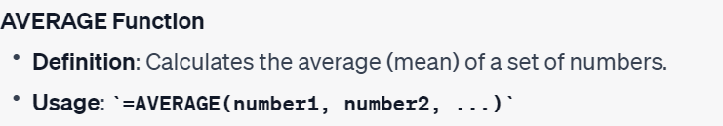
Math Functions

Slide 24
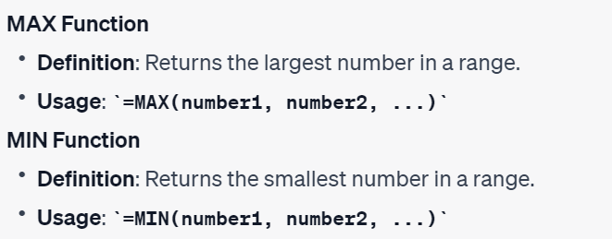
Math Functions

Slide 25
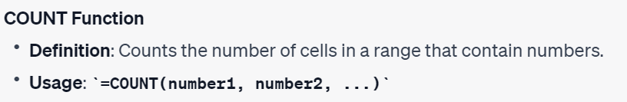
Math Functions

Slide 26
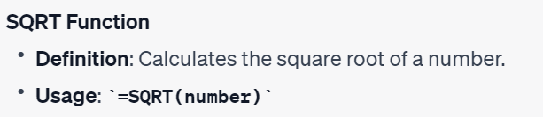
Math Functions

Slide 27

Math Functions

Slide 28
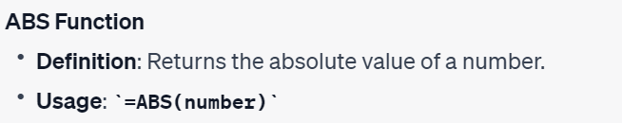
Math Functions

Slide 29

Math Functions

Slide 30

Thank You

