Slide 1

Java Core: Basic Concepts
Douglas Bonafé
"Omnia legentes, quae bona sunt tenentes”
(Read everything and stay only with is good)

Slide 2
Agenda
Is JAVA dead?
Static attribute
Community Index, Java Ecosystem, Security&Interoperability, Java in production, at Scale, etc.
What is static?
JAVA Ecosystem
Method
The program lifecycle and the VM.
Particularities of methods
Why Object Oriented Programming?
Static method
The advantages of OOP.
Difference between override an instance method and hide a class method
The structure of OOP
8
The final Keywords
Package, class, object, attribute, method
What is final?

Slide 3
Agenda
Nested classes
Interfaces vs Abstract Class
What is?
The difference between Interfaces and Abstract Classes.
Inheritance
Polymorphism
“IS A”
A consequence of inheritance
Interfaces & Generics
Collections
Interfaces and Generics: why and what is the difference?
Set, List, Queue, Deque, ArrayList or LinkedList?
Abstract Class and Abstract Method
8
Maps
What is abstract?
What is, HashMap, TreeMap, LinkedHashMap

Slide 4
Agenda
Strings
10 Things you MUST know about Strings
Wrappers
int or Ingeger?, bool or Boolean?
Exceptions
Try-catch, Throws, create new Exception
4
Files
How to manipulate files

Slide 5
Is JAVA Dead?

Slide 6
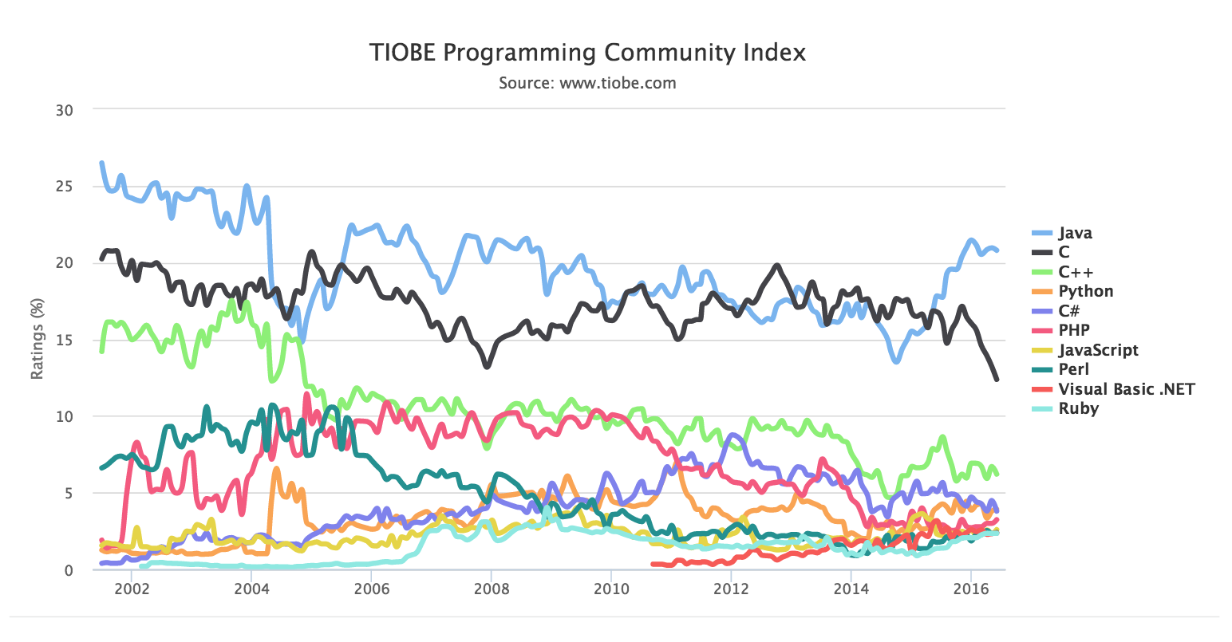

While newer languages grab the headlines, TIOBE ranked JAVA as its top language of 2015, and currently enjoying 5% growth in use since 2014!!!
Dominance: Java 8, Spring Boot
?

Slide 7
Java Ecosystem
JVM compiles codes into bytecodes that was interpreted by JVM, what allows your code to run in any architecture that supports JVM.
“Write once, run everywhere!”
Android:
JAVA allows the OS to run in a Virutal Machine. It doesn’t need to recompile for every device:
Stability
Usability
Flexibility: Scala, Groovy, Clojure, JRuby
Security: the way to exploit the OS kernel would be through a flaw in VM implementation
Java in Production, at Scale:
AWS, Google, eBay → backend.
Hadoop, Twitter, Minecraft.

Slide 8
Java Core...

Slide 9
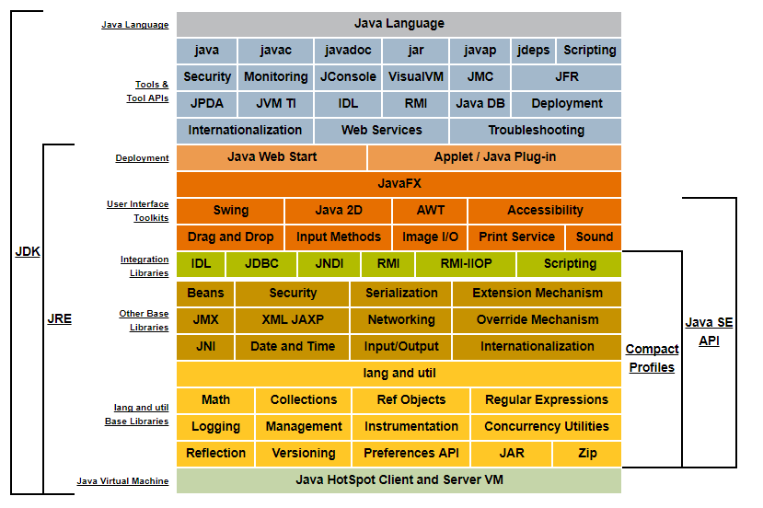
What do we have in the Core?

Slide 10
Why Object Oriented Programming?

Slide 11
Advantages:
Code near the business;
Code is an ABSTRACTION of real world, directly mapped.
Fast maintenance;
Reuse of code;
System padronization;
Security;
Inheritance!
Simple
Multiple
Polymorfism!
Universal:
Inclusion Relation
Generics
Ad-hoc:
Override
Coercion

Slide 12
Object Oriented Structure
Package
Folder that organize classes into groups.
Improve the organization of system in subsystems.
Structure hieraquically the project.
Classes
They are the structure that represents a set of objects (type) and they are the model of real world in the programming world.
Object
Is an implementation of a class, an individual instantiated in memory with the characteristics defined by the class.

Slide 13
Object Oriented Structure
Attribute
Is a property of class.
Method
Is an action that the objects of some class could perform.
Attributes and Methods should respect the encapsulation!

Slide 14
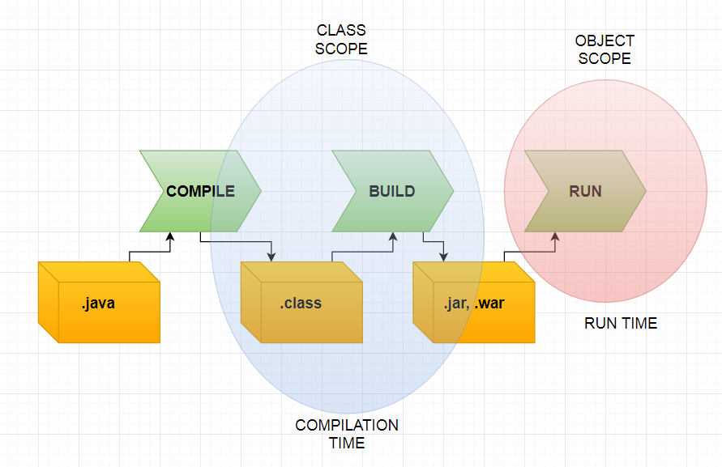
Object Oriented Structure
Static Attributes
Static attribute is an attribute which has a single value for all instances of the class, id est, for all objects of the class.
This value was defined in class scope, not in object scope.

Slide 15
Object Oriented Structure
Methods
We can invoke a behavior of an object through methods.
Methods are operations we can require from an object (of a class, obviously) to execute.
Objects of the same class have the same operations.
This value was defined in class scope, not in object scope.

Slide 16
Object Oriented Structure
Static Methods
Static methods are methods that is not invoked by any object, id est, THERE IS ANY INSTANCE OF THIS CLASS to invoke this method.
They are not class methods, but global functions prefixed with classnames.
Static method can access only static data. It can not access non-static data (instance variables) unless it has/creates an instance of the class.
A static mehtod can call only other static methods and can not call a non-static method from it unless it has/creates an instance of the class.
A static method can not refer to this or super keywords anyway.

Slide 17
Static Methods: Difference between override an instance method and hide a class method
The ability of a subclass to override a method allows a class to inherit from a superclass whose behavior is “close enough” and than to modify behavior as needed. The overriding method has the same name, number and type of parameters, and return type as the method that overrides. An overriding method can also return a subtype of the type returned by the overridden method. This subtype is called a covariant return type. When overriding a method, you might want to use the @Override annotation that instructs the compiler that you intend to override a method in the superclass. If, for some reason, the compiler detects that the method does not exist in one of the superclasses, the it will generate an error. If a subclass defines a static method with the same signature as a static method in the superclass, then the method in the subclass hides the one in the superclass. The distinction between hiding a static method and overriding an instance method has important implications:
The version of the overridden instance method that gets invoked is the one in the subclass;
The version of the hidden static method that gets invoked depends on whether it is invoked from the superclass or subclass.

Slide 18
The final keyword
The final class cannot be subclassed. This is done for reasons of security and efficiency. Accordingly, many of the Java standard library classes are final, for example java.lang.System and java.lang.String. All methods in a final class are IMPLICITLY final.
A final method can’t be overridden neither hidden by subclasses. This is used to prevent unexpected behavior from a subclass altering a method that may be crucial to the function or consistency of the class.
A final attribute can only initialized once, either via an initializer or assignment statement. It does not need to be initialized at the point of declaration: this is called blank final attribute. A blank final instance variable of a class must be definitely assigned at the end of every constructor of the class in which it is declared; similarly, a blank final static variable must be definitely assigned in a static initializer of the class in which it is declared; otherwise, a compile-time error occurs in both cases.

Slide 19
Some important notes
When an anonymous inner class is defined within the body of a method, all variables declared final in the scope of that method are accessible from within the inner class. Once it has been assigned, the value of the variable cannot change.
If the variable is a reference, this means that the variable cannot be re-bound to reference another object. But the object that it references is still mutable, if it was originally mutable.

Slide 20
Nested Classes
Nested classes are classes into other class.
It’s a way of logically grouping classes that are only used in one place.
We use nested classes to increase the encapsulation.
It can lead to more readable and maintainable code.
It can be static and non-static (or Inner Class).
Inner Classes exists ONLY with an instance of Outer Class.
public class OuterClass {
public static class StaticNestedClass{
public static int value;
}
}
...
OuterClass.StaticNestedClass.value = value;
public class OuterInnerClass {
public class InnerClass{
private int value;
//Getters and Setters
}
}
...
OuterInnerClass outer = new OuterInnerClass();
InnerClass inner = outer.new InnerClass();
inner.setValue(value);
Note:
- Shadowing

Slide 21

Inheritance

Slide 22
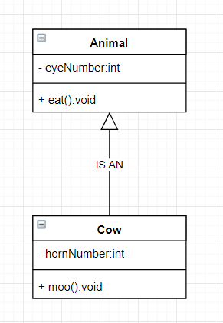
The main idea...
The main idea of inheritance is that should be possible create a new class using other existent classes.
Why not create less and most generic classes?
Create big classes with attributes and methods that works only for specific group of instantiated objects is not a good practice, because doing that, we will create a not significant class, that will not more be representative.

Slide 23
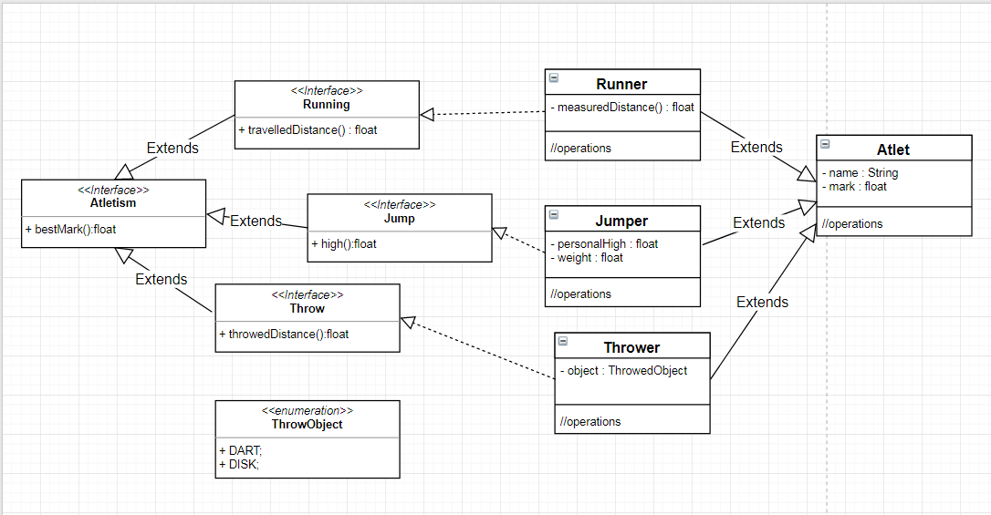
Interface & Generics
Interfaces
Interfaces specifies a set of methods without implementation, predicting wrapping of method protocols without restrinct their implementation only in one descendence.
The interface methods are EVER public and abstract and don’t have modifiers.
The attributes of an interface are EVER final, static and public and don’t have modifiers too.
Consequently variables are ever constants (initializated on the interface).

Slide 24

Interface & Generics
Generics
Is a workaround for the limitation of static typification languages that allow the programmers to create heteroginal collections, id est, collections overall equals, except for the type of they hendle.

Slide 25
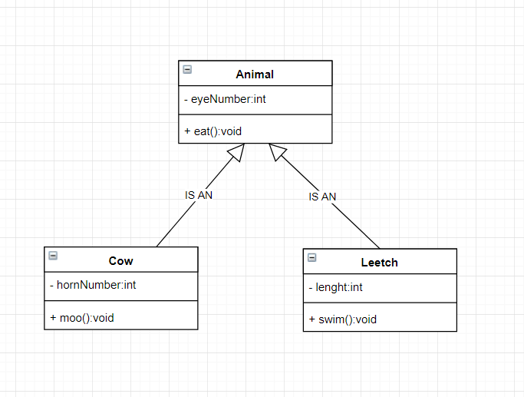
Method Override
Think on our last example: we have a cow that is an animal, right.
Look that, as any animal, a cow eats too. Think now we have a leetch. Leech is an animal too, and like any animal, eats too.
Leetch eats by suction and cow eats by chew. We can write the eat method for a leech in the following way:
public void eat(){
suck();
}
And for the cow:
public void eat(){
chew();
}
Both extends from Animal (both are animals). But how should eat an animal?

Slide 26
Abstract Class and Abstract Methods
A class that only represents a generalization, but doesn’t have a correspondent in real world!
See to the Animal. There are cows, dogs, cats, snakes, leetches, etc. But there are not any generic animal.
An abstract class, for this motive, cannot be instantiated.
We cannot use NEW!
And to guarantee this, we note the class with the keyword abstract!
Following this logic, as there are none real animal that is not specific animal, is not possible that a non-existent bean performs an action like “to eat”. So the eat method of the Animal class doesn’t make sense to be implemented in this class. But all children classes (so, each real animal) eat, but eat in this specific way as we have said. There is a way to just assign in mother class the method and force all children to implement it: declaring it as abstract.
public abstract class Animal{
private int eyeNumber;
public abstract void eat();
public int getEyeNumber(){
return this.eyeNumber;
}
public void setEyeNumber(int eyeNumber){
this.eyeNumber = eyeNumber;
}
}

Slide 27
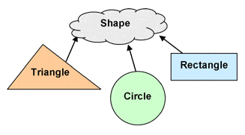
Abstract Classes
Abstract Classes
An abstract class is a class that groups a set of other classes in an abstraction.
They cannot be instantiated;
They can have non-static and non-final fields (attributes);
They can have methods with an without implementation.
They can have different access modificators.

Slide 28
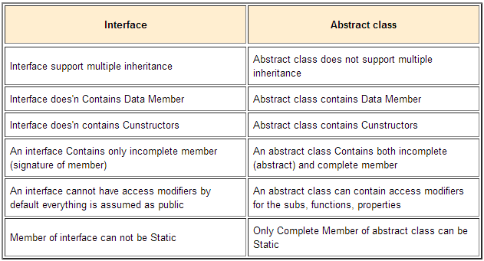

Slide 29
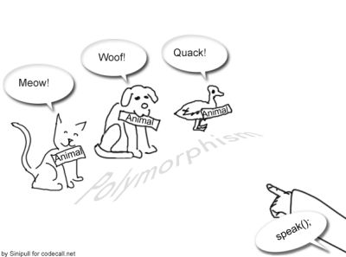
Polymorphism

Slide 30
Polymorphism By Inclusion
This is the most basic type of polymorphism: when a “mother-class” IS AN instance of one of its children.
Animal cow = new Cow();

Slide 31
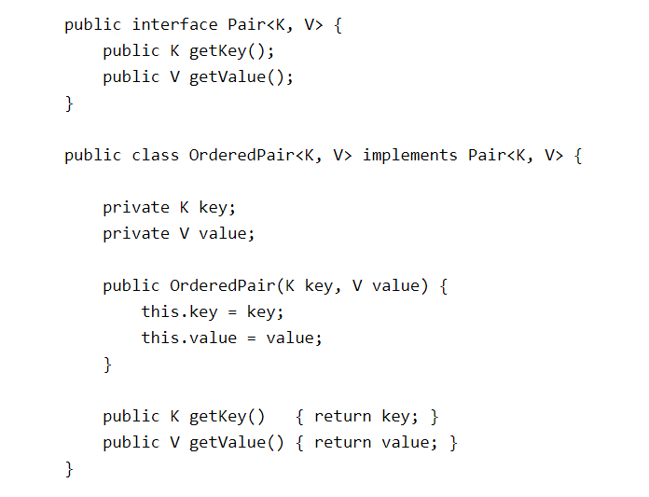
Parametric Polymorphism
Also called of Generics!!!
In a nutshell, generics enable types (classes and interfaces) to be parameters when defining classes, interfaces and methods.
“Generics are types as inputs”

Slide 32
Collections

Slide 33
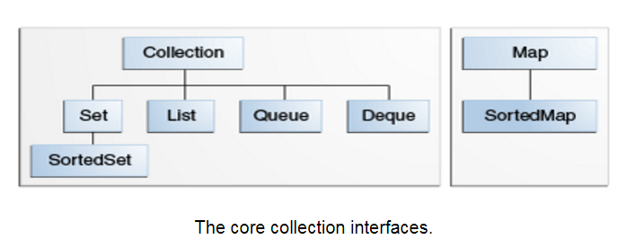
Type of collections

Slide 34
List x Set x Queue
List:
Ordered collection (sequence);
Can contain duplicate elements;
It has precise control over where in the list each element is inserted and can access elements by their integer position;
Set:
Cannot contain duplicated elements;
Queue:
Used to hold multiple elements prior to processing;
FIFO (first-in, first-out);
Deque:
Same use as Queue;
LIFO (last-in, first-out);

Slide 35
Array List x Linked List
ArrayList<E>
Fast random read access → grab any element in a constant time;
Adding or removing from anywhere but the end requires shifting all the latter elements over, either to make an opening or fill the grap;
Also, if you add more elements than the capacity of the underlying array, a new array (1.5 times the size) is allocated, and the old array is copied to the new one.
LinkedList<E>
Only sequential access of elements (forwards or backwards);
Find a position → O(n);
Allows for constant-time insertions and removals using iterators.

Slide 36
JAVA Maps

Slide 37
What is & Collection Views
Is an object that maps keys to values. Each key can map to at most one value. It’s a model to Mathematical function.
Collection Views: the collection view methods allow a Map to be viewed as a Collection in these three ways:
keySet: the Set of keys contained in the Map;
values: the Collection of values contained in the Map. This Collection is not a Set, because multiple keys can map to the same value.
entrySet: the Set of key-value pairs contained in the Map. The Map interface provides a small nested interface called Map.Entry, the type of the elements in the Set.

Slide 38
HashMap vs. TreeMap vs. LinkedMap
HashMap: makes absolutely no guarantees about the iteration order. It can (and will) change completely when new elements were added.
TreeMap: will iterate according to the “natural ordering” of the keys according to their compareTo() method (or an externally supplied Comparator). Additionally, it implements the SortedMap interface, which contains methods that depend on this sorted order.
LinkedHashMap: will iterate in the order in which the entries were put into the map.
Hashtable is the generic name for hash-based maps. In the context of the JAVA API, Hashtable is an absolute class from the days of Java 1.1 before the Collections Framework existed. It should not be used anymore (neither Vector for the same motive), because its API is cluttered with obsolete methods that duplicate functionality, and its methods are synchronized (which can decrease performance and is generally useless). Use ConcurrentHashMap instead of Hashtable.

Slide 39
Strings

Slide 40
10 Important Things Evevry JAVA Developer should know
Strings are not null terminated in JAVA.
Strings are immutable and final in JAVA.
Strings are maintained in String Pool in JAVA.
Use indexOf() and lastIndexOf() or matches(String regex) method to search inside String.
Use substring() to get part of String in JAVA.
“+” is overloaded for String concatenation method (.concat()).
Use trim() to remove white spaces from String.
Use split() for splitting String using Regular Expression (REGEX).
Don’t store sensitive data in Strings (like passwords).
Use format() to format a String in JAVA.

Slide 41
The most important thing about String in JAVA
The most important thing to know about Strings in JAVA is what to encoding your String is using!!!
It does not make sense to have a String without knowing what encoding it uses. There is no way to interpret an String if you don’t know the encoding it used.
You cannot assume that “plain” text is ASCII. If you have a String, in memory or stored in a file or database, you must know what encoding it is in, or you cannot display it correctly. By default JAVA uses platform encoding ide est, character encoding of your server, and belive me this can cause huge trouble if ou are handling Unicode data, specially if you are converting byte array to XML String.
Click here to read more about character encoding in JAVA.

Slide 42
Wrappers

Slide 43
When to use and when not?
Are classes tha wraps the primitive types in JAVA.
When to use?
Data convertion.
When we need null → for the attributes modeling in databased programs.
When don’t use?
Every other situation.
Caution:
Wrapper classes in JAVA are ALL immutable!

Slide 44
Exceptions

Slide 45
Introduction
Event in JAVA is an object that is created when something changes within what it is listening.
An exception is a particular type of event.
Exception is an event, which occurs during the execution of a program, that disrupts the normal flow of the program’s instruction.
When an error occurs within a method, the methos creates an object and hands it off to the runtime system. The object, called an exception object, contains information about the error, including its type and state of the program when the error occurred. Creating an exception object and handing it to the runtime system is called throwing an exception.

Slide 46
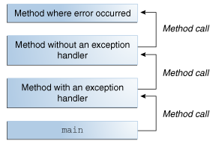
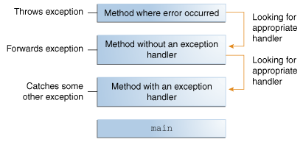
The Call Stack

Slide 47
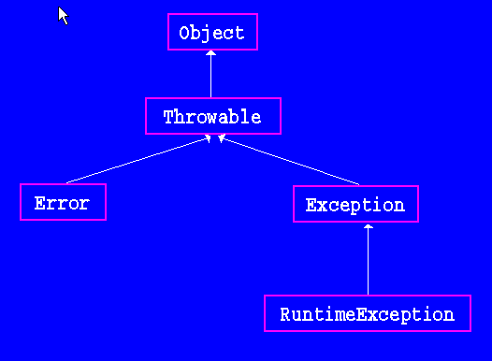
The Exception Inheritance: Types of Exception

Slide 48
More about Exceptions
Catching
Handling
Creating

Slide 49
Files

Slide 50
JAVA I/O – 5 minutes overview
File CRUD
Check if a file exists
Construct a file path
Set the file permitions
BufferedReader
BufferedWriter
What are the directories?
Copy and Move a file

Slide 51
JAVA Security Just a litle candy for you all...

Slide 52
Message Digest Class
This class provides applications the functionality of a message digest algorithm, such as SHA-1, SHA-256, MD5.
Message digest are secure one-way hash fucntions that take arbitrary-sized data and output a fixed-lenght hash value.
A MessageDigest object starts out initialized. The data is processed through it using the update methods. At any point reset can be called to reset the digest. Once all the data to be updated has been updated, on of digest methods should be called to complete the hash computation.
The digest method can be called once for a given number of updates.
After digest has been called, the MessageDigest object is reset to its initialized state.

Slide 53
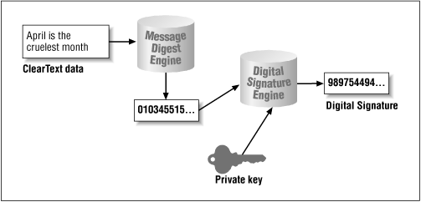
Simple security structure using hash and MessageDigest

Slide 54
Obtaining a hash from a file
The Hash is a mathematical cryptographic method to protect the integrity of some data!
You can study Hash Functions here:
https://www.cs.hmc.edu/~geoff/classes/hmc.cs070.200101/homework10/hashfuncs.html

Slide 55
Talking about study

Slide 56
Bibliography
https://docs.oracle.com/javase/8/docs/
http://www.java2s.com/Tutorials/
https://www.cs.hmc.edu/~geoff/classes/hmc.cs070.200101/homework10/hashfuncs.html
Bates, Bert; Sierra, Kathy. “Head First Java, 2nd Edition”; O’Reilly Media.
Bloch’s, Joshua; “Effective Java Programming Language Guide”.
http://www.mkyong.com/

Slide 57
Thank you for your time!
Douglas S. Bonafé
SET
Douglas.Bonafe@Wipro.com
Douglas.Bonafe@Mastercard.com

