Slide 1
Using a data set of your choosing, create two visualizations of the same data. One visualization will be the worst visualization you can create. The second visualization will be the best visualization you can create. Prepare a power point slide demonstrating both visualizations. Write a few paragraphs that compare and contrast the two visualizations based on the principles and concepts discussed in class.
Submit your completed work as a PDF document with the following file naming convention: LASTNAME_FIRSTNAME Name of Assignment.pdf.
Please also email the pdf to ian.mcculloh@jhuapl.edu

Slide 2
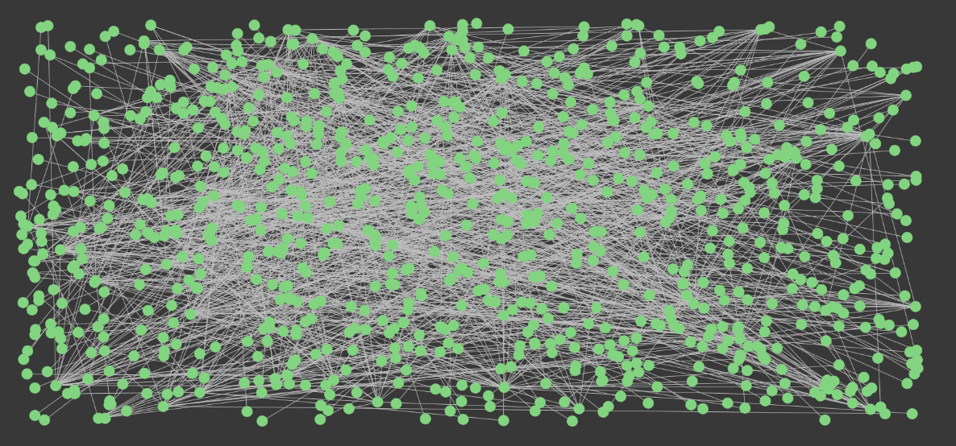
Bad Visualization

Slide 3
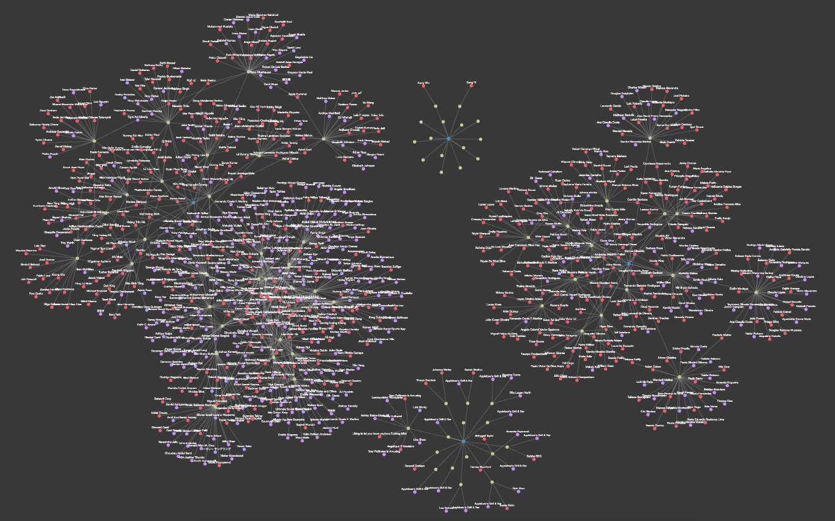
Good Visualization

