Slide 1
Good/Bad Visualization
With Facebook data

Slide 2
Background Information
Used the Facebook Graph API to query for public pages using the word ‘Apple’. Using the first three top results, query for query for posts of the pages and comments/likes on those pages.
Display data using Socrates Web.

Slide 3
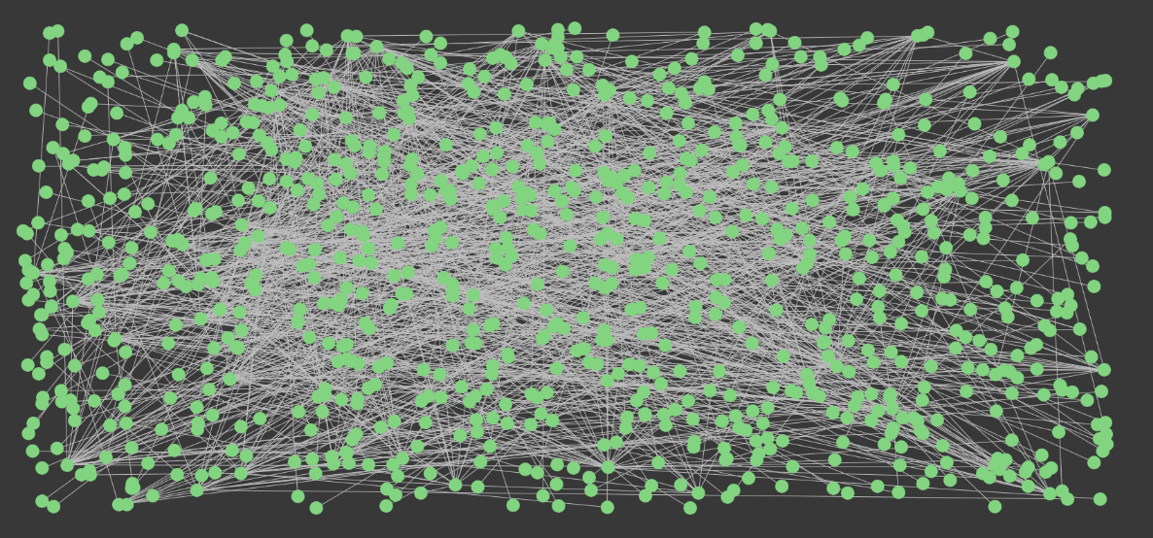
Original Visualization

Slide 4
Bad Visualization
No structure
Unable to tell which nodes connect with which
No information about what the nodes and edges mean
All nodes are one color
Unable to tell how long the lines are

Slide 5
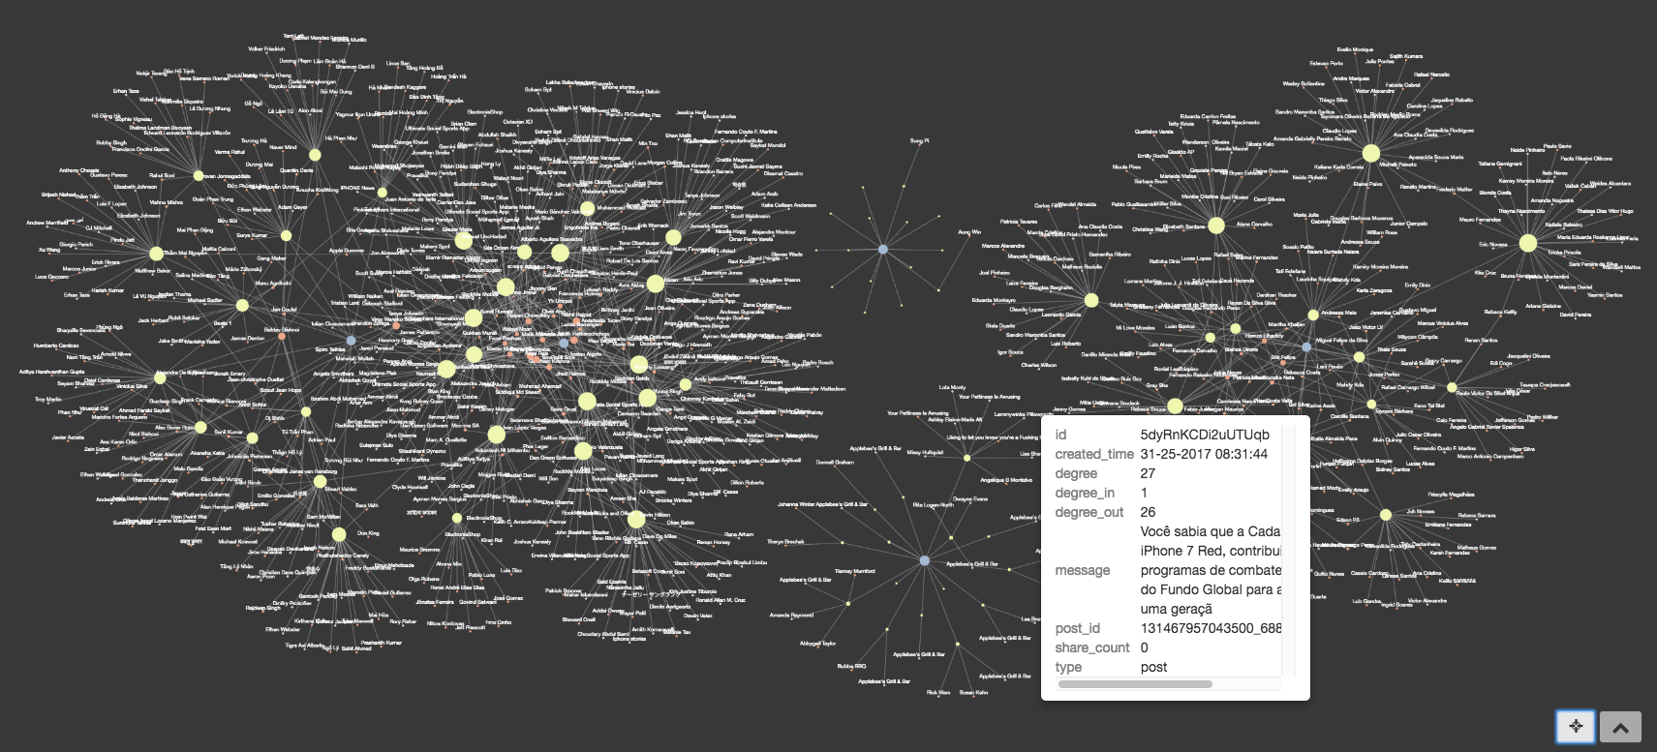
After Styling

Slide 6
Good Visualization
Used clustering to cluster the data in groups that they interact with.
Used degree centrality to size the nodes
Bigger nodes = bigger degree
Tooltip with box shows ordinal information such as post message, degree score, type, etc.
Uses colors to show type of node
Yellow – Post
Blue – Page
Orange – Comment
Attempted to maximize angles without lengthening the lines too much
Attempted to minimize line crossing without increasing the angles or the length of the lines

