Slide 1

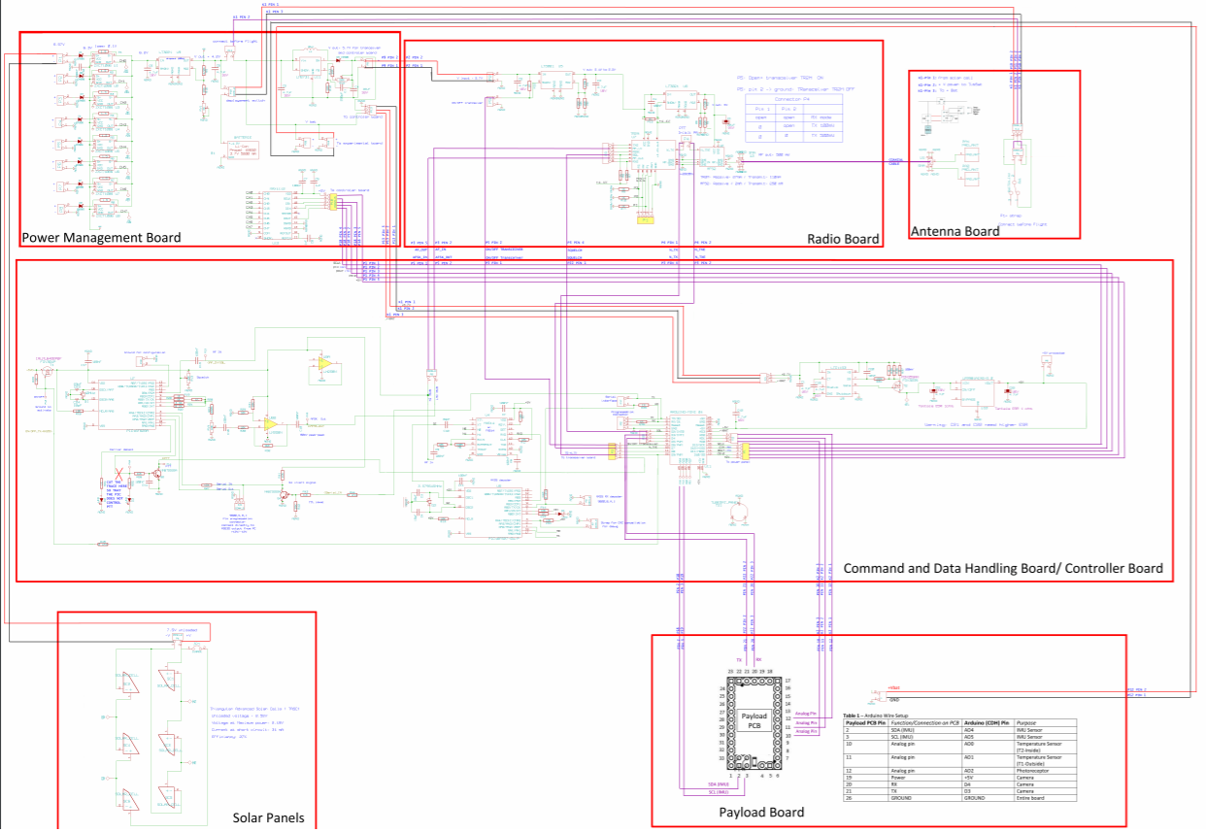
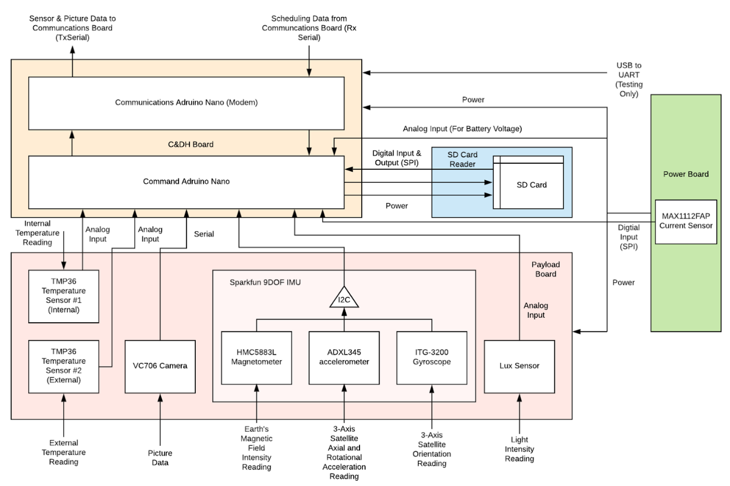
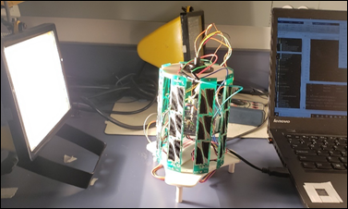
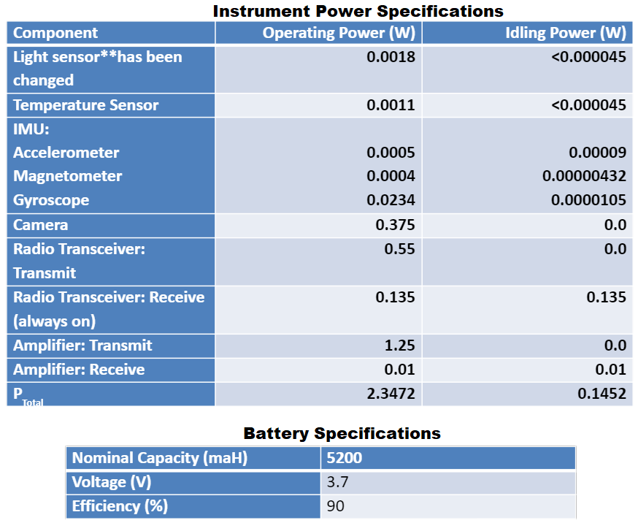
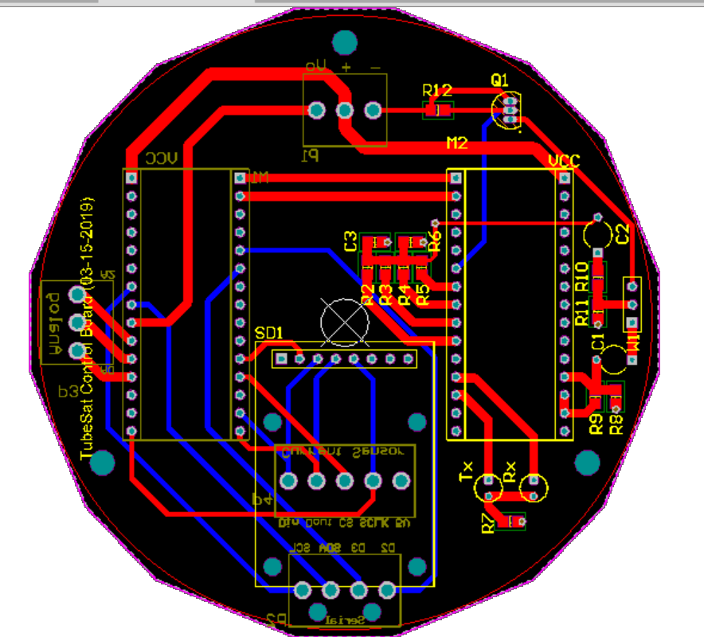
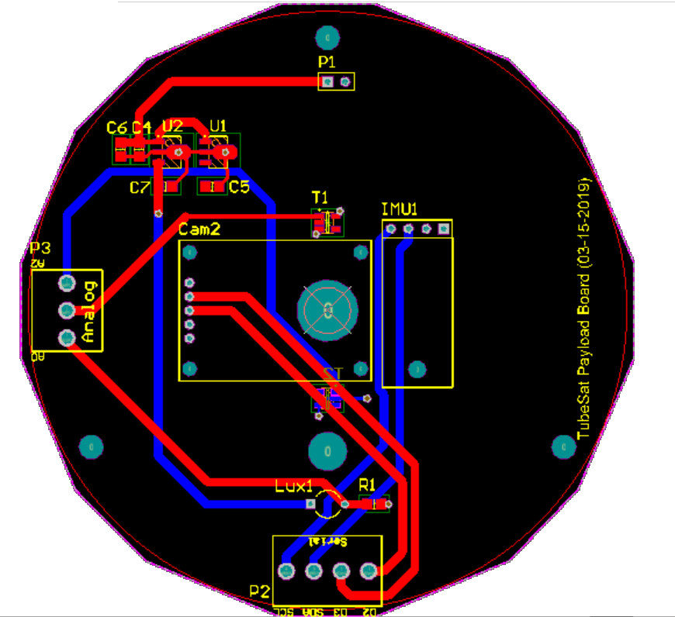
Design of Mini Satellite
RyeTubeSat Team (Bethany S., Owais N., Sam Y., et. al.)
Title of the project
OBJECTIVE
Develop a Minature Satellite for deployment in Low Earth Orbit (~300km distance from Earth)
Design for operation in vacuum of space between -40 and +125ºC
Instrument Payload consists of the System’s diagnostic data (Acceleration, Attitude, Orientation relative to Earth, Temperature, Image Data, etc.)
TESTING
Thermal and Vaccuum Tests of the Battery were performed at -20 and +100ºC
A downlink performance test was done to determine the accuracy of the data received (done without checksum and handshaking)
A Solar Panel Power Analysis was performed using an outdoor lamp and rotating assembly
MOTIVATION
The Main purpose of this project was to provide Final year Engineering Students in Electrical and Aerospace engineering the experience of developing a satellite system from the ground up
The secondary purpose was to finish the Ryerson Tubesat project and get it deployment ready
DESIGN AMMENDMENTS
WORK TO BE DONE
The Communications System needed to be simplified; The Communications System was changed from 3 separate PIC Microcontrollers (each for a different aspect of up and downlink communication in AX.25 protocol) to a Single ATMega328P Microcontroller programmed as the AX.25 Modem and Communication System
The Secondary Microcontroller used for System Monitoring and Data Collection was changed to a microcontroller with an onboard USB programmer for easier transition from prototype to board
The PCB Layout for both the Communications Board and Payload Board needed to be modified for the new Communications System, microcontrollers and additional external SD card memory
Additonal System Monitoring Features need to be applied
Further Simplification of System (Change Microcontroller to ATMega 2560 to remove external 8CH. 8bit ADC IC)
Apply Aerospace grade Conformal Coating and perform full system test in vacuum and at -40 and +125^{oC}
Apply Checksum and Handshake Protocol to Communication protocol to increase downlink packet reception rate
ACKNOWLEDGEMENTS
We would like to Give special Thanks to Dr. Kumar and PhD Candidate Mike Alger for allowing us to join the Aerospace Engineering Departments Tubesat Project
We would also like to Thank everyone on the RyeTubesat Team (Balin M., Francis P., Nathan P., et. al) for all the help they gave us during the project,
Notes:
1

