Slide 1
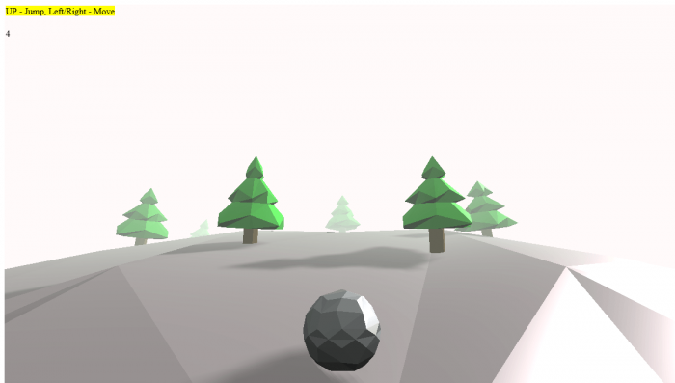
XR Design
Week 1 - Introduction

Slide 2
Module Summary
This module serves as an introduction to immersive technologies, as well as a platform for the creative application of the knowledge and skills developed in L4.
You will be introduced to the technical underpinnings of XR technology for mobile and web applications and produce a self-guided project exploring the techniques presented throughout the module.

Slide 3
Module Aims
To familiarize ourselves with a range of tools oriented towards WebXR development.
To explore XR as a medium for expression and design through emerging technology.
Equip you with the capability to prototype and create basic XR applications.
Encourage a culture of independent learning, investigation, and development.

Slide 4
Learning Outcomes
Develop an understanding of XR as an expressive, as well as technical medium for design
Apply principles of immersive design (presence, realism, immersion, engagement).
Design basic immersive and interactive applications using standard coding practice.
Demonstrate an intermediate level of prototyping and agile software design practice

Slide 5
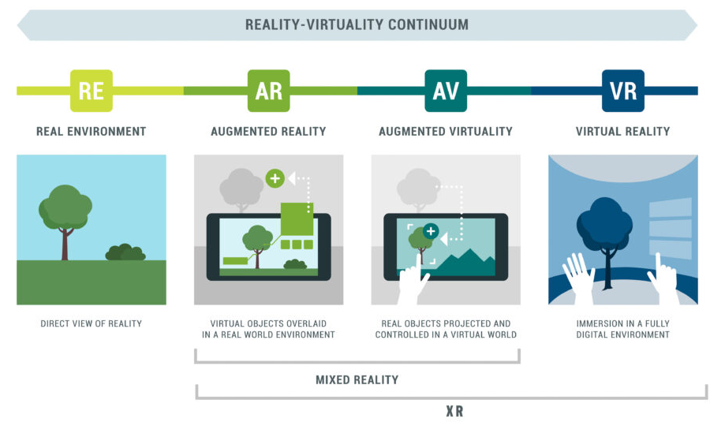
What is XR?
XR stands for extended-reality.
XR is an umbrella term that encompasses all immersive technologies, including Virtual Reality (VR), Augmented Reality (AR), and Mixed Reality (MR). XR represents the spectrum of digital and physical interactions

Slide 6
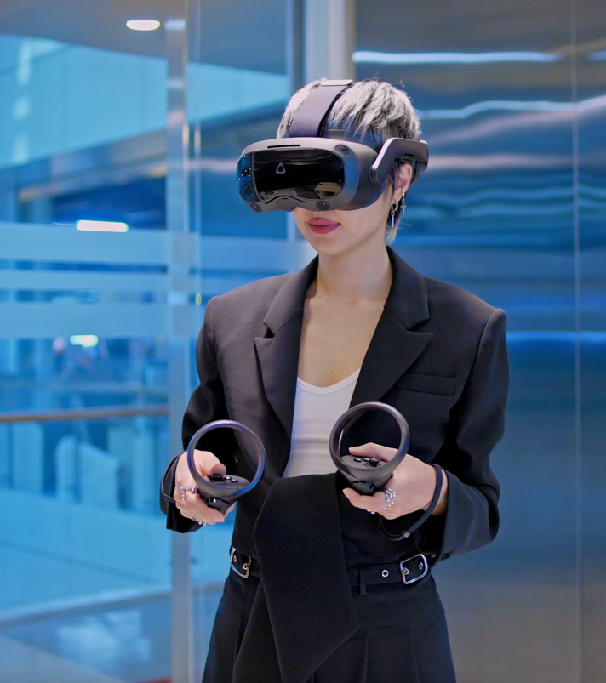
XR Now
XR has become a rapidly growing paradigm thanks to advancements in displays, headsets, GPU and CPU power.
So far, VR has dominated the market, with a primary focus on video games but many other applications exist.
As mobile phones have become more powerful, we have seen the progression of AR and VR for mobile and web.

Slide 7
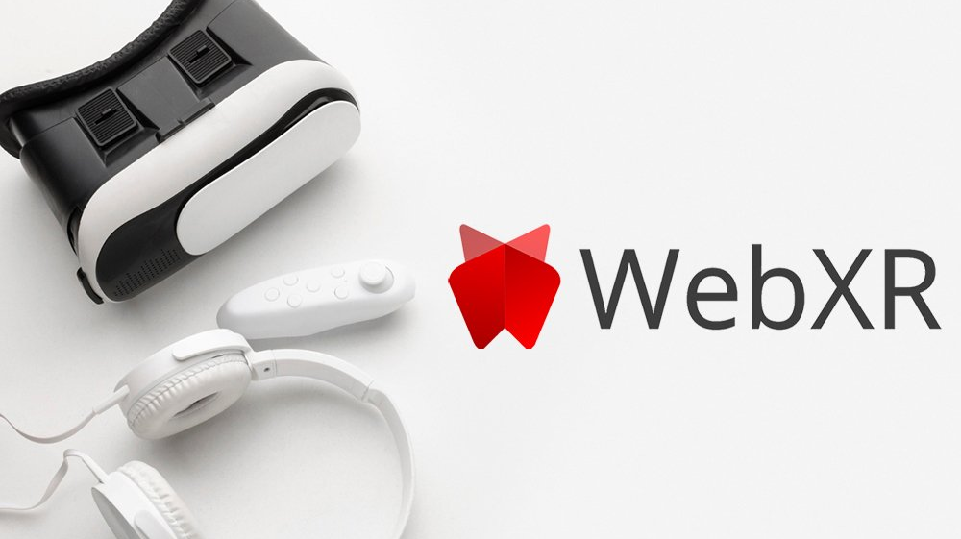

Slide 8
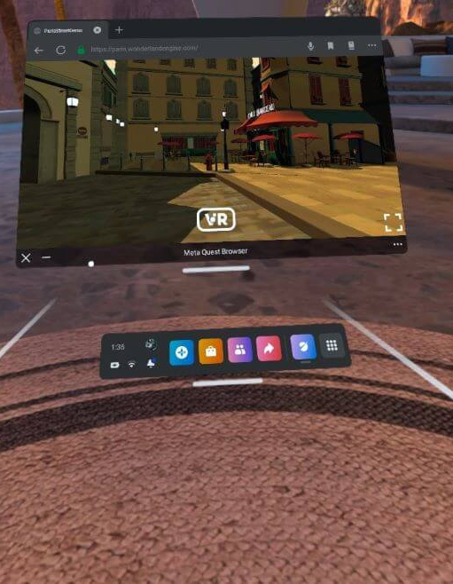
WebXR
WebXR is an open web standard (API) that lets developers create immersive virtual reality (VR) and augmented reality (AR) experiences that run directly in web browsers (mobile or desktop).
You can find out everything you need to know about WebXR here: https://developer.mozilla.org/en-US/docs/Web/API/WebXR_Device_API/Fundamentals

Slide 9
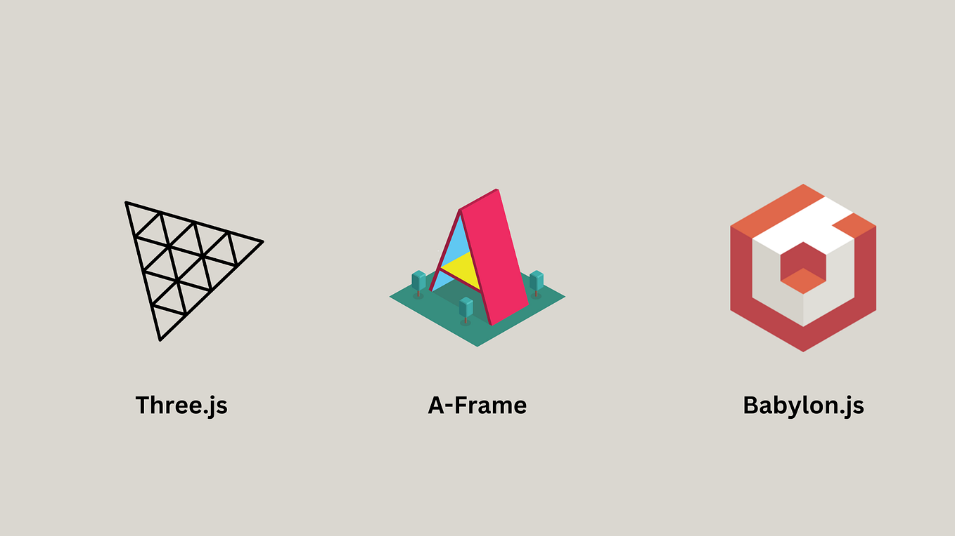
WebXR Tools
There are many tools that allow you to create projects that leverage the WebXR API.
They come in the form of JS libraries which provide dedicated functions and coding principles that enable easier WebXR development.
We will be using Three.js

Slide 10
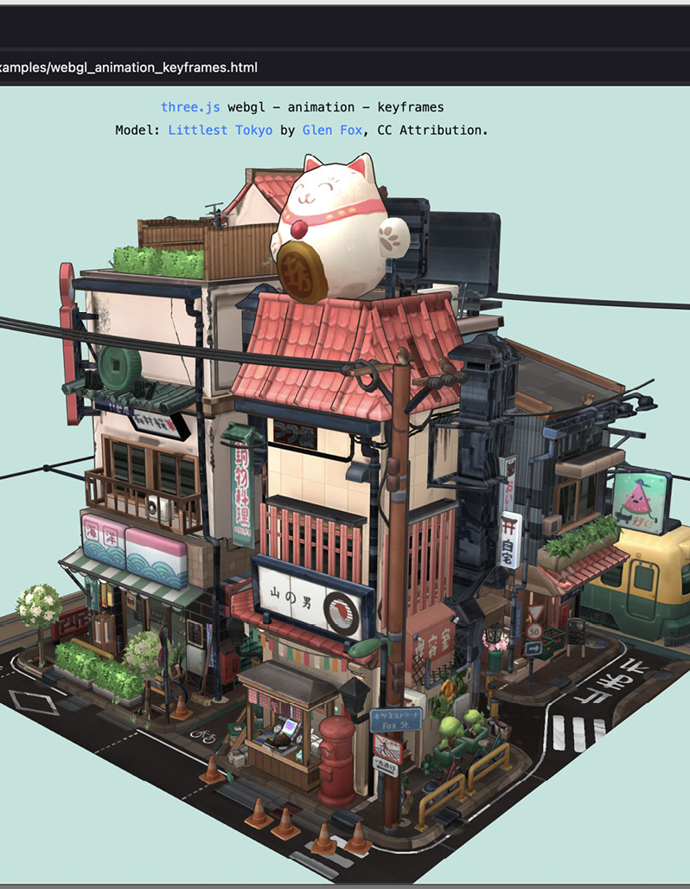
Three.js
Three.js is a 3D library that tries to make it as easy as possible to get 3D content on a webpage.
Three.js uses WebGL to draw 3D objects on screen.
WebGL is a very low-level system that only draws points, lines, and triangles. To do anything useful with WebGL generally requires quite a bit of code and that is where three.js comes in.
It handles stuff like scenes, lights, shadows, materials, textures, 3d math, all things that you'd have to write yourself if you were to use WebGL directly.
It additionally interfaces with the WebXR API allowing access to VR headsets and mobile device sensors to provide control and immersion.
https://threejs.org/

Slide 11
Three.js Concepts
Overall, three.js can be conceptualised similarly to P5.js
There is a setup part of the programme, where you will load or create all your 3D assets, lights, cameras and other environment parameters.
You also have an animation loop, which allows you to modify the parameters of your 3D scene and objects.

Slide 12
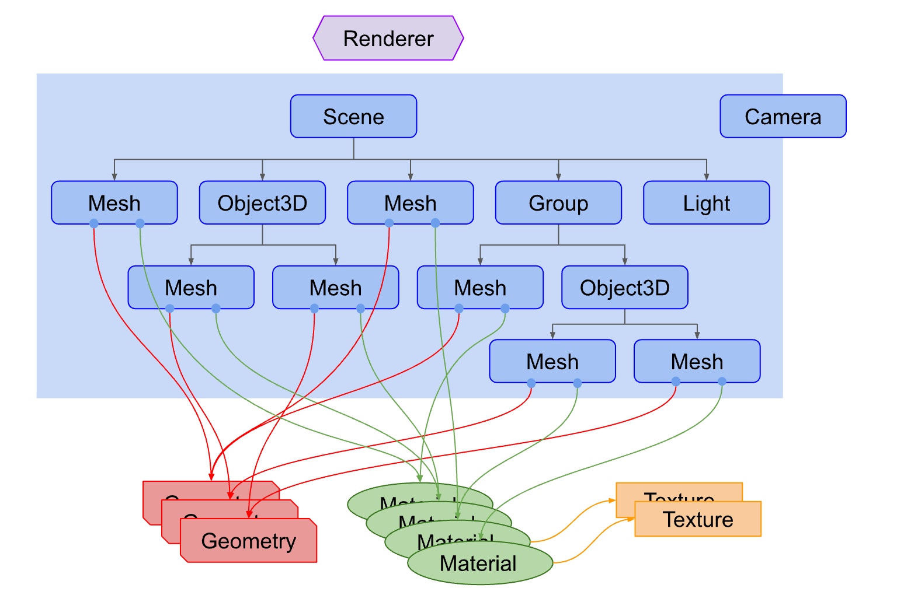
Anatomy of three.js Project
A three.js app requires you to create a bunch of objects and connect them together. Here's a diagram that represents a small three.js app
There is a Renderer into which you pass a Scene and a Camera and it renders (draws) the portion of the 3D scene that is visible to the camera as a 2D image to a canvas.
There is a scenegraph which is a tree-like structure, consisting of various objects like a Scene object, multiple Mesh objects, Light objects, Group, Object3D, and Camera objects.

Slide 13
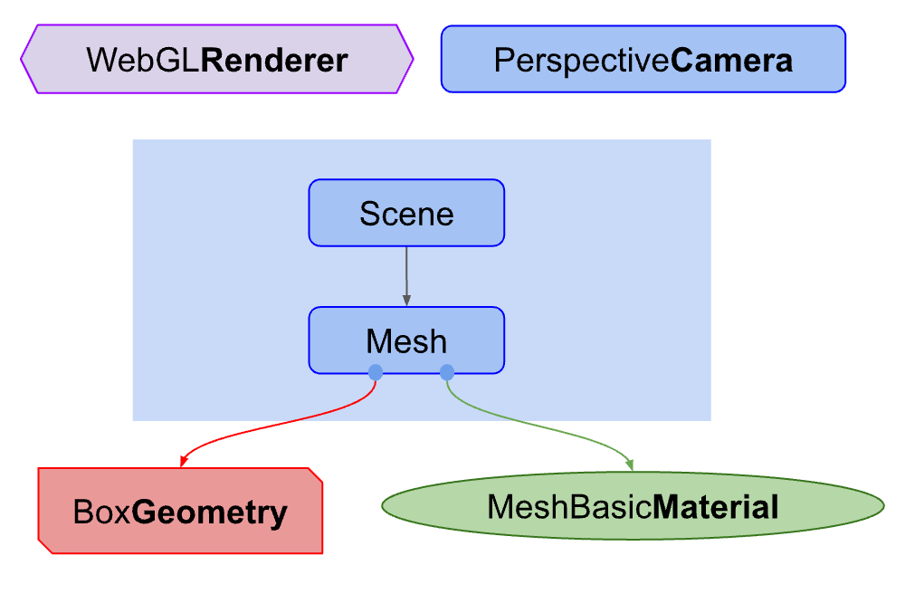
Our First three.js Project
Like all programming languages, we start of with the “hello, world!” programme.
In three.js it’s jokingly referred to as the “hello, cube!” programme.
This is the most basic scenegraph we can create in three.js
Follow the guide on blackboard to install and run your first three.js programme.

Slide 14
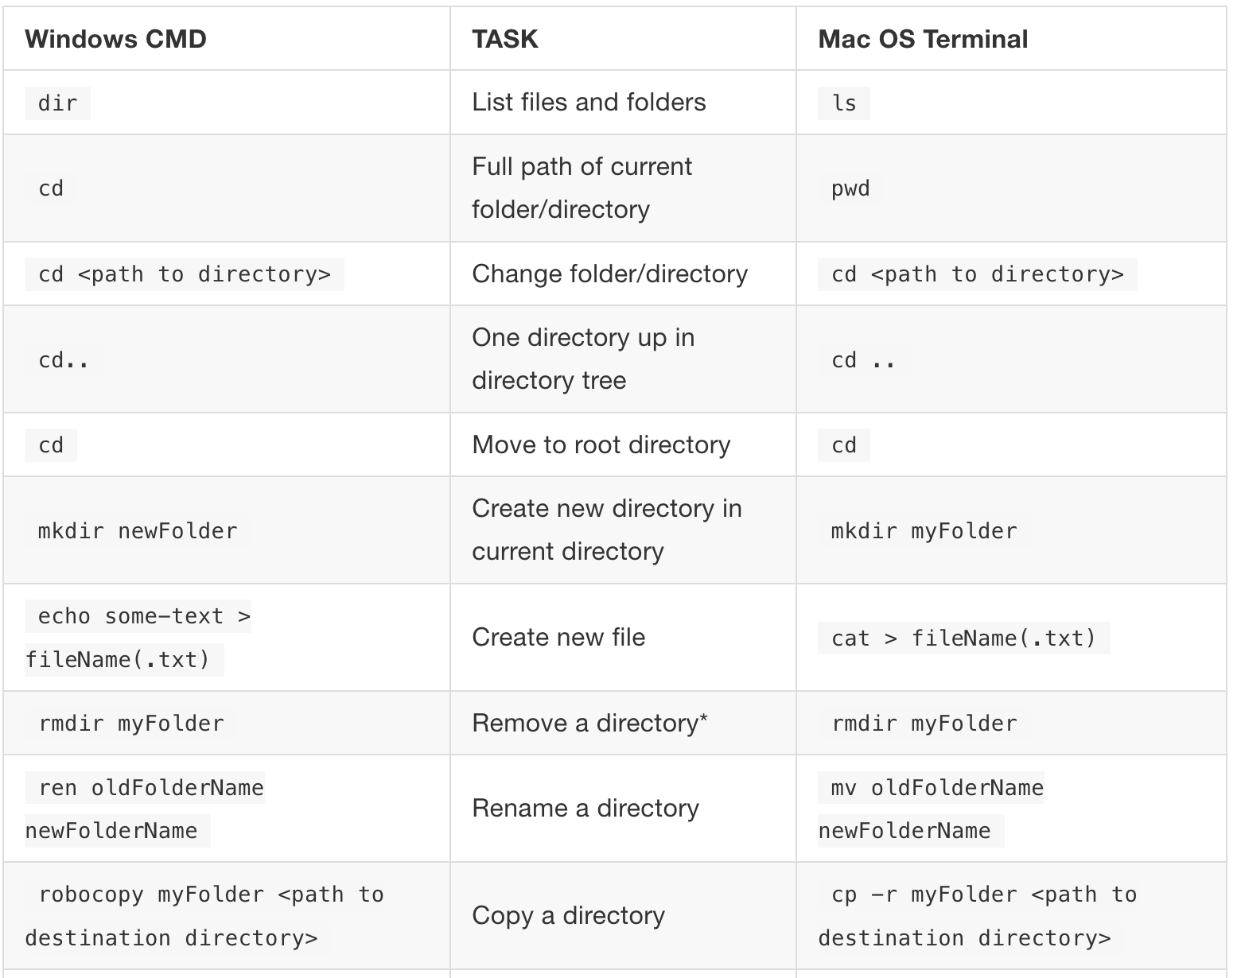
The Terminal
From this point onwards, we will need to familiarize ourselves with the terminal.
The terminal is the portal through which developers execute system commands for building software projects. It is an industry standard.
To use the terminal, we type command line prompts. These are instructions that tell the terminal what we want to do.
https://gfranzini.gitbooks.io/tracer/content/support/command-line-mac-vs.-windows.html

Slide 15

Node.js
The easiest way to install three.js and any JS package is through node.js and NPM (node package manager)
Node is primarily a backend tool, but we will use it to run and build our project while developing it.
In first year, we established that JS is an interpreted language (i.e., not compiled).
JS requires a runtime environment for the computer to execute the code.
This runtime environment can live in the browser, such as how we have been coding with JS so far; or directly on a computer, using node.js.
Node.js is a runtime environment for JS, primarily used for coding servers and API interactions.

Slide 16

Build Tools
The other thing we will need to run our project is a build tool.
A build tool is a crucial piece of software that simplifies and automates the transformation of software source code into a deployable, executable form.
Build tools consist of two parts:
  A development server which hosts your project at development.
  A set of build commands that package all your code and dependencies so that they can be deployed on the web,
We will be using Vite - https://vite.dev/guide/

