Slide 1
Medicare Program
Analytics
MEDICARE · FOUR-DOMAIN ANALYST DEEP-DIVE
Enrollment, claims and utilization, plan quality, and provider enrollment in a single view
70.5M
$377.3B
3.7 / 5
2.98M
BENEFICIARIES
FFS PAYMENTS
AVG STAR RATING
PROVIDER ENROLLMENT RECORDS
Data sources: CMS Medicare Monthly Enrollment (May 2026) · Geographic Variation (2014–2024) · MA & Part D Star Ratings (2024–2026) · Provider Enrollment PPEF (2026 Q3) · Part B PBAR (CY 2022–2024) · Independent portfolio analysis; not commissioned, reviewed, endorsed, or published by CMS.

Slide 2
The Bottom Line
FOR LEADERSHIP · EXECUTIVE SUMMARY
One page for decision-makers: who Medicare covers, what it spends, how plans perform, and how the enrolled provider network is composed.
70.5M
$377.3B
3.7 / 5
2.98M
BENEFICIARIES
FFS PAYMENTS
AVG STAR RATING
PROVIDER ENROLLMENT RECORDS
51.2% in MA & Other plans
$12,553 per beneficiary
44.4% of contracts at 4+ stars
2.55M individual-practitioner enrollments
What the data says
01
Coverage has tipped to MA & Other plans
Where to focus
MA and other plans now cover 36.1M of 70.5M beneficiaries — 51.2% — after crossing above Original Medicare.
1
Plan for an MA-majority program
02
FFS cost is rising per person
Half of beneficiaries are in MA & Other plans — quality and risk levers outweigh FFS pricing.
Standardized payment per beneficiary climbed from $9,191 in 2014 to $12,553 in 2024.
2
Bend the per-beneficiary curve
03
Quality has plateaued below 4 stars
Hospital inpatient is 28.0% of FFS payments — the largest single block.
The average contract has held near 3.7 of 5 since 2024, and only 44.4% reach 4+ stars.
3
Close the four-star gap
04
Nurse practitioners lead primary provider types
Contracts clustered at 3.5 stars are the clearest path to bonus-eligible performance.
Nurse practitioners are the largest primary provider type at 359,719 unique provider entities within 2.98M enrollment records.
Lisa A. Phillips | Independent analysis of publicly available CMS data
02

Slide 3
What This Analysis Covers
DATASET OVERVIEW
Scope
Population
Four CMS data domains — enrollment and demographics, FFS claims and utilization, MA plan quality, and provider enrollment.
All Medicare beneficiaries nationally, plus rated MA contracts and the enrolled fee-for-service provider network.
Primary Question
Source
Who does Medicare cover, what does it pay for, how well do plans perform, and how is the enrolled provider network composed?
CMS Monthly Enrollment (May 2026), Geographic Variation (2014–2024), MA & Part D Star Ratings (2024–2026), Provider Enrollment PPEF (2026 Q3), and Part B PBAR (CY 2022–2024).
4
Data domains
70.5M
Beneficiaries covered
516
Rated MA contracts
2.98M
Provider enrollment records
Lisa A. Phillips | Independent analysis of publicly available CMS data
03

Slide 4
Four Domains at a Glance
ORIENTATION
The four datasets in one line — 70.5M beneficiaries · $377.3B FFS payments · 3.7 avg stars · 2.98M provider enrollment records.
01
Enrollment & Beneficiaries
02
Claims & Utilization
70.5M covered, 51.2% of them in Medicare Advantage & Other plans, on a base weighted toward ages 65–74 (48.4%).
$377.3B of FFS payments in 2024 — $12,553 per beneficiary, led by hospital inpatient at 28.0%.
03
Quality & Star Ratings
04
Provider Network
516 rated contracts averaging 3.7 of 5; 44.4% reach 4+ stars and just 22 hit five.
2.98M enrollment records — 2.55M individual-practitioner enrollments and 432,233 organizations across 321 provider types.
Lisa A. Phillips | Independent analysis of publicly available CMS data
04

Slide 5
Medicare Advantage & Other Plans Now Cover the Majority
ENROLLMENT · DELIVERY SYSTEM
Medicare enrollment by coverage delivery system, May 2026 (Millions)
51.2%
MEDICARE ADVANTAGE & OTHER SHARE
May 2026
What's happening
Of 70.5M total beneficiaries, 36.1M are in Medicare Advantage and other plans.
Medicare Advantage & Other now exceed Original Medicare by approximately 1.7M beneficiaries, reflecting a continuing shift in delivery-system mix.
Lisa A. Phillips | Independent analysis of publicly available CMS data
05
Notes:
Source: CMS Medicare Monthly Enrollment, May 2026 release — data.cms.gov/summary-statistics-on-beneficiary-enrollment
Independent portfolio analysis; not commissioned, reviewed, endorsed, or published by CMS.

Slide 6
Where Medicare Advantage & Other Lead
ENROLLMENT · GEOGRAPHY
Highest Medicare Advantage & Other share by state or territory, May 2026.
86.8%
HIGHEST MA & OTHER SHARE
Puerto Rico
Concentration
Puerto Rico is a clear outlier at 86.8%, well above every mainland state.
The mainland leaders cluster tightly in the high 50s — Michigan, Alabama, Rhode Island, Maine and North Carolina all sit near 57–59%, so MA & Other majorities are now ordinary rather than exceptional.
Lisa A. Phillips | Independent analysis of publicly available CMS data
06
Notes:
Source: CMS Medicare Monthly Enrollment, May 2026 release — data.cms.gov/summary-statistics-on-beneficiary-enrollment
Independent portfolio analysis; not commissioned, reviewed, endorsed, or published by CMS.

Slide 7
FFS Spending per Beneficiary Keeps Rising
CLAIMS · NATIONAL TREND
Standardized payment per Original Medicare beneficiary ($)
$377.3B
TOTAL FFS PAYMENTS
2024
What's happening
Standardized payment per beneficiary rose from $9,191 in 2014 to $12,553 in 2024.
That is a 37% increase per person over a decade, on a shrinking Original Medicare population — the pressure is per-capita cost, not enrollment growth.
Lisa A. Phillips | Independent analysis of publicly available CMS data
07
Notes:
Source: CMS Medicare Geographic Variation, National/State/County, 2014–2024 — data.cms.gov/medicare-geographic-variation
Independent portfolio analysis; not commissioned, reviewed, endorsed, or published by CMS.

Slide 8
Where Fee-for-Service Dollars Go
CLAIMS · SERVICE MIX
Share of total Original Medicare FFS payments by service type, 2024 — selected published categories.
28.0%
LARGEST SERVICE TYPE
Hospital Inpatient
Concentration
Hospital inpatient alone absorbs 28.0% of every fee-for-service dollar.
Below hospital care the mix flattens into a long tail — procedures, rehab, dialysis and ambulance each land in the low single digits, so cost control has to start with the hospital block.
Lisa A. Phillips | Independent analysis of publicly available CMS data
08
Notes:
Source: CMS Medicare Geographic Variation, National/State/County, 2014–2024 — data.cms.gov/medicare-geographic-variation
Independent portfolio analysis; not commissioned, reviewed, endorsed, or published by CMS.

Slide 9
Plan Quality Has Remained Stable Near 3.7 Stars
QUALITY · THREE-YEAR TREND
Average overall star rating, unweighted contract average, 2024–2026
3.7 / 5
AVG OVERALL RATING
516 rated contracts
What's happening
The average contract moved from 3.68 in 2024 to 3.71 in 2026 — effectively flat.
Average ratings have remained stable near 3.7 across three years, so gains are likelier to come from contract-level execution than from a rising tide.
Lisa A. Phillips | Independent analysis of publicly available CMS data
09
Notes:
Source: CMS Medicare Advantage and Part D Star Ratings Data Tables, 2024–2026 — cms.gov/medicare/health-plans/medicareadvtgspecratestats
Independent portfolio analysis; not commissioned, reviewed, endorsed, or published by CMS.

Slide 10
Most Contracts Fall Short of Four Stars
QUALITY · DISTRIBUTION
Medicare Advantage contracts by CMS overall star rating, 2026 (n = 516).
44.4%
CONTRACTS AT 4+ STARS
22 contracts at five stars
Implication
The distribution peaks at 3.5 stars — 167 contracts sit one half-step below the bonus threshold.
That cluster is a priority segment for contract-level measure review: focused measure improvements could move some contracts toward four stars.
Contract-level CMS overall star ratings; nonnumeric rating statuses excluded.
Lisa A. Phillips | Independent analysis of publicly available CMS data
10
Notes:
Source: CMS Medicare Advantage and Part D Star Ratings Data Tables, 2024–2026 — cms.gov/medicare/health-plans/medicareadvtgspecratestats
Independent portfolio analysis; not commissioned, reviewed, endorsed, or published by CMS.

Slide 11
Nurse Practitioners Are the Largest Primary Provider Type
PROVIDER NETWORK · COMPOSITION
Unique PECOS provider entities by reported primary provider type, 2026 Q3.
2.98M
ENROLLMENT RECORDS
PPEF 2026 Q3
Composition
Nurse practitioners are the largest primary provider type at 359,719 unique provider entities.
Across 321 primary provider types, 2.55M enrollments are individual practitioners and 432,233 are organizations and suppliers. This describes enrollment composition, not workforce supply or care delivered.
Lisa A. Phillips | Independent analysis of publicly available CMS data
11
Notes:
Source: CMS Medicare FFS Public Provider Enrollment (PPEF), 2026 Q3 — data.cms.gov/provider-characteristics/medicare-provider-supplier-enrollment
Independent portfolio analysis; not commissioned, reviewed, endorsed, or published by CMS.

Slide 12
Where to Focus Next
RECOMMENDATIONS
01
Plan for an MA-majority program
02
Bend the per-beneficiary cost curve
With 51.2% of beneficiaries in plans, network adequacy, risk adjustment and star performance move more value than fee-for-service pricing levers.
Standardized spend per beneficiary rose 37% in a decade; hospital inpatient at 28.0% of payments is the largest service category in this dataset.
03
Close the four-star gap
04
Use enrollment composition to guide network analysis
Only 44.4% of contracts reach 4+ stars and the average has been flat since 2024 — concentrate improvement on the 167 contracts sitting at 3.5.
Advanced-practice types dominate enrollment records; use that composition as an input to network design and analysis, not as a measure of care delivered.
Lisa A. Phillips | Independent analysis of publicly available CMS data
12

Slide 13
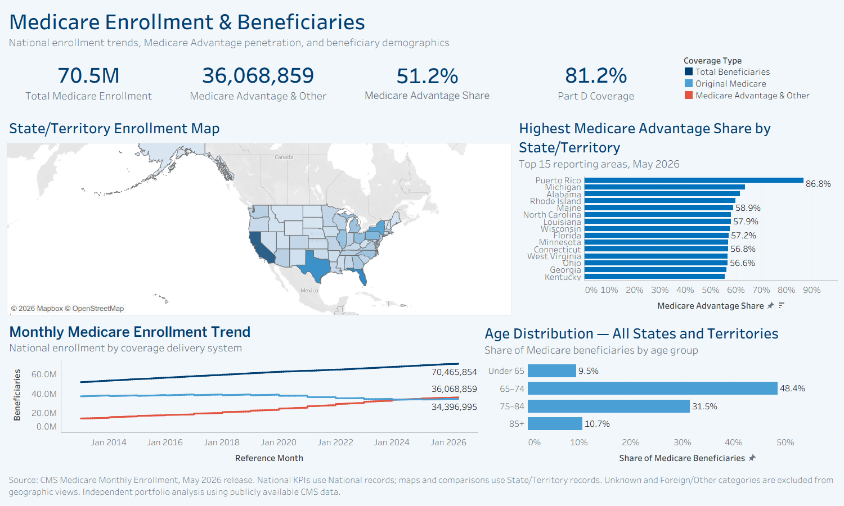
Medicare Enrollment & Beneficiaries
DASHBOARD 1 · ENROLLMENT
Coverage mix, geography, and age structure.
Live on Tableau Public: public.tableau.com/app/profile/lisa.a.phillips
Lisa A. Phillips | Independent analysis of publicly available CMS data
13
Notes:
Source: CMS Medicare Monthly Enrollment, May 2026 release — data.cms.gov/summary-statistics-on-beneficiary-enrollment
Independent portfolio analysis; not commissioned, reviewed, endorsed, or published by CMS.

Slide 14
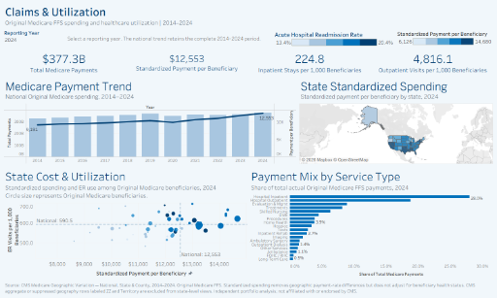
Claims & Utilization
DASHBOARD 2 · CLAIMS
FFS payments, service mix, and per-beneficiary cost.
Live on Tableau Public: public.tableau.com/app/profile/lisa.a.phillips
Lisa A. Phillips | Independent analysis of publicly available CMS data
14
Notes:
Source: CMS Medicare Geographic Variation, National/State/County, 2014–2024 — data.cms.gov/medicare-geographic-variation
Independent portfolio analysis; not commissioned, reviewed, endorsed, or published by CMS.

Slide 15
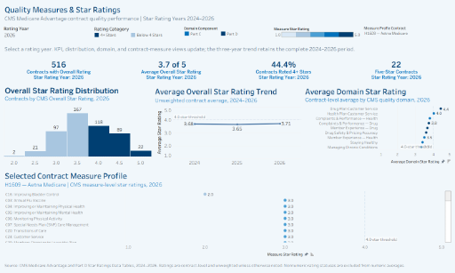
Quality Measures & Star Ratings
DASHBOARD 3 · QUALITY
Contract-level rating trend and distribution.
Live on Tableau Public: public.tableau.com/app/profile/lisa.a.phillips
Lisa A. Phillips | Independent analysis of publicly available CMS data
15
Notes:
Source: CMS Medicare Advantage and Part D Star Ratings Data Tables, 2024–2026 — cms.gov/medicare/health-plans/medicareadvtgspecratestats
Independent portfolio analysis; not commissioned, reviewed, endorsed, or published by CMS.

Slide 16
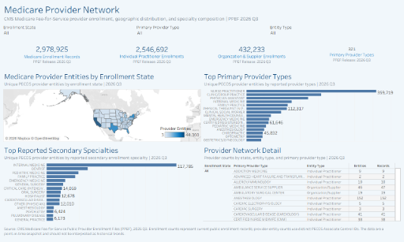
Medicare Provider Network
DASHBOARD 4 · PROVIDERS
Enrollment composition by primary provider type.
Live on Tableau Public: public.tableau.com/app/profile/lisa.a.phillips
Lisa A. Phillips | Independent analysis of publicly available CMS data
16
Notes:
Source: CMS Medicare FFS Public Provider Enrollment (PPEF), 2026 Q3 — data.cms.gov/provider-characteristics/medicare-provider-supplier-enrollment
Independent portfolio analysis; not commissioned, reviewed, endorsed, or published by CMS.

Slide 17
Sources & Notes
APPENDIX
CMS Datasets
Notes & Limitations
Enrollment
Medicare Monthly Enrollment — May 2026 release
Aggregated public-use national summary data — not beneficiary-level claims.
Provider figures use the PPEF enrollment extract related through ENRLMT_ID.
Star ratings are contract-level; nonnumeric statuses excluded from averages.
Specialty-level charts use CY 2022 as a historical baseline; national totals span CY 2022–2024.
Aggregate/Total and source rows excluded; figures rounded for presentation.
Independent portfolio analysis; not commissioned, reviewed, endorsed, or published by CMS.
https://data.cms.gov/summary-statistics-on-beneficiary-enrollment
Claims
Medicare Geographic Variation — National, State & County, 2014–2024
https://data.cms.gov/medicare-geographic-variation
Quality
MA and Part D Star Ratings Data Tables, 2024–2026
https://www.cms.gov/medicare/health-plans/medicareadvtgspecratestats
Providers
Medicare FFS Public Provider Enrollment (PPEF), 2026 Q3
data.cms.gov/provider-characteristics/medicare-provider-supplier-enrollment
Part B
Medicare Part B PBAR — National Summary, CY 2022–2024
data.cms.gov/provider-summary-by-type-of-service
Lisa A. Phillips | Independent analysis of publicly available CMS data
17

Slide 18
APPENDIX
Technical Appendix: Part B Specialty Analysis
Descriptive Part B analysis, analyst-defined specialty segments, and the payment reconciliation checks that support the main findings.
Lisa A. Phillips | Independent analysis of publicly available CMS data
18

Slide 19
Medicare Part B Spending Is Climbing
DESCRIPTIVE · NATIONAL TREND
Total Medicare Payment Amount by Year ($ Billions)
+13.6%
2-YR PAYMENT GROWTH
2022 → 2024
What's happening
Payments rose +8.4% in 2023, then a softer +4.8% in 2024.
Growth slowed in 2024; the following analysis separates changes in service volume and payment per service.
Lisa A. Phillips | Independent analysis of publicly available CMS data
19
Notes:
Source: CMS Medicare Part B PBAR national summary files, CY 2022–2024 — data.cms.gov
Independent portfolio analysis; not commissioned, reviewed, endorsed, or published by CMS.

Slide 20
Top 10 Specialties by Medicare Payment
DESCRIPTIVE · RANKING
CY 2022 specialty baseline; national totals run through CY 2024.
$7.29B
TOP SPECIALTY
Internal Medicine
Concentration
The top 10 specialties alone account for ~$54.8B of 2022 payments.
Primary care, ophthalmology, labs, and oncology anchor the spend — a mix of high-volume and drug-heavy fields.
Lisa A. Phillips | Independent analysis of publicly available CMS data
20
Notes:
Source: CMS Medicare Part B PBAR national summary files, CY 2022–2024 — data.cms.gov
Independent portfolio analysis; not commissioned, reviewed, endorsed, or published by CMS.

Slide 21
Payment Rate Holds Near 77%
DESCRIPTIVE · CHARGES VS. PAYMENTS
Allowed Charges vs. Medicare Payment ($ Billions)
76.8%
2024 PAYMENT RATE
of allowed charges paid
Why it matters
Roughly 77 cents on every approved dollar is paid, and that ratio barely moves year to year.
The ratio eased slightly to 76.8% in 2024 — a change small enough that no single driver can be identified from these data.
Payment rate: 2022 77.3% 2023 77.1% 2024 76.8%
Lisa A. Phillips | Independent analysis of publicly available CMS data
21
Notes:
Source: CMS Medicare Part B PBAR national summary files, CY 2022–2024 — data.cms.gov
Independent portfolio analysis; not commissioned, reviewed, endorsed, or published by CMS.

Slide 22
Volume Peaked in 2023; Unit Cost Rebounded
DESCRIPTIVE · VOLUME VS. UNIT COST
Allowed Services (Billions)
Payment per Service ($)
6.14B
PEAK SERVICES (2023)
eased to 5.96B in 2024
Reading the split
Service volume peaked in 2023 then eased, while payment per service dipped then rebounded to $22.08.
2024's spending growth was driven more by higher unit cost than by more services.
Lisa A. Phillips | Independent analysis of publicly available CMS data
22
Notes:
Source: CMS Medicare Part B PBAR national summary files, CY 2022–2024 — data.cms.gov
Independent portfolio analysis; not commissioned, reviewed, endorsed, or published by CMS.

Slide 23
Internal Medicine: The Volume Engine
SPECIALTY SPOTLIGHT · #1 BY PAYMENT
The single largest specialty by Medicare payment — built on immense service volume at a modest unit price (CY 2022).
$7.29B
175.2M
$41.59
74.1%
MEDICARE PAYMENT
ALLOWED SERVICES
PAYMENT / SERVICE
PAYMENT RATE
#1 of all specialties
Highest physician volume
Modest unit cost
Just below the ~77% norm
Why it tops the ranking
Same spend, opposite shape
Internal Medicine and Ophthalmology each paid ≈ $7.3B in 2022 — by completely different mechanics.
Internal Medicine bills 175 million services a year at just $41.59 each — modest prices multiplied by enormous volume produce the largest payment total of any specialty.
On $9.83B of allowed charges, Medicare pays 74.1% — slightly below the national norm. The combination of exceptionally high service volume and moderate payment per service explains Internal Medicine’s top payment rank.
Internal Medicine
Ophthalmology
Allowed services
175.2M
58.5M
Payment / service
$41.59
$123.92
Archetype
Volume
Intensity
Lisa A. Phillips | Independent analysis of publicly available CMS data
23
Notes:
Source: CMS Medicare Part B PBAR national summary files, CY 2022–2024 — data.cms.gov
Independent portfolio analysis; not commissioned, reviewed, endorsed, or published by CMS.

Slide 24
A 160× Spread in Payment per Service
DESCRIPTIVE · COST INTENSITY
Selected specialties, 2022 payment per service ($) — commodity dispensing to complex surgery.
160×
COST INTENSITY SPREAD
$1.71 → $276 / service
Implication
Total spend and unit cost tell different stories.
Commodity fields win on volume; surgical fields win on intensity. Any cost-management lever must be matched to the right group.
Specialty-level figures are CY 2022; national trends span CY 2022–2024.
Lisa A. Phillips | Independent analysis of publicly available CMS data
24
Notes:
Source: CMS Medicare Part B PBAR national summary files, CY 2022–2024 — data.cms.gov
Independent portfolio analysis; not commissioned, reviewed, endorsed, or published by CMS.

Slide 25
Three Analytical Specialty Segments
SEGMENTATION · CLUSTERING
Analyst-defined clusters: K-means on log-transformed, standardized volume, payment, payment-per-service and payment rate; k = 3 chosen by elbow and interpretability.
01
High-Volume Commodity
02
Balanced High-Spend
03
Specialized High-Intensity
LABS, PHARMACY, IMAGING, SUPPLIES
INTERNAL MEDICINE, FAMILY PRACTICE, NP, OPHTHALMOLOGY
CARDIAC, THORACIC & NEUROSURGERY, ONCOLOGY
Low unit cost, immense throughput, high payment rate. Managed through pricing and volume controls.
Moderate unit cost at large scale — the core of aggregate spending and the biggest budget levers.
Low volume, very high payment per service. Managed through appropriateness and clinical review.
Lisa A. Phillips | Independent analysis of publicly available CMS data
25
Notes:
Source: CMS Medicare Part B PBAR national summary files, CY 2022–2024 — data.cms.gov
Independent portfolio analysis; not commissioned, reviewed, endorsed, or published by CMS.

Slide 26
The Clusters, Made Visible
SEGMENTATION · THE EVIDENCE
Allowed services vs. payment per service, 12 representative specialties by analyst-defined cluster.
READING THE CHART
Each dot is a specialty, positioned by annual volume and unit cost.
High-Volume Commodity Low unit cost, immense volume
Balanced High-Spend Moderate cost at large scale
Specialized High-Intensity High cost, low volume
Clusters separate cleanly. Volume and unit cost trade off along a clear diagonal. Unlabelled lower-left points: Pharmacy, Medical Supply, Clinical Lab, Diagnostic Radiology.
Lisa A. Phillips | Independent analysis of publicly available CMS data
26
Notes:
Source: CMS Medicare Part B PBAR national summary files, CY 2022–2024 — data.cms.gov
Independent portfolio analysis; not commissioned, reviewed, endorsed, or published by CMS.

Slide 27
Tableau Build Blueprint: Part B Specialty Analysis
BUILD SPEC
A step-by-step recipe to reproduce this dashboard — data source, worksheets, and the assembled canvas.
1 · DATA SOURCE & FIELDS
2 · SHEET: KPI TILES
3 · SHEET: PAYMENTS BY YEAR
▪ Connect CMS PBAR national summary files (CY 2022–2024).
▪ Union the three yearly files into one specialty-year table.
Dimensions: Specialty, Year
Measures: Allowed Services, Allowed Charges, Payment
Calc — Pay/Svc: SUM([Payment]) / SUM([Services])
Calc — Rate: SUM([Payment]) / SUM([Allowed Charges])
▪ Exclude aggregate / “All” / source rows.
Marks: Text (BAN)
Text: Payment, Services, Pay/Svc, Rate
Layout: one BAN per KPI, 4 across
Marks: Bar
Columns: YEAR(Year)
Rows: SUM([Payment])
Label: SUM([Payment]); blue fill
4 · SHEET: TOP SPECIALTIES
5 · SHEET: COST INTENSITY
Marks: Bar (horizontal)
Rows: Specialty (sort desc)
Columns: SUM([Payment])
Filter: Top 10 by Payment
Marks: Circle (scatter)
Columns: SUM([Services])
Rows: Payment / Service
Detail / Size: Specialty / Payment
6 · DASHBOARD ASSEMBLY
LAYOUT
FILTERS & PARAMETERS
ACTIONS
Tiled container: KPI row on top, trend + top-specialties in the middle band, cost-intensity scatter below.
Year & Specialty as dropdowns, applied to all worksheets on the dashboard.
Click a specialty bar to filter the trend and scatter (dashboard filter action) for instant drill-down.
Lisa A. Phillips | Independent analysis of publicly available CMS data
27

Slide 28
Payment Reconciles to Volume × Price
APPENDIX · RECONCILIATION & VALIDATION
MODEL FIT
FITTED MODEL
Payment = Services × Allowed Charge / Service × Payment Rate
R² = 0.9995
Payment is volume × price × payment rate by construction, so the near-perfect fit confirms the accounting reconciles.
Share of payment variance explained
What this actually tells us
Test R² = 1.00
Consistent with the payment identity
Both elasticities ≈ 1.0, as expected
70/30 holdout validation
Error = 1.9%
Payment rate near-constant (~78%)
Checked on all 125 CY 2022 specialties
Median payment miss, all 125
An identity check, not a predictive finding — OLS on all 125 CY 2022 specialties.
Lisa A. Phillips | Independent analysis of publicly available CMS data
28
Notes:
Source: CMS Medicare Part B PBAR national summary files, CY 2022–2024 — data.cms.gov
Independent portfolio analysis; not commissioned, reviewed, endorsed, or published by CMS.

Slide 29
The Fit Holds, Year After Year
APPENDIX · RECONCILIATION & VALIDATION
Predicted vs. actual payment, all 125 CY 2022 specialties — 2023 and 2024 refit reproduce it.
DOES IT HOLD? YES
Refit each year, the model barely moves.
YEAR | MODEL R² | VOL. ELAST. | PAY RATE
2022 | 0.9995 | 1.00 | 77.3%
2023 | 0.9996 | 1.00 | 77.1%
2024 | 0.9997 | 1.00 | 76.8%
The fit is structural. Payment ≈ volume × price × a near-constant rate — so the relationship reproduces every year, not just 2022.
Lisa A. Phillips | Independent analysis of publicly available CMS data
29
Notes:
Source: CMS Medicare Part B PBAR national summary files, CY 2022–2024 — data.cms.gov
Independent portfolio analysis; not commissioned, reviewed, endorsed, or published by CMS.

Slide 30
Six Core Measures
METRIC FRAMEWORK
Every specialty-year record is measured on the same six dimensions of volume, cost, and payment.
Allowed Services
Allowed Charges
Payment Amount
Count of covered services delivered — the core utilization volume measure.
Medicare-approved billed amount across all allowed services.
Dollars actually paid by Medicare — the spending headline.
Charge / Service
Payment / Service
Payment Rate
Allowed charges ÷ services — average approved price per service.
Payment ÷ services — average dollars paid per service (cost intensity).
Payment ÷ allowed charges — share of approved charges that is paid.
Lisa A. Phillips | Independent analysis of publicly available CMS data
30
Notes:
Source: CMS Medicare Part B PBAR national summary files, CY 2022–2024 — data.cms.gov
Independent portfolio analysis; not commissioned, reviewed, endorsed, or published by CMS.

Slide 31
Analytical Approach
METHODOLOGY
Data Preparation
Analysis Tracks
1
Combine years
Descriptive
Stack CY 2022–2024 into one specialty-year table.
Totals, averages, medians, percent change, correlations, and top/bottom rankings.
2
Standardize names
Normalize specialty labels for consistent grouping.
Reconciliation & Validation
Regression used as an accounting-identity check on payment amount; evaluated with MAE, RMSE, and R².
3
Exclude Total row
Remove aggregate/source rows from specialty analysis.
Segmentation
4
Validate numerics
K-means (k = 3, chosen by elbow) on log-transformed, standardized volume and cost measures; surfaces high-volume, high-cost and specialized low-volume clusters.
Parse currency, services, and rate fields; check ranges.
Lisa A. Phillips | Independent analysis of publicly available CMS data
31
Notes:
Source: CMS Medicare Part B PBAR national summary files, CY 2022–2024 — data.cms.gov
Independent portfolio analysis; not commissioned, reviewed, endorsed, or published by CMS.

