Slide 1
Healthcare sales
operations
Referral, follow-up and activity performance
Operational questions for leadership
Identify performance gaps, monitor follow-through and focus attention
on territories or workflow stages needing intervention.
Operations leadership briefing
01

Slide 2
6,000 referrals against a 6,504 target
92.3%
target attainment
504
referrals below target
Leadership focus: close the intake gap while protecting completion performance.
02

Slide 3
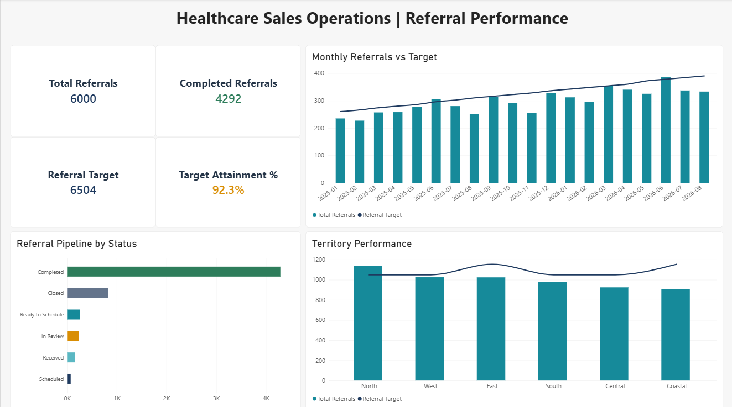
Referral volume by month and territory
Monthly target
Referrals generally rise, but most months remain below target.
North has the highest total and exceeds its territory target.
Territory gaps
Other territory bars fall below target. Exact gaps require the underlying values.
03

Slide 4
Completed referrals represent 71.5% of total
4,292 completed
1,708 in all other statuses
Completed is the largest pipeline category. Closed is the next largest status in the dashboard.
Other pipeline stages
Ready to Schedule, In Review, Received and Scheduled. The 71.5% figure is a snapshot share, not a cohort conversion rate.
04

Slide 5
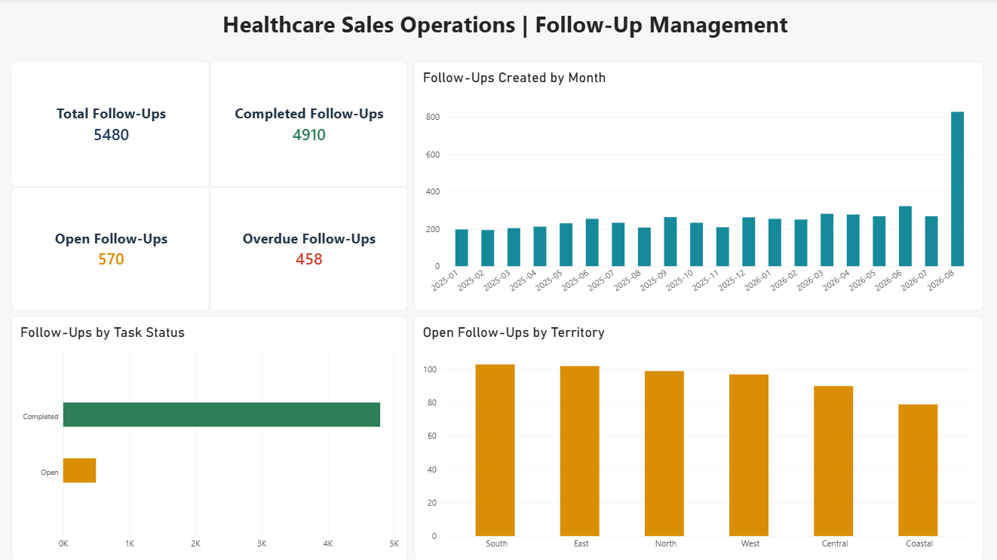
458 follow-ups are overdue
458
overdue follow-ups
570 open
4,910 completed
5,480 total
Proposed action
Assign an owner and next step to each overdue task.
05

Slide 6
Follow-up workload and monthly change
View | Dashboard signal | Leadership question
Open tasks by territory | South and East have the most | Where does workload need attention?
Monthly follow-ups created | Latest displayed month spikes | Does the spike reflect new demand?
Completed and open tasks | 4,910 completed and 570 open | Which open tasks need follow-through?
Overdue follow-ups | 458 overdue | Who owns the next action?
Workload concentration guides follow-through
Review South and East first for open-task workload. Confirm the latest creation spike before changing staffing or priorities.
06

Slide 7
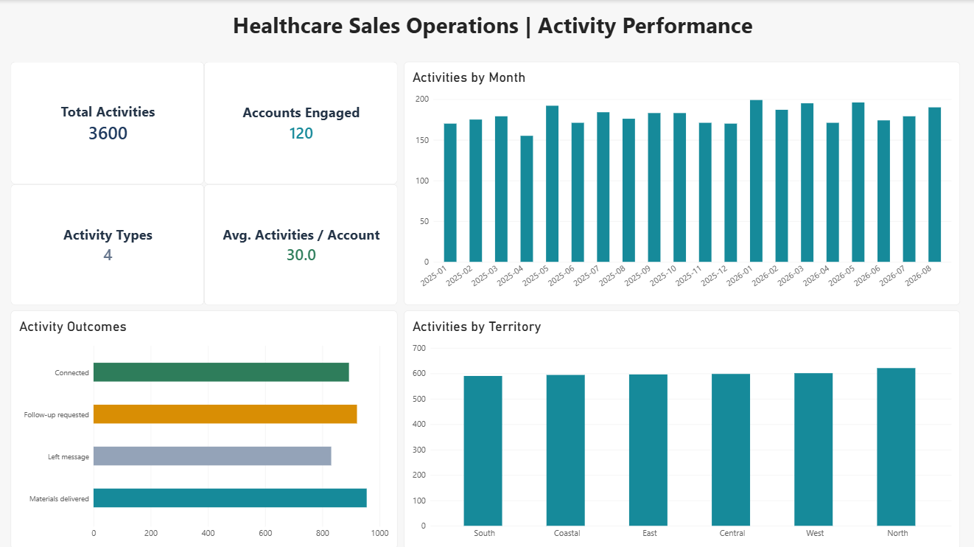
3,600 activities across 120 engaged accounts
3,600
activities across
120 accounts
30.0
activities per account
4 activity types
North has the highest activity volume.
07

Slide 8
Activity outcomes and territory coverage
Recorded outcomes
Territory activity
Connected
Follow-up required
Left message
Materials delivered
North has the highest volume.
Other territories show
similar activity totals.
Materials delivered has the largest outcome bar. Left message has the smallest.
Monthly activity fluctuates within a relatively narrow range across the displayed period.
These outcomes describe outreach activity. They do not establish completed visits or referral conversion.
08

Slide 9
Operational questions covered by the report
Question area | Leadership question | Report view
Referral performance | Are volumes meeting target? | Monthly and territory targets
Referral pipeline | What is complete or in progress? | Status mix and completed count
Follow-up management | What is open or overdue? | Task totals and status mix
Follow-up workload | Where and when does work build? | Open tasks by territory, creation trend
Activity performance | How much outreach and what outcomes? | Activity, account and outcome views
Together, these views focus leadership attention on performance gaps and operational follow-through.
Scope: referral performance, follow-up management and activity performance.
09

Slide 10
Leadership focus across the three areas
Referral performance
Follow-up management
504 referrals
below target
570 open and 458 overdue follow-ups.
Review workload in South and East.
Assign owners and next actions.
Review monthly and territory gaps alongside the 4,292 completed referrals and remaining pipeline.
Activity performance
3,600 activities engage 120 accounts. Review recorded outcomes and territory coverage to guide outreach.
Leadership response
Focus intervention on territories or workflow stages that need attention.
Use a consistent reporting period and filter scope across all three views.
Actions for discussion based on the supplied dashboard snapshots.
10

