Slide 1
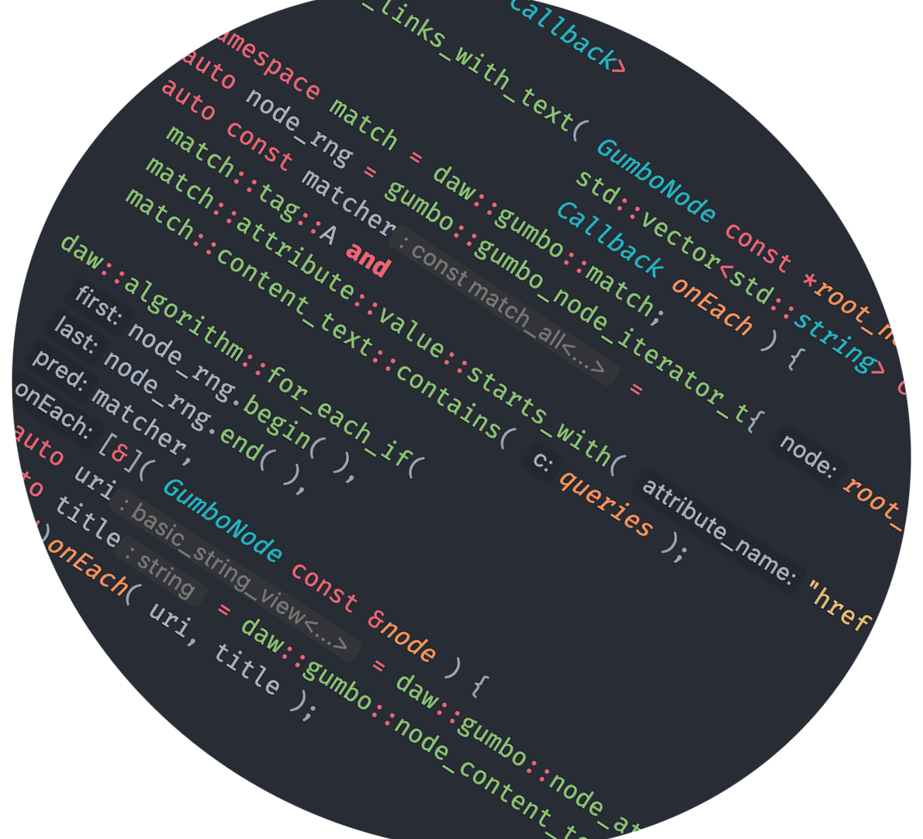

Contemporary C++ Web Scraping
It’s not as low level as one might think
Darrell Wright
@beached_whale

Slide 2
What is needed
Retrieve documents
Parse documents
Query documents

Slide 3
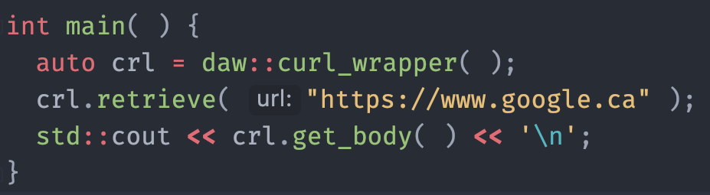
Retrieving Documents
Surprise, it’s Curl.
Using a simple Curl wrapper
https://github.com/beached/curl_wrapper

Slide 4
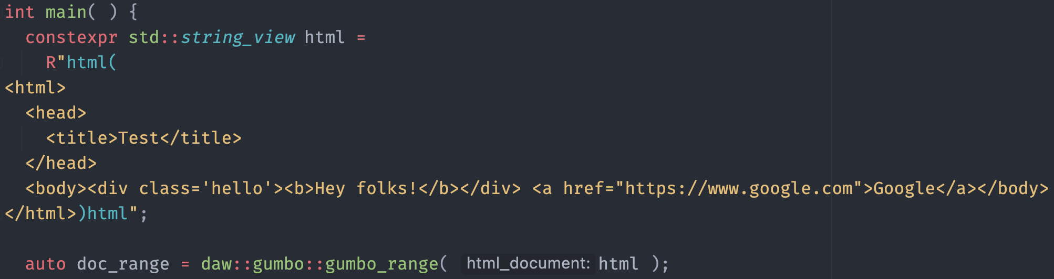
Parse Documents
Wrapping Gumbo to get document tree
https://github.com/beached/gumbo_pp
https://github.com/google/gumbo-parser
We have an iterator interface into the document tree that uses DFS ordering

Slide 5
Query Documents
Gumbo_pp provides a set of combinable predicates based on
attribute | class type | id | inner text
outer text | content text | tag
Each predicate type has associated verbs like attribute::is
All have the where clause to allow for using custom matcher predicates
They can be combined with and(match_all), or(match_any), not(negate match), xor(match_one) operators to form complex expressions
Usable with std::algorithms, e.g. std::find_if, daw::algorithm::for_each_if
Does not allocate unless asked to

Slide 6
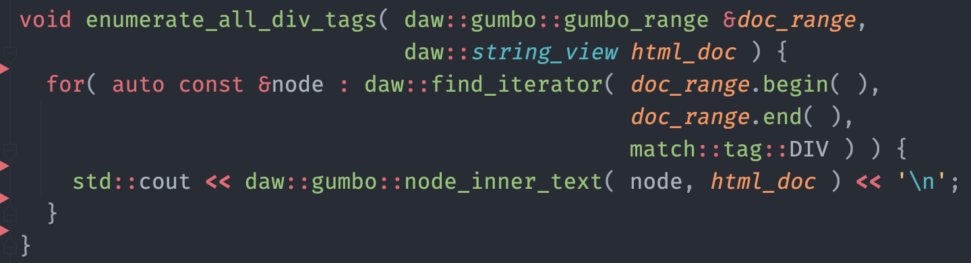
Show me the Code
Enumerate all div tags
Notes:
Mention the hints from Clion and how awesome they are ☺
Talk to GUMBO_TAG_DIV and future direction

Slide 7
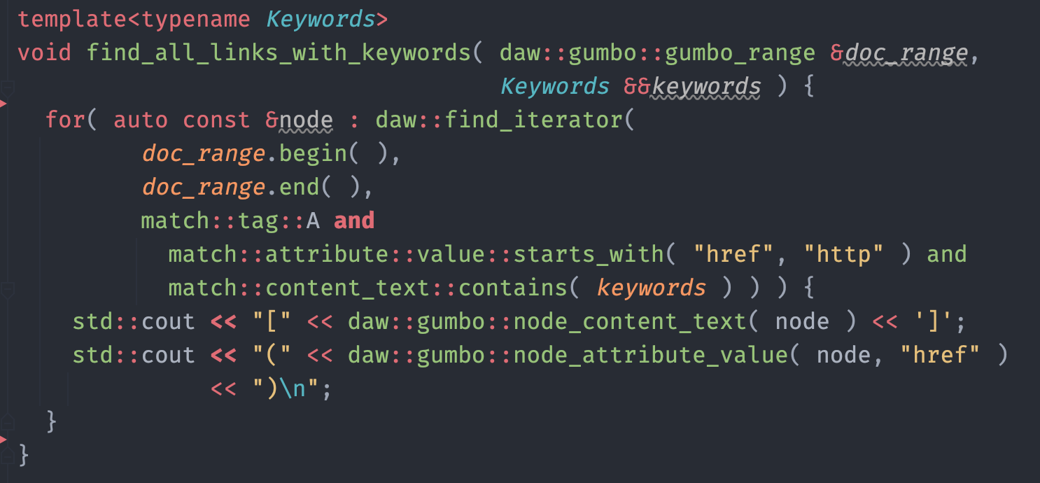
Show me the Code
Find all links that contain a keyword
Notes:
Mention and/or/not/xor for combining predicate expressions

Slide 8
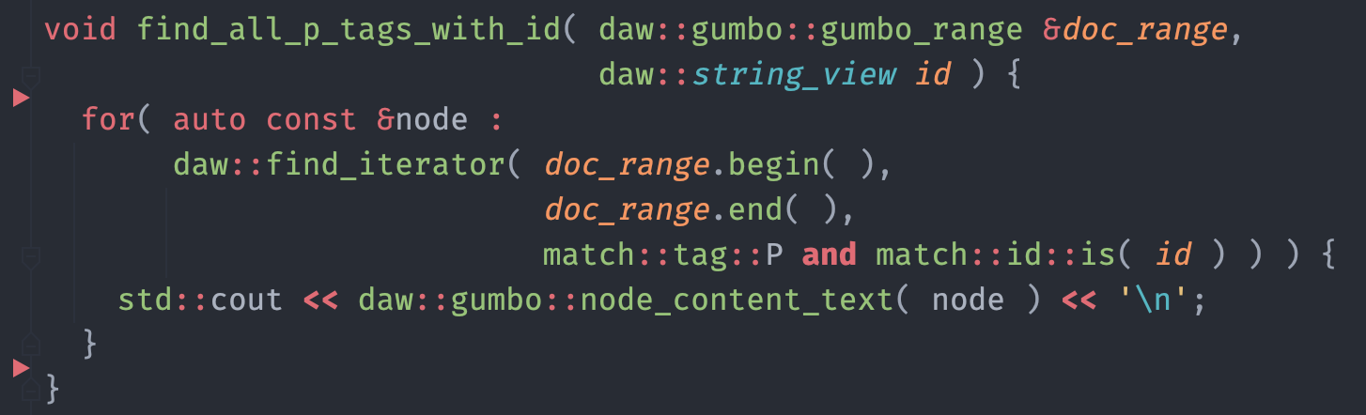
Show me the Code
Find all Paragraph’s with matching matching
Notes:
Mention and/or/not/xor for combining predicate expressions

Slide 9
Examples
Code from slides and slides
https://github.com/beached/denver_cug_web_scraping
Full example web service
https://github.com/beached/climate_change_api_example

Slide 10
What’s Next
Add a full Node type with accessors/matcher methods
Use/write a library like Puppeteer/Selenium that uses headless Chrome/Firefox

Slide 11
Questions

