Slide 1

I GOT IN,
NOW WHAT?
Establishing a Beachhead : Post Exploitation in Azure DevOps
DEF CON 34 · Adversary Village · Aug 6-9, 2026 · LVCC West Hall

Slide 2



// 01 · whoami
bash - fr13ndz@defcon34
bash - nullspace@defcon34
$ whoami
Display Name: Jared Dobbelaer
Handle: Fr13ndz
Role: Adversarial Engineer
$ whoami
Display Name: Jon Rhodes
Handle: nullspace
Role: Adversarial Engineer
bash – dm0n3y@defcon34
$ whoami
Display Name: Doug Mooney
Handle: dm0n3y
Role: Cat Herder
2

Slide 3

// 02 · the premise
You already have a PAT.
How you got it (phished session, leaked PAT, over-scoped OAuth consent) is a different talk. This one starts the moment after.
STARTING STATE
A valid ADO credential
Contributor-ish reach
Azure DevOps org
Azure DevOps PAT
not an admin, not a global role, likely privileged
the blast radius you inherited
Everything from here uses only the access you already hold.
See Grapnel (https://github.com/fd22vrsfpv-star/bitm-proxy) for obtaining a PAT.
3

Slide 4
// 03 · the surface
Why Azure DevOps?
Wide area of attack paths. CI/CD Pipelines, misconfigurations, policies, and other ADO surface area allows for simple mistakes to lead to a breach scenario
Source
Build
Control plane
Repositories and their full history. Whatever gets committed stays reachable to anyone who can read.
Pipelines run code under a service identity. Their reach is exactly what the identity was granted.
Variable groups, service connections, and permissions. The wiring between source, build and everything else.
The gap: CI/CD post-exploitation gets talked about. The tenants are everywhere; the offensive playbook for Azure DevOps is not.
4

Slide 5
// 04 · the path
The path we walk live
1
2
3
4
›
›
›
Enumerate
Harvest
Analyze
Exploit
Identify what the PAT can access
Gather credential data from ADO
Turn your data into insights
Here be dragons
5

Slide 6
// 05 · the tool
One tool: Beachhead
Give the tool a valid ADO PAT and Beachhead maps what that token can do.
bh - one operator surface
20 modules
enumerate · harvest · analyze · exploit
$ bh enumerate run ado_repos
$ bh harvest run ado_credential_scan
$ bh analyze run discovered_credentials
$ bh exploit run ado_pipeline_vardump
$ bh findings # read the store
$ bh tui # run the Text UI
Scope-enforced
no scope config, it refuses to run
SQLite datastore
encrypted, collect once, analyze offline
6

Slide 7
// 06 · the range
The range: two projects, one org
A purpose-built ADO org. Everything is synthetic and the secrets are fake. The secure project is the control.
THE TARGET
THE CONTROL
defcon-adolab-insecure
defcon-adolab-secure
Credentials, credentials, everywhere:
  Pipelines, repos, wikis, work items, etc…
Secrets in a masked variable group
Least privilege violations
Policy gaps
No secrets in source (Key Vault refs)
Protected main: required reviews + build
Hardened policies
Least privilege applied
All Terraform. Grab it and rebuild the range yourself.
7

Slide 8
// 08 · Beachhead !=
What Beachhead is not
The boundaries matter as much as the capabilities. It uses the token you bring and stops there.
Not initial access
Not invisible
Not an autonomous agent
No phishing, spraying, or exploits to land the token.
Every action is a token call in the sign-in logs.
It makes no decisions and takes no actions on its own.
-> it starts after you're in
-> quiet, not silent
-> you're the operator
8

Slide 9
LIVE DEMO
enumerate › harvest › analyze > exploit

Slide 10
LIVE · run it
// stage 1 · enumerate
What is within reach?
bh - enumerate (live)
# run individual modules
$ bh enumerate run ado_pipelines
$ bh enumerate run ado_repos
# run all modules
$ bh enumerate run-all
10

Slide 11
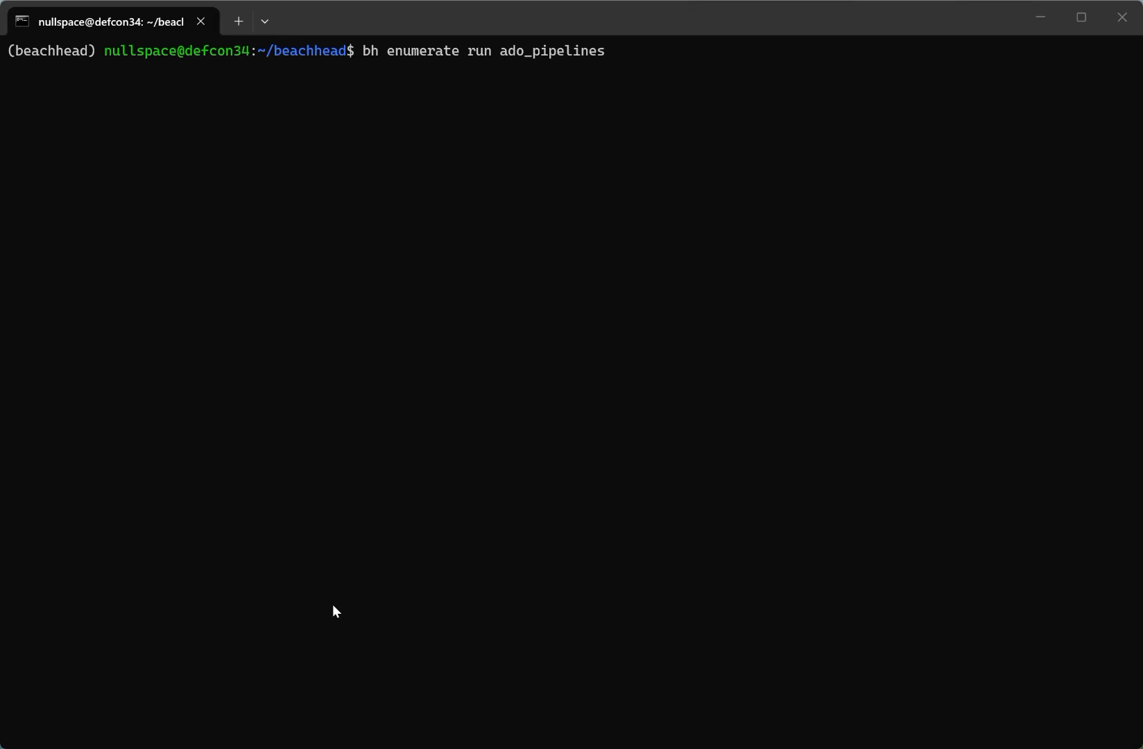
BACKUP · VIDEO
// stage 1 · enumerate
Enumerate - recorded run
11

Slide 12
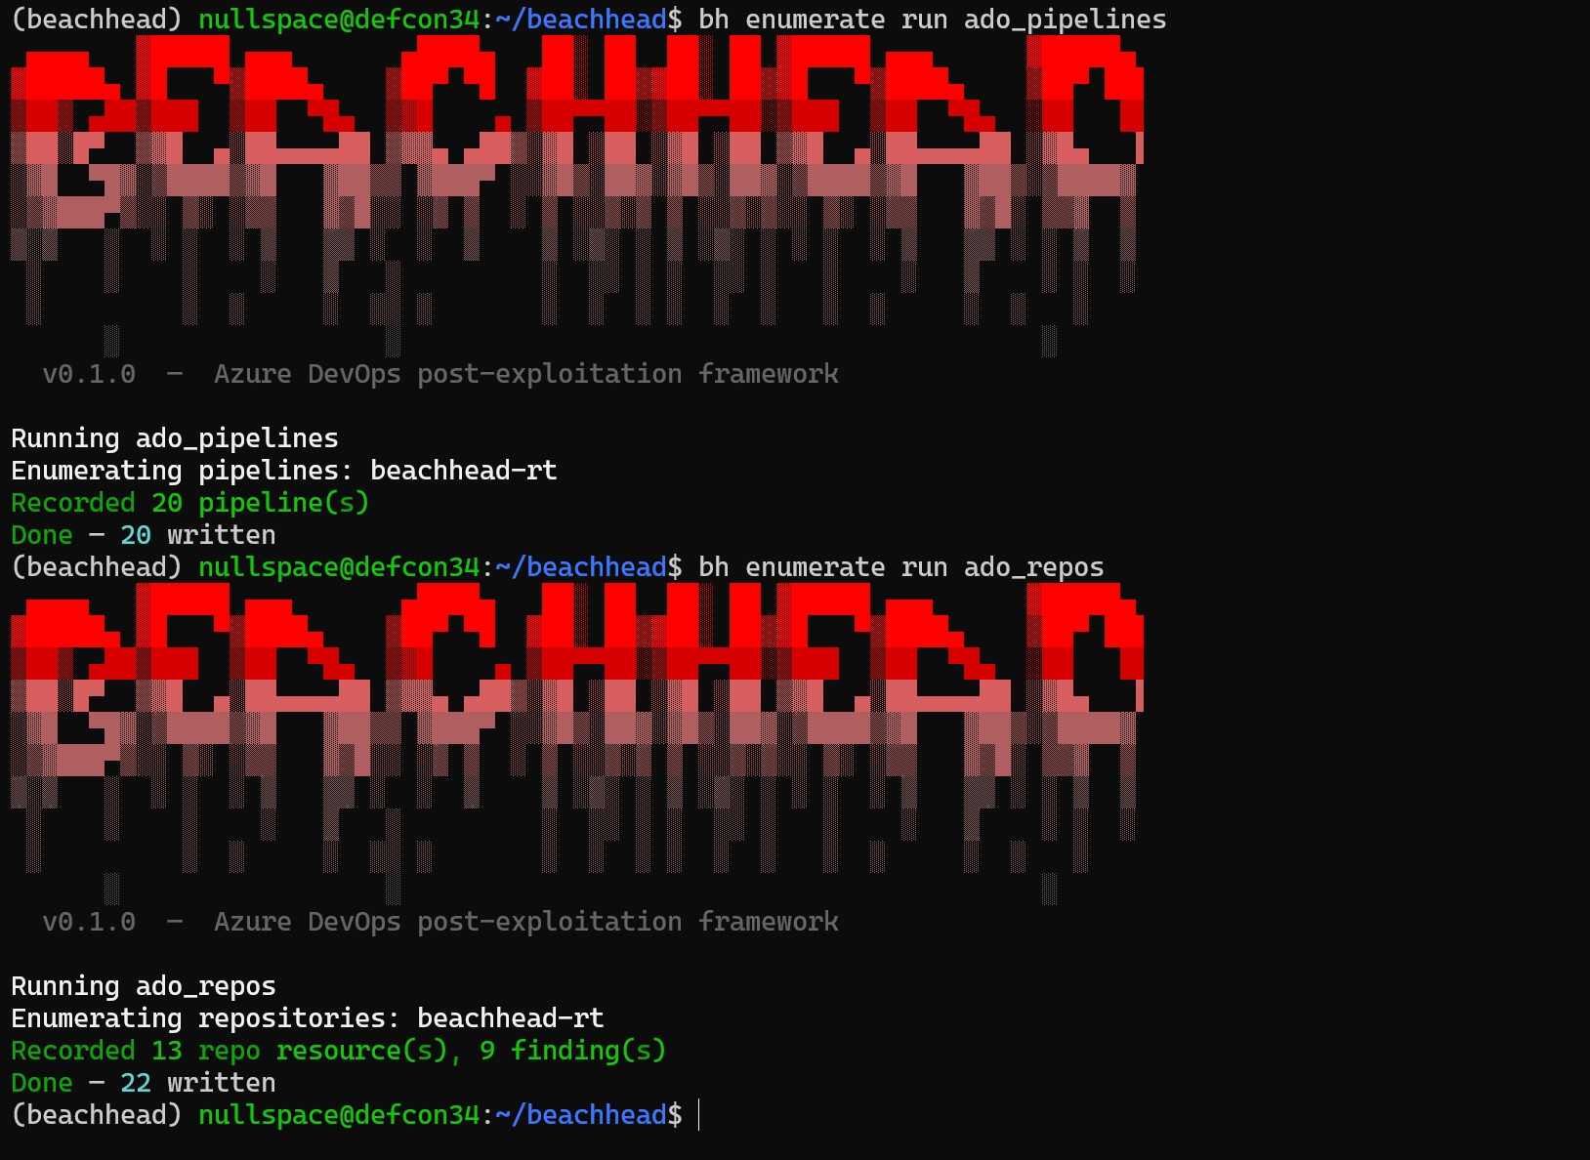
BACKUP · SCREENSHOT
// stage 1 · enumerate
Enumerate - captured output
12

Slide 13
LIVE · run it
// stage 2 · harvest
Gathering credentials
bh - harvest (live)
# run individual modules
$ bh harvest run ado_credential_scan
$ bh harvest run ado_variable_scan
$ bh harvest run ado_wiki_scan
# run all modules
$ bh harvest run-all
13

Slide 14
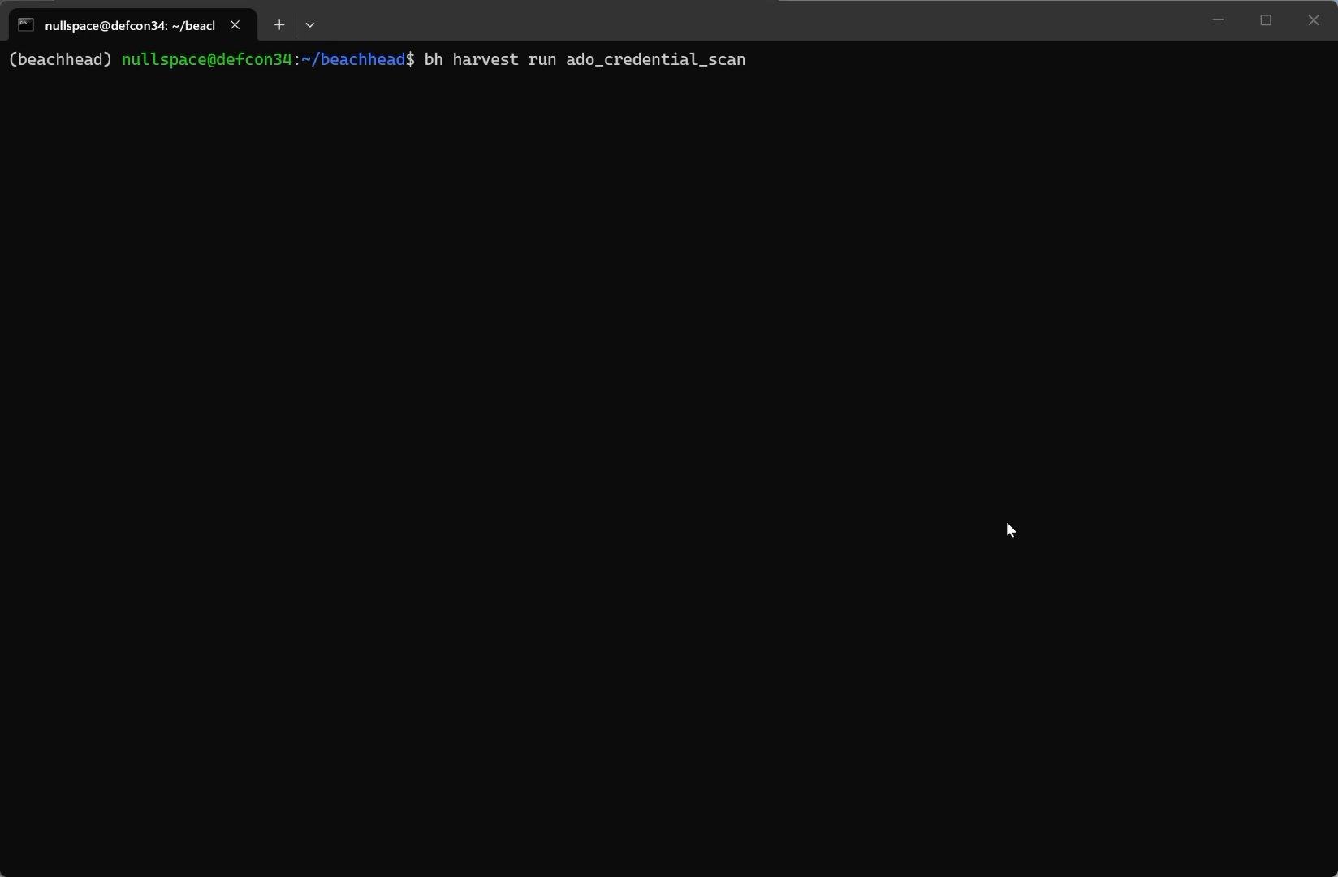
BACKUP · VIDEO
// stage 2 · harvest
Harvest - recorded run
14

Slide 15
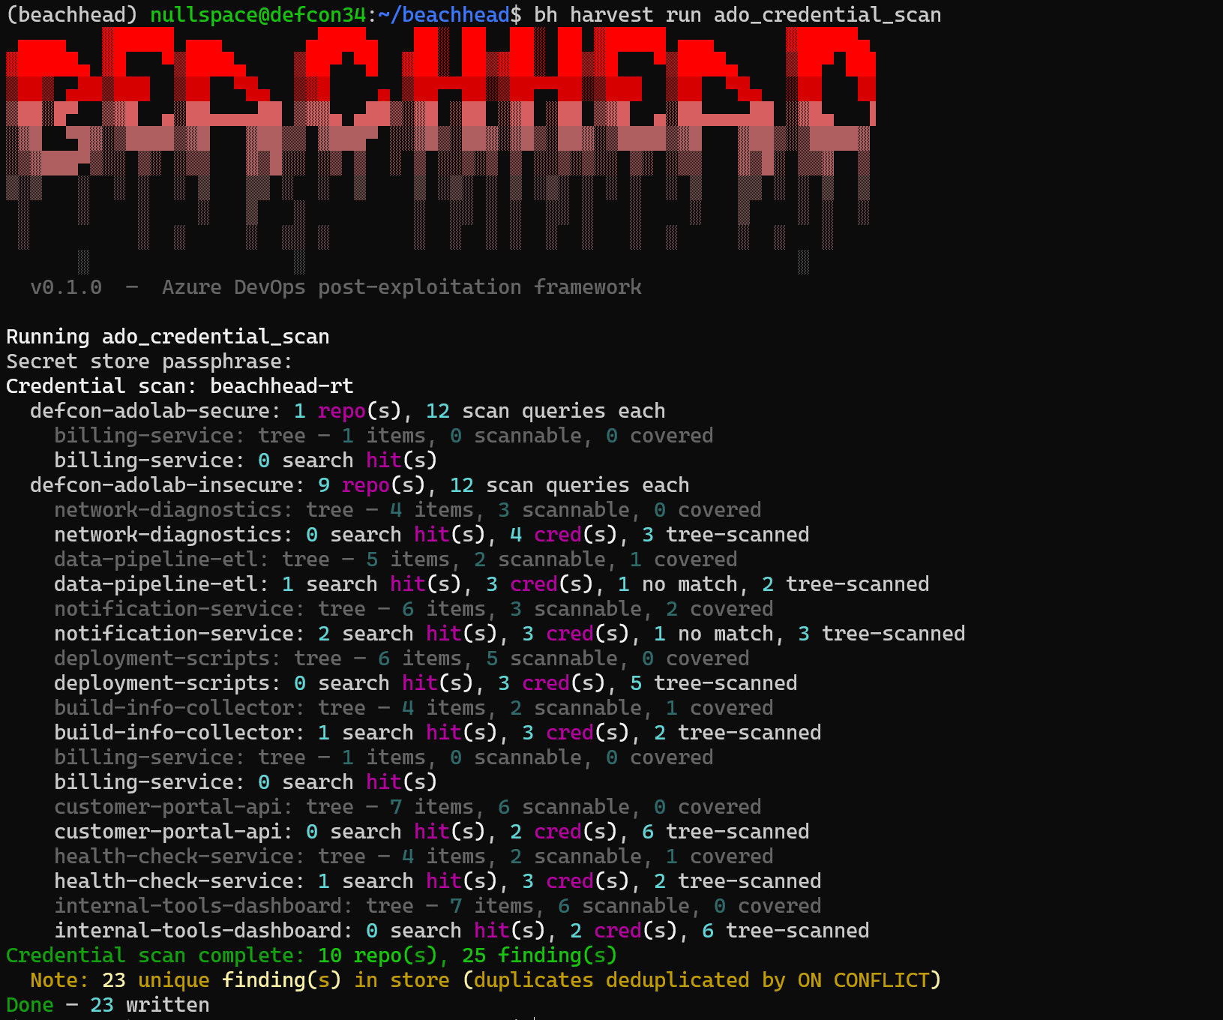
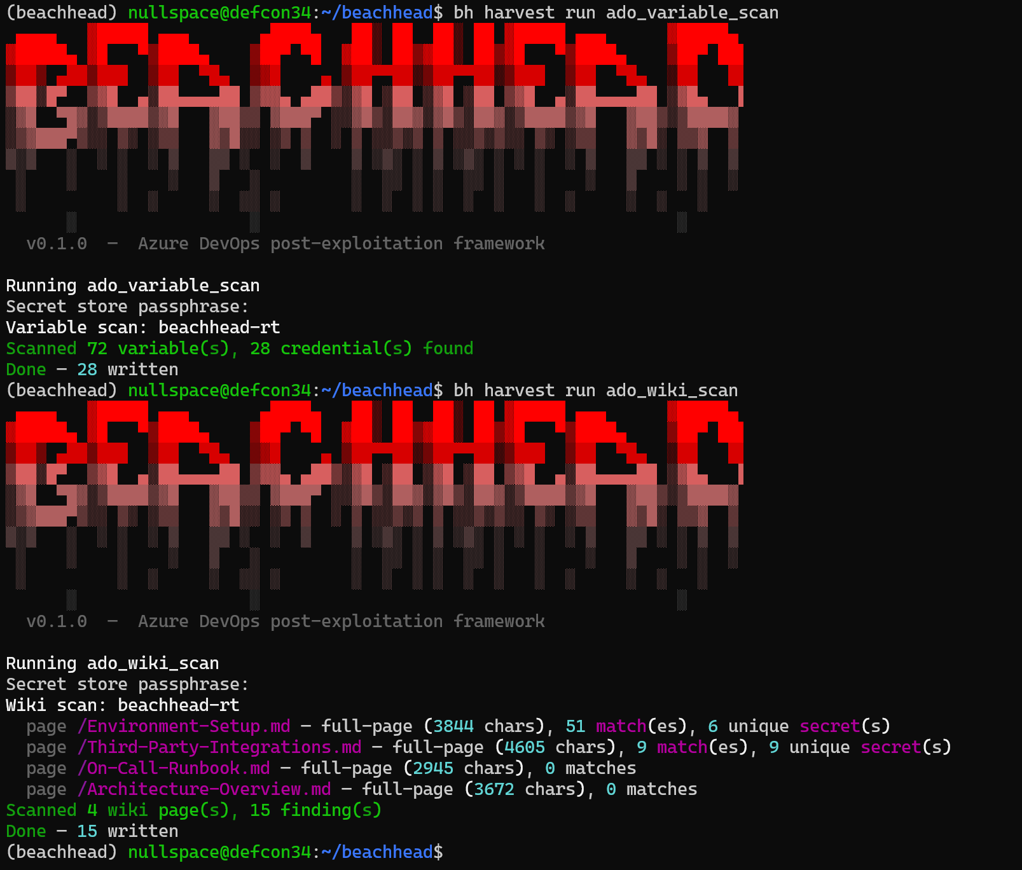
BACKUP · SCREENSHOT
// stage 2 · harvest
Harvest - captured output
15

Slide 16
LIVE · run it
// stage 3 · analyze
Gathering insights
bh - analyze (live)
# run individual modules
$ bh analyze run ado_attack_paths
$ bh analyze run collected_resources
$ bh analyze run discovered_credentials
# run all modules
$ bh analyze run-all
16

Slide 17
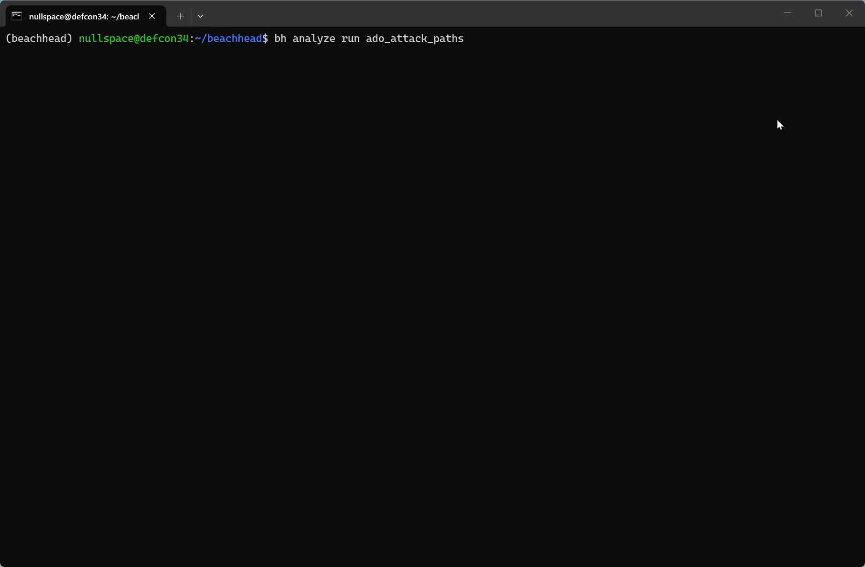
BACKUP · VIDEO
// stage 3 · analyze
Analyze - recorded run
17

Slide 18
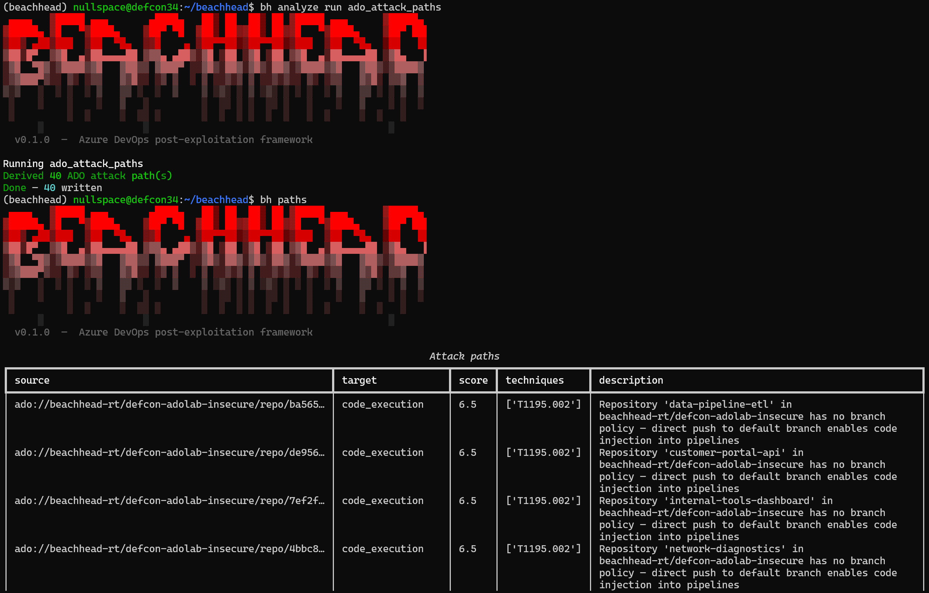
BACKUP · SCREENSHOT
// stage 3 · analyze
Attack Paths - captured output
18

Slide 19
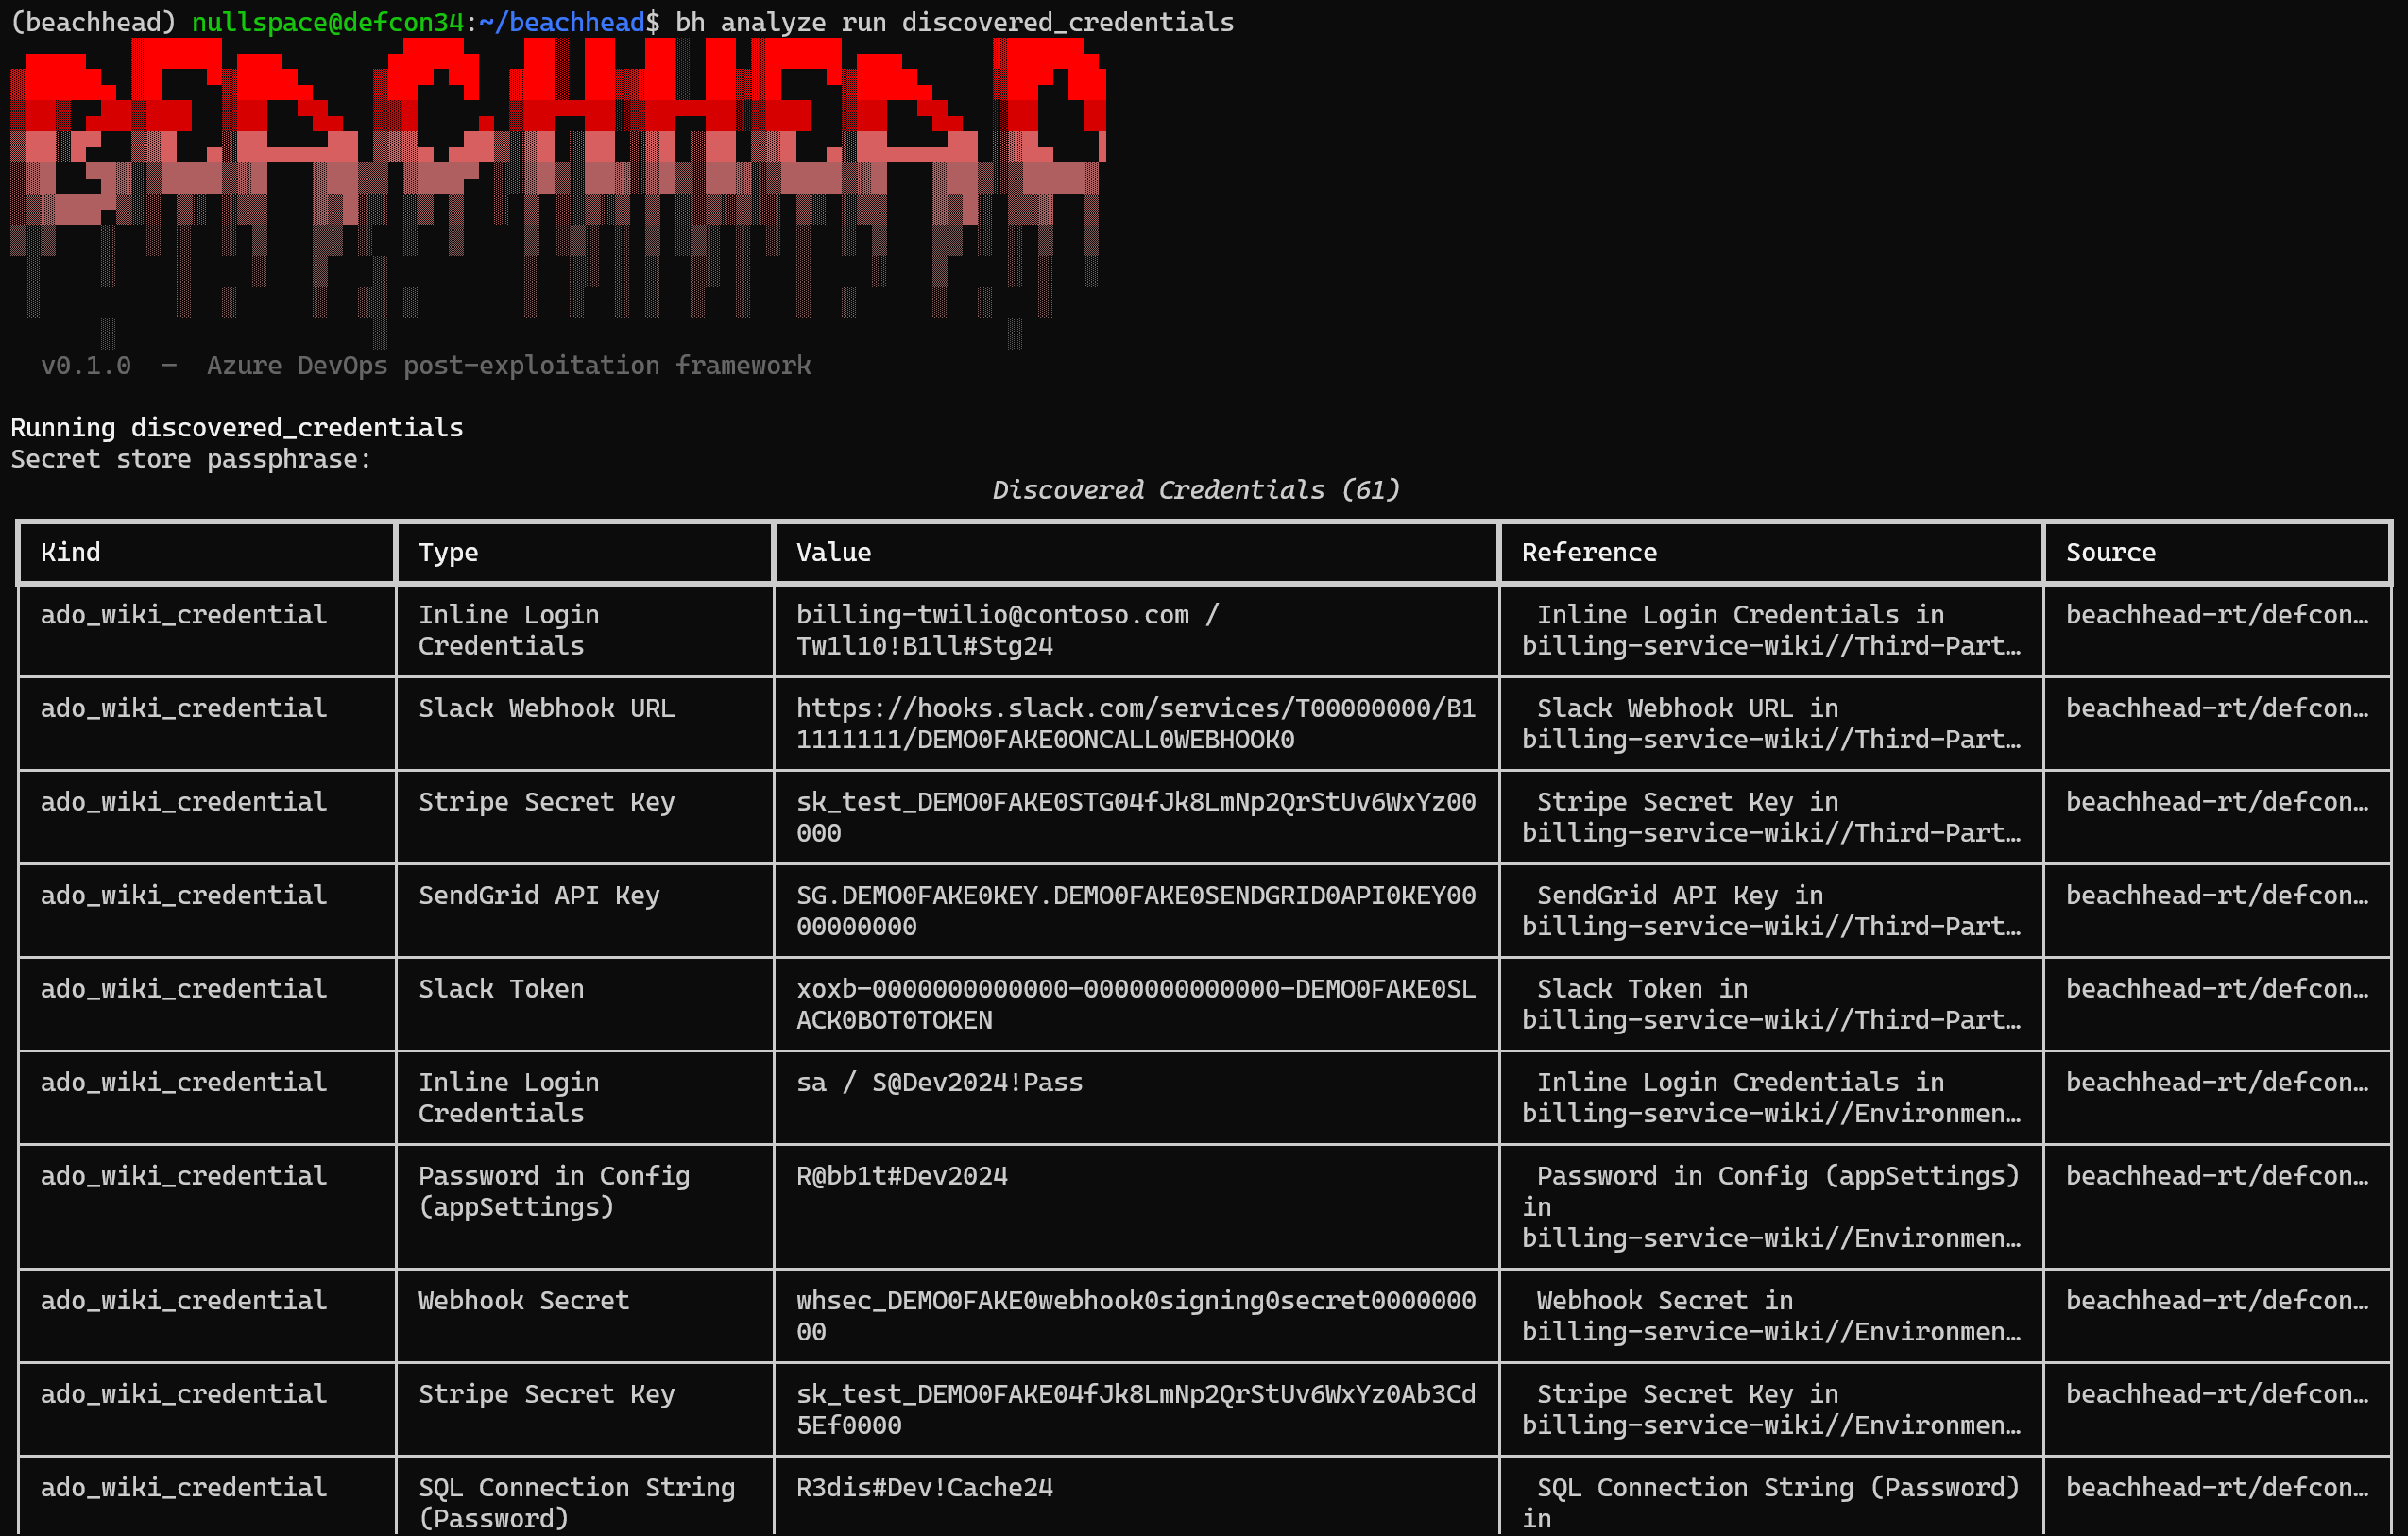
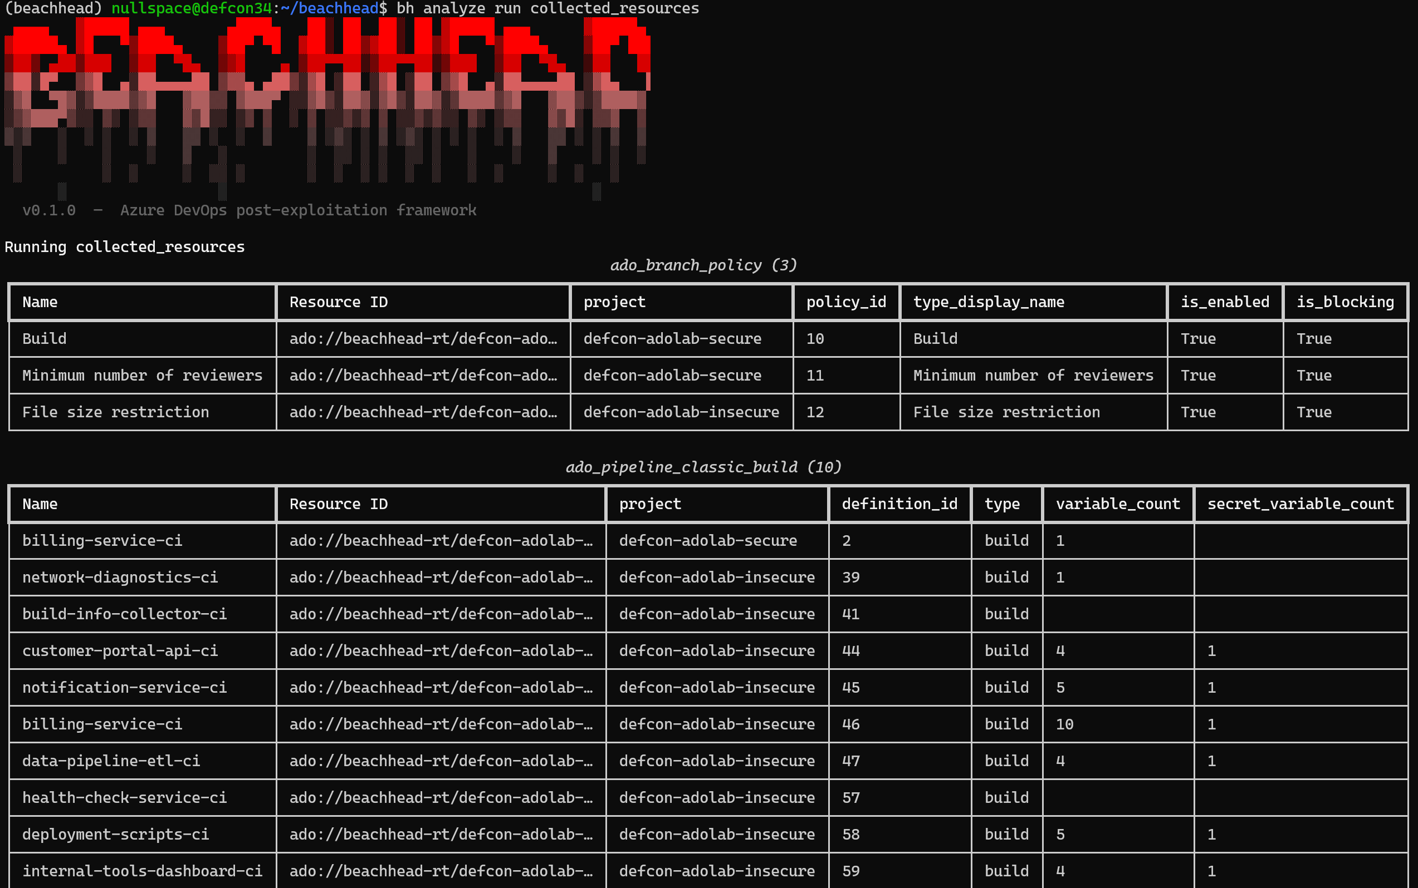
BACKUP · SCREENSHOT
// stage 3 · analyze
Analyze - captured output
19

Slide 20
LIVE · run it
// stage 4 · exploit
Lights, Camera, Chaos!
bh - exploit (live)
# run individual modules
$ bh exploit run ado_pipeline_vardump –confirm
$ bh exploit run ado_yaml_pipeline_vardump –confirm
20

Slide 21
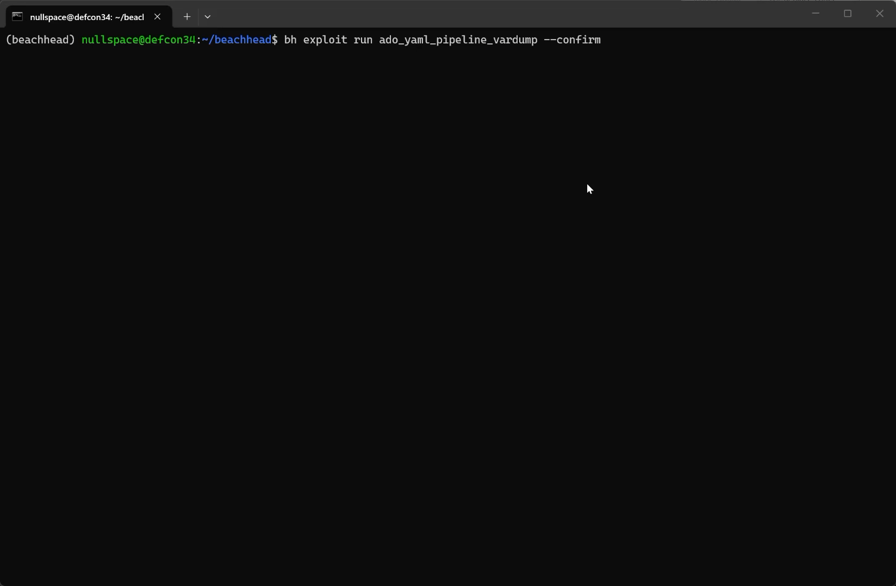
BACKUP · VIDEO
// stage 4 · exploit
Exploit Pipelines - recorded run
21

Slide 22
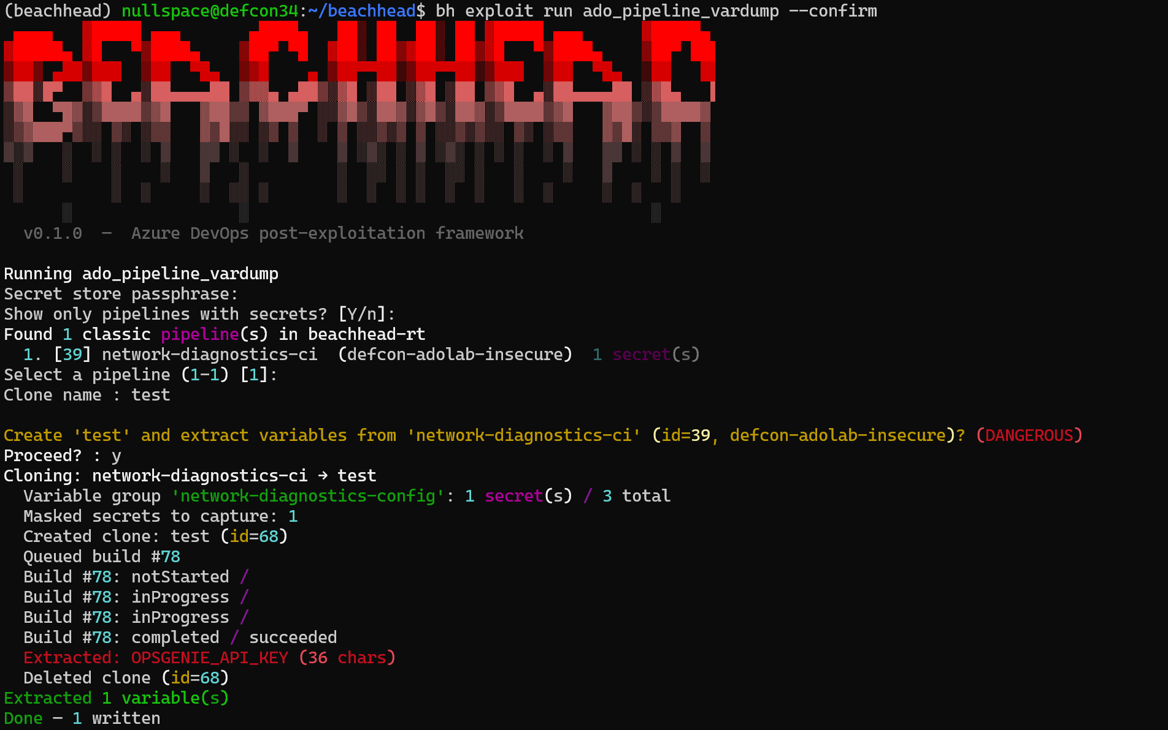
BACKUP · SCREENSHOT
// stage 4 · exploit
Exploit Classic Pipeline - captured output
22

Slide 23
// stage 4 · exploit
ado_pipeline_vardump - Walkthrough
1
2
3
4
Discover
Clone
Prepare
Run
›
›
›
Uses ADO REST API to list classic pipelines
Clones pipeline, replacing all tasks with a single PowerShell script
The script reads each variable, reverses the string to bypass ADO's log masker, and base64-encodes the output
Queues a build, polls for completion, fetches the log
5
6
7
Gather
›
Store
›
Clean
Decodes and reverses values to recover original secrets
Stores credentials in the encrypted secret store
After secret retrieval, deletes the cloned pipeline and pipeline run
23

Slide 24
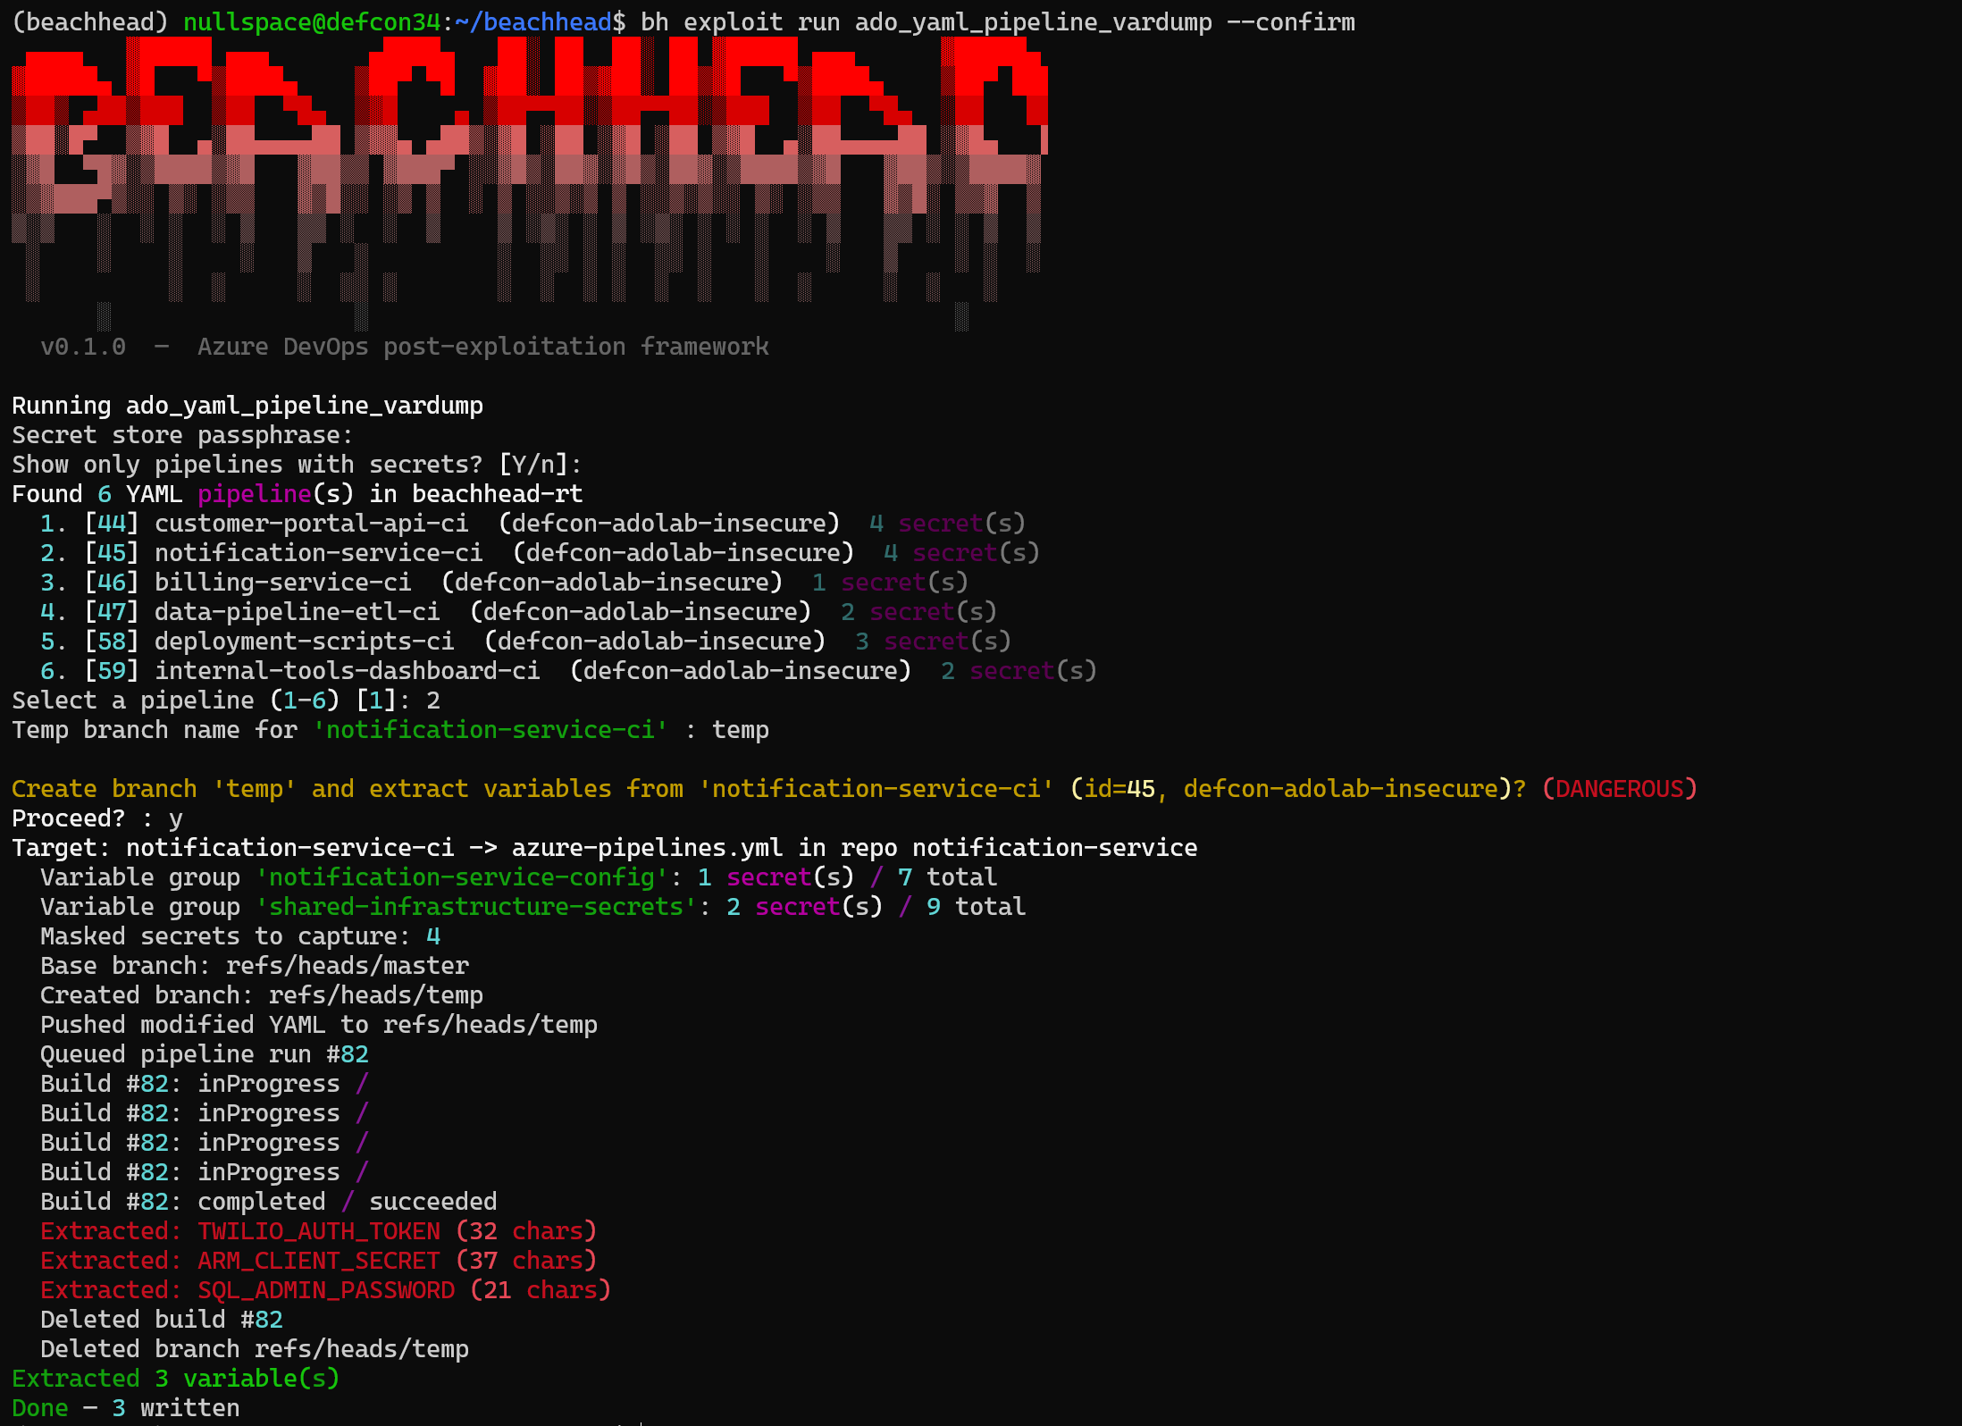
BACKUP · SCREENSHOT
// stage 4 · exploit
Exploit YAML Pipeline - captured output
24

Slide 25
// stage 4 · exploit
ado_yaml_pipeline_vardump - Walkthrough
1
2
3
4
Discover
Prepare
Branch
Run
›
›
›
Uses ADO REST API to list yaml pipelines
Script to read masked variables, reverses the string to bypass ADO's log masker, and base64-encodes the output
Creates a temporary branch on the repo to execute the script with a modified yaml file.
Queues a build, polls for completion, fetches the log
5
6
7
Gather
›
Store
›
Clean
Decodes and reverses values to recover original secrets
Stores credentials in the encrypted secret store
After secret retrieval, deletes the temp branch and pipeline run.
25

Slide 26
// stage 4 · exploit
Classic vs YAML Pipelines
Exploit | Classic Pipeline | YAML Pipeline
Entry point | Build Definitions API (clone + replace tasks) | Git repo (branch + push modified YAML)
Permissions | Build R&X, Variable Groups R | Code R&W, Build R&X, Variable Groups R
Queue API | /_apis/build/builds | /_apis/pipelines/{id}/runs
Branch policies | N/A | Temp branch avoids protected-branch policies
Artifact cleanup | Temp clone, pipeline run | Temp branch + commit, pipeline run
OPSEC footprint | Cloned pipeline definition, pipeline run | Branch + commit visible in repo history briefly
26

Slide 27
LIVE · run it
// stage 1-4 · tui
Time for tui
bh - tui (live)
# start the tui
$ bh tui
27

Slide 28
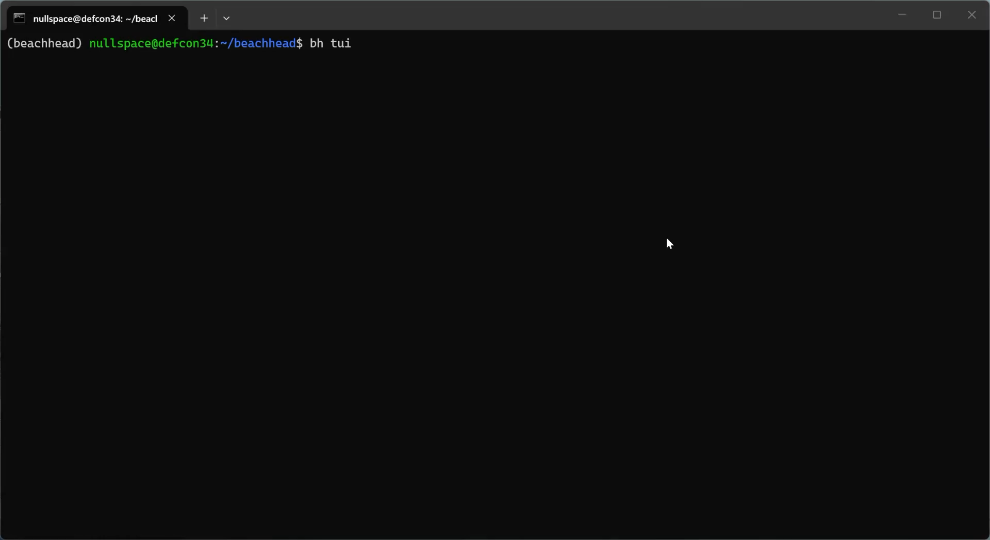
BACKUP · VIDEO
// stage 1-4 · tui
tui - recorded run
28

Slide 29
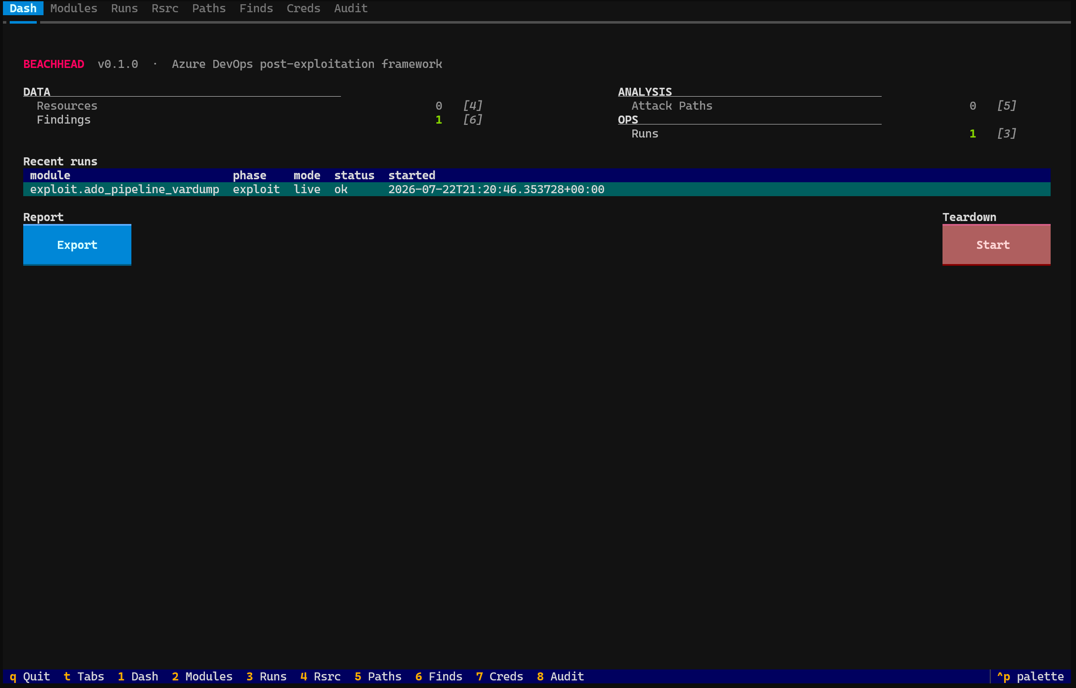
BACKUP · SCREENSHOT
// stage 1-4 · tui
tui - captured output
29

Slide 30
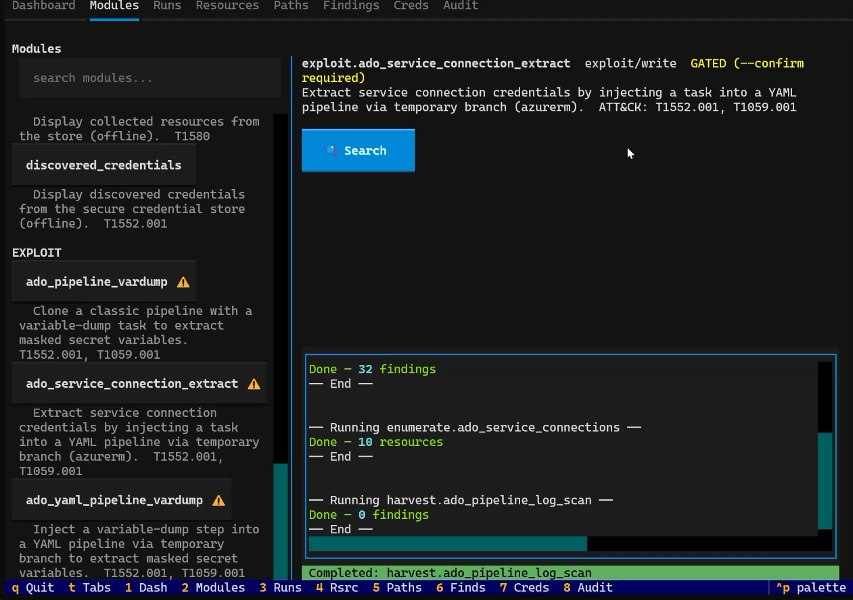
BACKUP · VIDEO
// stage 4 · exploit
Exploit Service Connection - recorded run
27

Slide 31
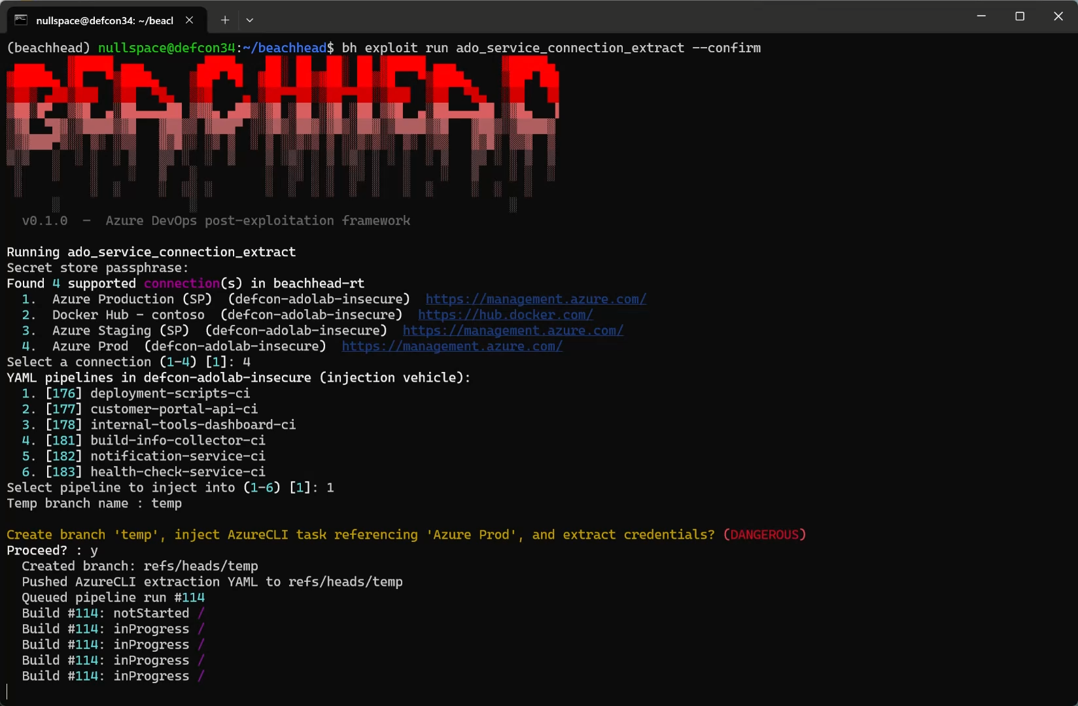
BACKUP · SCREENSHOT
// stage 4 · exploit
Exploit – Service Connections
28

Slide 32
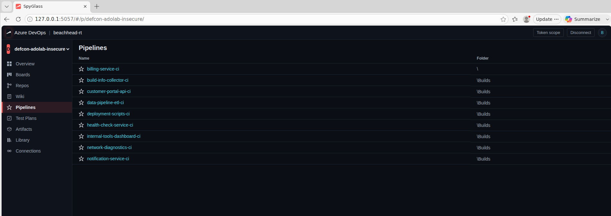
// tui · SpyGlass
SpyGlass
Fully functional ADO client inside Beachhead
Based on project by https://github.com/TROUBLE-1/AzDevRecon
32

Slide 33
LIVE · run it
// engage · export
Reporting
run ado_pipeline_vardump --confirm
bh – engage export(live)
# Export engagement report (findings, attack paths, audit).
$ bh engage export -o test.md
# Export engagement report (findings, attack paths, audit, and plaintext credentials).
$ bh engage export -o test.md --include-secrets --confirm
33

Slide 34
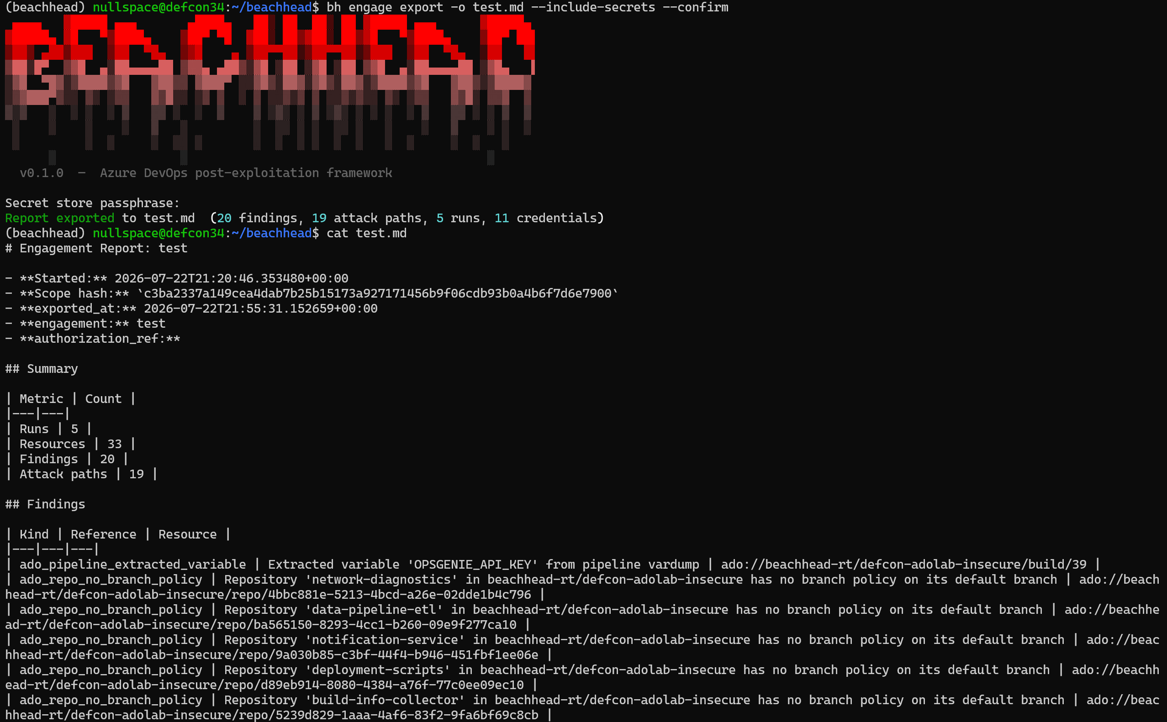
BACKUP · SCREENSHOT
// engage · export
Report - captured output
34

Slide 35
LIVE · run it
// engage · teardown
Destroy everything!
run ado_pipeline_vardump --confirm
bh – engage teardown(live)
# Delete engagement – store, secret-store, tokens, engagement config, etc…
$ bh engage teardown --confirm
35

Slide 36
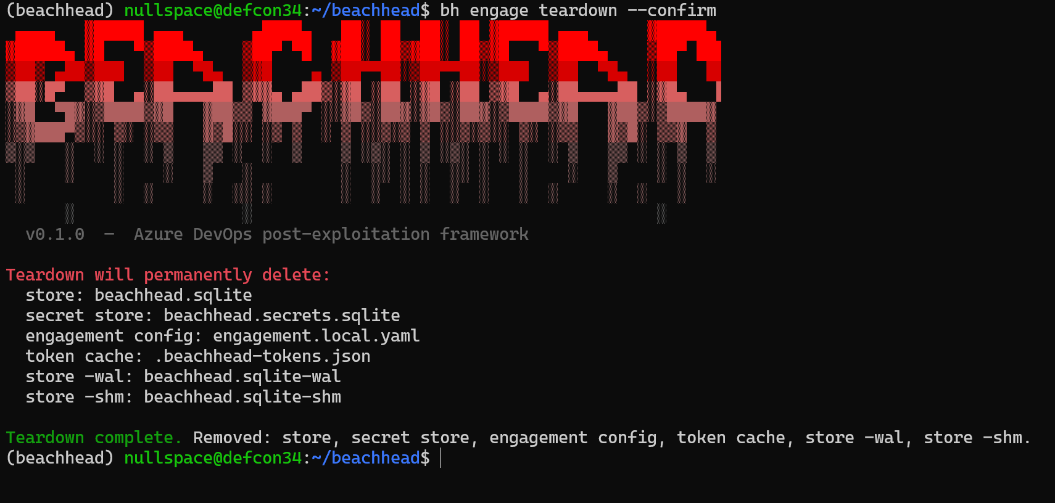
BACKUP · SCREENSHOT
// engage · teardown
Teardown - captured output
36

Slide 37
// detection · ADO post-ex · enumeration + harvest
Detecting ADO Reconnaissance
T1526 T1580 T1069.003 T1078.004 T1213.003 T1195.002 T1102.002 T1176 T1552.001
Audit Log Signals
Harden & Baseline
Bulk API enumeration: Alert on >50 list-project / list-definition calls from a single PAT within 5 min
ALM Search for secrets: Monitor code & wiki search queries containing password, secret, key, token, etc.
Permission enumeration: Flag bulk security-namespace and ACL reads across multiple projects
Service connection listing: Alert when a single identity queries endpoints across >1 projects
Agent pool inventory: Watch for systematic pool + agent capability enumeration (self-hosted pools)
Repo & branch scanning: Detect rapid ref-listing, branch-policy reads, and PR enumeration across repos
Least-privilege PAT scopes: Scope tokens per project; revoke full-access PATs; enforce short expiry
Stream audit logs to SIEM: Enable ADO Audit Streaming to a SIEM and build detection rules
Restrict ALM Search API: Limit code-search access to authorized identities; disable for service accounts
Review service hooks: Alert on hooks targeting HTTP (not HTTPS) or external domains outside allow-list
Baseline normal API volumes: Profile per-identity call rates so anomalous enumeration spikes trigger alerts
37
37
Notes:
On the recon side: alert on bulk API enumeration, more than fifty list-project or list-definition calls from one PAT in five minutes; watch ALM search for secret-pattern queries; flag bulk permission and service-connection enumeration across projects.

Slide 38
// detection · ADO post-ex · exploit
Detecting Secret Exfiltration
T1552.001 T1552.004 T1059.001 T1059.009
Secret Exfiltration Indicators
Harden & Baseline
Short-lived definitions: BuildDefinition.Create followed by .Delete within 1 hour (classic vardump pattern)
Ephemeral branches: Git.RefUpdate creating then deleting branches rapidly
YAML injection: Git.Push modifying pipeline YAML on non-default branches with inline scripts
Suspicious task combos: Builds with AzureCLI@2 + addSpnToEnvironment or Docker@2 login + PowerShell
Encoded build output: Base64-encoded blocks in build logs (credential exfil bypassing ADO log masking)
Retention lease manipulation: Lease deletion immediately before build deletion signals artifact cleanup
Pipeline-level approvals: Require explicit approval for each pipeline to use a service connection
Manual approval gates: Add pre-deployment approval checks on pipelines referencing production connections
Branch protection on YAML: Require PR review for changes to pipeline YAML files; block direct pushes
Build log monitoring: Scan build output for base64-encoded strings and reversed-value patterns
Variable group access alerts: Alert when variable groups are read by new or recently-modified definitions
Same-day create-delete: Investigate any build definition or branch created and deleted within the same day
38
Notes:
On the exploit side, the tells are sharper: a build definition created and deleted within an hour could indicate the classic vardump pattern; a branch created and deleted rapidly could indicate the YAML path; and base64-encoded blocks in build logs can indicate secret smuggling. Stream your ADO audit log to a SIEM and most of this is a straightforward rule."

Slide 39
// future days
What’s next for beachhead?
Expanded attack path logic:
    Additional Paths to explore
    Additional "next steps" provided
Exploit module expansion:
    Azure Container Registry
    Azure Kubernetes
    etc.
Credential Engine tweaks:
    Search filters (time-based)
    Custom (user) patterns
    False-positive detection
Additional Features:
    Work Item attachment scanning/download
39

Slide 40

Questions?
The demo lab is Terraform. Grab it and build your own range.
RESOURCES
Beachhead
github.com/beachhead-rt/beachhead
Demo lab
github.com/beachhead-rt/defcon-adolab
Spyglass (standalone)
github.com/beachhead-rt/spyglass
DEF CON 34 · Adversary Village · thanks for coming

