Slide 1
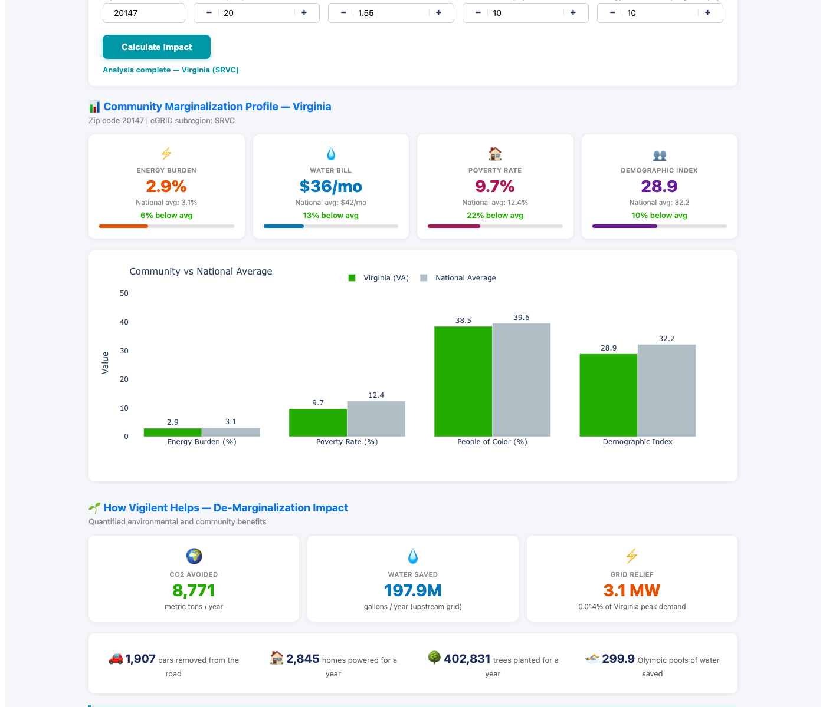
Beyond Cost Savings: Vigilent as an Environmental Justice Solution
How intelligent cooling optimization reduces energy burden, conserves water, and helps de-marginalize overburdened communities
INTERACTIVE EJ CALCULATOR — LIVE DEMO
VIRGINIA CASE STUDY — ASHBURN (20147)
Largest US data center market | SRVC eGRID subregion | 20 MW facility
CO₂ AVOIDED
WATER SAVED
GRID RELIEF
8,771
198M
3.1 MW
metric tons/yr
gallons/yr
capacity freed
= 1,907 cars removed | 2,845 homes powered | 300 Olympic pools saved
COMMUNITY MARGINALIZATION SNAPSHOT
Energy Burden
Nat'l avg: 3.1%
6% below avg
Water Bill
Nat'l avg: $42/mo
13% below avg
2.9%
$36/mo
Poverty Rate
Nat'l avg: 12.4%
22% below avg
Demographic Idx
Nat'l avg: 32.2
10% below avg
9.7%
28.9
THE VIGILENT DIFFERENTIATOR
COMPETITORS
"We reduce cooling energy by X%, saving $Y/yr."
Pure cost optimization — treats energy as a commodity, ignores community impact
VIGILENT
Measurable environmental justice impact — quantified grid relief, upstream water savings, and CO₂ reduction tied to community marginalization metrics.
Every optimization = community benefit
1
COST
Payback & savings
▶
2
GRID
Capacity relief
▶
3
COMMUNITY
De-margin- alization
▶
4
ESG
EJ compliance & equity
Ashburn, VA (20147) — 20 MW data center, PUE 1.55, 10% load growth, 10% energy reduction with Vigilent
Only Vigilent quantifies all four layers — transforming every cooling optimization into a measurable community impact story that satisfies ESG mandates and EJ compliance requirements.
Sources: EPA eGRID2022 · DOE LEAD Tool · EIA RECS 2020 · ACEEE Energy Burden Report · Census ACS 2023 · EPA EJScreen v2.3 · NREL SLOPE · DataPandas.org Water Rates
Vigilent Confidential

