Slide 1
Pipelines!
CTB
9/28/13

Slide 2
A pipeline view of the world

Slide 3
Each computational step is one or more commands
Trimmomatic
fastx
Velvet

Slide 4
The breakdown into steps is dictated by input/output…
In: reads; out: reads
In: reads; out: reads
In: reads; out: contigs

Slide 5
The breakdown into steps is driven by input/output and “concept”
In: reads; out: reads.
Trimmomatic OR scythe OR …
In: reads; out: reads.
FASTX OR sickle OR ConDeTri OR …
In: reads; out: contigs
Velvet OR SGA OR …

Slide 6
Generally, I don’t include diagnostic steps as part of the main “flow”.

Slide 7
Generally, I don’t include diagnostic steps as part of the main “flow”.

Slide 8
…but there isn’t exactly a standard :)

Slide 9
What is a pipeline, anyway?
Conceptually: series of data in/data out steps.
Practically: series of commands that load data, process it, and save it back to disk.
This is generally true in bioinformatics
You can also have programs that do multiple steps, which involves less disk “traffic”
Actually: a bunch of UNIX commands.

Slide 10
“Shell scripting”
The shell (bash, csh, etc) is specialized for exactly this: running commands.
Shell “scripting” is putting together a series of commands – “scripting actions” to be run.
Scripting vs programming – fuzzy line.
Scripting generally involves less complex organization.
Scripting typically done w/in single file

Slide 11
Writing a shell script: It’s just a series of shell commands, in a file.
# trim adapters
… Trimmomatic …
# shuffle reads together
Interleave.py …
# Trim bad reads
fastx_trimmer
# Run velvet
velveth...
velvetg…
trim-and-assemble.sh

Slide 12
Back to pipelines
Automated pipelines are good things.
Encode each and every step in a script;
Provide all the details, incl parameters;
Explicit: each command is present.
Reusable: can easily tweak a parameter, re-run & re-evaluate.
Communicable: you can give to lab mate, PI, etc.
Minimizes confusion as to what you actually did :)
Automated: start & walk away from long-running pipelines.

Slide 13
Why pipelines?
Automation:
Convenience
Reuse
Reproducibility
Pipelines encode knowledge in an explicit & executable computational representation.

Slide 14
Reproducibility
Most groups can’t reproduce their own results, 6 months later.
Other groups don’t even have a chance.
Limits:
Reusability
Bug finding/tracking/fixing
Both convenience and correctness.

Slide 15
Citations re importance of reproducibility
Go read this:
http://www.motherjones.com/politics/2013/09/austerity-reinhart-rogoff-stimulus-debt-ceiling
And this:
http://boscoh.com/protein/a-sign-a-flipped-structure-and-a-scientific-flameout-of-epic-proportions.html
And this:
http://pharma.about.com/b/2012/04/06/researchers-vast-majority-of-preclinical-cancer-studies-not-reproducible.htm

Slide 16
Some nonobvious corollaries
Each processing step from the raw data onwards is interesting; so you need to provide close-to-raw data.
Making the figures is part of the pipeline; but Excel cannot be automated.
Keeping track of what exact version of the pipeline script you used to generate the results now becomes a problem…

Slide 17

http://www.phdcomics.com/comics/archive.php?comicid=1531

Slide 18
This is what version control is about.
Version control gives you can explicit way to track, mark, and annotate changes to collections of files.
(Git is one such system.)
In combination with Web sites like github.com, you can:
View changes and files online
Download specific marked versions of files

Slide 19
An actual pipeline
The results in our digital normalization paper are about 80% automated.
Raw data
Single command to go from raw data to fully processed data.
Single IPython Notebook to go from raw data to figures.
(Super special) single command to go from figures + paper source to submission PDF.
Figures & text are tied to a specific version of our pipeline => 100% reproducible.

Slide 20
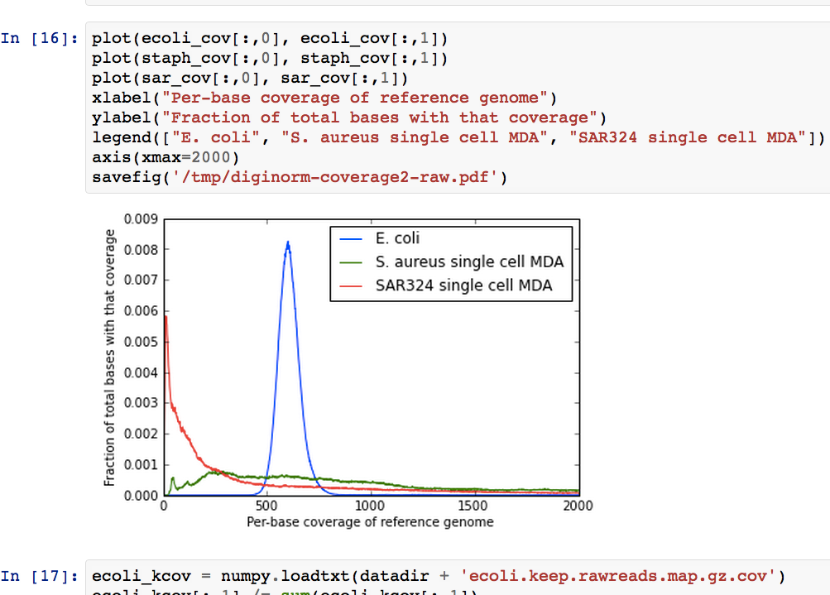
IPython Notebook
Notes:
Increasingly being connected via SOA to backend db

Slide 21
Tips & tricks
Develop a systematic naming scheme for files => easier to investigate results.
Work with a small data set first & develop the pipeline; then, once it’s working, apply to full data set.
Put in friendly “echo” commands.
Advanced: use loops and wildcards to write generic processing steps.

