Slide 1
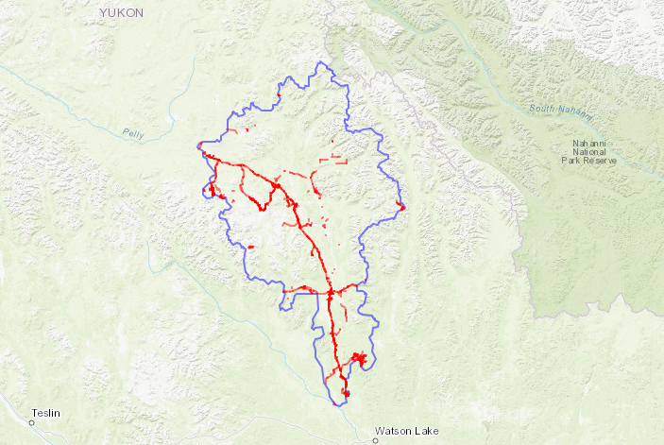
Workflow: Developing a Regional anthropogenic disturbance database
1. Define project parameters
- Area and year(s) of interest
- Key industry and disturbance types
2. Assemble existing datasets
- Roads, forestry, oil & gas, mining
- Rivers & streams, topography
Regional-level datasets
7. Optional: Temporal mapping
- Assemble historic imagery
- Record year of appearance & digitize historic features
3. Identify gaps in mapping
- Spatial gaps (never mapped)
- Temporal gaps (older maps)
Linear
disturbances
6. Validate disturbance maps
- Develop validation plan
- Validate features and attributes
4. Digitize disturbances in gaps
- Select high resolution imagery
- Digitize disturbance features
- Assign attributes
Areal
disturbances
5. Merge existing and new datasets
- Develop common attribute schema
- Merge digitized features with existing features
Combined dataset (existing & new disturbances)

