Slide 1


The city breathes
Real-time AI control of district heating
TechHeads 2026
Glaze
Fredrik Svensson
Alexander Wallin

Slide 2
Who we are
Glaze — eleven years bringing IoT and AI to small and mid-size companies. Offices in Malmö and Denmark.
Beacon Tower is our platform for real-time data and AI on physical systems, built from the start for cost and automation — to make this affordable for the many, not just the few. A product in its own right, used across many industries (beacontower.io).
RACE — Real-time AI Computing in the Energy sector — is what we build on it for district heating, and the product we’re now bringing to market.

Slide 3
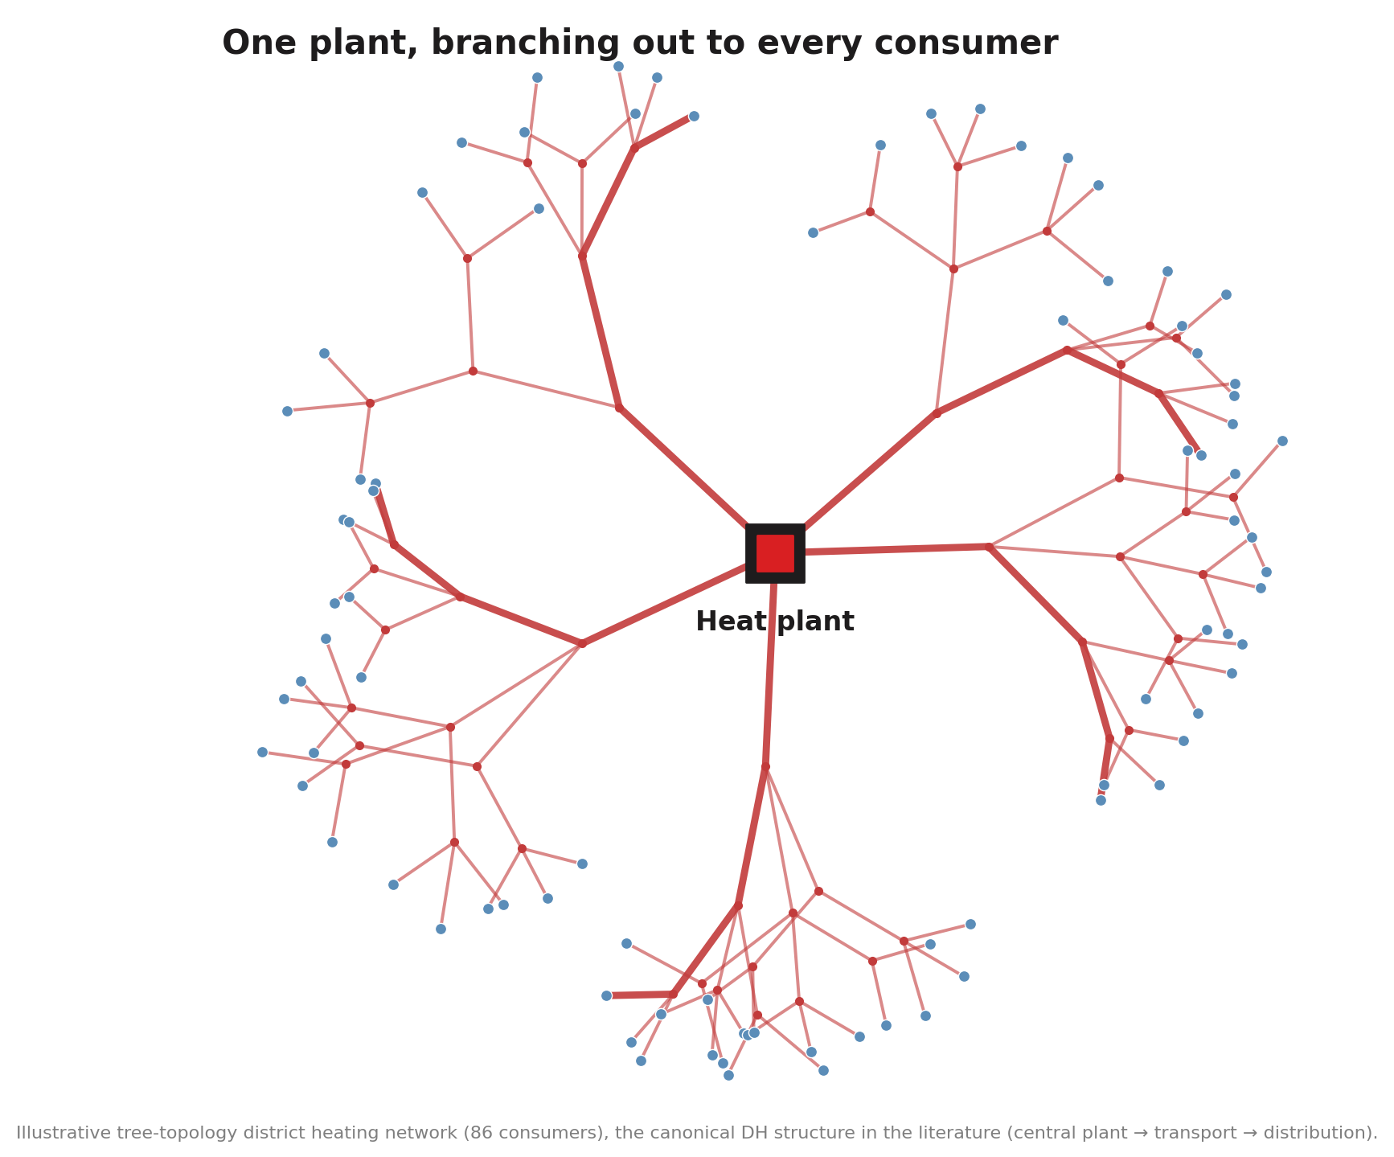
District heating is a living system
Roughly half the heat in Sweden and Denmark flows through district heating: hot water pumped through kilometres of buried pipe.
It behaves like an organism: it breathes with the day and the seasons, it changes as it grows, and it reacts slowly — in minutes to hours, not seconds.
And most of it still runs on fixed schedules and operator experience — a living system that never learns to regulate itself.

Slide 4
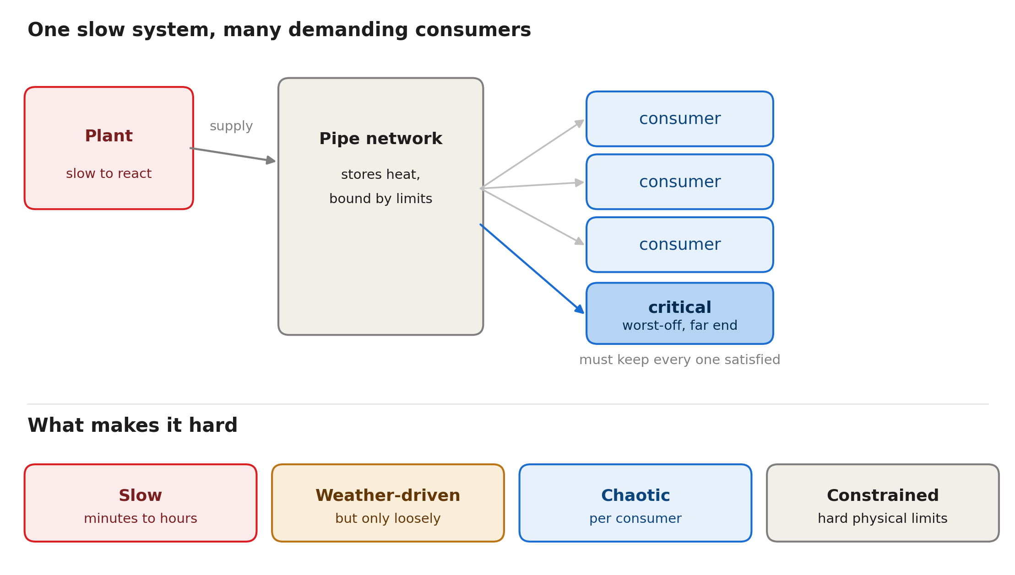
So what makes this hard?
A slow system, hard physical limits, and thousands of consumers to keep warm at once — the worst-served one sets the bar.
And you can’t experiment freely — get it wrong and people feel it, in a lukewarm shower or a cold radiator.

Slide 5
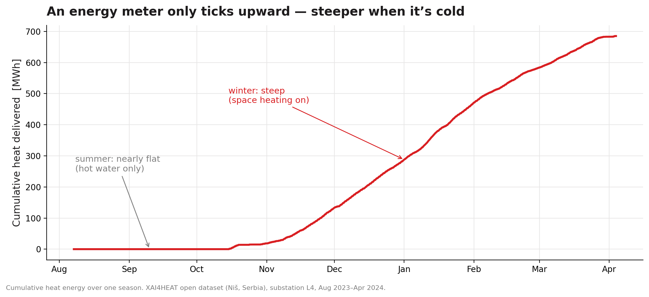
Every building already has a meter
It only ever ticks upward. The slope is the demand — flat in summer, steep in winter. This is the data every grid already owns.

Slide 6
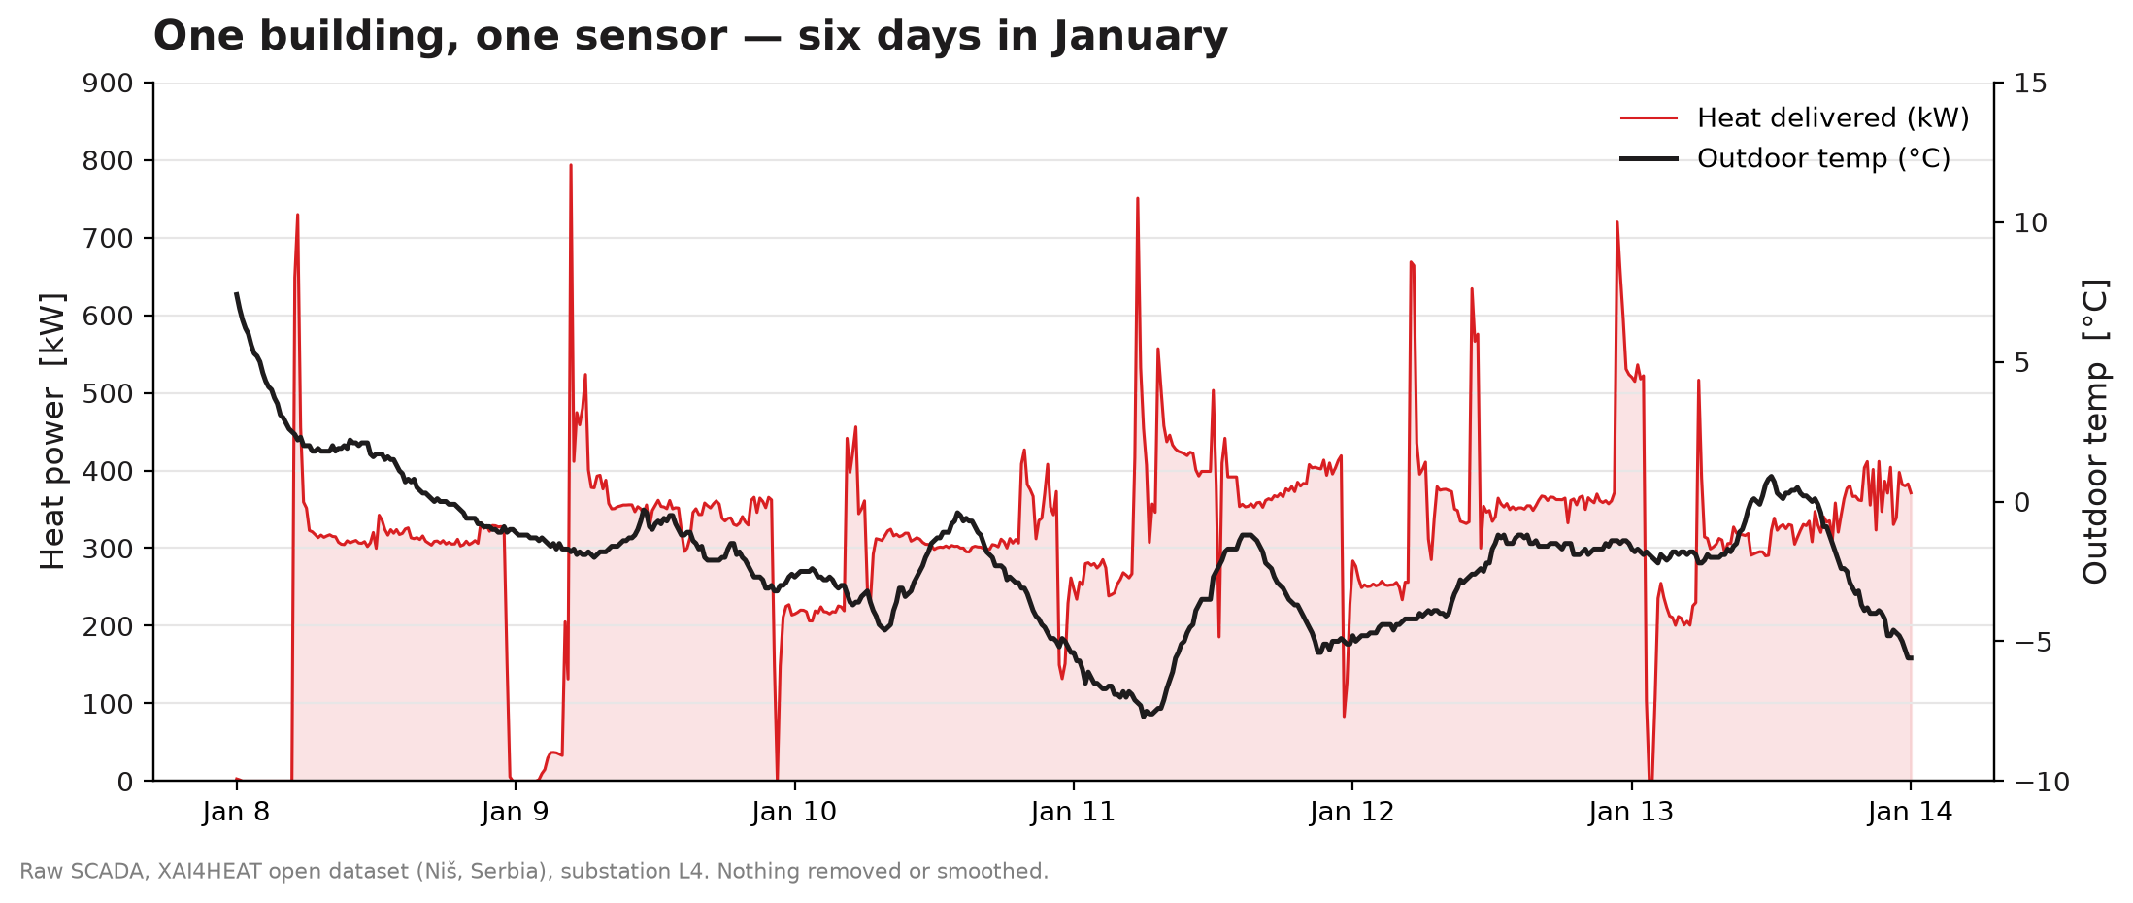
This is what one building looks like
Real heat data from a single building (substation). No model yet — just what the sensors on the building see.

Slide 7
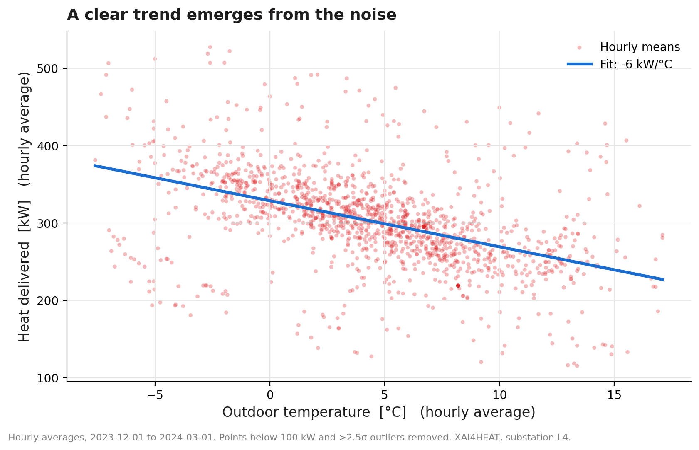
Plot it against the weather, and it starts to make sense
The same messy demand, plotted against outdoor temperature. Out of the noise, a clear trend appears — colder means more heat.

Slide 8
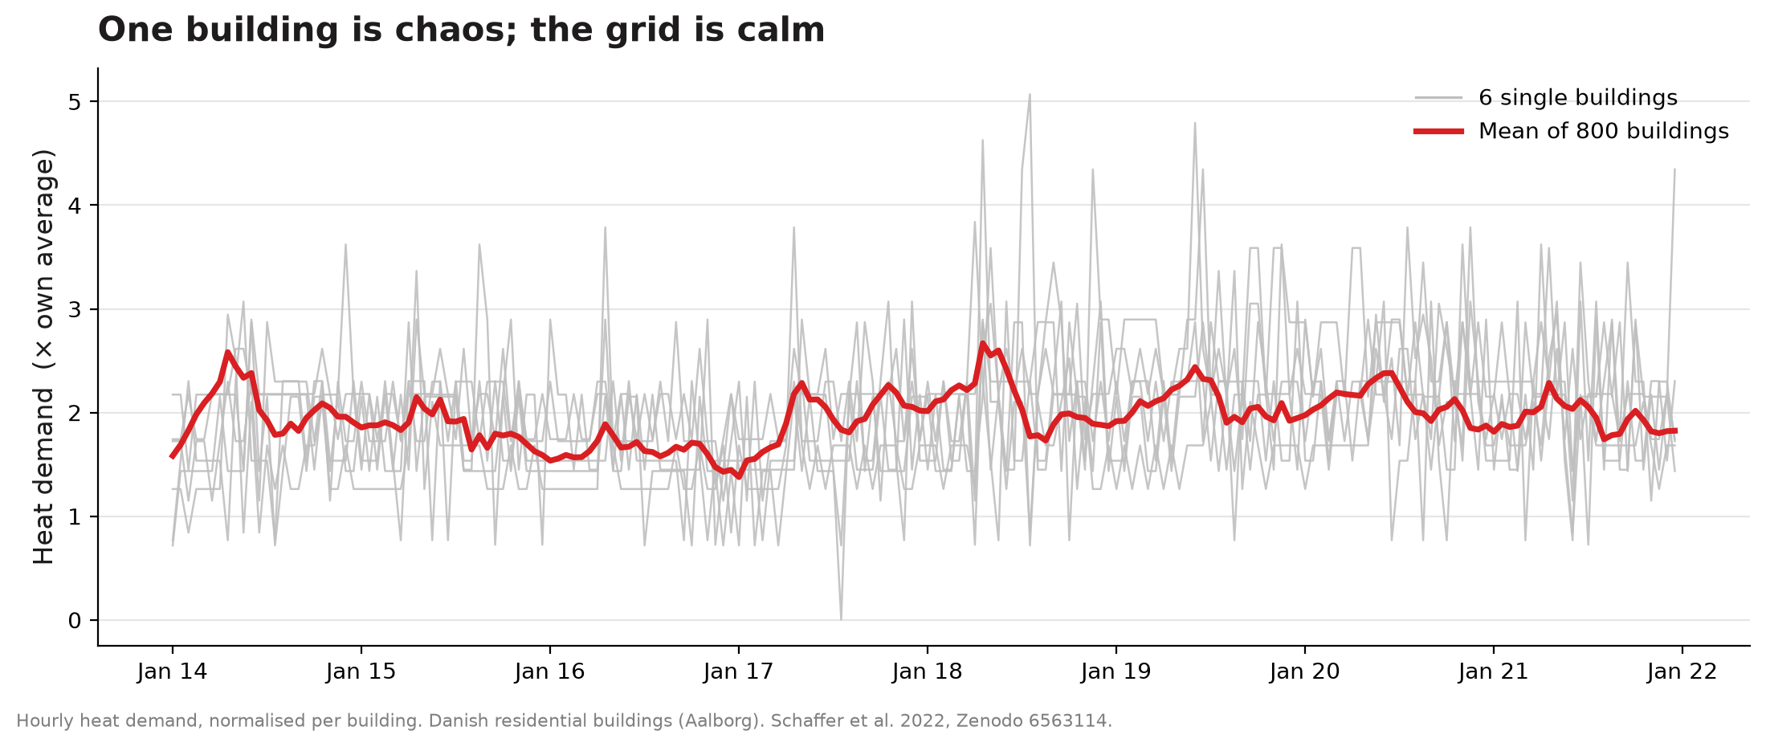
One building is chaos; the grid is calm
A single building’s demand jumps around wildly. Average enough of them and it settles into something smooth and predictable.

Slide 9
Why so many energy optimisation projects fail
Too complex: models that capture every detail need data the utility doesn’t have and an expert to babysit. When the grid changes, they quietly go stale.
Too brittle: they shine in the demo, then break on the first messy week of real SCADA. Operators stop trusting them — and trust doesn’t come back.
And all of that costs money to build and keep alive. Energy is a big industry on thin margins, run by engineers who can think and count — charge X a year and save barely more than X, and they will know. The value has to clearly beat the cost.

Slide 10
The RACE collaboration
RACE grew from deep domain knowledge in district heating — and from working alongside the people who run these grids. They are the real experts; no model is any good without them. The best results come with the operators in the loop, not replaced by it.
An EUDP-funded collaboration led by Glaze, with Aalborg University, Brønderslev Forsyning, Energy Cluster Denmark, DEVELCO and Agerkrantz Controls.

Slide 11
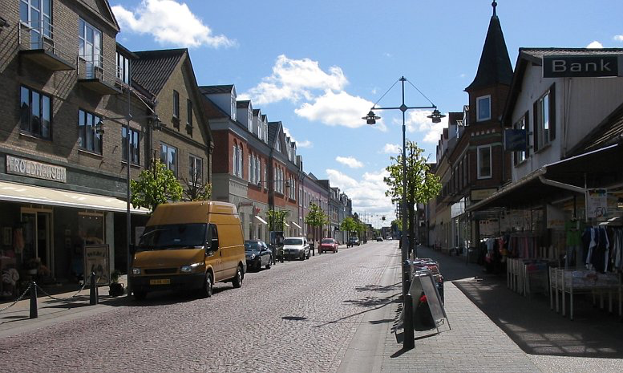
A real grid: Brønderslev
Live on the Jyllandsgade section — 454 connected consumers — as part of the EUDP-funded RACE project with Aalborg University.
13 intelligent bypasses plus AI-based pressure control, taking setpoints from Beacon Tower through the plant’s existing SCADA.
A hydraulic optimisation: getting heat to where it’s needed more efficiently — without raising the temperature leaving the plant.
Brønderslev © tsca, CC BY-SA 3.0, via Wikimedia Commons

Slide 12
The result
WINTER
SUMMER
HEAT UTILISATION
7.3 %
26.3 %
+2.7 pts winter
+3.3 pts summer
less energy used
(degree-day corrected)
less energy used
(larger — still verifying why)
more delivered heat
reaches consumers
Live on a real grid — measured and validated independently by Aalborg University, part of the
EUDP-funded RACE project. Achieved without raising the flow temperature leaving the plant.

Slide 13
What we learned
The gains showed up across the whole area — not just next to the hardware we installed. Better hydraulics help the system as a whole.
The grid was conservatively run to begin with — which is exactly why there was so much to gain. Most small and mid-size grids are run the same way.
Summer losses are structurally high — low demand means water sits and goes stale, so standby losses dominate. That is why summer had more to recover here. But 26% is not a promise for every grid.

Slide 14
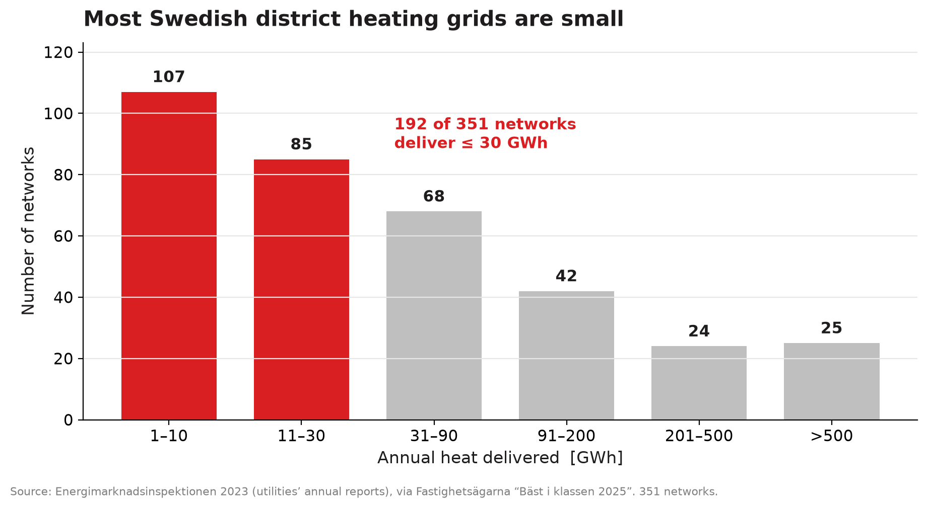
The opportunity is the small grids
The big grids are already run tight — they have the money, the staff and the incentive to optimise. There’s no product for a market that already solves its own problem. The opening is the many small and mid-size grids, which are conservatively run and rarely optimised.
This is what Glaze was built for: cheap and automated from the start — function first, not bells and whistles.

Slide 15
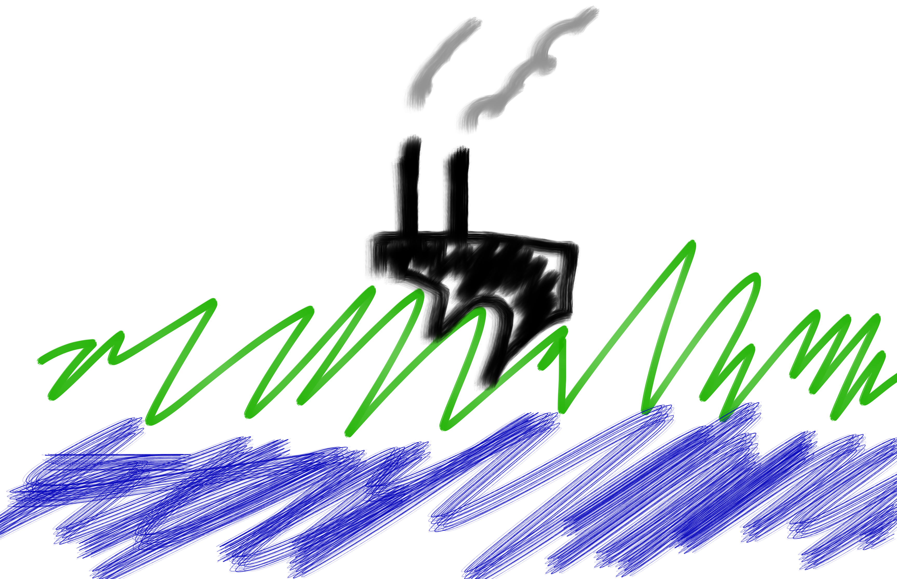
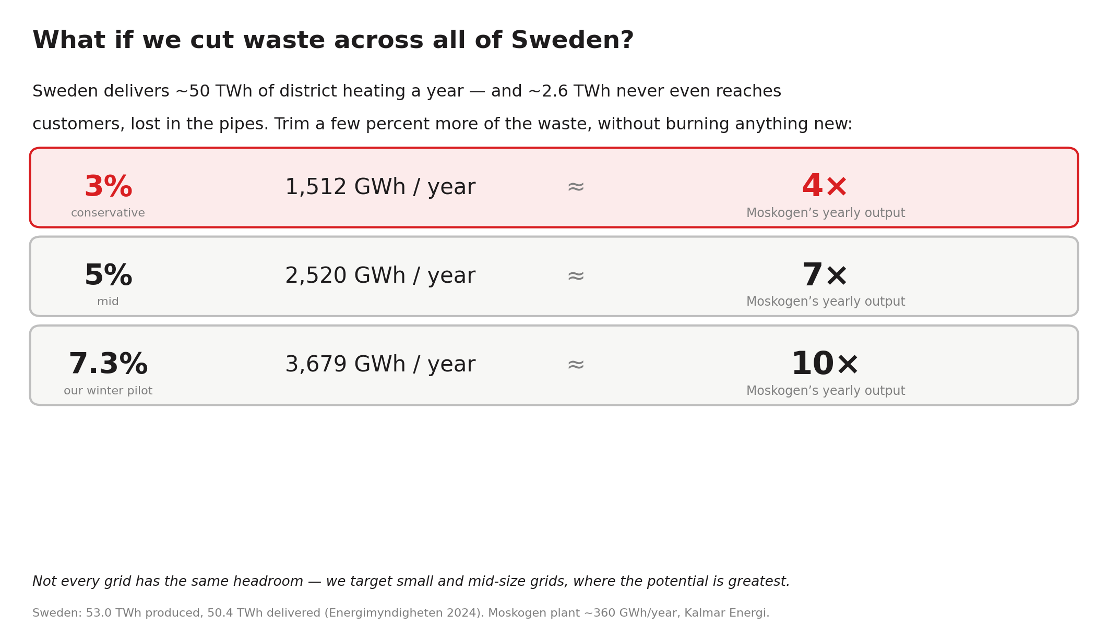
Kalmar’s Moskogen: ~360 GWh of heat a year — one “Moskogen”

Slide 16
This is a fast-moving moment
RACE 2.0 is live now: two new Danish grids, with RACE also heading to Swedish grids — as we bring it to market as a product.
We’re adding demand-side management, targeting 10%+ yearly savings even as networks grow — using the heat already stored in buildings and pipes to spread demand in time, so the system serves everyone without over-building for the worst hour.
Same principle throughout: start simple, stay cheap, earn trust before adding complexity.

Slide 17

The city breathes
Heat demand runs in cycles — and any single moment is almost impossible to predict. Together, across a grid, it averages out.
Most district heating can run far leaner than it does today.
A genuinely interesting problem — with real potential, if it is done simply and well.

Slide 18

Thank you
See for yourself: the slides, the open datasets behind every chart, the code that makes them, and the reports we base our claims on — all here.
github.com/beacontower/techheads2026

