Slide 1
热辐射角度纠正模拟 阶段性结果
滕沅建
2021.8.28

Slide 2
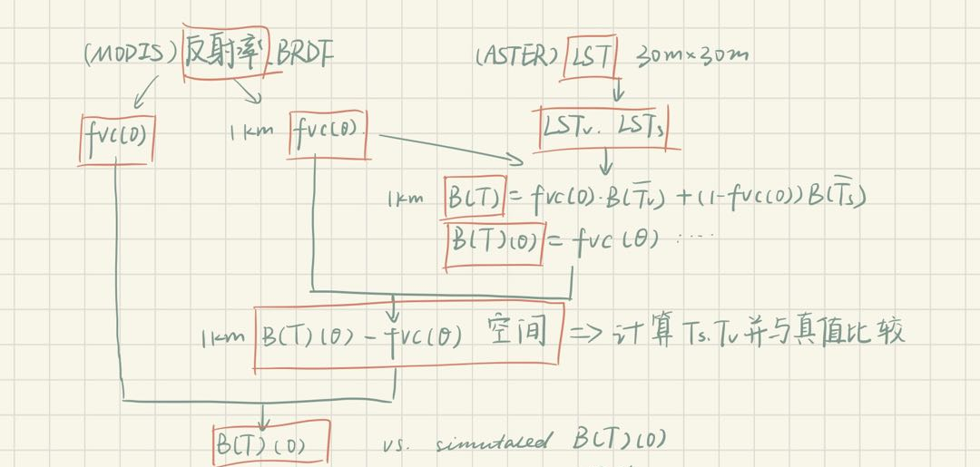
Procedure
2021.08.28

Slide 3
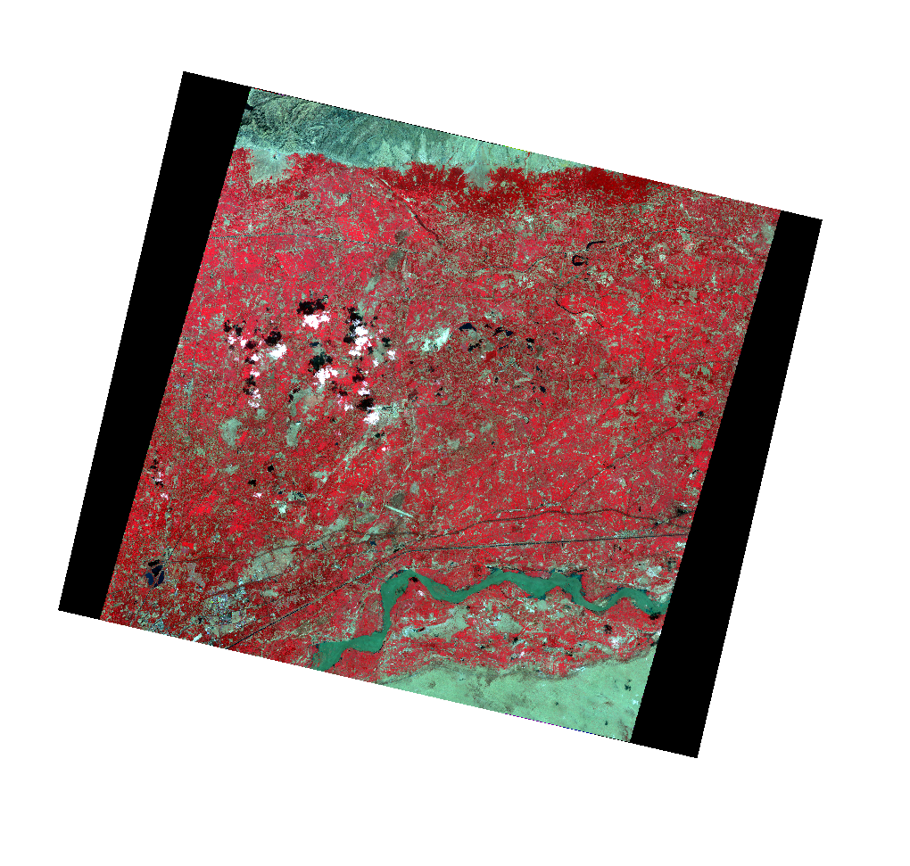
Simulation Result
有效像元提取
2021.08.28

Slide 4
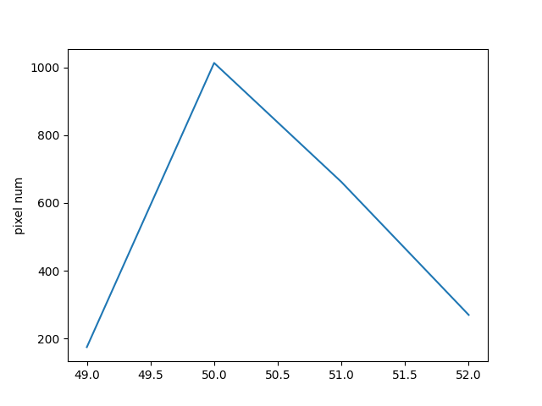
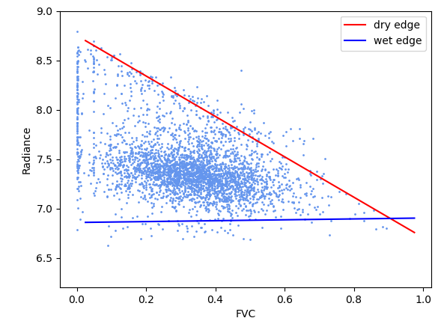
Result
2021.08.28

Slide 5
Simulation Result
模拟/特征空间计算辐亮度对比
Date | Diff_RMSE (simulated nadir vs. space) | Diff_RMSE (simulated nadir vs. original) | Diff_RMSE (simulated original vs. space)
0828_1 | 0.0353 | 0.0424 | 0.0318
0828_2 | 0.0601 | 0.0857 | 0.0844
0904 | 0.0352 | 0.0325 | 0.0592
2021.08.28

Slide 6
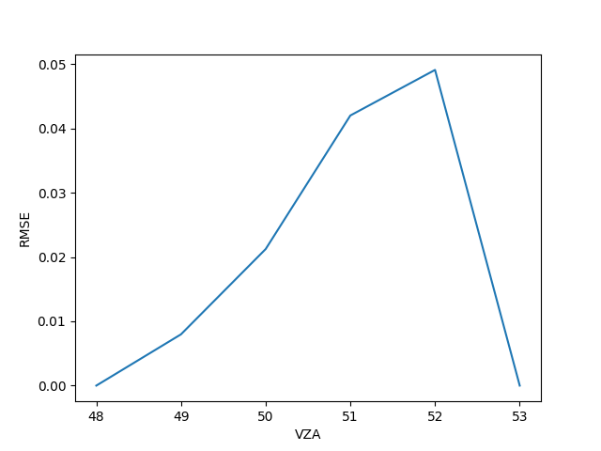
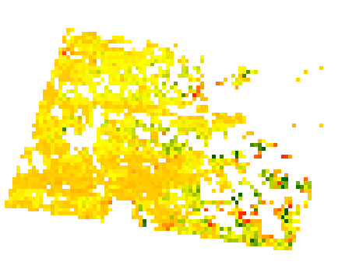

Simulation Result
0828_1
BT_diff
LST_diff
2021.08.28

Slide 7
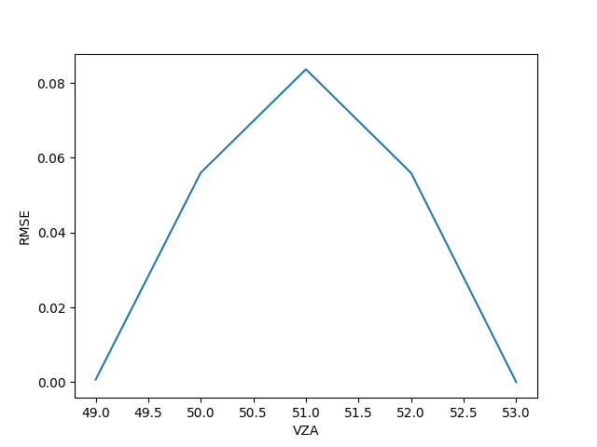
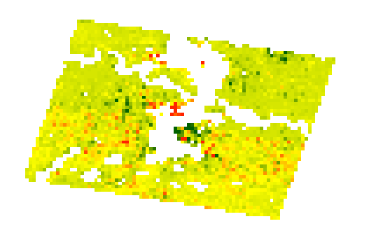
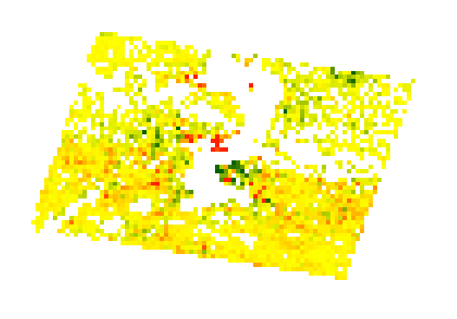
Simulation Result
0828_2
BT_diff
LST_diff
2021.08.28

Slide 8
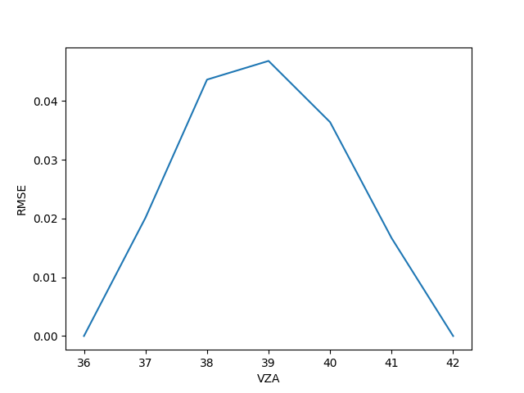
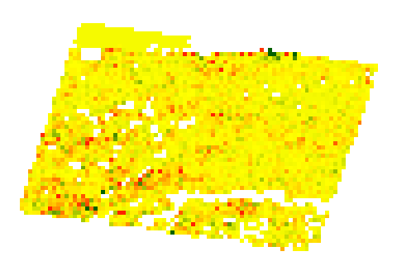
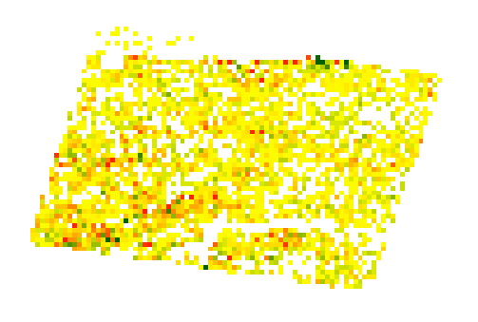
Simulation Result
0828_2
BT_diff
LST_diff
2021.08.28

Slide 9
THANK YOU!

