Slide 1
REACT JS
BASIC FEATURES

Slide 2
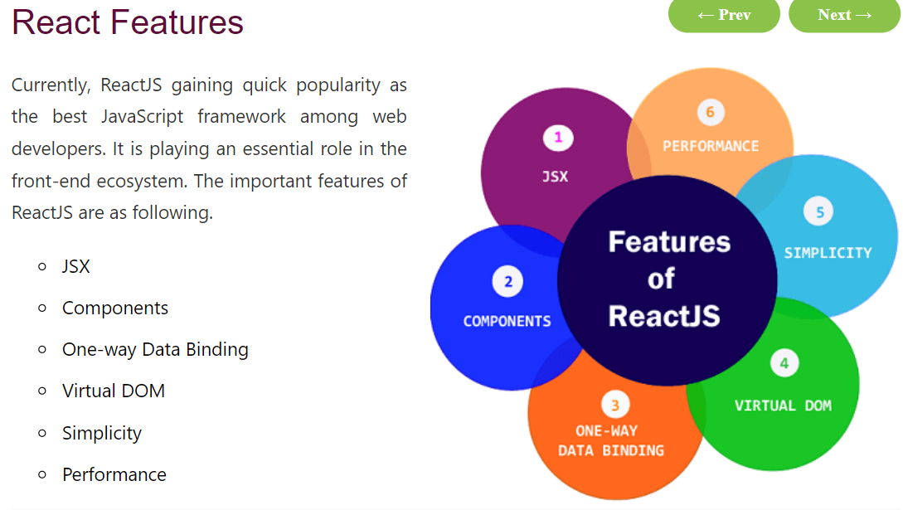
Basic Features

Slide 3
Features
JSX
JSX stands for JavaScript XML. It is a JavaScript syntax extension. Its an XML or HTML like syntax used by ReactJS. This syntax is processed into JavaScript calls of React Framework. It extends the ES6 so that HTML like text can co-exist with JavaScript react code. It is not necessary to use JSX, but it is recommended to use in ReactJS.
Components
ReactJS is all about components. ReactJS application is made up of multiple components, and each component has its own logic and controls. These components can be reusable which help you to maintain the code when working on larger scale projects.

