Slide 1
REACT JS
BASIC FEATURES

Slide 2
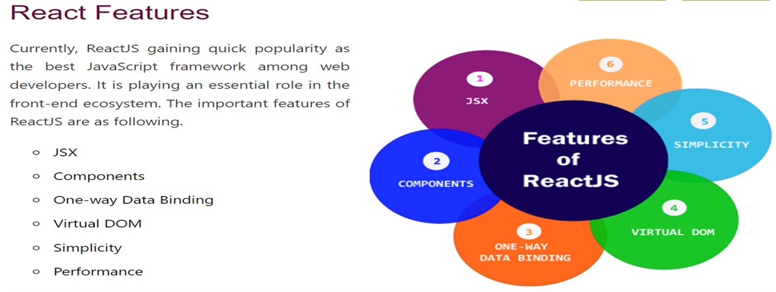
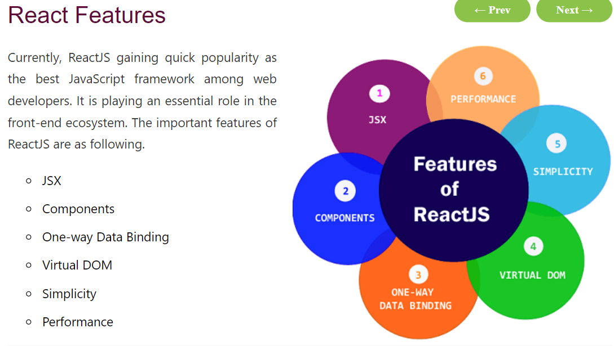
Basic Features

Slide 3
Features
JSX
JSX stands for JavaScript XML. It is a JavaScript syntax extension. Its an XML or HTML like syntax used by ReactJS. This syntax is processed into JavaScript calls of React Framework. It extends the ES6 so that HTML like text can co-exist with JavaScript react code. It is not necessary to use JSX, but it is recommended to use in ReactJS.
Components
ReactJS is all about components. ReactJS application is made up of multiple components, and each component has its own logic and controls. These components can be reusable which help you to maintain the code when working on larger scale projects.
Virtual DOM
A virtual DOM object is a representation of the original DOM object. It works like a one-way data binding. Whenever any modifications happen in the web application, the entire UI is re-rendered in virtual DOM representation. Then it checks the difference between the previous DOM representation and new DOM. Once it has done, the real DOM will update only the things that have actually changed. This makes the application faster, and there is no wastage of memory.
Simplicity
ReactJS uses JSX file which makes the application simple and to code as well as understand. We know that ReactJS is a component-based approach which makes the code reusable as your need. This makes it simple to use and learn.
Performance
ReactJS is known to be a great performer. This feature makes it much better than other frameworks out there today. The reason behind this is that it manages a virtual DOM. The DOM is a cross-platform and programming API which deals with HTML, XML or XHTML. The DOM exists entirely in memory. Due to this, when we create a component, we did not write directly to the DOM. Instead, we are writing virtual components that will turn into the DOM leading to smoother and faster performance.

