Slide 1
Table cars
speed
dist
speed | dist
4 | 2
4 | 10
7 | 4
7 | 22
8 | 16
9 | 10
10 | 18
10 | 26
10 | 34
11 | 17
11 | 28
12 | 14
12 | 20
12 | 24
12 | 28
13 | 26
13 | 34
13 | 34
13 | 46
14 | 26
14 | 36
14 | 60
14 | 80
15 | 20
15 | 26
15 | 54
16 | 32
16 | 40
17 | 32
17 | 40
17 | 50
18 | 42
18 | 56
18 | 76
18 | 84
19 | 36
19 | 46
19 | 68
20 | 32
20 | 48
20 | 52
20 | 56
20 | 64
22 | 66
23 | 54
24 | 70
24 | 92
24 | 93
24 | 120
25 | 85

Slide 2


Slide 3
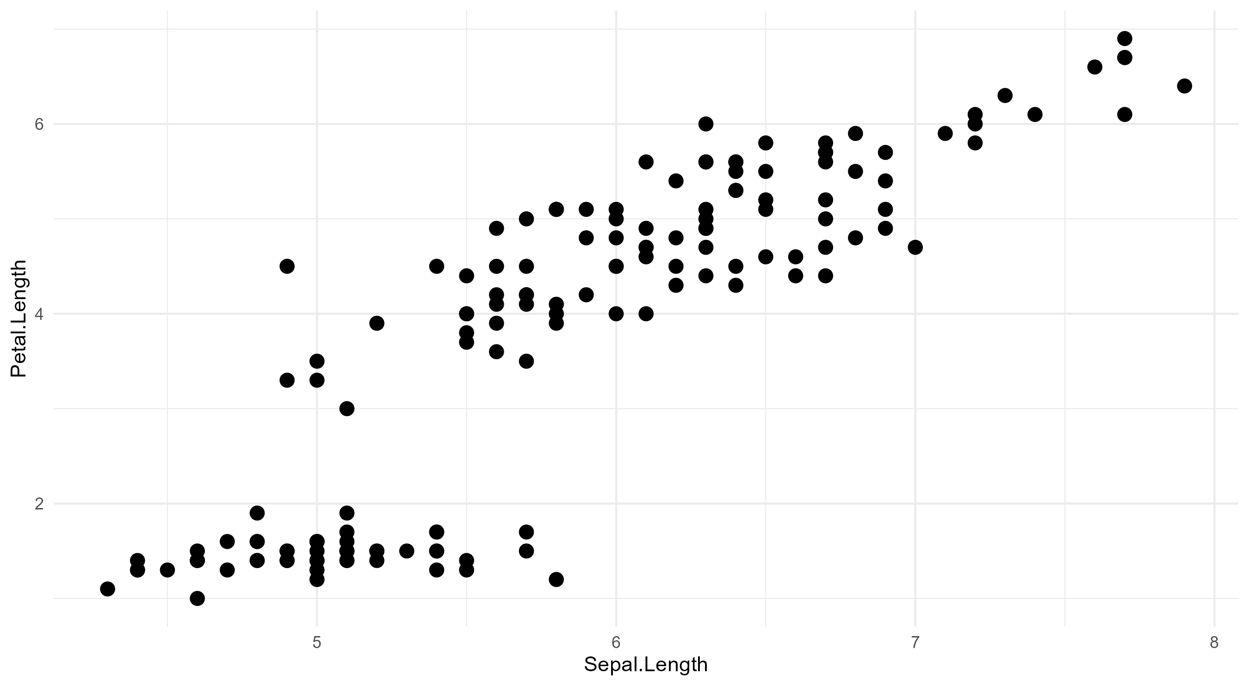
graphic title

