Slide 1
My PowerPoint Presentation

Slide 2
Introduction
This presentation includes images with legends.

Slide 3
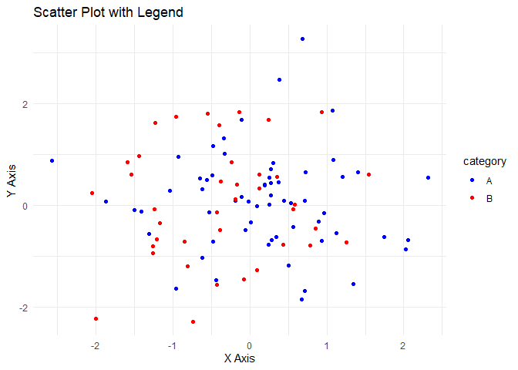
Slide with Image and Legend
This slide contains an image with a legend.

Slide 4
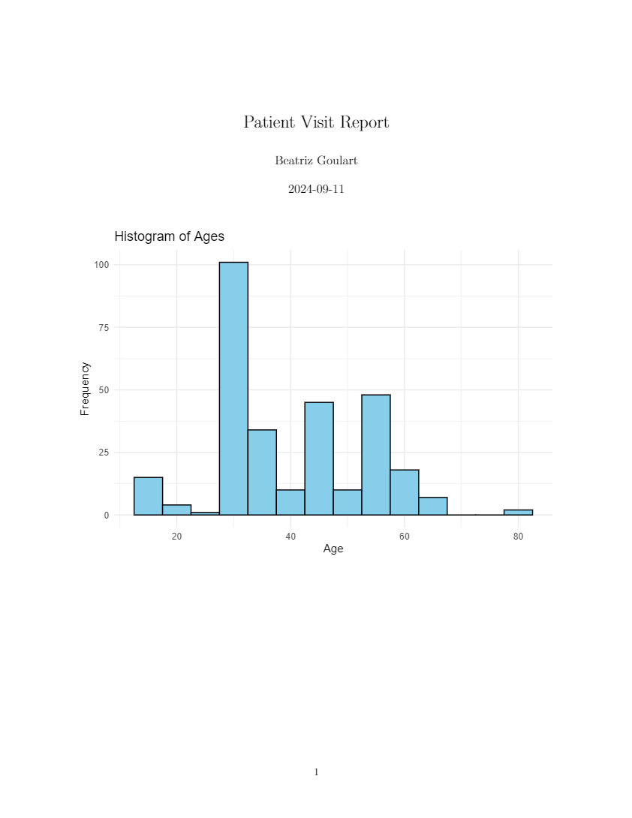
Slide with External Image
This slide includes an external image with a legend.
Legend: Description of the image here.
Legend for Image

