Slide 1
renege-free auctions?

Slide 2
Motivation
Bidders’ reneging on auctions is not uncommon and causes problems.
It is costly for sellers when bidders renege on auctions or to prevent it in the first place
In more anonymous environments (internet), bidders may submit insincere bids
Characterizing renege-free auctions where a seller can collect payments upfront even if the seller has imperfect reputation.

Slide 3
Renege on auctions
Renege on auctions
Sotheby : Although reneging is not prevalent, once it happens it could result in costly lawsuit.
ebay : bidders reneging is quite common and hard to prevent
customers can make multiple accounts.
legal actions are limited - The value of items are often not worth filing a lawsuit. It is Difficult to prove the bid is made by the account holder (“my cat pressed the button”)
Reasons for reneging
Uncertain valuation at the time of bidding (cost overrun literature, CV)
Preference shocks (no longer need it: return, Cadsdy et al. , Lu and Wang)
Liquidity constraint (Che and Gale)
Notes:
Credit Card – Easy to dispute. Also, it is risky for ebay to allow bidder save the credit card information. IF An account got hacked…
Costly lawsuits – don’t emphasize that the money amount is big. If I emphasize the amount of money, people easily think of procurement auctions or other auctions with huge stake where all pay auctions do not make much senses. (time consuming)
cost overrun – a lot of them
Cost overrun and auction format in small size public works
Standard Auctions with Financially Constrained Bidders (Che, Gale)
Expected revenue of all-pay auctions and first-price sealed-bid auctions with budget constraints (Che, Gale)
Goodwill Can Hurt: A theoretical and experimental investigation of return policies in auctions (Cadsdy et al)

Slide 4
Problems of reneging on auctions
Reneging is costly
If the winner reneges on auction, the seller may sell the item to the second highest bidder, but the revenue will be decreasing
Taking measures to prevent reneging is costly (lawsuit, …)
Insincere bids
Ability to renege may prevent sincere bid
ex) bidding equal or more than one’s value is a (weakly) dominant strategy in the second price auctions (sport bidders in ebay – they bid for fun)
low-balling in procurement auctions with free withdrawal of bids (Merlob, Plot and Zhang 2012)
This invalidates a desire property of auctions: Incentive compatibility
Notes:
sometimes, the seller may try to recoup the money from the reneging buyer by filing lawsuit,
There could be an equilibrium like everyone bids two times of their values and renege if the price higher than the value. This sounds too extreme, but this is actually what happens.
(in a more anonymous environment, punishment is even harder) – ebay sport bidders
There is a paper that shows free withdrawal in procurement auctions has a problem of low-balling bids.
THE CMS AUCTION (Merlob, Plot and Zhang 2012)

Slide 5
How to prevent reneging
Punish when it happens
Severe punishment can prevent reneging
Such a severe punishment may not be available without authorities (and associated cost)
Collect money upfront
Bidders pay the maximum possible payments at the time of making bids
Seller ’s (or a third party’s) reputation matters – bidders may not trust the seller for this.
I will take this approach – are there auctions where bidders willingly pay upfront?
Notes:
The question is that how can we prevent reneging without an authority, of third party who has strong reputation.
The first think we can think about is punishment, if we can punish the reneging bidder severely, of course, it will prevent reneging.
so ask the bidders when they bid
are there auctions where bidders willingly pay upfront even if the seller’s reputation is not perfect?

Slide 6
The environment of this study
Assumptions
Bidders have no commitment to pay. (The seller do not know much about the bidders but knows that bidders may have reasons for reneging)
Sellers have imperfect reputation - Bidders believe that if they pay upfront, the seller can fail to return excessive money with positive probability α.
Sellers commit to the auction rules
The seller can not cheat on the auction rule – information on bids will be made public (unlike Akbarpour and Li)
The seller puts no value on the item. so bidders believe the seller would not fail to deliver the item.
Auctions are renege-free if when bidders are forced to pay their maximum possible payments upfront, their optimal bids are the same as in perfect reputation case.
ex) first price auction is not renege-free
Notes:
For this assumption, I am not going to specify what are the potential reasons for reneging. Simply think about a situation where the seller does not know much about the bidders (as in internet auctions) The seller does not know whether bidders have potential preference shock, uncertain values, the bidders are sport bidders. but the seller knows that they are bidders who can potentially renege, and he just really want to avoid reneging.
So under imperfect reputation, collecting money upfront may not work well.
this assumption does make sense because, it is tempting not to return the money back to the bidders. especially when the number of bidders are many.
So, you are selling your own book through an auction. There is not much reason for you keep the book and not deliver it to the winner. But you may be tempted to keep the money of bidders if all bidders pay upfront.
no values on the item – This is something that I can defend.
1) most theories assume this.
2) keeping the item is at least less tempting than keeping all the money paid by all bidders and not returning them (this is linearly increasing in the number of bidders)
3) Sometimes you really want to deliver the item – for example, you wrote a book and sell it thorough an auctions, would you really keep your book? and not deliver it? And In IPO auction in Google’s case not delivering the share in IPO auctions will do nothing to the company, if not doing harm. The kept share will not be valuable at all since the company became a scam company.
Credible Mechanisms (Akbarpour and Li)
Perfect reputation –> standard theory
I don’t know whether this is the best wording, but let me explain.
But with imperfect reputation – the bidders will pay less. because the become more cautious. (in other words, when a seller with imperfect reputation collects the payments upfront, the intended first price auction is not implemented) – because the bidders changes their bidding behavior.
- Second price auction is the same – Imagine that the probability of not getting money is approaching 1, do you still bid your value and pay the money upfront?
- optimal bids are determined by the tradeoff of marginal benefit and marginal cost of bidding more. The probability of not getting money back is a additional marginal cost of biding more
- In the paper, I can explicitly calculate the optimal bids in first price (or) the second price auctions

Slide 7
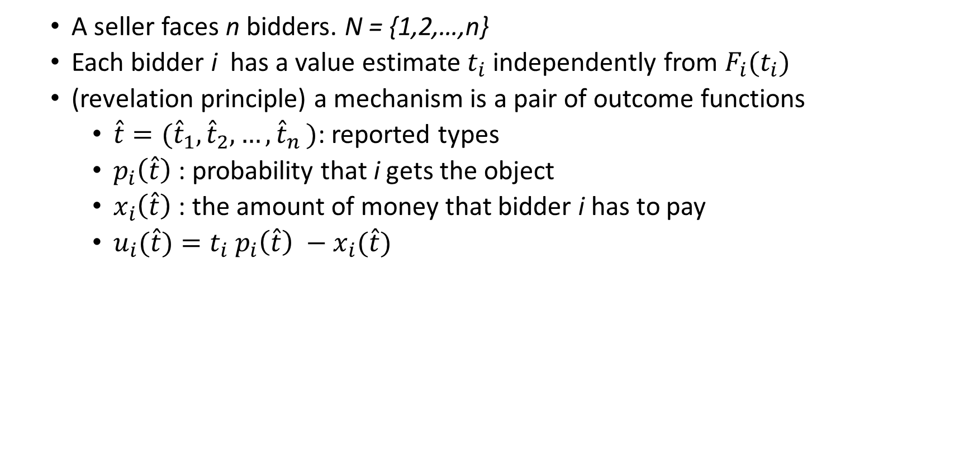
Static Model.
A seller faces n bidders. N = {1,2,…,n}
Each bidder i has a value estimate $t_{i}$ independently from $F_{i}(t_{i})$
(revelation principle) a mechanism is a pair of outcome functions
$\hat{t}=({\hat{t}}_{1},{\hat{t}}_{2},{…,\hat{t}}_{n})$: reported types
$p_{i}\left(\hat{t}\right)$ : probability that i gets the object
$x_{i}\left(\hat{t}\right)$ : the amount of money that bidder i has to pay
$u_{i}(\hat{t})=t_{i} p_{i}\left(\hat{t}\right) −x_{i}(\hat{t})$
Notes:
What will be renege-free auctions?
There could be common-value aspect in Myerson’ paper, it’s okay, for now let’ ignore it.
Appeal to the revelation principle

Slide 8
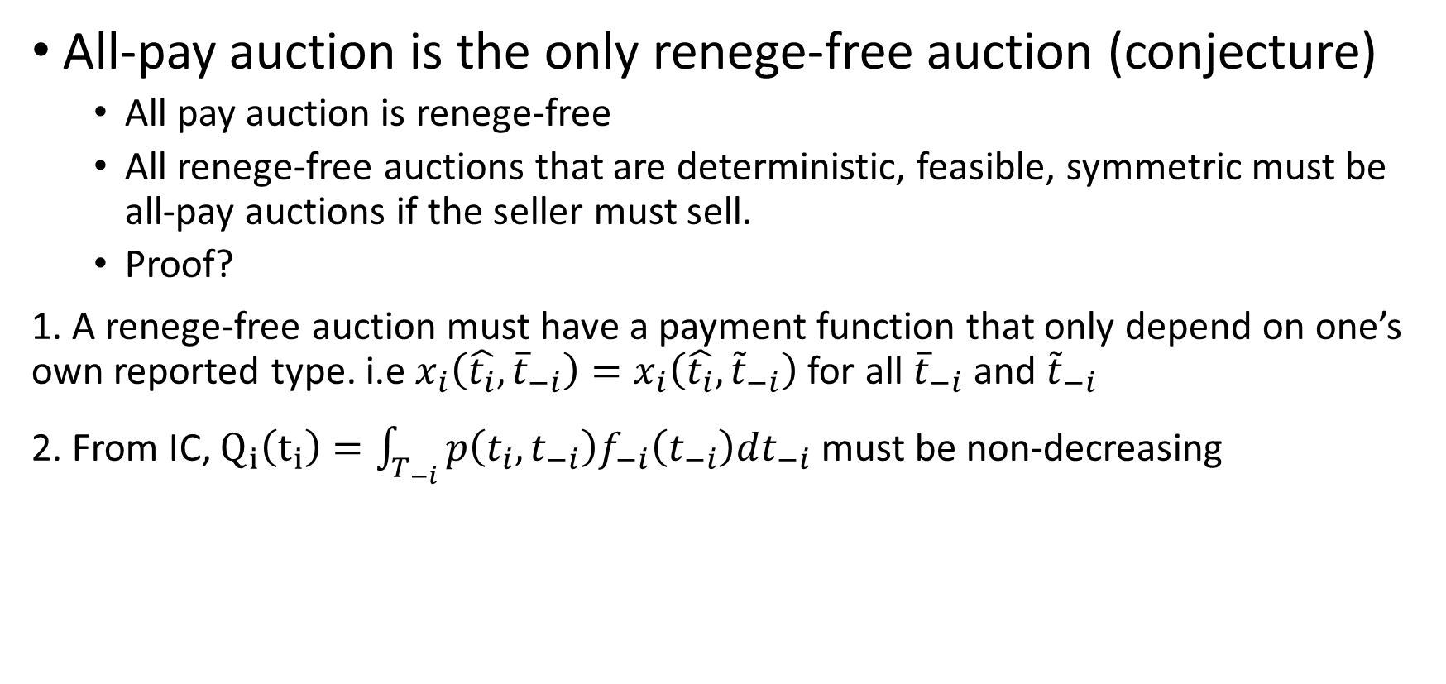
Static Model
All-pay auction is the only renege-free auction (conjecture)
All pay auction is renege-free
All renege-free auctions that are deterministic, feasible, symmetric must be all-pay auctions if the seller must sell.
Proof?
1. A renege-free auction must have a payment function that only depend on one’s own reported type. i.e $x_{i}\left(\hat{t_{i}},{\overline{t}}_{−i}\right)=x_{i}\left(\hat{t_{i}},{\tilde{t}}_{−i}\right)$ for all ${\overline{t}}_{−i}$ and ${\tilde{t}}_{−i}$
2. From IC, $Q_{i}\left(t_{i}\right)=\int_{T_{−i}}{p\left(t_{i},t_{−i}\right)f_{−i}\left(t_{−i}\right)dt_{−i}}$ must be non-decreasing
Notes:
All-pay auctions is renege free – it is easy to show

Slide 9
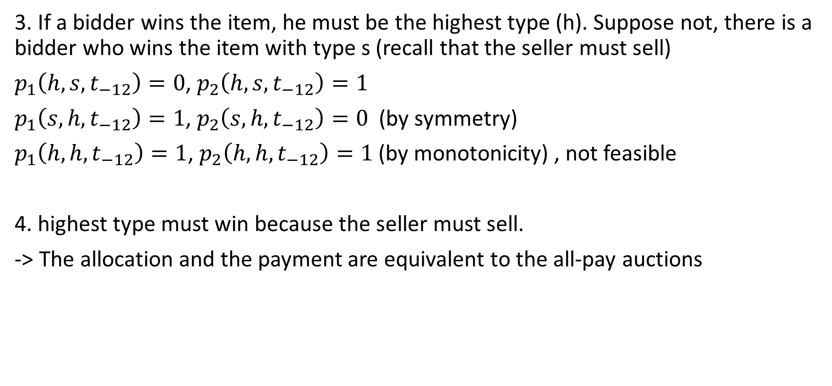
Static Model
3. If a bidder wins the item, he must be the highest type (h). Suppose not, there is a bidder who wins the item with type s (recall that the seller must sell)
$p_{1}\left(h,s,t_{−12}\right)=0$, $p_{2}\left(h,s,t_{−12}\right)=1$
$p_{1}\left(s,h,t_{−12}\right)=1$, $p_{2}\left(s,h,t_{−12}\right)=0$ (by symmetry)
$p_{1}\left(h,h,t_{−12}\right)=1$, $p_{2}\left(h,h,t_{−12}\right)=1$ (by monotonicity) , not feasible
4. highest type must win because the seller must sell.
-> The allocation and the payment are equivalent to the all-pay auctions
Notes:
symmetry is important -> if the seller favors one over the other, highest bidder may not win
deterministic is also important -> for example, highest wins 80% and the second wins 20%
must sell is also important -> the seller sets some weird condition. highest bid wins only if his bid is greater than the sum of the other bids
Now forget about all-pay auctions. no one use it.

Slide 10
Dynamic environment (extensive form)
More of renege-free auctions
Dutch auction
War of attritions
Penny auctions
Price reveal auction
……
Notes:
Dutch auction the winner pays the bid at the time of making his bid, and the other even do not make bids
Price Reveal Auctions (Gallice,2016) – the price begins some high price, if a bidder want to buy the item, he must pay to see the price. when the bidder pay C to see the price, he can either buy or not buy. If he does not buy, the price goes down. other bidders choice is not observable
Penny acution characteriazation – N bidders, periods, 0,1,2,3,4,5……. In period 0 no one is a learder and all can bid, if no one bid seller gets the item. if k bidders bid at 0, each pay C to the seller and one of k bidders become the leader. in period 1, the leader cannot bid, and non-leaders can bid as in round 0. If no one bid at 1, the leader wins the item. If someone bid, the auction continues

Slide 11
Dynamic environment
Characterization (very informal, maybe inaccurate)
After player i makes his last move, any resulting payments of i must be the same (do not depend on others’ strategies)
Whenever player i moves, the seller collect the differences between the resulting payments before i moves and after i moves.
This includes the class of pay-per bid auctions (Gallice, 2016) – These auctions are popular forms of e-commerce
Incompatibility with dominant strategy-proofness (??)
- If a mechanism is dominant strategy proof, it must be a Grove mechanism (Green and Laffont) where transfer functions only depend on others’ report.
Notes:
If player i makes two move, any resulting payments from the first move must the same, unless he makes
Because of this characteristics, the payment can be collected whenever player I moves.
Penny auction often assumes common-value (no consideration of IC) But, yes anyway, we can think of
Note for me.
Strategy proof : willing to tell the true type. -> by revelation mechanism, Strategy proof = incentive compatible = truthfully implementable <-> monotone allocation function. (linear unity world of course)
Dominant strategy proof : revealing one’s type it a dominant strategy. So even with dynamic auctions, renege-free cannot be implemented with dominant strategy.
Penny auctions – without price increase / Also, even in a positive price increment, the bidder can choose not to buy. (since the seller collect a tons of money from increment bids, do not really need to sell it to make money) IJIO (Hinnosar,2016)
Pay per bid auction gets popular and popular

Slide 12
Static / Divisible item – practical applications
Reciprocity
Losers pay for nothing in all-pay auctions - this seems unfair. This could be a reason why all-pay auctions are not popular in spite of renege-free property.
When the item is divisible, all bidders can win with all-pay auctions
Reciprocity is satisfies.
There are two classes of renege-free mechanisms where all pennies have the same purchasing power (uniform pirce)
This two classes of mechanisms have been used when selling shares of firms (IPO, privatization)
Notes:
All pay auctions are not used in practice. Pay-per bid

Slide 13
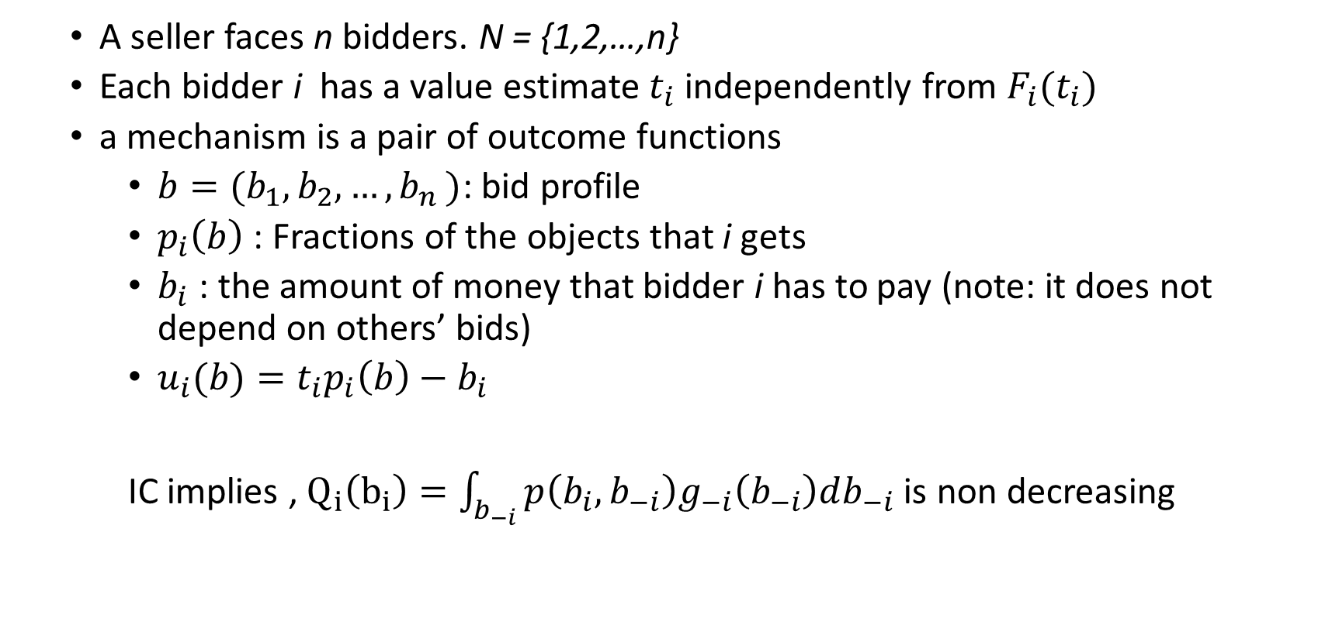
Divisible item
A seller faces n bidders. N = {1,2,…,n}
Each bidder i has a value estimate $t_{i}$ independently from $F_{i}(t_{i})$
a mechanism is a pair of outcome functions
$b=(b_{1},b_{2},{…,b}_{n})$: bid profile
$p_{i}\left(b\right)$ : Fractions of the objects that i gets
$b_{i}$ : the amount of money that bidder i has to pay (note: it does not depend on others’ bids)
$u_{i}(b)=t_{i}p_{i}\left(b\right)−b_{i}$
IC implies , $Q_{i}\left(b_{i}\right)=\int_{b_{−i}}{p\left(b_{i},b_{−i}\right)g_{−i}\left(b_{−i}\right)db_{−i}}$ is non decreasing
Notes:
IPO pays 4-7% fees to the investment bank…..

Slide 14
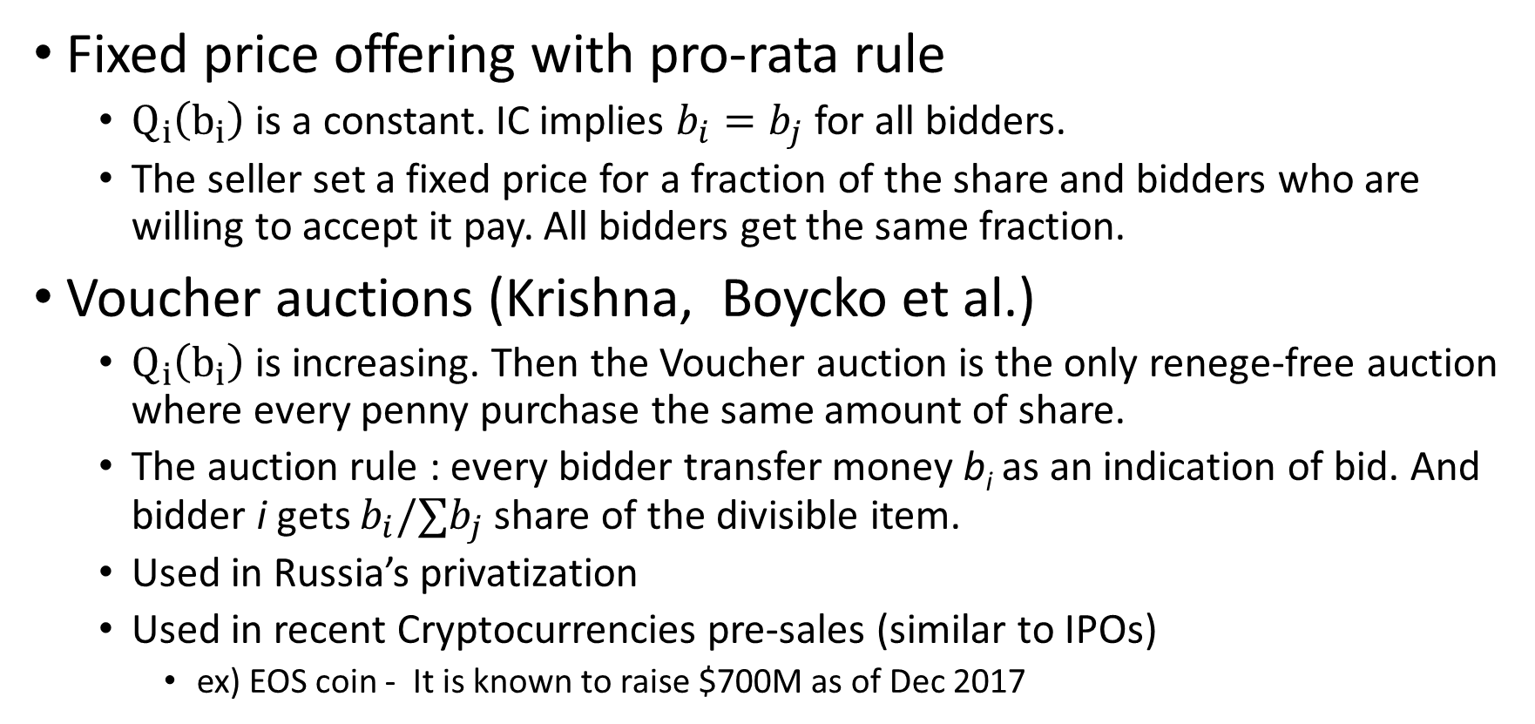
Divisible item
Fixed price offering with pro-rata rule
$Q_{i}\left(b_{i}\right)$ is a constant. IC implies $b_{i}=b_{j}$ for all bidders.
The seller set a fixed price for a fraction of the share and bidders who are willing to accept it pay. All bidders get the same fraction.
Voucher auctions (Krishna, Boycko et al.)
$Q_{i}\left(b_{i}\right)$ is increasing. Then the Voucher auction is the only renege-free auction where every penny purchase the same amount of share.
The auction rule : every bidder transfer money b_{i} as an indication of bid. And bidder i gets $b_{i}/∑b_{j}$ share of the divisible item.
Used in Russia’s privatization
Used in recent Cryptocurrencies pre-sales (similar to IPOs)
ex) EOS coin - It is known to raise $700M as of Dec 2017
Notes:
IPO pays 4-7% fees to the investment bank…..
So the voucher auction also

Slide 15
Revenue implication of renege-free auctions
Private, risk neutral environment
All-pay auctions can do as much as other auctions. (optimal)
In other cases?
Risk aversion – maybe less revenue.
Liquidity constraint –
…. and more? what are interesting environments?
Revenue implication of Voucher auctions in the divisible case?
Not in the previous literature (neither theory or experiment) – clearly not an optimal auction though
Notes:
Voucher auction is clearly not

Slide 16
Experiment?
Voucher auction VS uniform price auctions (renege) VS uniform price auctions (no renege)
An environment where bidders really have incentive to renege
Uncertain value or something
Questions
How much loss in revenue will occur due to reneging?
is it worth using a reputable third party to prevent renege?
Insincere bids are observed?
Want to investigate bidding behavior and revenue implications of Voucher auctions
Some over bidding in all-pay auction is known, is this persist in voucher auction??
Notes:
very low screening.
under private value may not be good. but may be good with CV? (maximum game sort of?)
50% of not returning the money?? how would you bid?

