Slide 1
Why Do Cryptocurrency Crowdsales Use Unconventional Auctions : Renege-Free Auctions

Slide 2
Motivation
Cryptocurrency crowdsales (aka. initial coin offering : ICO) becomes a popular method to raise funds for start-ups to avoid costs of regulatory compliances and financial intermediaries.
Although ICOs are similar to IPOs, ICO auctions use unconventional auctions such as Voucher auction unlike traditional IPO auctions.
This paper propose a theoretical explanation why ICOs use unconventional auctions and investigate the revenue implications of those auctions.
Notes:
References will be added

Slide 3
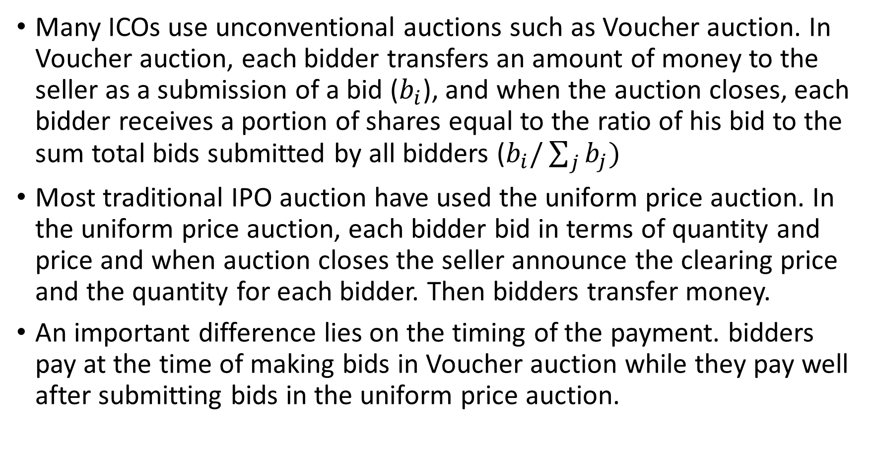
Voucher auction vs. uniform price auction
Many ICOs use unconventional auctions such as Voucher auction. In Voucher auction, each bidder transfers an amount of money to the seller as a submission of a bid ($b_{i}$), and when the auction closes, each bidder receives a portion of shares equal to the ratio of his bid to the sum total bids submitted by all bidders ($b_{i}/\sum_{j}{b_{j}})$
Most traditional IPO auction have used the uniform price auction. In the uniform price auction, each bidder bid in terms of quantity and price and when auction closes the seller announce the clearing price and the quantity for each bidder. Then bidders transfer money.
An important difference lies on the timing of the payment. bidders pay at the time of making bids in Voucher auction while they pay well after submitting bids in the uniform price auction.

Slide 4
Why is timing of payment important
Suppose ICOs use the uniform price auction. All bidders submit bids and the auction outcome is announced. What if the bidders renege on the auction and refuse to pay?
Since ICOs do not involves a reputable third party, there is no effective way to prevent bidders from reneging
When bidders can renege on the auction, 1) the auction may leave the supply unfulfilled and 2) bidders may submit insincere bids in the first place as they know the bids are non-binding
What if the sellers collects the money upfront in the uniform price auction?

Slide 5
Why is timing of payment important
Suppose ICOs use the uniform price auction and collect the payments at the time of making bids (and return the excessive money to the bidders later). How do the bidders respond to this payment upfront policy?
Again, since ICOs do not involves a reputable third party and the seller (start-up) has almost no reputation, the bidders will be very cautious to bid in such an auction (since the seller may run away with the money).
The cautious bidders will significantly reduce the amount of their bids
When the seller has imperfect reputation and do not use a reputable intermediaries (auctioneers), it is difficult to implement the uniform auction (and any other standard auctions) due to reneging of bidders.
Notes:
The money collected could be the maximum possible amount = equal to the bid in the uniform price auction
or the money collected is proportional to the bid -> the main point does not change.
If the payment amount is not proportional to the bid (maybe fixed amount), then the size of the deposit is important. If it is too big, it discourages the entrance of the bidders, and if it is too small, it will be less effective.

Slide 6
What is special in the Voucher auction
However, In Voucher auction, the bidders know exactly how much money they have to pay even before the auction outcome is determined. Thus, the bidders make the payment upfront without worrying about the probability that the seller fails to return the excessive money.
Important feature is that the amount of payment does not depend on the auction outcome but only on one’s bid. This feature essentially makes the timing of payment irrelevant.
The paper will classifies auctions that shares this property and study revenue implication.
Notes:
There is no money to return in Voucher auction.

Slide 7
Environment of this study
Assumptions
Bidders have no commitment to pay. (bidders may have reasons for reneging)
Sellers have imperfect reputation - Bidders believe that if they pay upfront, the seller can fail to return excessive money with positive probability α.
Sellers commit to the auction rules
The seller can not cheat on the auction rule – information on bids will be made public (unlike Akbarpour and Li)
The seller puts no value on the item. so bidders believe the seller would not fail to deliver the item.
Auctions are renege-free if when bidders are asked to pay their maximum possible payments upfront, their optimal bids do not change from the perfect reputation case.
Notes:
Sellers do not know much about the bidders (this is natural under anonymous environment) but assumes that the bidders have reason for reneging

Slide 8
Static Environment
The main theoretical result in static environment is that all-pay auction is the only symmetric renege-free auction
The proof is omitted here.
Revenue implication
Under risk neutrality, all-pay auction is an optimal auction (Myerson 1981)
In experiments, a common pattern of overbidding is observed.

Slide 9
Dynamic Environment
In dynamic environment there are more renege-free auctions than all-pay auctions. ex) Dutch auction/war of attrition/penny auction…
The main theoretical result in dynamic environment is that renege-free auctions must be pay-per-bid (pay whenever submitting bids) auctions
The proof is omitted here.
Revenue implication
Many pay-per-bid auction known to be have the same expected revenue with standard auctions (Gallice,2016)
Experiment or empirical studies show that bidders over-bid (Caldara, 2012), or suffer from sunk cost fallacy (Augenblick, 2015)
Notes:
The term pay-per-bid auction is recently appears in auction literature (ex. Gallice, 2016)

Slide 10
Static but Divisible item
This environment is closest to ICO auctions
The main theoretical result in this environment is that Voucher auctions is the only renege-free auctions where all pennies have the same purchasing power (the same price for all bidders)
Revenue implications
Not much is known about the equilibrium behavior of voucher auction (documented in Krishna, 2009) - I guess only numerically can be solved
No experimental study about this (As far as I know)

Slide 11
Experimental study
Some questions to investigate
Voucher auctions
Is overbidding observed as in all-pay auction?
Uniform price auctions with non-binding bids
How often the shares are unfulfilled
How often bidders submit insincere bids?
Which auction format earns more revenue? (practitioner's view point)

Slide 12
Experimental design (tentative)
Three treatments
Voucher auction, uniform price auction (non-binding bid), uniform price auction (binding bid, as a control)
Three to five bidders in each auction. (as in many previous studies)
Compare market price of shares, seller’s revenue, bidding behaviors.

