Slide 1
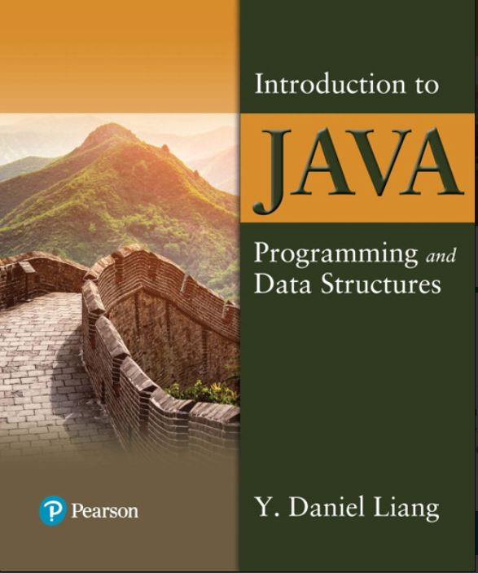

Introduction to Java Programming and Data Structures
Twelfth Edition
Chapter 4
Mathematical Functions, Characters, and Strings
Copyright © 2020 Pearson Education, Inc. All Rights Reserved
Notes:
If this PowerPoint presentation contains mathematical equations, you may need to check that your computer has the following installed:
1) MathType Plugin
2) Math Player (free versions available)
3) NVDA Reader (free versions available)
Slides in this presentation contain hyperlinks. JAWS users should be able to get a list of links by using INSERT+F7

Slide 2
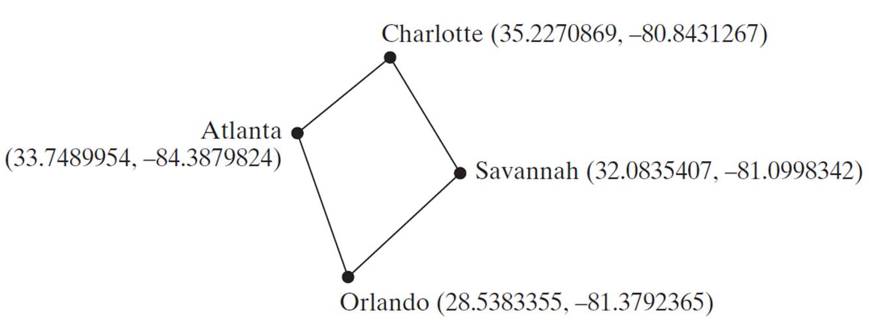
Motivations
Suppose you need to estimate the area enclosed by four cities, given the G P S locations (latitude and longitude) of these cities, as shown in the following diagram. How would you write a program to solve this problem? You will be able to write such a program after completing this chapter.
Notes:
Charlotte left parenthesis 35.2270869 to 80.8431267 right parenthesis
Savannah left parenthesis 32.0835407 to 81.0998342 right parenthesis
Orlando left parenthesis 28.5383355 to 81.3792365 right parenthesis
Atlanta left parenthesis 33.7489954 to 84.3879824 right parenthesis

Slide 3
Objectives (1 of 2)
4.1 To solve mathematics problems by using the methods in the Math class (§4.2).
4.2 To represent characters using the char type (§4.3).
4.3 To encode characters using A S C I I and Unicode (§4.3.1).
4.4 To represent special characters using the escape sequences (§4.4.2).
4.5 To cast a numeric value to a character and cast a character to an integer (§4.3.3).
4.6 To compare and test characters using the static methods in the Character class (§4.3.4).
4.7 To introduce objects and instance methods (§4.4).
4.8 To represent strings using the String objects (§4.4).
4.9 To return the string length using the length() method (§4.4.1).
4.10 To return a character in the string using the charAt(i) method (§4.4.2).
4.11 To use the + operator to concatenate strings (§4.4.3).

Slide 4
Objectives (2 of 2)
4.12 To read strings from the console (§4.4.4).
4.13 To read a character from the console (§4.4.5).
4.14 To compare strings using the equals method and the compareTo methods (§4.4.6).
4.15 To obtain substrings (§4.4.7).
4.16 To find a character or a substring in a string using the indexOf method (§4.4.8).
4.17 To program using characters and strings (GuessBirthday) (§4.5.1).
4.18 To convert a hexadecimal character to a decimal value (HexDigit2Dec) (§4.5.2).
4.19 To revise the lottery program using strings (LotteryUsingStrings) (§4.5.3).
4.20 To format output using the System.out.printf method (§4.6).

Slide 5
Mathematical Functions
Java provides many useful methods in the Math class for performing common mathematical functions.

Slide 6
The Math Class
Class constants:
PI
E
Class methods:
Trigonometric Methods
Exponent Methods
Rounding Methods
min, max, abs, and random Methods

Slide 7
Trigonometric Methods
sin(double a)
cos(double a)
tan(double a)
acos(double a)
asin(double a)
atan(double a)
Examples:
Math.sin(0) returns 0.0
Math.sin(Math.PI / 6) returns 0.5
Math.sin(Math.PI / 2) returns 1.0
Math.cos(0) returns 1.0
Math.cos(Math.PI / 6) returns 0.866
Math.cos(Math.PI / 2) returns 0
Radians
toRadians(90)

Slide 8
Exponent Methods
exp(double a)
Returns e raised to the power of a.
log(double a)
Returns the natural logarithm of a.
log10(double a)
Returns the 10-based logarithm of a.
pow(double a, double b)
Returns a raised to the power of b.
sqrt(double a)
Returns the square root of a.
Examples:
Math.exp(1) returns 2.71
Math.log(2.71) returns 1.0
Math.pow(2, 3) returns 8.0
Math.pow(3, 2) returns 9.0
Math.pow(3.5, 2.5) returns 22.91765
Math.sqrt(4) returns 2.0
Math.sqrt(10.5) returns 3.24

Slide 9
Rounding Methods
double ceil(double x)
x rounded up to its nearest integer. This integer is returned as a double value.
double floor(double x)
x is rounded down to its nearest integer. This integer is returned as a double value.
double rint(double x)
x is rounded to its nearest integer. If x is equally close to two integers, the even one is returned as a double.
int round(float x)
Return (int)Math.floor(x+0.5).
long round(double x)
Return (long)Math.floor(x+0.5).

Slide 10
Rounding Methods Examples
Math.ceil(2.1) returns 3.0
Math.ceil(2.0) returns 2.0
Math.ceil(-2.0) returns –2.0
Math.ceil(-2.1) returns -2.0
Math.floor(2.1) returns 2.0
Math.floor(2.0) returns 2.0
Math.floor(-2.0) returns –2.0
Math.floor(-2.1) returns -3.0
Math.rint(2.1) returns 2.0
Math.rint(2.0) returns 2.0
Math.rint(-2.0) returns –2.0
Math.rint(-2.1) returns -2.0
Math.rint(2.5) returns 2.0
Math.rint(-2.5) returns -2.0
Math.round(2.6f) returns 3
Math.round(2.0) returns 2
Math.round(-2.0f) returns -2
Math.round(-2.6) returns -3

Slide 11
min, max, and abs
max(a, b) and min(a, b)
Returns the maximum or minimum of two parameters.
abs(a)
Returns the absolute value of the parameter.
random()
Returns a random double value in the range [0.0, 1.0).
Examples:
Math.max(2, 3) returns 3
Math.max(2.5, 3) returns 3.0
Math.min(2.5, 3.6) returns 2.5
Math.abs(-2) returns 2
Math.abs(-2.1) returns 2.1

Slide 12
The random Method
Generates a random double value greater than or equal to 0.0 and less than 1.0 (0 <= Math.random() < 1.0).
Examples:
In general,
Notes:
Math.random left parenthesis right parenthesis times 10 right parenthesis. From this equation, an arrow points to Returns a random integer between 0 and 9.
50 + left parenthesis int right parenthesis left parenthesis Math.random left parenthesis right parenthesis times 50 right parenthesis. From this equation, an arrow points to Returns a random integer between 50 and 99.

Slide 13
Case Study: Computing Angles of a Triangle
Write a program that prompts the user to enter the x- and y-coordinates of the three corner points in a triangle and then displays the triangle’s angles.
ComputeAngles
Notes:
The left angle is labeled as Angle A with its vertices x 1, y 1. The top angle is labeled as Angle B with its vertices x 2, y 2. The angle on the right side is labeled as Angle C with its vertices x 3, y 3. The sides between angle A and angle B is labeled as c. The side between angle A and angle C is labeled as b. The side between angle B and angle C is labeled as a. The three equations along the triangle are,
A = a cos left parenthesis left parenthesis a times a minus b times b minus c times c right parenthesis over left parenthesis negative 2 times b times c right parenthesis right parenthesis.
B = a cos left parenthesis left parenthesis b times b minus a times a minus c times c right parenthesis over left parenthesis negative 2 times a times c right parenthesis right parenthesis.
C = a cos left parenthesis left parenthesis c times c minus b times b minus a times a right parenthesis over left parenthesis negative 2 times a times b right parenthesis right parenthesis.
ComputeAngles: https://liveexample.pearsoncmg.com/html/ComputeAngles.html

Slide 14
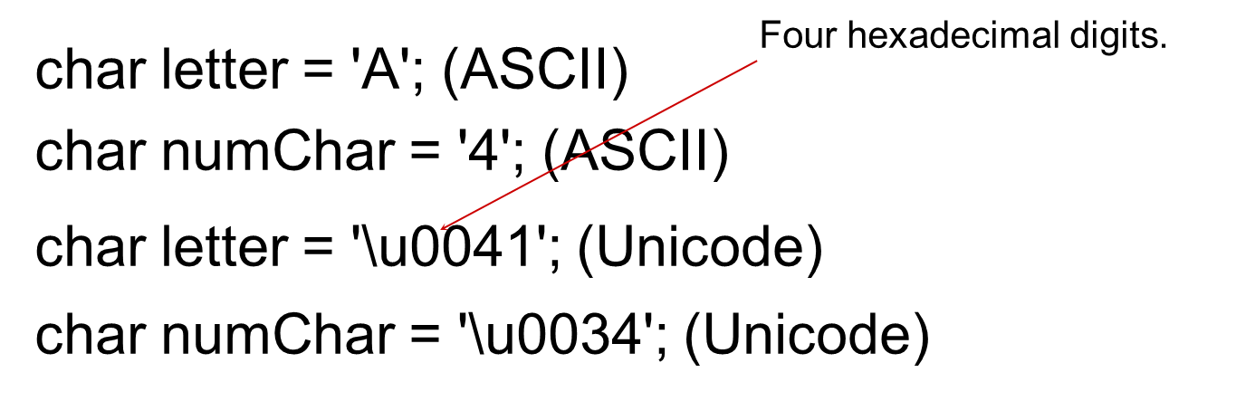
Character Data Type
NOTE: The increment and decrement operators can also be used on char variables to get the next or preceding Unicode character. For example, the following statements display character b.
char ch = 'a';
System.out.println(++ch);

Slide 15
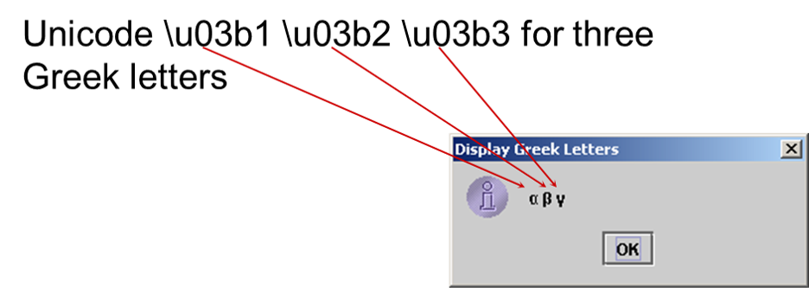
Unicode Format
Java characters use Unicode, a 16-bit encoding scheme established by the Unicode Consortium to support the interchange, processing, and display of written texts in the world’s diverse languages. Unicode takes two bytes, preceded by \u, expressed in four hexadecimal numbers that run from '\u0000' to '\uFFFF'. So, Unicode can represent 65535 + 1 characters.

Slide 16
A S C I I Code for Commonly Used Characters
Characters | Code Value in Decimal | Unicode Value
'0' to '9' | 48 to 57 | \u0030 to \u0039
'A' to 'Z' | 65 to 90 | \u0041 to \u005A
'a' to 'z' | 97 to 122 | \u0061 to \u007A

Slide 17
Escape Sequences for Special Characters
Escape Sequence | Name | Unicode Code | Decimal Value
\b | Backspace | \u0008 | 8
\t | Tab | \u0009 | 9
\n | Linefeed | \u000A | 10
\f | Formfeed | \u000C | 12
\r | Carriage Return | \u000D | 13
\\ | Backslash | \u005C | 92
\” | Double Quote | \u0022 | 34

Slide 18
Appendix B: A S C I I Character Set (1 of 2)
A S C I I Character Set is a subset of the Unicode from \u0000 to \u007f
TABLE B.1 A S C I I Character Set in the Decimal Index
Blank | 0 | 1 | 2 | 3 | 4 | 5 | 6 | 7 | 8 | 9
0 | nul | soh | stx | etx | eot | enq | ack | bel | bs | ht
1 | nl | vt | ff | cr | so | si | dle | dcl | dc2 | dc3
2 | dc4 | nak | syn | etb | can | em | sub | esc | fs | gs
3 | rs | us | sp | ! | “ | # | $ | % | & | ‘
4 | ( | ) | * | + | , | - | . | / | 0 | 1
5 | 2 | 3 | 4 | 5 | 6 | 7 | 8 | 9 | : | ;
6 | < | = | > | ? | @ | A | B | C | D | E
7 | F | G | H | I | J | K | L | M | N | O
8 | P | Q | R | S | T | U | V | W | X | Y
9 | Z | [ | \ | ] | ^ | _ | ` | a | b | c
10 | d | e | f | g | h | i | j | k | l | m
11 | n | o | p | q | r | s | t | u | v | w
12 | x | y | z | { | | | } | ~ | del | Blank | Blank

Slide 19
Appendix B: A S C I I Character Set (2 of 2)
A S C I I Character Set is a subset of the Unicode from \u0000 to \u007f
TABLE B.2 A S C I I Character Set in the Hexadecimal Index
Blank | 0 | 1 | 2 | 3 | 4 | 5 | 6 | 7 | 8 | 9 | A | B | C | D | E | F
0 | nul | soh | stx | etx | eot | enq | ack | bel | bs | ht | nl | vt | ff | cr | so | si
1 | dle | dcl | dc2 | dc3 | dc4 | nak | syn | etb | can | em | sub | esc | fs | gs | rs | us
2 | sp | ! | “ | # | $ | % | & | ‘ | ( | ) | * | + | , | - | . | /
3 | 0 | 1 | 2 | 3 | 4 | 5 | 6 | 7 | 8 | 9 | : | ; | < | = | > | ?
4 | @ | A | B | C | D | E | F | G | H | I | J | K | L | M | N | O
5 | P | Q | R | S | T | U | V | W | X | Y | Z | [ | \ | ] | ^ | _
6 | ‘ | a | b | c | d | e | f | g | h | i | j | k | l | m | n | o
7 | p | q | r | s | t | u | v | w | x | y | z | { | | | } | ~ | del

Slide 20
Casting between char and Numeric Types
int i = 'a'; // Same as int i = (int)'a';
char c = 97; // Same as char c = (char)97;

Slide 21
Comparing and Testing Characters
if (ch >= 'A' && ch <= 'Z')
System.out.println(ch + " is an uppercase letter");
else if (ch >= 'a' && ch <= 'z')
System.out.println(ch + " is a lowercase letter");
else if (ch >= '0' && ch <= '9')
System.out.println(ch + " is a numeric character");

Slide 22
Methods in the Character Class
Method | Description
isDigit(ch) | Returns true if the specified character is a digit.
isLetter(ch) | Returns true if the specified character is a letter.
isLetterOfDigit(ch) | Returns true if the specified character is a letter or digit.
isLowerCase(ch) | Returns true if the specified character is a lowercase letter.
isUpperCase(ch) | Returns true if the specified character is an uppercase letter.
toLowerCase(ch) | Returns the lowercase of the specified character.
toUpperCase(ch) | Returns the uppercase of the specified character.

Slide 23
The String Type
The char type only represents one character. To represent a string of characters, use the data type called String. For example,
String message = "Welcome to Java";
String is actually a predefined class in the Java library just like the System class and Scanner class. The String type is not a primitive type. It is known as a reference type. Any Java class can be used as a reference type for a variable. Reference data types will be thoroughly discussed in Chapter 9, “Objects and Classes.” For the time being, you just need to know how to declare a String variable, how to assign a string to the variable, how to concatenate strings, and to perform simple operations for strings.

Slide 24
Simple Methods for String Objects (1 of 2)
Method | Description
length() | Returns the number of characters in this string.
charAt(index) | Returns the character at the specified index from this string.
concat(s1) | Returns a new string that concatenates this string with string s1.
toUpperCase() | Returns a new string with all letters in uppercase.
toLowerCase() | Returns a new string with all letters in lowercase.
trim() | Returns a new string with whitespace characters trimmed on both sides.

Slide 25
Simple Methods for String Objects (2 of 2)
Strings are objects in Java. The methods in the preceding table can only be invoked from a specific string instance. For this reason, these methods are called instance methods. A non-instance method is called a static method. A static method can be invoked without using an object. All the methods defined in the Math class are static methods. They are not tied to a specific object instance. The syntax to invoke an instance method is
referenceVariable.methodName(arguments).

Slide 26
Getting String Length
String message = "Welcome to Java";
System.out.println("The length of " + message + " is "
+ message.length());

Slide 27
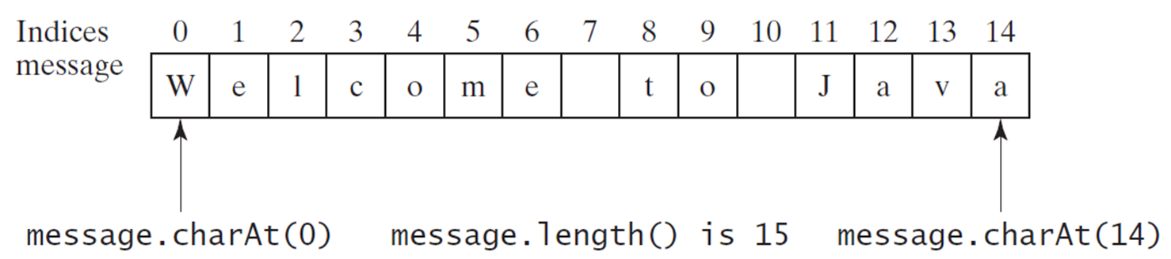
Getting Characters from a String
String message = "Welcome to Java";
System.out.println("The first character in message is "
+ message.charAt(0));
Notes:
A row of numbers are placed above a table with single row and 15 columns. The numbers are labeled as Indices, and the row shows the message. The numbers and their respective text in the row are,
0, W in upper case
1, e in lower case
2, l in lower case
3, c in lower case
4, o in lower case
5, m in lower case
6, e in lower case
7, blank
8, t in lower case
9, o in lower case
10, blank
11, J in upper case
12, a in lower case
13, v in lower case
14, a in lower case
W is labeled as message.charAt left parenthesis 0 right parenthesis
message. length left parenthesis right parenthesis is 15.
The last a of Java is labeled message.charAt left parenthesis 14 right parenthesis.

Slide 28
Converting Strings
"Welcome".toLowerCase() returns a new string, welcome.
"Welcome".toUpperCase() returns a new string, WELCOME.
" Welcome ".trim() returns a new string, Welcome.

Slide 29
String Concatenation
String s3 = s1.concat(s2); or String s3 = s1 + s2;
// Three strings are concatenated
String message = "Welcome " + "to " + "Java";
// String Chapter is concatenated with number 2
String s = "Chapter" + 2; // s becomes Chapter2
// String Supplement is concatenated with character B
String s1 = "Supplement" + 'B'; // s1 becomes SupplementB

Slide 30
Reading a String From the Console
Scanner input = new Scanner(System.in);
System.out.print("Enter three words separated by spaces: ");
String s1 = input.next();
String s2 = input.next();
String s3 = input.next();
System.out.println("s1 is " + s1);
System.out.println("s2 is " + s2);
System.out.println("s3 is " + s3);

Slide 31
Reading a Character From the Console
Scanner input = new Scanner(System.in);
System.out.print("Enter a character: ");
String s = input.nextLine();
char ch = s.charAt(0);
System.out.println("The character entered is " + ch);

Slide 32
Comparing Strings
Method | Description
equals(s1) | Returns true if this string is equal to string s1.
equalsIgnoreCase(s1) | Returns true if this string is equal to string s1; it is case insensitive.
compareTo(s1) | Returns an integer greater than 0, equal to 0, or less than 0 to indicate whether this string is greater than, equal to, or less than s1.
compareToIgnoreCase(s1) | Same as compareTo except that the comparison is case insensitive.
startsWith(prefix) | Returns true if this string starts with the specified prefix.
endsWith(suffix) | Returns true if this string ends with the specified suffix.
OrderTwoCities

Slide 33
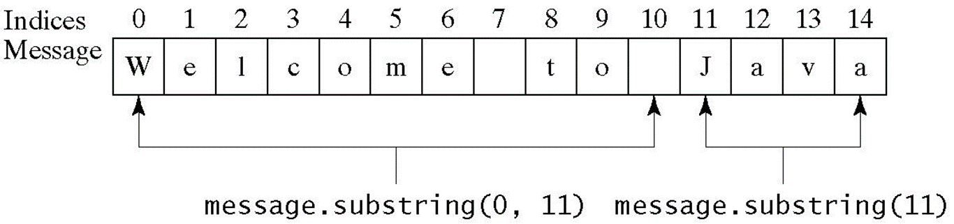
Obtaining Substrings
Method | Description
substring(beginIndex) | Returns this string’s substring that begins with the character at the specified beginIndex and extends to the end of the string, as shown in Figure 4.2.
substring(beginIndex, endIndex) | Returns this string’s substring that begins at the specified beginIndex and extends to the character at index endIndex – 1, as shown in Figure 9.6. Note that the character at endIndex is not part of the substring.
Notes:
The numbers are labeled as Indices, and the row shows the message. The numbers and their respective text in the row are,
0, W in upper case
1, e in lower case
2, l in lower case
3, c in lower case
4, o in lower case
5, m in lower case
6, e in lower case
7, blank
8, t in lower case
9, o in lower case
10, blank
11, J in upper case
12, a in lower case
13, v in lower case
14, a in lower case
The area from W of Welcome up to the blank box before Java is labeled as message. substring left parenthesis 0, 11 right parenthesis.
The area from J of Java to the last a of Java is labeled message.substring left parenthesis 11 right parenthesis.

Slide 34
Finding a Character or a Substring in a String (1 of 2)
Method | Description
indexOf(ch) | Returns the index of the first occurrence of ch in the string. Returns -1 if not matched.
indexOf(ch, fromIndex) | Returns the index of the first occurrence of ch after fromIndex in the string. Returns -1 if not matched.
indexOf(s) | Returns the index of the first occurrence of string s in this string. Returns -1 if not matched.
indexOf(s, fromIndex) | Returns the index of the first occurrence of string s in this string after fromIndex. Returns -1 if not matched.
lastIndexOf(ch) | Returns the index of the last occurrence of ch in the string. Returns -1 if not matched.
lastIndexOf(ch, fromIndex) | Returns the index of the last occurrence of ch before fromIndex in this string. Returns -1 if not matched.
lastIndexOf(s) | Returns the index of the last occurrence of string s. Returns -1 if not matched.
lastIndexOf(s, fromIndex) | Returns the index of the last occurrence of string s before fromIndex. Returns -1 if not matched.

Slide 35
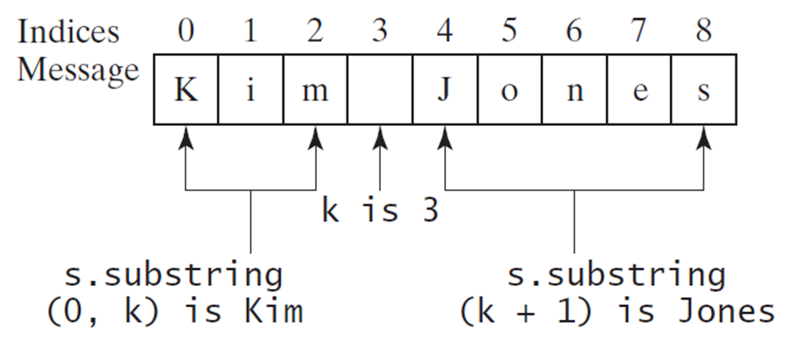
Finding a Character or a Substring in a String (2 of 2)
int k = s.indexOf(' ');
String firstName = s.substring(0, k);
String lastName = s.substring(k + 1);
Notes:
It shows a series of numbers from 0 to 8, labeled Indices. These numbers are above a row of letters with multiple columns. This row is labeled Message.
0, K in upper case
1, I in lower case
2, m in lower case
3, blank
4, J in upper case
5, o in lower case
6, n in lower case
7, e in lower case
8, s in lower case
Kim is labeled as s.substring left parenthesis 0, k right parenthesis is Kim. The blank box between Kim and Jones is labeled as k is 3. Jones is labeled as s.substring left parenthesis 0, k + 1 right parenthesis is Jones.

Slide 36
Conversion between Strings and Numbers
int intValue = Integer.parseInt(intString);
double doubleValue = Double.parseDouble(doubleString);
String s = number + "";

Slide 37
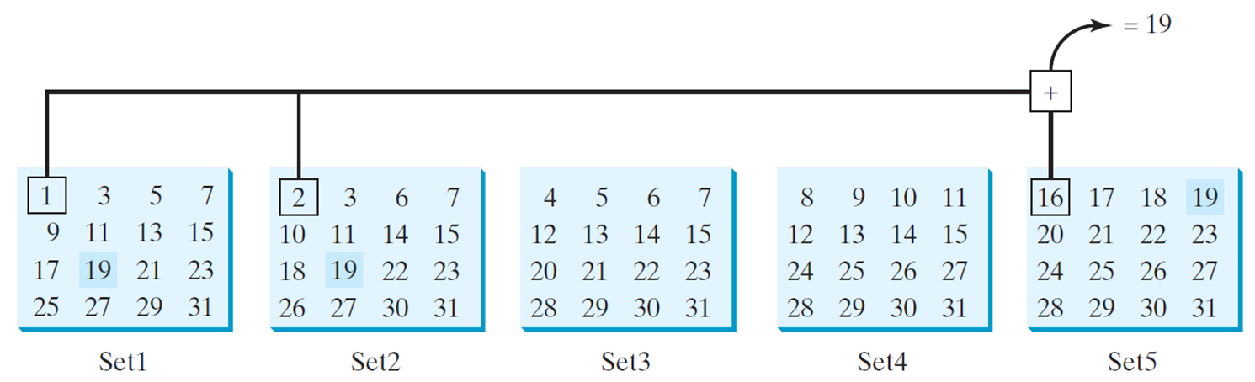
Problem: Guessing Birthday
The program can guess your birth date. Run to see how it works.
GuessBirthday
Notes:
Set 1. Row 1. 1, 3, 5, 7. Row 2. 9, 11, 13, 15. Row 3. 17, 19, 21, 23. Row 4. 25, 27, 29, 31.
Set 2. Row 1. 2, 3, 6, 7. Row 2. 10, 11, 14, 15. Row 3. 18, 19, 22, 23. Row 4. 26, 27, 30, 31.
Set 3. Row 1. 4, 5, 6, 7. Row 2. 12, 13, 14, 15. Row 3. 20, 21, 22, 23. Row 4. 28, 29, 30, 31.
Set 4. Row 1. 8, 9, 10, 11. Row 2. 12, 13, 14, 15. Row 3. 24, 25, 26, 27. Row 4. 28, 29, 30, 31.
Set 5. Row 1. 16, 17, 18, 19. Row 2. 20, 21, 22, 23. Row 3. 24, 25, 26, 27. Row 4. 28, 29, 30, 31.
A line connecting first element of set 1, set 2, and set 5 is labeled, = 19.

Slide 38
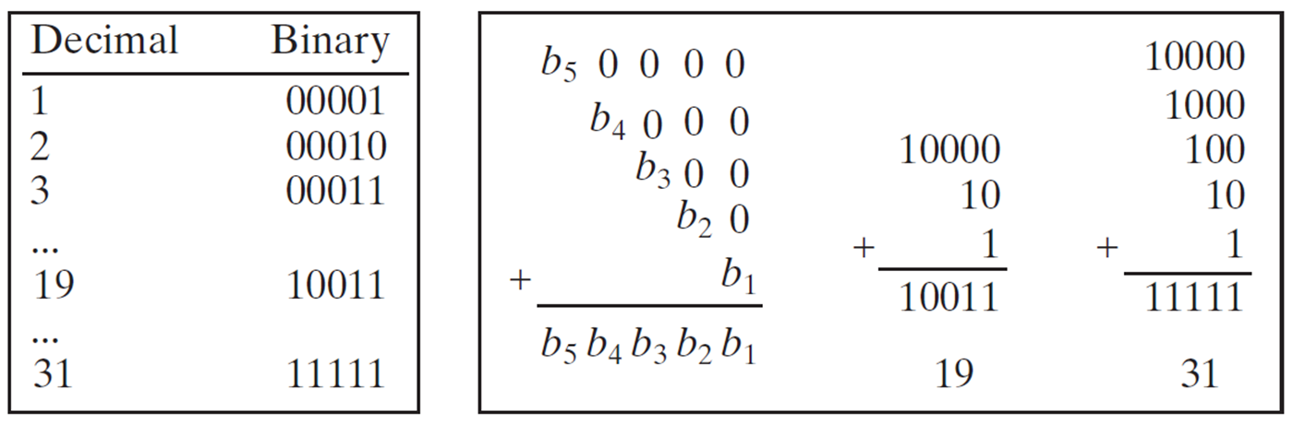
Mathematics Basis for the Game
19 is 10011 in binary. 7 is 111 in binary. 23 is 11101 in binary
Notes:
10000 in the first row, 10 aligned to right in the second row, and 1 aligned to the right in the third row. The sum is 10011. 19 is written below the addition.
00110 in the first row, 10 aligned to right in the second row, and 1 aligned to the right in the third row. The sum is 00111. 7 is written below the addition.
10000 in the first row, 1000 aligned to right in the second row, 100 aligned to the right in the third row, and 1 aligned to right in the fourth row. The sum is 11101. 23 is written below the addition.
There are two columns with headings Decimal, and Binary.
Row 1. Decimal, 1. Binary, 00001.
Row 2. Decimal, 2. Binary, 00010.
Row 3. Decimal, 3. Binary, 00011.
Row 4. Decimal, ellipses. Binary, blank.
Row 5. Decimal, 19. Binary, 10011.
Row 6. Decimal, ellipses. Binary, blank.
Row 7. Decimal, 31. Binary, 11111.
Row 1. b sub 5 0 0 0 0.
Row 2. blank b sub 4 0 0 0.
Row 3. blank blank b sub 3 0 0.
Row 4. blank blank blank b sub 2 0.
Row 5. blank blank blank blank b sub 1.
When all the five rows are added together, the sum is b sub 5 b sub 4 b sub 3 b sub 2 b sub 1.
When adding 10000, 10, and 1, the sum is 10011. Below it 19 is written.
When adding 10000, 1000, 100, 10, and 1, the sum is 11111. 31 is written below the sum.

Slide 39
Case Study: Converting a Hexadecimal Digit to a Decimal Value
Write a program that converts a hexadecimal digit into a decimal value.
HexDigit2Dec
Notes:
HexDigit2Dec: https://liveexample.pearsoncmg.com/html/HexDigit2Dec.html

Slide 40
Case Study: Revising the Lottery Program Using Strings
A problem can be solved using many different approaches. This section rewrites the lottery program in Listing 3.7 using strings. Using strings simplifies this program.
LotteryUsingStrings
Notes:
LotteryUsingStrings: https://liveexample.pearsoncmg.com/html/HexDigit2Dec.html

Slide 41
Formatting Output
Use the printf statement.
System.out.printf(format, items);
Where format is a string that may consist of substrings and format specifiers. A format specifier specifies how an item should be displayed. An item may be a numeric value, character, boolean value, or a string. Each specifier begins with a percent sign.

Slide 42
Frequently-Used Specifiers
Specifier | Output | Example
%b | a boolean value | true or false
%c | a character | 'a'
%d | a decimal integer | 200
%f | a floating-point number | 45.460000
%e | a number in standard scientific notation | 4.556000e+01
%s | a string | "Java is cool"
Notes:
double amount = 45.56;
System.out.print left parenthesis double quotes count is percent symbol d and amount is percent symbol f double quotes, count, amount right parenthesis;
Count and amount are labeled as items. The text from percent symbol d to count is labeled as display. The text from percent symbol f to amount is labeled as count is 5 and amount is 45.560000.

Slide 43
FormatDemo
The example gives a program that uses printf to display a table.
FormatDemo

Slide 44

Copyright
This work is protected by United States copyright laws and is provided solely for the use of instructors in teaching their courses and assessing student learning. Dissemination or sale of any part of this work (including on the World Wide Web) will destroy the integrity of the work and is not permitted. The work and materials from it should never be made available to students except by instructors using the accompanying text in their classes. All recipients of this work are expected to abide by these restrictions and to honor the intended pedagogical purposes and the needs of other instructors who rely on these materials.

