Slide 1
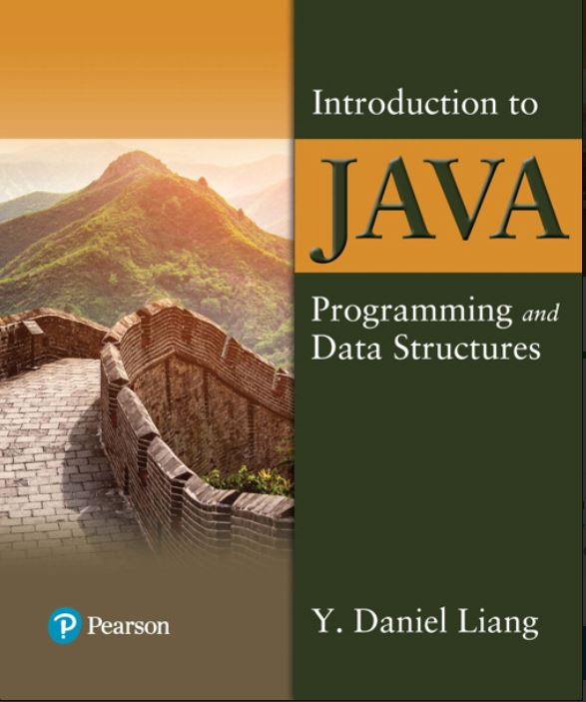

Introduction to Java Programming and Data Structures
Twelfth Edition
Chapter 19
Generics
Copyright © 2020 Pearson Education, Inc. All Rights Reserved
Notes:
If this PowerPoint presentation contains mathematical equations, you may need to check that your computer has the following installed:
1) MathType Plugin
2) Math Player (free versions available)
3) NVDA Reader (free versions available)
Slides in this presentation contain hyperlinks. JAWS users should be able to get a list of links by using INSERT+F7

Slide 2
Objectives
19.1 To know the benefits of generics (§19.1).
19.2 To use generic classes and interfaces (§19.2).
19.3 To declare generic classes and interfaces (§19.3).
19.4 To understand why generic types can improve reliability and readability (§19.3).
19.5 To declare and use generic methods and bounded generic types (§19.4).
19.6 To use raw types for backward compatibility (§19.5).
19.7 To know wildcard types and understand why they are necessary (§19.6).
19.8 To convert legacy code using J D K 1.5 generics (§19.7).
19.9 To understand that generic type information is erased by the compiler and all instances of a generic class share the same runtime class file (§19.8).
19.10 To know certain restrictions on generic types caused by type erasure (§19.8).
19.11 To design and implement generic matrix classes (§19.9).

Slide 3
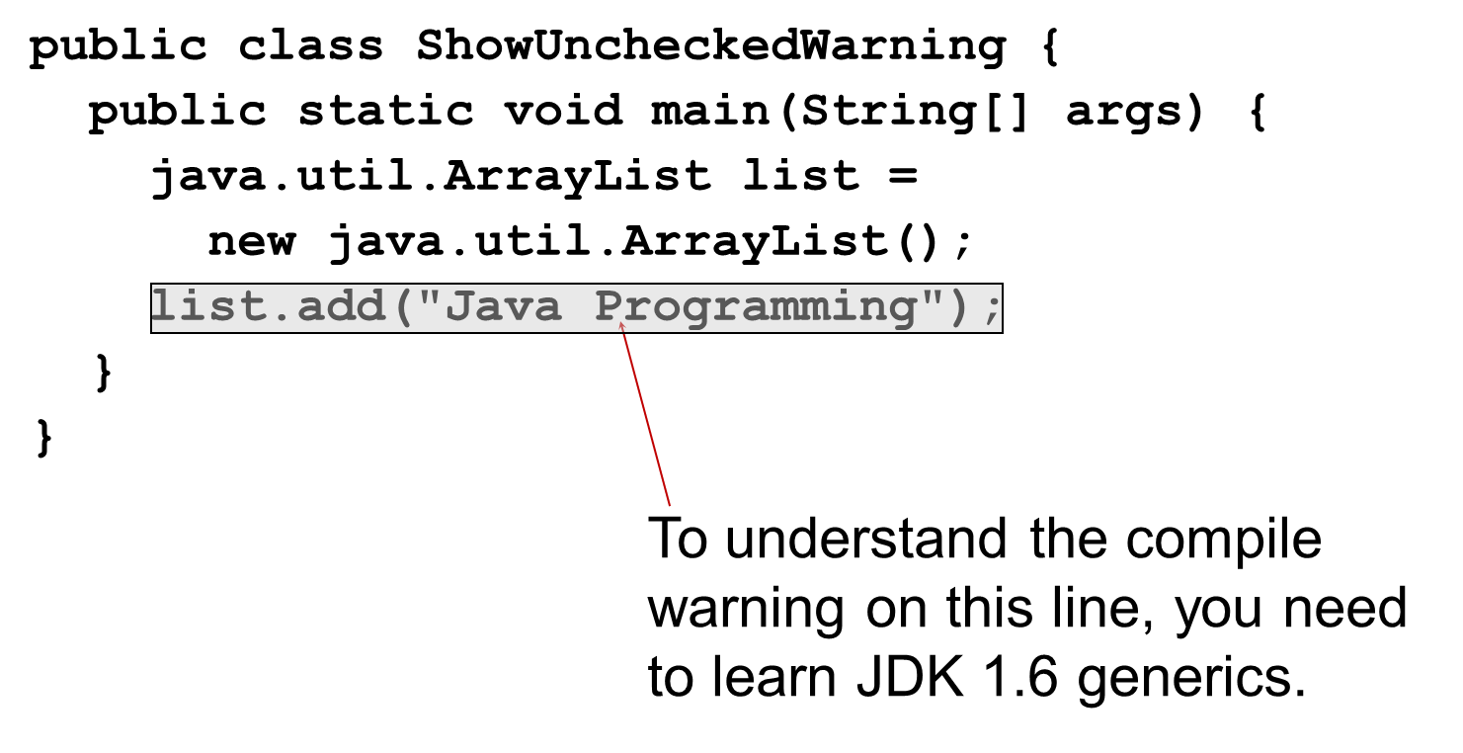
Why Do You Get a Warning?
Notes:
public static void main left parenthesis String left bracket right bracket args right parenthesis left brace
java.util.ArrayList list =
new java.util.ArrayList left parenthesis right parenthesis semicolon
list.add left parenthesis start quotation marks Java Programming end quotation marks right parenthesis semi colon
right brace
right brace
The code line, list.add left parenthesis start quotation marks Java Programming end quotation marks right parenthesis semi colon, is labeled, to understand the compile warning on this line, you need to learn J D K 1.6 generics.

Slide 4
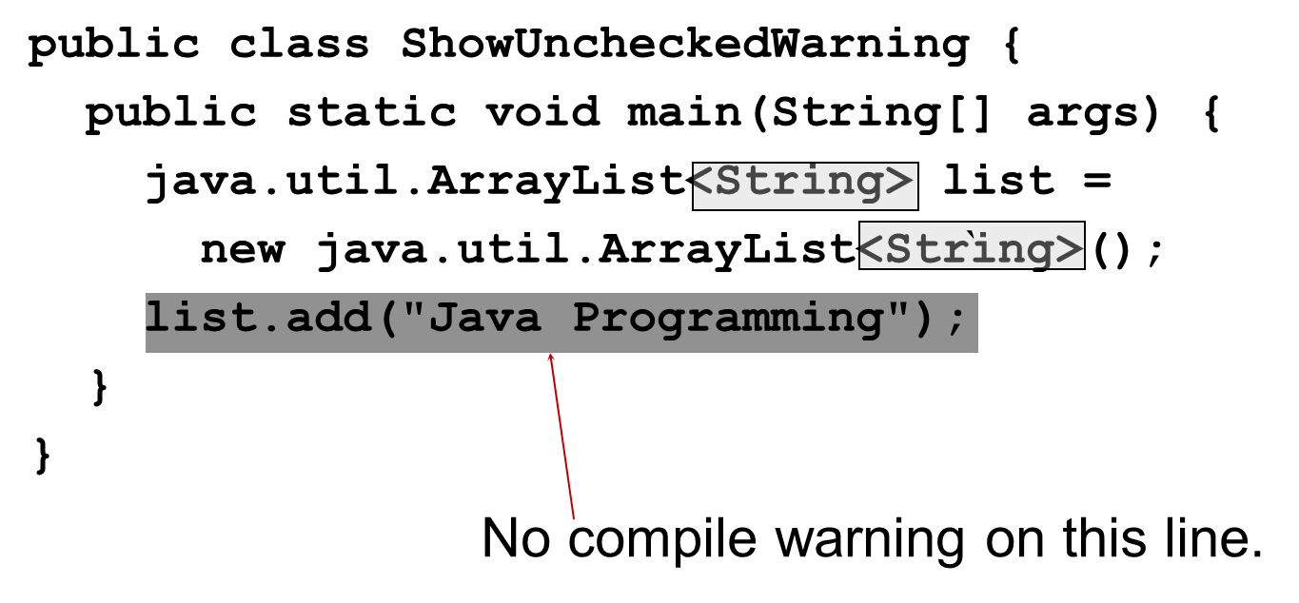
Fix the Warning
Notes:
public class ShowUncheckedWarning left brace
public static void main left parenthesis String left bracket right bracket args right parenthesis left brace
java.util.ArrayList less than symbol String greater than symbol list = (String is highlighted)
new java.util.ArrayList less than symbol String greater than sy left parenthesis right parenthesis semi colon (String is highlighted)
list.add left parenthesis start double quotation marks Java Programming end double quotation marks right parenthesis semi colon
right brace
right brace
The last row of code block is labeled, No compile warning on this line.

Slide 5
What Is Generics?
Generics is the capability to parameterize types. With this capability, you can define a class or a method with generic types that can be substituted using concrete types by the compiler. For example, you may define a generic stack class that stores the elements of a generic type. From this generic class, you may create a stack object for holding strings and a stack object for holding numbers. Here, strings and numbers are concrete types that replace the generic type.

Slide 6
Why Generics?
The key benefit of generics is to enable errors to be detected at compile time rather than at runtime. A generic class or method permits you to specify allowable types of objects that the class or method may work with. If you attempt to use the class or method with an incompatible object, a compile error occurs.

Slide 7
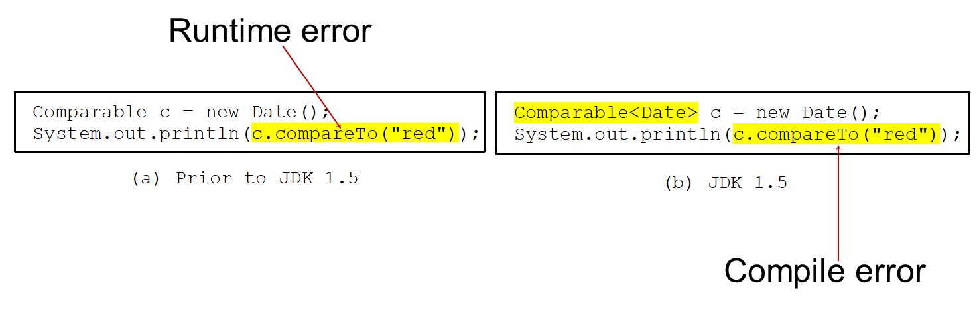
Generic Type
Generic Instantiation
Improves reliability
Notes:
(a) Prior to J D K 1.5.
package java.lang semi colon
public interface comparable left brace
public int compareTo left parenthesis Object o right parenthesis
right brace
(b) J D K 1.5.
package java.lang semi colon
public interface comparable less than symbol T greater than symbol left brace
public int compareTo left parenthesis T o right parenthesis
right brace
(a) Prior to J D K 1.5.
Comparable c = new date left parenthesis right parenthesis semi colon
System.out.println left parenthesis c.compareTo left parenthesis start double quotation marks red end double quotation marks right parenthesis right parenthesis semi colon
The codes c.compareTo left parenthesis start double quotation marks red end double quotation marks right parenthesis are highlighted and labeled, runtime error.
(b) J D K 1.5.
Comparable less than symbol c greater than symbol = new Date left parenthesis right parenthesis semi colon
System.out.println left parenthesis c.compareTo left parenthesis start double quotation marks red end double quotation marks right parenthesis, right parenthesis semi colon
c.compareTo left parenthesis start double quotation marks red end double quotation marks right parenthesis is highlighted and labeled, compile error.

Slide 8
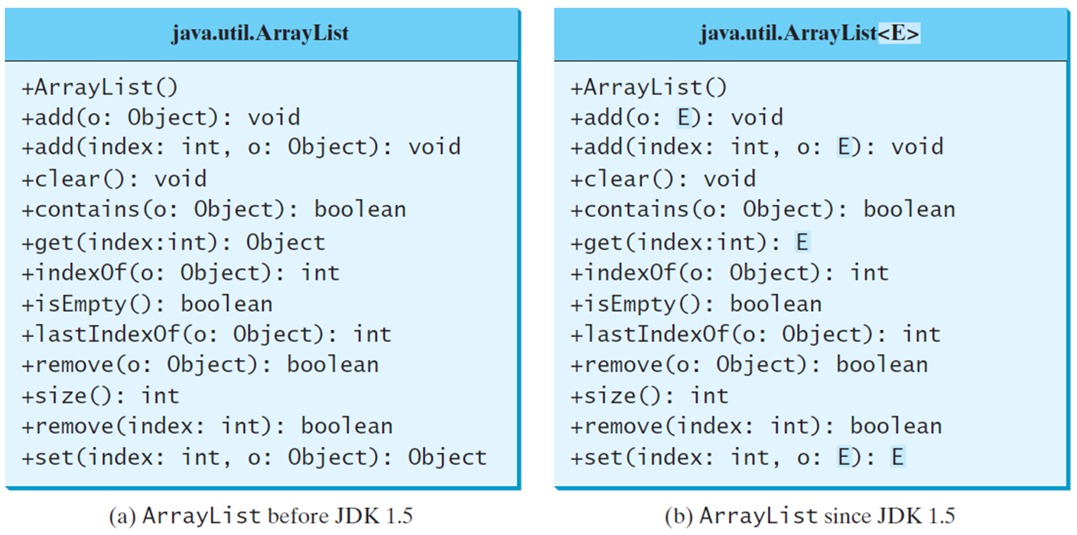
Generic ArrayList in J D K 1.5
Notes:
(a) ArrayList before J D K 1.5. java.util.ArrayList
+ArrayList left parenthesis right parenthesis
+add left parenthesis o colon Object right parenthesis colon void
+add left parenthesis index colon int, o colon Object right parenthesis colon void
+clear left parenthesis right parenthesis colon void
+contains left parenthesis o colon Object right parenthesis colon Boolean
+get left parenthesis index colon int right parenthesis colon Object
+indexOf left parenthesis o colon Object right parenthesis colon int
+isEmpty left parenthesis right parenthesis colon Boolean
+lastIndexOf left parenthesis o colon Object right parenthesis colon int
+remove left parenthesis o colon Object right parenthesis colon Boolean
+size left parenthesis right parenthesis colon int
+remove left parenthesis index colon int right parenthesis colon Boolean
+set left parenthesis index colon int, o colon Object right parenthesis colon Object
(b) ArrayList since J D K 1.5. java.util.ArrayList less than symbol E greater than symbol.
+ArrayList left parenthesis right parenthesis
+add left parenthesis o colon E right parenthesis colon void
+add left parenthesis index colon int, o colon E right parenthesis colon void
+clear left parenthesis right parenthesis colon void
+contains left parenthesis o colon Object right parenthesis colon Boolean
+get left parenthesis index colonint right parenthesis colon E
+indexOf left parenthesis o colon Object right parenthesis colon int
+isEmpty left parenthesis right parenthesis colon boolean
+lastIndexOf left parenthesis o colon Object right parenthesis colon int
+remove left parenthesis o colon Object right parenthesis colon boolean
+size left parenthesis right parenthesis colon int
+remove left parenthesis index colon int right parenthesis colon boolean
+set left parenthesis index colon int, o colon E right parenthesis colon E.

Slide 9
No Casting Needed
ArrayList<Double> list = new ArrayList<>();
list.add(5.5); // 5.5 is automatically converted to new Double(5.5)
list.add(3.0); // 3.0 is automatically converted to new Double(3.0)
Double doubleObject = list.get(0); // No casting is needed
double d = list.get(1); // Automatically converted to double

Slide 10
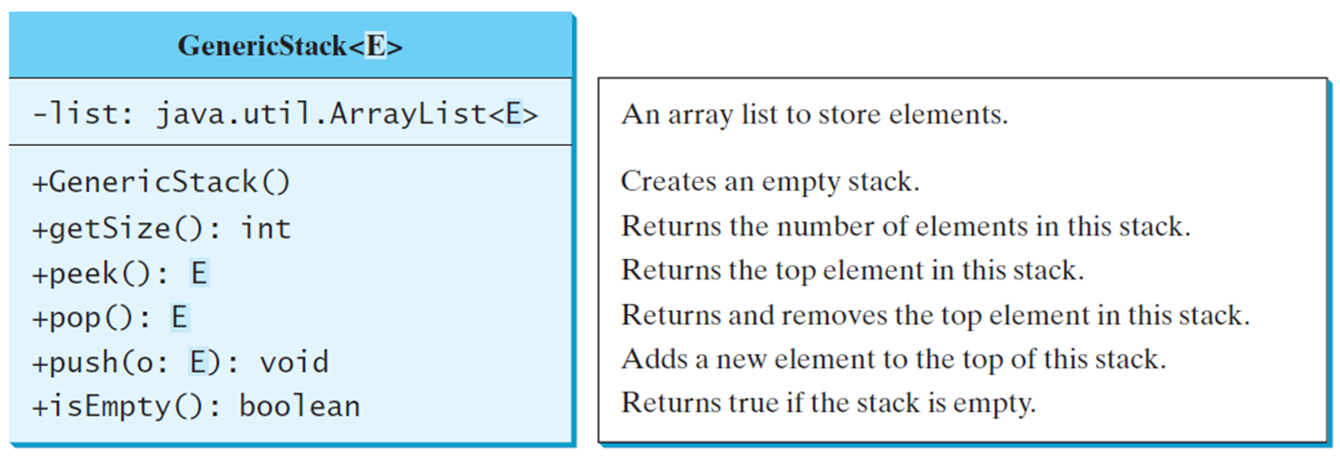
Declaring Generic Classes and Interfaces
GenericStack
Notes:
Row 1. List colon java.util.ArrayList less than symbol E greater than symbol. An array list to store elements.
Row 2. +GenericStack left parenthesis right parenthesis. Creates an empty stack.
Row 3. +getSize left parenthesis right parenthesis colon int. Returns the number of elements in this stack.
Row 4. +peek left parenthesis right parenthesis colon E. Returns the top element in this stack.
Row 5. +pop left parenthesis right parenthesis colon E. Returns and removes the top element in this stack.
Row 6. +push left parenthesis o colon E right parenthesis colon void. Adds a new element to the top of this stack.
Row 7. +isEmpty left parenthesis right parenthesis colon Boolean. Returns true if the stack is empty.
GenericStack: https://liveexample.pearsoncmg.com/html/GenericStack.html

Slide 11
Generic Static Methods
public static <E> void print(E[] list) {
for (int i = 0; i < list.length; i++)
System.out.print(list[i] + " ");
System.out.println();
}
public static void print(Object[] list) {
for (int i = 0; i < list.length; i++)
System.out.print(list[i] + " ");
System.out.println();
}

Slide 12
Bounded Generic Type
public static void main(String[] args ) {
Rectangle rectangle = new Rectangle(2, 2);
Circle circle = new Circle (2);
System.out.println("Same area? " +
equalArea(rectangle, circle));
}
public static <E extends GeometricObject> boolean
equalArea(E object1, E object2) {
return object1.getArea() == object2.getArea();
}

Slide 13
Raw Type and Backward Compatibility
// raw type
ArrayList list = new ArrayList();
This is roughly equivalent to
ArrayList<Object> list = new ArrayList<Object>();

Slide 14
Raw Type Is Unsafe
// Max.java: Find a maximum object
public class Max {
/** Return the maximum between two objects */
public static Comparable max(Comparable o1, Comparable o2) {
if (o1.compareTo(o2) > 0)
return o1;
else
return o2;
}
}
Runtime Error:
Max.max("Welcome", 23); // No compile error

Slide 15
Avoiding Unsafe Raw Types
Use
new ArrayList<ConcreteType>()
Instead of
new ArrayList();
TestArrayListNew
Notes:
TestArrayListNew: https://liveexample.pearsoncmg.com/html/TestArrayListNew.html

Slide 16
Make It Safe
// Max1.java: Find a maximum object
public class Max1 {
/** Return the maximum between two objects */
public static <E extends Comparable<E>> E max(E o1, E o2) {
if (o1.compareTo(o2) > 0)
return o1;
else
return o2;
}
}
Max.max("Welcome", 23);

Slide 17
Wildcards
Why wildcards are necessary? See this example.
WildCardNeedDemo
?
unbounded wildcard
? extends T
bounded wildcard
? super T
lower bound wildcard
AnyWildCardDemo
SuperWildCardDemo
Notes:
WildCardNeedDemo: https://liveexample.pearsoncmg.com/html/WildCardNeedDemo.html
AnyWildCardDemo: https://liveexample.pearsoncmg.com/html/AnyWildCardDemo.html
SuperWildCardDemo: https://liveexample.pearsoncmg.com/html/SuperWildCardDemo.html

Slide 18
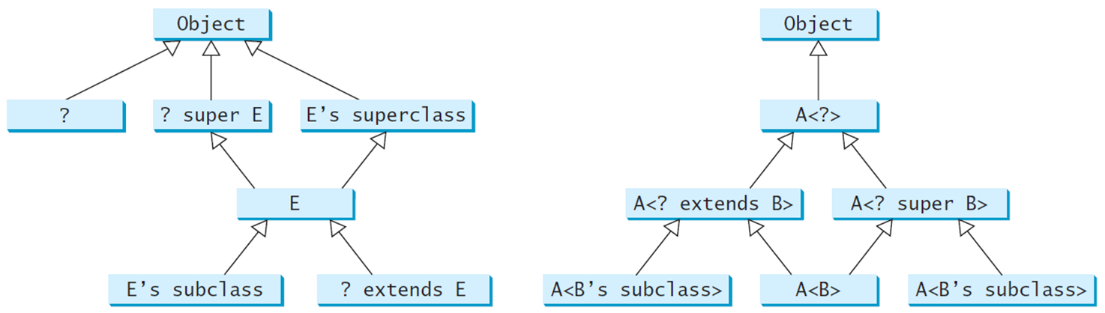
Generic Types and Wildcard Types
Notes:
An arrow each from a question mark, question mark super E, and E's superclass points to Object. Two arrows from E point to question mark super E and E's superclass. An arrow each from E's subclass and question mark extends E points to E.
An arrow from A less than symbol question mark greater than symbol leads to Object. An arrow each from A less than symbol question mark extends B greater than symbol leads to A less than symbol question mark greater than symbol. An arrow each from A less than symbol B's subclass greater than symbol and A less than symbol B greater than symbol leads to A less than symbol question mark extends B greater than symbol. An arrow each from A less than symbol B greater than symbol and A less than symbol B's subclass greater than symbol leads to A less than symbol question mark super B greater than symbol.

Slide 19
Erasure and Restrictions on Generics
Generics are implemented using an approach called type erasure. The compiler uses the generic type information to compile the code, but erases it afterwards. So the generic information is not available at runtime. This approach enables the generic code to be backward-compatible with the legacy code that uses raw types.

Slide 20
Compile Time Checking
For example, the compiler checks whether generics is used correctly for the following code in (a) and translates it into the equivalent code in (b) for runtime use. The code in (b) uses the raw type.
Notes:
(a) ArrayList less than symbol String greater than symbol list = new ArrayList less than symbol greater than symbol left parenthesis right parenthesis semi colon
list.add left parenthesis start double quotation marks Oklahoma end double quotation marks right parenthesis semi colon
String state = list.get left parenthesis 0 right parenthesis semi colon
(b) ArrayList less = new ArrayList left parenthesis right parenthesis semi colon
list.add left parenthesis Oklahoma right parenthesis semi colon
String state = left parenthesis String right parenthesis left parenthesis list.get left parenthesis 0 right parenthesis semi right parenthesis colon

Slide 21
Important Facts
It is important to note that a generic class is shared by all its instances regardless of its actual generic type.
GenericStack<String> stack1 = new GenericStack<>();
GenericStack<Integer> stack2 = new GenericStack<>();
Although GenericStack<String> and GenericStack<Integer> are two types, but there is only one class GenericStack loaded into the J V M.

Slide 22
Restrictions on Generics
Restriction 1: Cannot Create an Instance of a Generic Type. (i.e., new E()).
Restriction 2: Generic Array Creation is Not Allowed. (i.e., new E[100]).
Restriction 3: A Generic Type Parameter of a Class Is Not Allowed in a Static Context.
Restriction 4: Exception Classes Cannot be Generic.

Slide 23
Designing Generic Matrix Classes
Objective: This example gives a generic class for matrix arithmetic. This class implements matrix addition and multiplication common for all types of matrices.
GenericMatrix
Notes:
GenericMatrix: https://liveexample.pearsoncmg.com/html/GenericMatrix.html

Slide 24
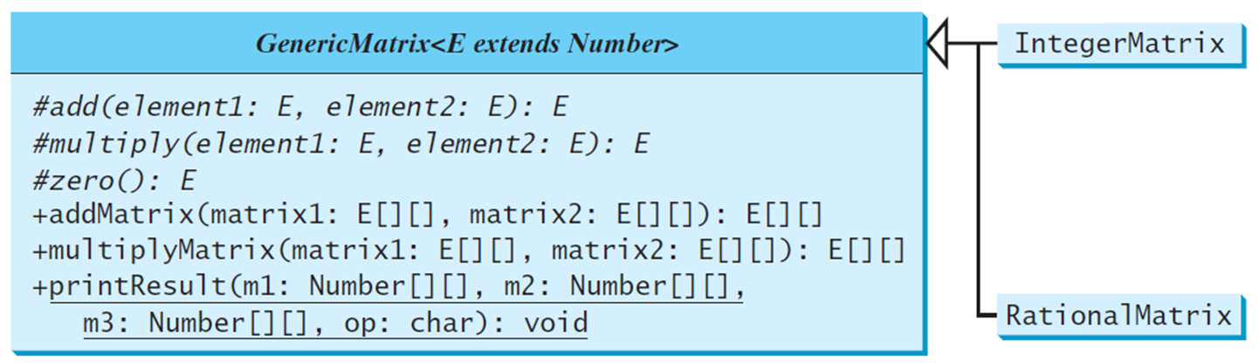
U M L Diagram
Notes:
Hash symbol add left parenthesis element1 colon E, element2 colon E right parenthesis colon E
Hash symbol multiply left parenthesis element1 colon E, element2 colon E right parenthesis colon E
#zero left parenthesis right parenthesis colon E
+addMatrix left parenthesis matrix1 colon E left bracket right bracket left bracket right bracket, matrix2 colon E left bracket right bracket left bracket right bracket right parenthesis colon E left bracket right bracket left bracket right bracket
+multiplyMatrix left parenthesis matrix1 E left bracket right bracket left bracket right bracket, matrix2 E left bracket right bracket left bracket right bracket right parenthesis colon E left bracket right bracket left bracket right bracket
+printResult left parenthesis m1 colon Number left bracket right bracket left bracket right bracket, m2 colon Number left bracket right bracket left bracket right bracket, m3 colon Number left bracket right bracket left bracket right bracket, op colon char right parenthesis colon void
Arrows from IntergMatrix and RationalMatrix lead to this code block.

Slide 25
Source Code
Objective: This example gives two programs that utilize the GenericMatrix class for integer matrix arithmetic and rational matrix arithmetic.
IntegerMatrix
TestIntegerMatrix
RationalMatrix
TestRationalMatrix
Notes:
IntegerMatrix: https://liveexample.pearsoncmg.com/html/IntegerMatrix.html
RationalMatrix: https://liveexample.pearsoncmg.com/html/RationalMatrix.html
TestIntegerMatrix: https://liveexample.pearsoncmg.com/html/TestIntegerMatrix.html
TestRationalMatrix: https://liveexample.pearsoncmg.com/html/TestRationalMatrix.html

Slide 26

Copyright
This work is protected by United States copyright laws and is provided solely for the use of instructors in teaching their courses and assessing student learning. Dissemination or sale of any part of this work (including on the World Wide Web) will destroy the integrity of the work and is not permitted. The work and materials from it should never be made available to students except by instructors using the accompanying text in their classes. All recipients of this work are expected to abide by these restrictions and to honor the intended pedagogical purposes and the needs of other instructors who rely on these materials.

