Slide 1
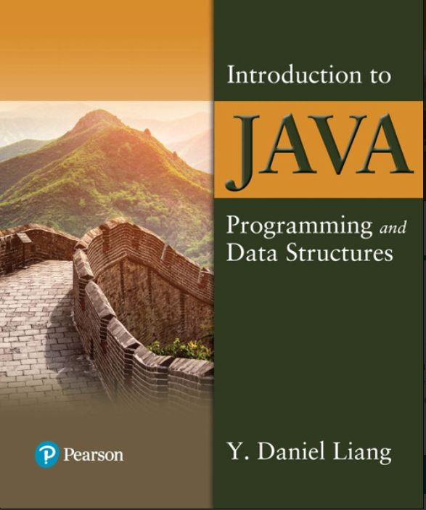

Introduction to Java Programming and Data Structures
Twelfth Edition
Chapter 21
Sets and Maps
Copyright © 2020 Pearson Education, Inc. All Rights Reserved
Notes:
If this PowerPoint presentation contains mathematical equations, you may need to check that your computer has the following installed:
1) MathType Plugin
2) Math Player (free versions available)
3) NVDA Reader (free versions available)
Slides in this presentation contain hyperlinks. JAWS users should be able to get a list of links by using INSERT+F7

Slide 2
Objectives
21.1 To store unordered, nonduplicate elements using a set (§21.2).
21.2 To explore how and when to use HashSet (§21.2.1), LinkedHashSet (§21.2.2), or TreeSet (§21.2.3) to store elements.
21.3 To compare performance of sets and lists (§21.3).
21.4 To use sets to develop a program that counts the keywords in a Java source file (§21.4).
21.5 To tell the differences between Collection and Map and describe when and how to use HashMap, LinkedHashMap, and TreeMap to store values associated with keys (§21.5).
21.6 To use maps to develop a program that counts the occurrence of the words in a text (§21.6).
21.7 To obtain singleton sets, lists, and maps, and unmodifiable sets, lists, and maps, using the static methods in the Collections class (§21.7).

Slide 3
Motivations
The “No-Fly” list is a list, created and maintained by the U.S. government’s Terrorist Screening Center, of people who are not permitted to board a commercial aircraft for travel in or out of the United States. Suppose we need to write a program that checks whether a person is on the No-Fly list. You can use a list to store names in the No-Fly list. However, a more efficient data structure for this application is a set.
Suppose your program also needs to store detailed information about terrorists in the No-Fly list. The detailed information such as gender, height, weight, and nationality can be retrieved using the name as the key. A map is an efficient data structure for such a task.

Slide 4
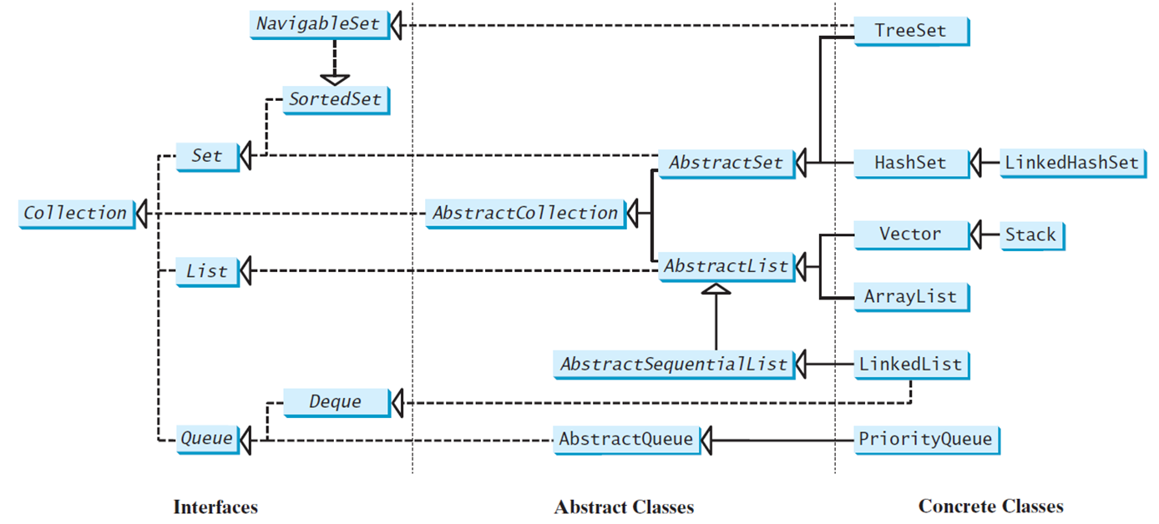
Review of Java Collection Framework Hierarchy
Set and List are subinterfaces of Collection.
Notes:
The Navigable Set and Tree Set are at the top with an arrow from the Tree Set pointing to the Navigable Set. Sorted Set is below the Navigable Set. Set below the Sorted Set and Abstract Set is below the Tree Set. An arrow from Linked Hash Set points to Hash Set and an arrow from Hash Set points to Abstract Set. List and Queue are the next two levels below Set. At the next level an arrow from Stack points to Vector. An arrow form ArrayList and an arrow from Vector point to Abstract list. An arrow from abstract list and an arrow from Abstract Set lead to Abstract Collection which further leads to Collection. At the next level, an arrow from Linked List points to Abstract Sequential List which leads to Abstract List at the previous level. An arrow from Linked List points to Deque which leads to queue. An arrow from Priority Queue leads to Abstract Queue which further leads to Queue.

Slide 5
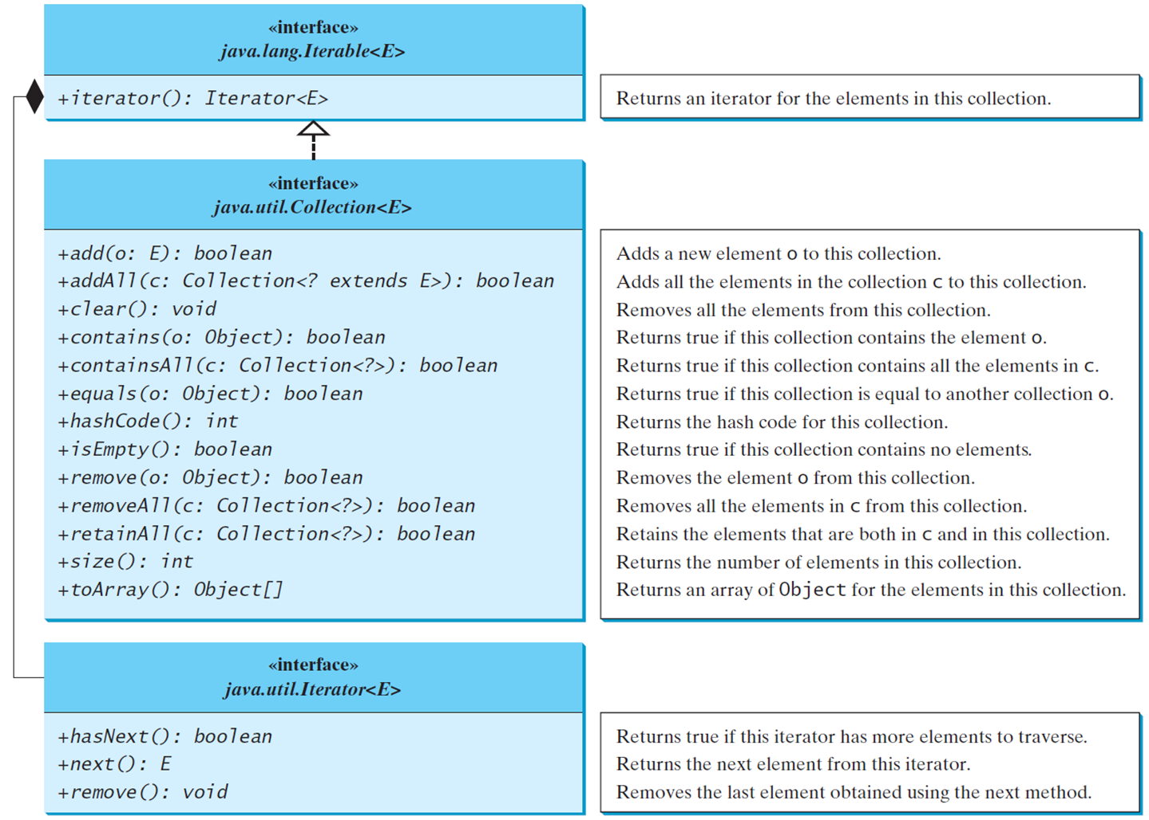
The Collection Interface
Notes:
Less than symbol less than symbol interface greater than symbol Less than symbol
java.witCollection less than symbol E greater than symbol
+add left parenthesis o colon E right parenthesis colon Boolean. Adds a new element o to this collection.
+addAll left parenthesis c colon Collection less than symbol question mark extends E greater than symbol right parenthesis colon Boolean. Adds all the elements in the collection c to this collection.
+clear left parenthesis right parenthesis colon void. Removes all the elements from this collection.
+contains left parenthesis o colon Object right parenthesis colon Boolean. Returns true if this collection contains the element o.
+containsAll left parenthesis c colon Collection less than symbol question mark greater than symbol right parenthesis colon Boolean. Returns true if this collection contains all the elements in c.
+equals left parenthesis o colon Object right parenthesis colon Boolean. Returns true if this collection is equal to another collection o.
+hashCode left parenthesis right parenthesis colon int. Returns the hash code for this collection.
+isEmpty left parenthesis right parenthesis colon Boolean. Returns true if this collection contains no elements.
+remove left parenthesis o colon Object right parenthesis colon Boolean. Removes the element o from this collection.
+removeAll left parenthesis c colon Collection less than symbol question mark greater than symbol right parenthesis colon Boolean. Removes all the elements in c from this collection.
+retainAll left parenthesis c colon Collection less than symbol question mark greater than symbol right parenthesis colon Boolean. Retains the elements that are both in c and in this collection.
+size left parenthesis right parenthesis colon int. Returns the number of elements in this collection.
+toArray left parenthesis right parenthesis colon Object left bracket right bracket. Returns an array of Object for the elements in this collection.
Less than symbol less than symbol interface greater than symbol greater than symbol
Java.unit.Iterator less than symbol E greater than symbol.
+hasNext left parenthesis right parenthesis colon Boolean. Returns true if this iterator has more elements to traverse.
+next left parenthesis right parenthesis colon E. Returns the next element from this iterator.
+remove left parenthesis right parenthesis colon void. Removes the last element obtained using the next method.

Slide 6
The Set Interface
The Set interface extends the Collection interface. It does not introduce new methods or constants, but it stipulates that an instance of Set contains no duplicate elements. The concrete classes that implement Set must ensure that no duplicate elements can be added to the set. That is no two elements e1 and e2 can be in the set such that e1.equals(e2) is true.

Slide 7
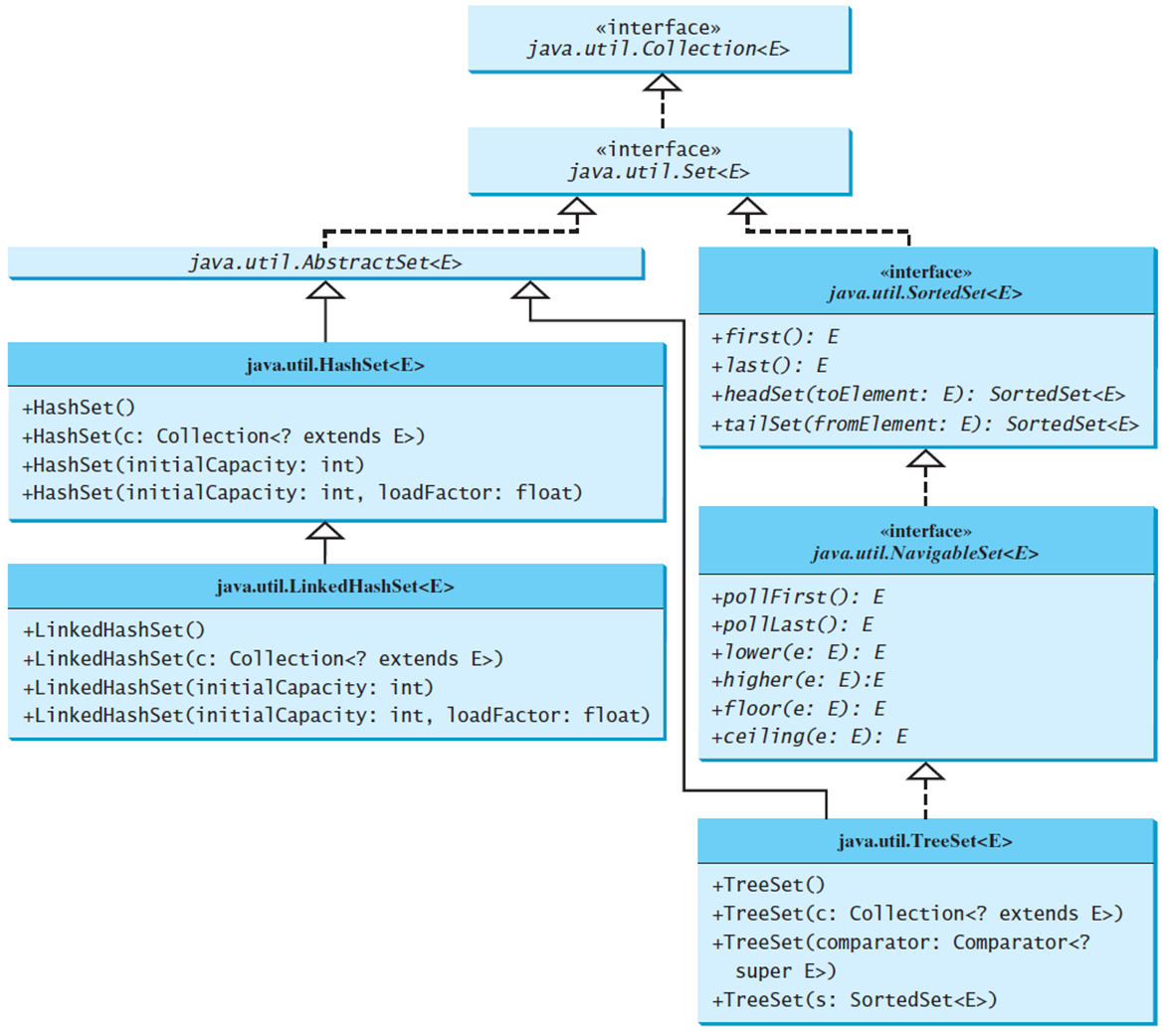
The Set Interface Hierarchy
Notes:
TreeSet less than symbol E greater than symbol at the bottom leads to the interface java.until.NavigableSet less than symbol E greater than symbol and java.until.AbstractSet. The interface java.until.NavigableSet less than symbol E greater than symbol leads to the interface java.until.SortedSet less than symbol E greater than symbol. On the left java.until.LinkedHashSet less than symbol E greater than symbol leads to java.until.HashSet less than symbol E greater than symbol which leads to java.until.AbstractSet less than symbol E greater than symbol. The interface java.until.SortedSet less than symbol E greater than symbol and java.until.AbstractSet less than symbol E greater than symbol together leads to the interface java.until.Set less than symbol E greater than symbol which finally leads to the interface java.until.Collection less than symbol E greater than symbol.

Slide 8
The AbstractSet Class
The AbstractSet class is a convenience class that extends AbstractCollection and implements Set. The AbstractSet class provides concrete implementations for the equals method and the hashCode method. The hash code of a set is the sum of the hash code of all the elements in the set. Since the size method and iterator method are not implemented in the AbstractSet class, AbstractSet is an abstract class.

Slide 9
The HashSet Class
The HashSet class is a concrete class that implements Set. It can be used to store duplicate-free elements. For efficiency, objects added to a hash set need to implement the hashCode method in a manner that properly disperses the hash code.

Slide 10
Example: Using HashSet and Iterator
This example creates a hash set filled with strings, and uses an iterator to traverse the elements in the list.
TestHashSet
Notes:
TestHashSet: https://liveexample.pearsoncmg.com/html/TestHashSet.html

Slide 11
TIP: for-each loop
You can simplify the code in Lines 21-26 using a J D K 1.5 enhanced for loop without using an iterator, as follows:
for (Object element: set)
System.out.print(element.toString() + " ");

Slide 12
Example: Using LinkedHashSet
This example creates a hash set filled with strings, and uses an iterator to traverse the elements in the list.
TestLinkedHashSet
Notes:
TestLinkedHashSet: https://liveexample.pearsoncmg.com/html/TestLinkedHashSet.html

Slide 13
The SortedSet Interface and the TreeSet Class (1 of 2)
SortedSet is a subinterface of Set, which guarantees that the elements in the set are sorted. TreeSet is a concrete class that implements the SortedSet interface. You can use an iterator to traverse the elements in the sorted order. The elements can be sorted in two ways.

Slide 14
The SortedSet Interface and the TreeSet Class (2 of 2)
One way is to use the Comparable interface.
The other way is to specify a comparator for the elements in the set if the class for the elements does not implement the Comparable interface, or you don’t want to use the compareTo method in the class that implements the Comparable interface. This approach is referred to as order by comparator.

Slide 15
Example: Using TreeSet to Sort Elements in a Set
This example creates a hash set filled with strings, and then creates a tree set for the same strings. The strings are sorted in the tree set using the compareTo method in the Comparable interface. The example also creates a tree set of geometric objects. The geometric objects are sorted using the compare method in the Comparator interface.
TestTreeSet
Notes:
TestTreeSet: https://liveexample.pearsoncmg.com/html/TestTreeSet.html

Slide 16
Example: The Using Comparator to Sort Elements in a Set
Write a program that demonstrates how to sort elements in a tree set using the Comparator interface. The example creates a tree set of geometric objects. The geometric objects are sorted using the compare method in the Comparator interface.
TestTreeSetWithComparator
Notes:
TestTreeSetWithComparator: https://liveexample.pearsoncmg.com/html/TestTreeSetWithComparator.html

Slide 17
Performance of Sets and Lists
TestTreeSetWithComparator
Notes:
TestTreeSetWithComparator: https://liveexample.pearsoncmg.com/html/SetListPerformanceTest.html

Slide 18
Case Study: Counting Keywords
This section presents an application that counts the number of the keywords in a Java source code file.
CountKeywords
Notes:
CountKeywords: https://liveexample.pearsoncmg.com/html/CountKeywords.html

Slide 19
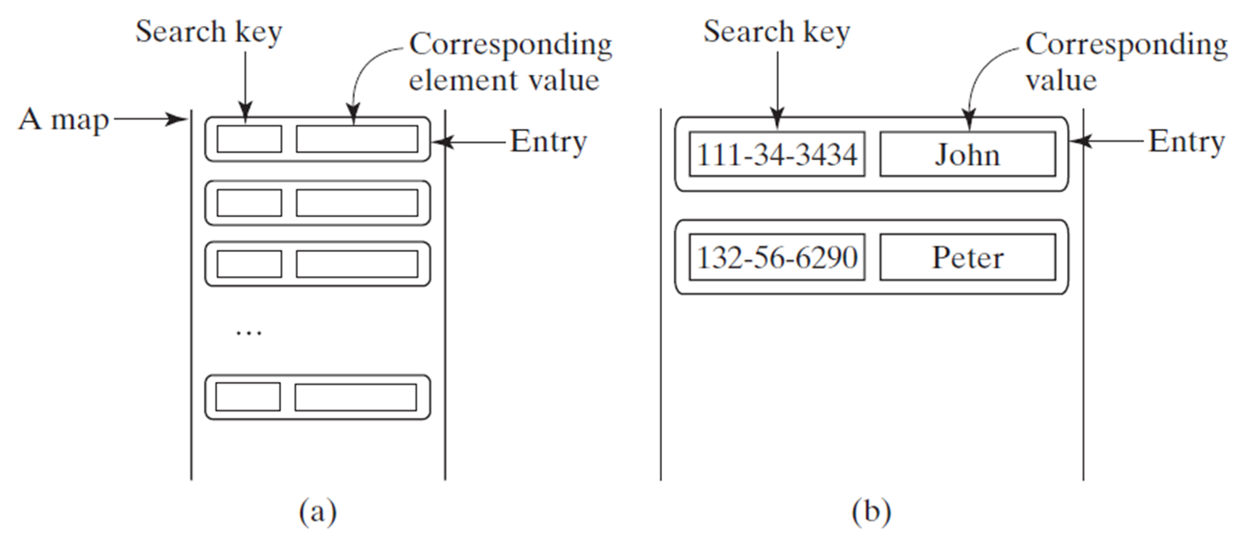
The Map Interface
The Map interface maps keys to the elements. The keys are like indexes. In List, the indexes are integer. In Map, the keys can be any objects.
Notes:
(a) A map with many rectangular boxes. There are two boxes inside each rectangular box. The first box is labeled, search key and the second box is labeled, corresponding element value, entry.
(b) Two example of search key and corresponding value, entry are as follows.
Search key, 111 hyphen 34 hyphen 3434. Corresponding value, entry, John.
Search key, 132 hyphen 56 hyphen 6290. Corresponding value, entry, Peter.

Slide 20
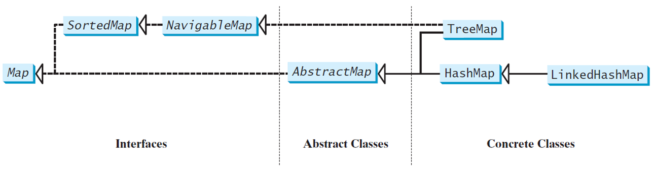
Map Interface and Class Hierarchy
An instance of Map represents a group of objects, each of which is associated with a key. You can get the object from a map using a key, and you have to use a key to put the object into the map.
Notes:
The diagram is divided into three parts interfaces on the left, abstract classes in the middle, and concrete classes on the right. In the interface, navigable map leads to sorted map to the left which further leads to map on the left. In abstract classes, abstract map leads to map. In concrete classes tree map leads to navigable map in the interfaces. Also, linked hash map leads to hash map which further leads to abstract map, which eventually leads to map.

Slide 21
The Map Interface U M L Diagram
UML Diagram
Notes:
UML Diagram: http://liveexample.pearsoncmg.com/dsanimation/Figure21_4v2.html

Slide 22
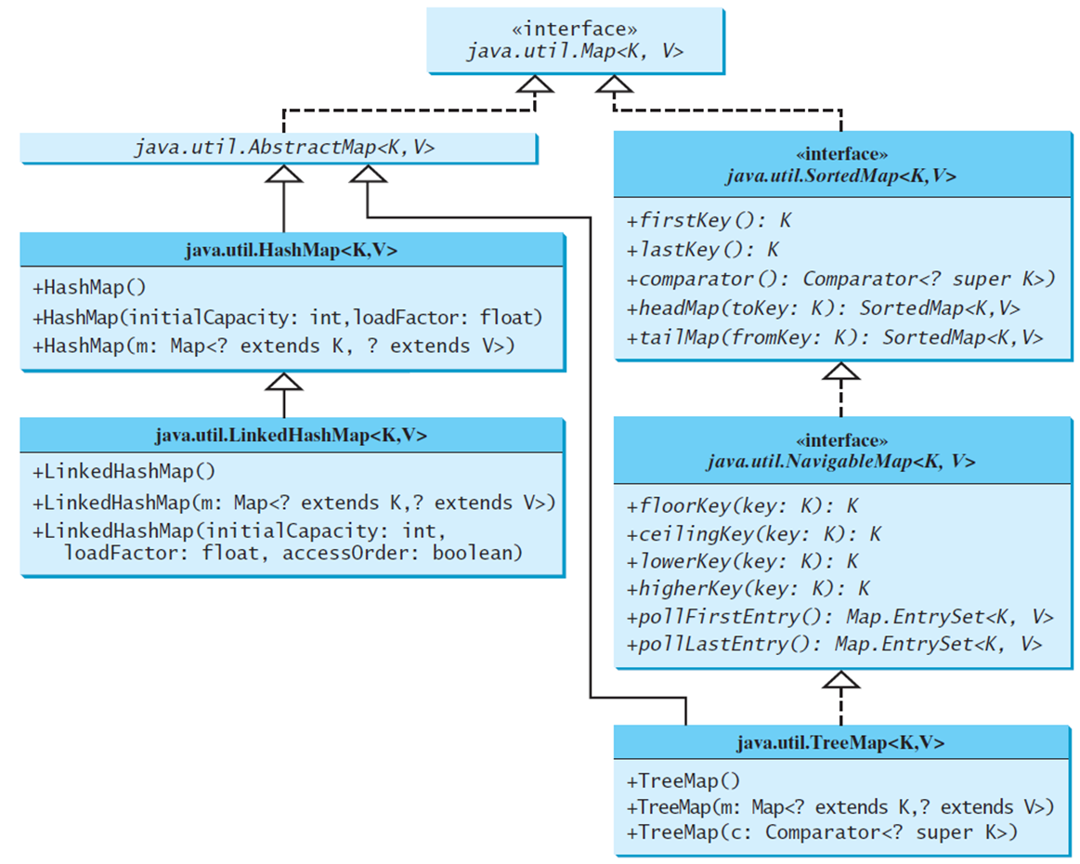
Concrete Map Classes
Notes:
On the right, the java.until.TreeMap less than symbol K, V greater than symbol at the bottom leads to the interface java.until.NavigableMap less than symbol K, V greater than symbol and java.until.AbstractMap. The interface java.until.NavigableMap less than symbol K, V greater than symbol leads to the interface java.until.SortedMap less than symbol K, V greater than symbol. On the left java.until.LinkedHashMap less than symbol K, V greater than symbol leads to java.until.HashMap less than symbol K, V greater than symbol which leads to java.until.AbstractMap less than symbol K, V greater than symbol. The interface java.until.SortedMap less than symbol K, V greater than symbol and java.until.AbstractMap less than symbol K, V greater than symbol together leads to the interface java.until.Map less than symbol K, V greater than symbol which finally leads to the interface java.until.Collection less than symbol K, V greater than symbol.

Slide 23
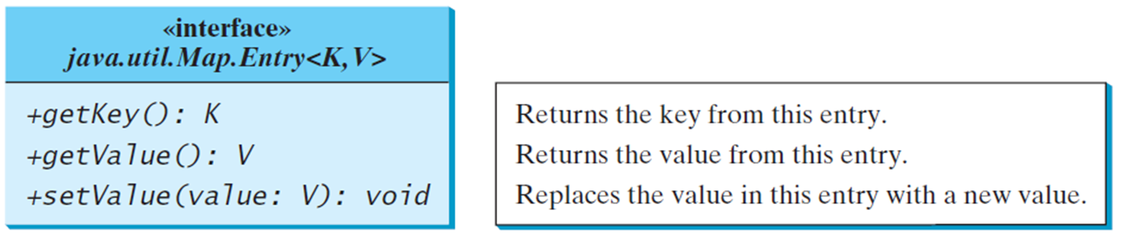
Entry
Notes:
+getKey left parenthesis right parenthesis colon K. Returns the key from this entry.
+getValue left parenthesis right parenthesis colon V. Returns the value from this entry.
+setValue left parenthesis value colon v right parenthesis colon void. Replace the value in this entry with a new value.

Slide 24
HashMap
The HashMap class is efficient for locating a value, inserting a mapping, and deleting a mapping.

Slide 25
LinkedHashMap
LinkedHashMap was introduced in J D K 1.4. It extends HashMap with a linked list implementation that supports an ordering of the entries in the map. The entries in a HashMap are not ordered, but the entries in a LinkedHashMap can be retrieved in the order in which they were inserted into the map (known as the insertion order), or the order in which they were last accessed, from least recently accessed to most recently (access order). The no-arg constructor constructs a LinkedHashMap with the insertion order. To construct a LinkedHashMap with the access order, use the LinkedHashMap(initialCapacity, loadFactor, true).

Slide 26
TreeMap
The HashMap, LinkedHashMap, and TreeMap classes are three concrete implementations of the Map interface. The HashMap class is efficient for locating a value, inserting a mapping, and deleting a mapping. The TreeMap class, implementing SortedMap, is efficient for traversing the keys in a sorted order.

Slide 27
Example: Using HashMap, LinkedHashMap, and TreeMap
This example creates a hash map that maps borrowers to mortgages. The program first creates a hash map with the borrower’s name as its key and mortgage as its value. The program then creates a tree map from the hash map, and displays the mappings in ascending order of the keys.
TestMap
Notes:
TestMap: https://liveexample.pearsoncmg.com/html/TestMap.html

Slide 28
Case Study: Counting the Occurrences of Words in a Text
This program counts the occurrences of words in a text and displays the words and their occurrences in ascending order of the words. The program uses a hash map to store a pair consisting of a word and its count. For each word, check whether it is already a key in the map. If not, add the key and value 1 to the map. Otherwise, increase the value for the word (key) by 1 in the map. To sort the map, convert it to a tree map.
CountOccurrenceOfWords
Notes:
CountOccurrenceOfWords: https://liveexample.pearsoncmg.com/html/CountOccurrenceOfWords.html

Slide 29
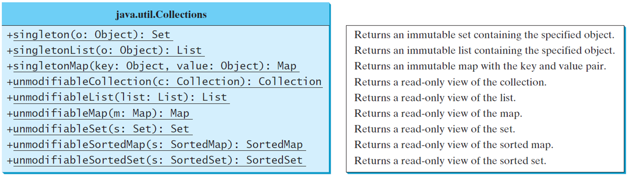
The Singleton and Unmodiable Collections
Notes:
Row 1. +singleton left parenthesis o colon Object right parenthesis colon Set. Returns an immutable set containing the specified object.
Row 2. +singletonList left parenthesis o colon Object right parenthesis colon List. Returns an immutable list containing the specified object.
Row 3. +singletonMap left parenthesis key colon Object, value colon Object right parenthesis colon Map. Returns an immutable map with the key and value pair.
Row 4. +unmodifiableCollection left parenthesis c colon Collection right parenthesis colon Collection. Returns a read-only view of the collection.
Row 5. +unmodifiableList left parenthesis list colon List right parenthesis colon List. Returns a read only view of the list.
Row 6. +unmodifiableMap left parenthesis m colon Map right parenthesis colon Map. Returns a readonly view of the map.
Row 7. +unmodifiableSet left parenthesis s colon Set right parenthesis colon Set. Returns a read-only view of the set.
Row 8. +unmodifiableSortedMap left parenthesis s colon SortedMap right parenthesis colon SortedMap. Returns a read only view of the sorted map.
Row 9. +unmodifiableSortedSet left parenthesis s colon SortedSet right parenthesis colon SortedSet. Returns a read-only view of the sorted set.

Slide 30

Copyright
This work is protected by United States copyright laws and is provided solely for the use of instructors in teaching their courses and assessing student learning. Dissemination or sale of any part of this work (including on the World Wide Web) will destroy the integrity of the work and is not permitted. The work and materials from it should never be made available to students except by instructors using the accompanying text in their classes. All recipients of this work are expected to abide by these restrictions and to honor the intended pedagogical purposes and the needs of other instructors who rely on these materials.

