Slide 1
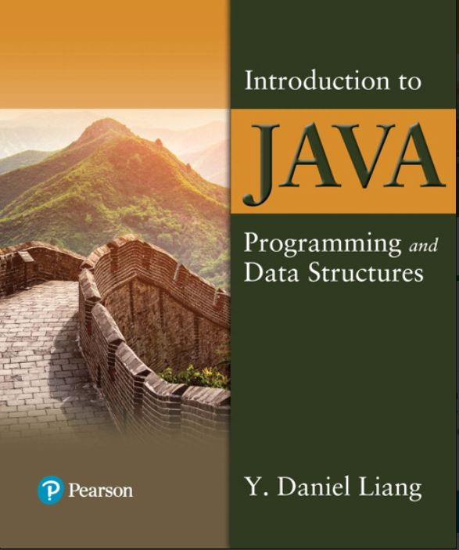

Introduction to Java Programming and Data Structures
Twelfth Edition
Chapter 34
Java Database Programming
Copyright © 2020 Pearson Education, Inc. All Rights Reserved
Notes:
If this PowerPoint presentation contains mathematical equations, you may need to check that your computer has the following installed:
1) MathType Plugin
2) Math Player (free versions available)
3) NVDA Reader (free versions available)
Slides in this presentation contain hyperlinks. JAWS users should be able to get a list of links by using INSERT+F7

Slide 2
Objectives
34.1 To understand the concept of database and database management systems (§34.2).
34.2 To understand the relational data model: relational data structures, constraints, and languages (§34.2).
34.3 To use S Q L to create and drop tables, and to retrieve and modify data (§34.3).
34.4 To learn how to load a driver, connect to a database, execute statements, and process result sets using J D B C (§34.4).
34.5 To use prepared statements to execute precompiled S Q L statements (§34.5).
34.6 To use callable statements to execute stored S Q L procedures and functions (§34.6).
34.7 To explore database metadata using the DatabaseMetaData and ResultSetMetaData interfaces (§34.7).

Slide 3
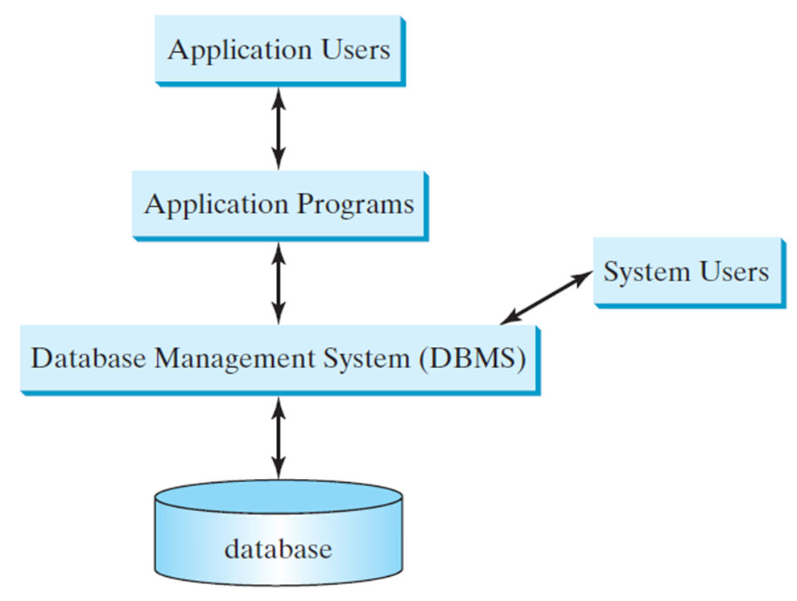
What is a Database System?

Slide 4
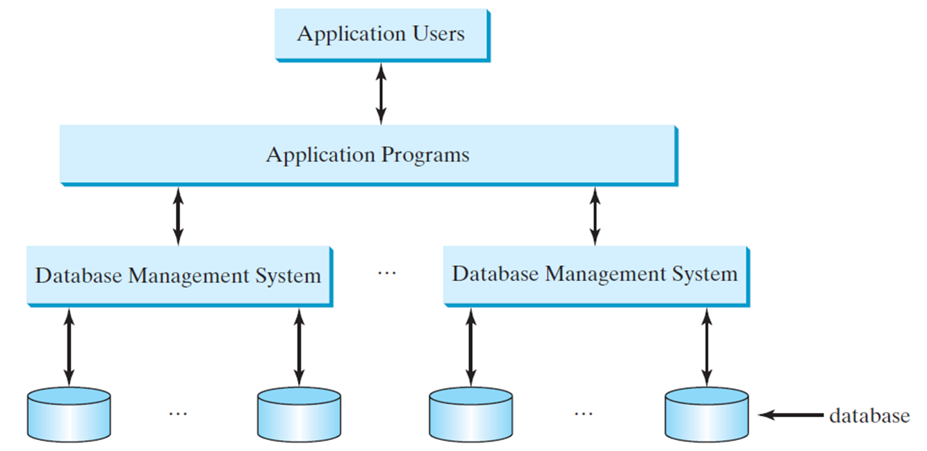
Database Application Systems

Slide 5
Rational Database and Relational Data Model
Most of today’s database systems are relational database systems, based on the relational data model. A relational data model has three key A relational data model has three key components: structure, integrity and languages.
Structure defines the representation of the data.
Integrity imposes constraints on the data.
Language provides the means for accessing and manipulating data.

Slide 6
Relational Structure
A relational database consists of a set of relations. A relation has two things in one: a schema and an instance of the schema. The schema defines the relation and an instance is the content of the relation at a given time. An instance of a relation is nothing more than a table with rows and named columns. For convenience with no confusion, we refer instances of relations as just relations or tables.

Slide 7
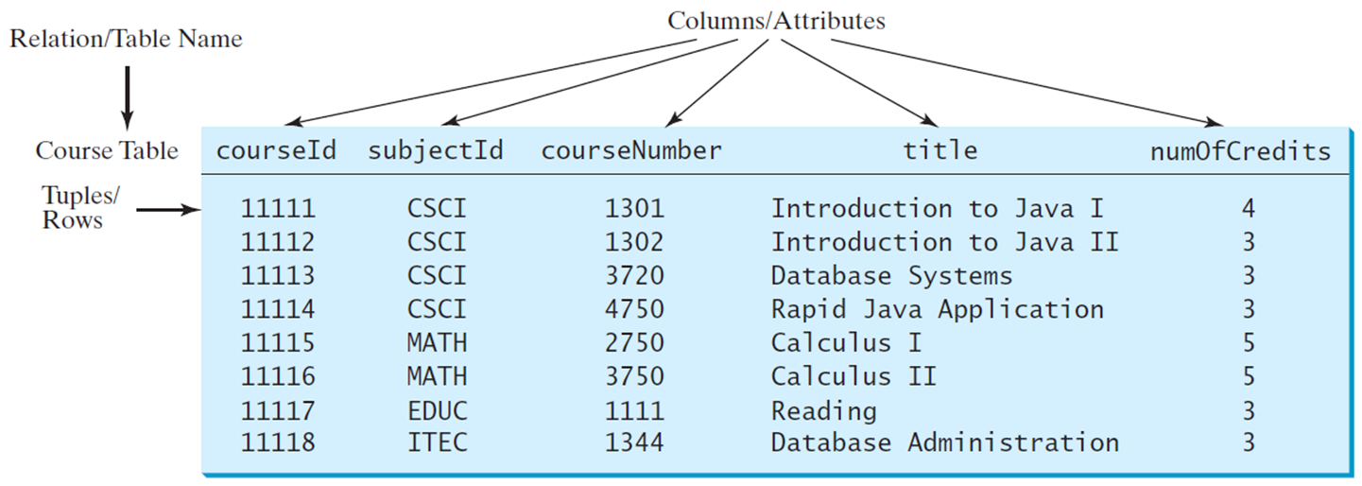
Course Table
Notes:
Arrows from columns or attributes lead to each column of the table. An arrow from relation or table name leads to column heading course table. The first row is labeled, tuples rows. The column headings from left to right are courseId, subjectId, courseNumber, title, num0fCredits. The row entries are as follows.
Row 1. 11111, CSCI, 1301, Introduction to Java first, 4.
Row 2. 11112, CSCI, 1302, Introduction to Java second, 3.
Row 3. 11113, CSCI, 3720, Database Systems, 3.
Row 4. 11114, CSCI, 4750, Rapid Java Application, 3.
Row 5. 11115, MATH, 2750, Calculus first, 5.
Row 6. 11116, MATH, 3750, Calculus second, 5.
Row 7. 11117, EDUC, 1111, Reading, 3.
Row 8. 11118, ITEC, 1344, Database Administration, 3.

Slide 8
Student Table
s s n | firstName | mi | lastName | phone | birthDate | birthDate | street | zi pCode | deptID
444111110 | Jacob | R | Smith | 9129219434 | 1985- 04-09 | 99 | Kingston Street | 31435 | BIOL
444111111 | John | K | Stevenson | 9129219434 | null | 100 | Main Street | 31411 | BIOL
444111112 | George | K | Smith | 9129213454 | 1974-10-10 | 1200 | Abercorn St. | 31419 | C S
444111113 | Frank | E | Jones | 9125919434 | 1970-09-09 | 100 | Main Street | 31411 | BIOL
444111114 | Jean | K | Smith | 9129219434 | 1970-02-09 | 100 | Main Street | 31411 | CHEN!
444111115 | Josh | R | Woo | 7075989434 | 1970-02-09 | 555 | Franklin St. | 31411 | CHEM
444111116 | Josh | R | Smith | 9129219434 | 1973- 02-09 | 100 | Main Street | 31411 | BIOL
444111117 | Joy | P | Kennedy | 9129229434 | 1974- 03-19 | 103 | Bay Street | 31412 | C S
444111118 | Torn" | R | Peterson | 9129229434 | 1964-04-29 | 103 | Bay Street | 31412 | MATH
444111119 | Patrick | R | Stoneman | 9129229434 | 1969-04-29 | 101 | Washington St. | 31435 | MATH
444111120 | Rick | R | Carter | 9125919434 | 1986- 04-09 | 19 | West Ford St. | 31411 | BIOL

Slide 9
Enrollment Table
s s n | courseld | dateRegistered | grade
444111110 | 11111 | 2004-03-19 | A
444111110 | 11112 | 2004-03-19 | B
444111110 | 11113 | 2004-03-19 | C
444111111 | 11111 | 2004-03-19 | D
444111111 | 11112 | 2004-03-19 | F
444111111 | 11113 | 2004-03-19 | A
444111112 | 11114 | 2004-03-19 | B
444111112 | 11115 | 2004-03-19 | C
444111112 | 11116 | 2004-03-19 | D
444111113 | 11111 | 2004-03-19 | A
444111113 | 11113 | 2004-03-19 | A
444111114 | 11115 | 2004-03-19 | B
444111115 | 11115 | 2004-03-19 | F
444111115 | 11116 | 2004-03-19 | F
444111116 | 11111 | 2004-03-19 | D
444111117 | 11111 | 2004-03-19 | D
444111118 | 11111 | 2004-03-19 | A
444111118 | 11112 | 2004-03-19 | D
444111118 | 11113 | 2004-03-19 | B

Slide 10
Table versus File
Note:
A table or a relation is not same as a file. Most of the relational database systems store multiple tables in a file.

Slide 11
Integrity Constraints
An integrity constraint imposes a condition that all legal instances of the relations must satisfy. In general, there are three types of constraints: domain constraint, primary key constraint, and foreign key constraint. Domain constraints and primary key constraints are known as intra-relational constraints, meaning that a constraint involves only one relation. The foreign key constraint is known as inter-relational, meaning that a constraint involves more than one relation.

Slide 12
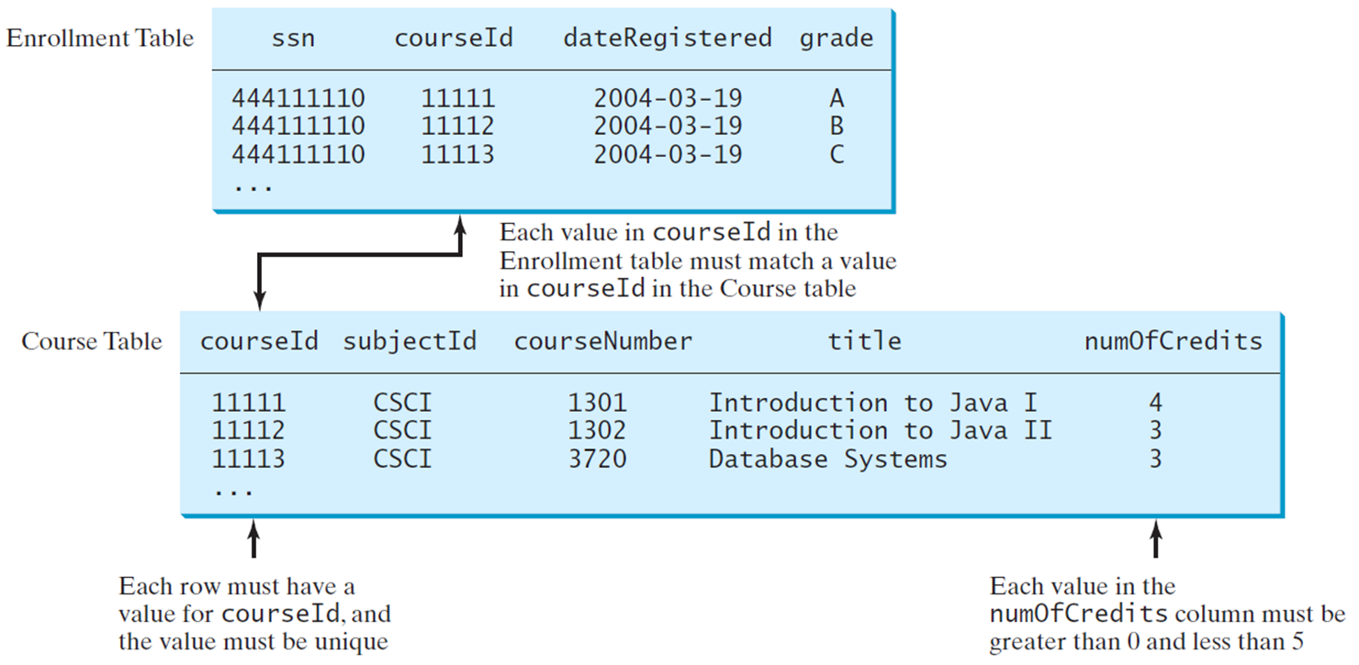
Domain Constraints (1 of 2)
Notes:
The row entries are as follows.
Row 1. 444111110, 11111, 2004-03-19, A.
Row 2. 444111110, 11112, 2004-03-19, B.
Row 3. 444111110, 11113, 2004-03-19, C.
A course table with column headings from left to right as courseID, subjectID, courseNumber, title, and numberOfCredits. The row entries are as follows.
Row 1. 11111, CSCI, 1301, Introduction to Java first, 4.
Row 2. 11112, CSCI, 1302, Introduction to Java second, 3.
Row 3. 11113, CSCI, 3720, Database system, 3.
A two way arrow between these two tables is labeled, each value in couseID in the enrollment table must match a value in courseID in the course table.
The courseID column of course table is labeled, each row must have a value for courseID and the value must be unique. The numberOfCredits column is labeled, each value in the numberOfCredits column must be greater than 0 and less than 5.

Slide 13
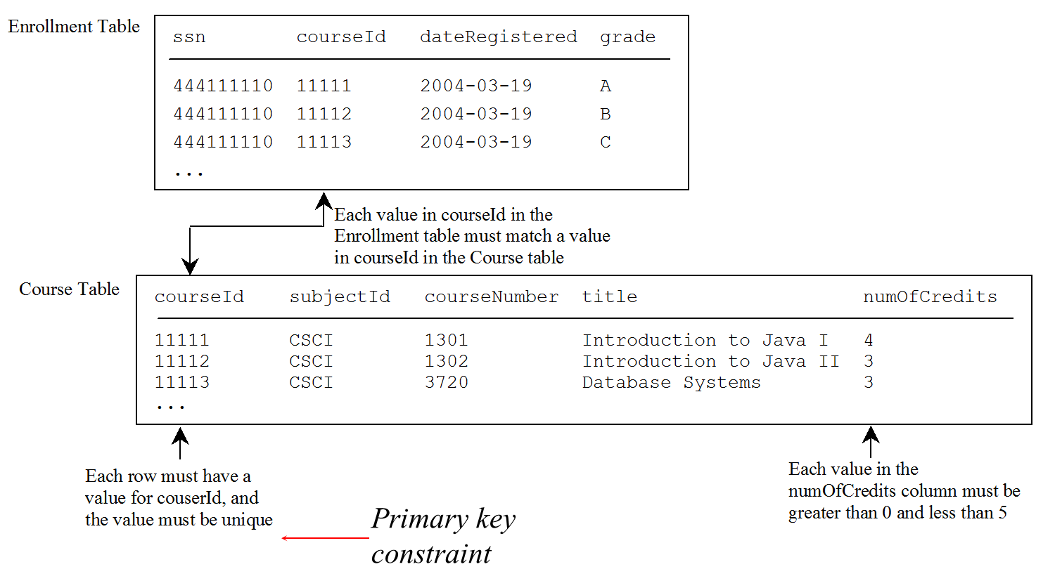
Primary Key Constraints (1 of 2)
Notes:
The row entries are as follows.
Row 1. 444111110, 11111, 2004-03-19, A.
Row 2. 444111110, 11112, 2004-03-19, B.
Row 3. 444111110, 11113, 2004-03-19, C.
A course table with column headings from left to right as courseID, subjectID, courseNumber, title, and numberOfCredits. The row entries are as follows.
Row 1. 11111, CSCI, 1301, Introduction to Java first, 4.
Row 2. 11112, CSCI, 1302, Introduction to Java second, 3.
Row 3. 11113, CSCI, 3720, Database system, 3.
A two way arrow between these two tables is labeled, each value in couseID in the enrollment table must match a value in courseID in the course table.
The courseID column of course table is labeled, each row must have a value for courseID and the value must be unique. The numberOfCredits column is labeled, each value in the numberOfCredits column must be greater than 0 and less than 5. The courseID is labeled, primary key constraint.

Slide 14
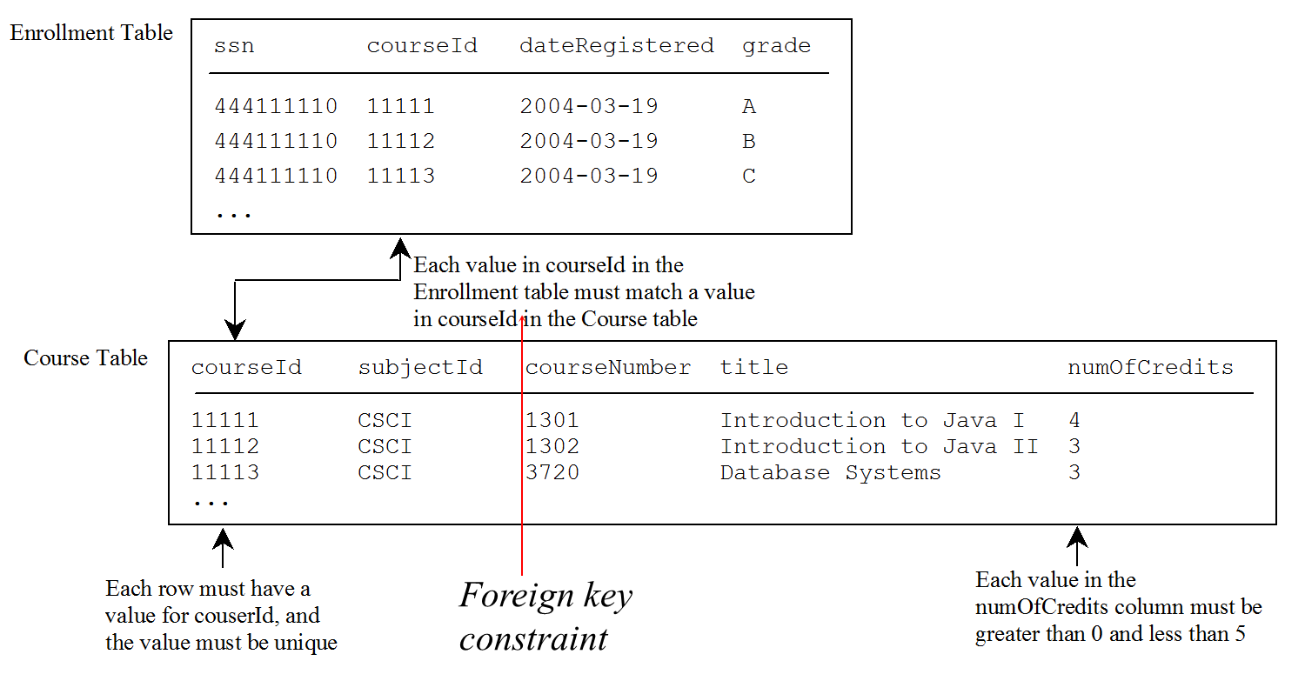
Foreign Key Constraints (1 of 2)
Notes:
The row entries are as follows.
Row 1. 444111110, 11111, 2004-03-19, A.
Row 2. 444111110, 11112, 2004-03-19, B.
Row 3. 444111110, 11113, 2004-03-19, C.
A course table with column headings from left to right as courseID, subjectID, courseNumber, title, and numberOfCredits. The row entries are as follows.
Row 1. 11111, CSCI, 1301, Introduction to Java first, 4.
Row 2. 11112, CSCI, 1302, Introduction to Java second, 3.
Row 3. 11113, CSCI, 3720, Database system, 3.
A two way arrow between these two tables is labeled, each value in couseID in the enrollment table must match a value in courseID in the course table.
The courseID column of course table is labeled, each row must have a value for courseID and the value must be unique. The numberOfCredits column is labeled, each value in the numberOfCredits column must be greater than 0 and less than 5. The courseID in each table is labeled, foreign key constraint.

Slide 15
Domain Constraints (2 of 2)
Domain constraints specify the permissible values for an attribute. Domains can be specified using standard data types such as integers, floating-point numbers, fixed-length strings, and variant-length strings. The standard data type specifies a broad range of values. Additional constraints can be specified to narrow the ranges. You can also specify whether an attribute can be null.

Slide 16
Domain Constraints Example
create table Course(
subjectCode char(4) not null,
courseNumber int not null,
title varchar(50) not null,
numOfCredits int not null
constraint greaterThanOne
check (numOfCredits >= 1));
create table Course (
courseId char(5),
subjectId char(4) not null,
courseNumber integer,
title varchar(50) not null,
numOfCredits integer,
constraint greaterThanOne
check (numOfCredits >= 1));

Slide 17
Superkey
Superkey*
*A superkey is an attribute or a set of attributes that uniquely identify the relation. That is, no two tuples have the same values on the superkey. By definition, a relation consists of a set of distinct tuples. The set of all attributes in the relation forms a superkey.
Key
Candidate key
Primary key

Slide 18
Key and Candidate Key
Superkey
*A key K is a minimal superkey, meaning that any proper subset of K is not a superkey. It is possible that a relation has several keys. In this case, each of the keys is called a candidate key.
Key*
Candidate key*
Primary key

Slide 19
Primary Key (1 of 2)
Superkey
*The primary key is one of the candidate keys designated by the database designer. The primary key is often used to identify tuples in a relation.
Key
Candidate key
Primary key*
create table Course(
subjectCode char(4),
courseNumber int,
title varchar(50), numOfCredits int
constraint greaterThanOne check (numOfCredits >= 1),
primary key (subjectCode, courseNumber));

Slide 20
Primary Key (2 of 2)
The primary key is one of the candidate keys designated by the database designer. The primary key is often used to identify tuples in a relation.
create table Course (
courseId char(5),
subjectId char(4) not null,
courseNumber integer,
title varchar(50) not null,
numOfCredits integer,
primary key (courseId)
);

Slide 21
Primary Key Constraints (2 of 2)
The primary key constraint specifies that the primary key value of a tuple cannot be null and no two tuples in the relation can have the same value on the primary key. The DBMS enforces the primary key constraint. For example, if you attempt to insert a record with the same primary key as an existing record in the table, the D B M S would report an error and reject the operation.

Slide 22
Foreign Key Constraints (2 of 2)
In a relational database, data are related. Tuples in a relation are related and tuples in different relations are related through their common attributes. Informally speaking, the common attributes are foreign keys. The foreign key constraints define the relationships among relations.

Slide 23
Foreign Key Constraints Formal Definition
Formally, a set of attributes F K is a foreign key in a relation R that references relation T if it satisfies the following two rules:
The attributes in F K have the same domain as the primary key in T.
A non-null value on F K in R must match a primary key value in T.

Slide 24
Foreign Key Example
create table Enrollment (
ssn char(9),
courseId char(5),
dateRegistered date,
grade char(1),
primary key (ssn, courseId),
foreign key (ssn) references Student,
foreign key (courseId) references Course
);

Slide 25
Foreign Key Discussion (1 of 4)
A foreign key is not necessarily the primary key or part of the primary in the relation. For example, subjectCode is a foreign key in the Course table that references the Subject table, but it is not the primary key in Course. departmentCode is a foreign key in the Subject table that references Department, but it is not the primary key in Subject.

Slide 26
Foreign Key Discussion (2 of 4)
The referencing relation and the referenced relation may be the same table. For example, supervisorId is a foreign key in Faculty that references facultyId in Faculty.

Slide 27
Foreign Key Discussion (3 of 4)
The foreign key is not necessary to have the same name as its referenced primary key as long as they have the same domain. For example, headId is a foreign key in Department that references facultyId in Faculty.

Slide 28
Foreign Key Discussion (4 of 4)
A relation may have more than one foreign key. For example, headId and collegeCode are both foreign keys in Department.

Slide 29
S Q L
Structured Query Language, pronounced S-Q-L, or Sequel
To access or write applications for database systems, you need to use the Structured Query Language (S Q L). S Q L is the universal language for accessing relational database systems. Application programs may allow users to access database without directly using S Q L, but these applications themselves must use S Q L to access the database.

Slide 30
Examples of Simple SQL Statements (1 of 7)
Create table*
Drop table
Describe table
Select
Insert
Delete
Update
*create table Course (
courseId char(5),
subjectId char(4) not null,
courseNumber integer,
title varchar(50) not null,
numOfCredits integer,
primary key (courseId)
);
*create table Student (
ssn char(9),
firstName varchar(25),
mi char(1),
lastName varchar(25),
birthDate date,
street varchar(25),
phone char(11),
zipCode char(5),
deptId char(4),
primary key (ssn)
);

Slide 31
Examples of Simple S Q L Statements (2 of 7)
Create table
Drop table*
Describe table
Select
Insert
Delete
Update
*drop table Enrollment;
drop table Course;
drop table Student;

Slide 32
Examples of Simple S Q L Statements (3 of 7)
Create table
Drop table
Describe table*
Select
Insert
Delete
Update
*describe Course; -- Oracle

Slide 33
Examples of Simple S Q L Statements (4 of 7)
Create table
Drop table
Describe table
Select*
Insert
Delete
Update
*firstName, mi, lastName
from Student
where deptId = 'CS';
select firstName, mi, lastName
from Student
where deptId = 'CS' and zipCode = '31411';
select *
from Student
where deptId = 'CS' and zipCode = '31411';

Slide 34
Examples of Simple S Q L Statements (5 of 7)
Create table
Drop table
Describe table
Select
Insert*
Delete
Update
*insert into Course (courseId, subjectId, courseNumber, title)
values ('11113', 'CSCI', '3720', 'Database Systems', 3);

Slide 35
Examples of Simple S Q L Statements (6 of 7)
Create table
Drop table
Describe table
Select
Insert
Update*
Delete
*update Course
set numOfCredits = 4
where title = 'Database Systems';

Slide 36
Examples of Simple S Q L Statements (7 of 7)
Create table
Drop table
Describe table
Select
Insert
Update
Delete*
*delete Course
where title = 'Database System';

Slide 37
Why Java for Database Programming?
First, Java is platform independent. You can develop platform-independent database applications using S Q L and Java for any relational database systems.
Second, the support for accessing database systems from Java is built into Java A P I, so you can create database applications using all Java code with a common interface.
Third, Java is taught in almost every university either as the first programming language or as the second programming language.

Slide 38
Database Applications Using Java
G U I
Client/Server
Server-Side programming

Slide 39
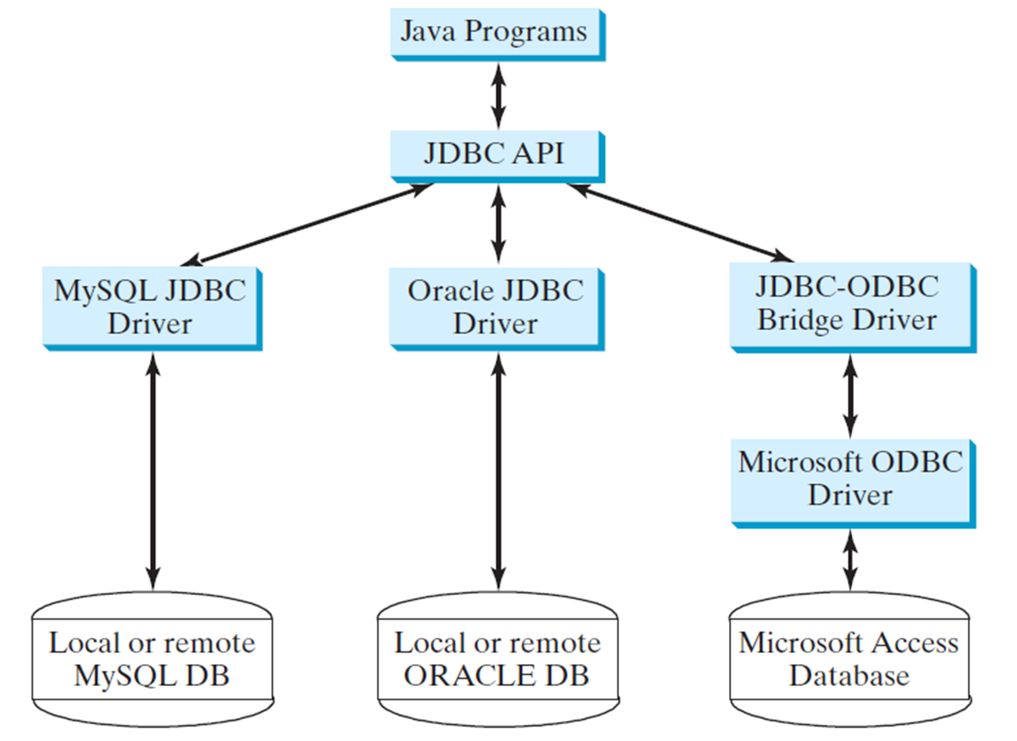
The Architecture of J D B C
Notes:
There is a two way arrow between elements as follows.
MySQL JDBC Drive and Local or remote MySQL DB.
Oracle JDBC Driver and Local or remote JDBC DB.
JDBC ODBC Bridge Driver and Microsoft ODBC Driver.
Microsoft ODBC Driver and Microsoft Access Database.

Slide 40
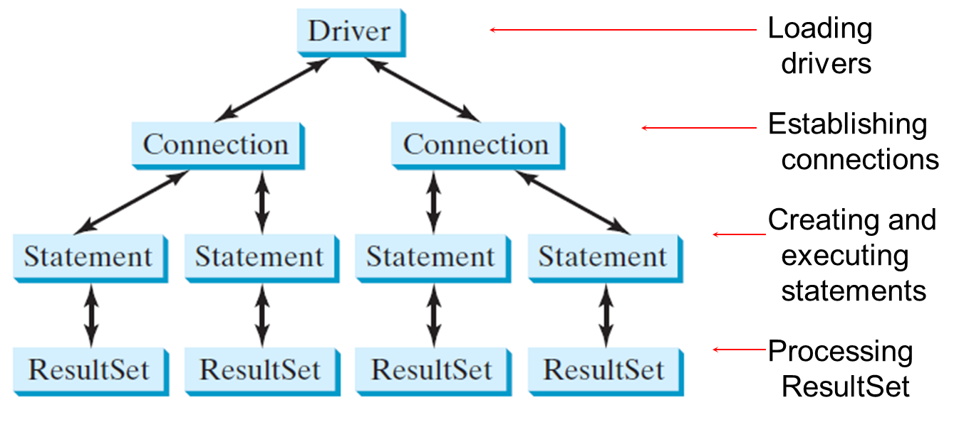
The J D B C Interfaces
Notes:
Driver at the top is labeled, loading drivers.
Connections at the second level are labeled, establishing connections.
Statements at the third level are labeled, creating and executing statements.
ResultSet at the fourth level are labeled, processing ResultSet.

Slide 41
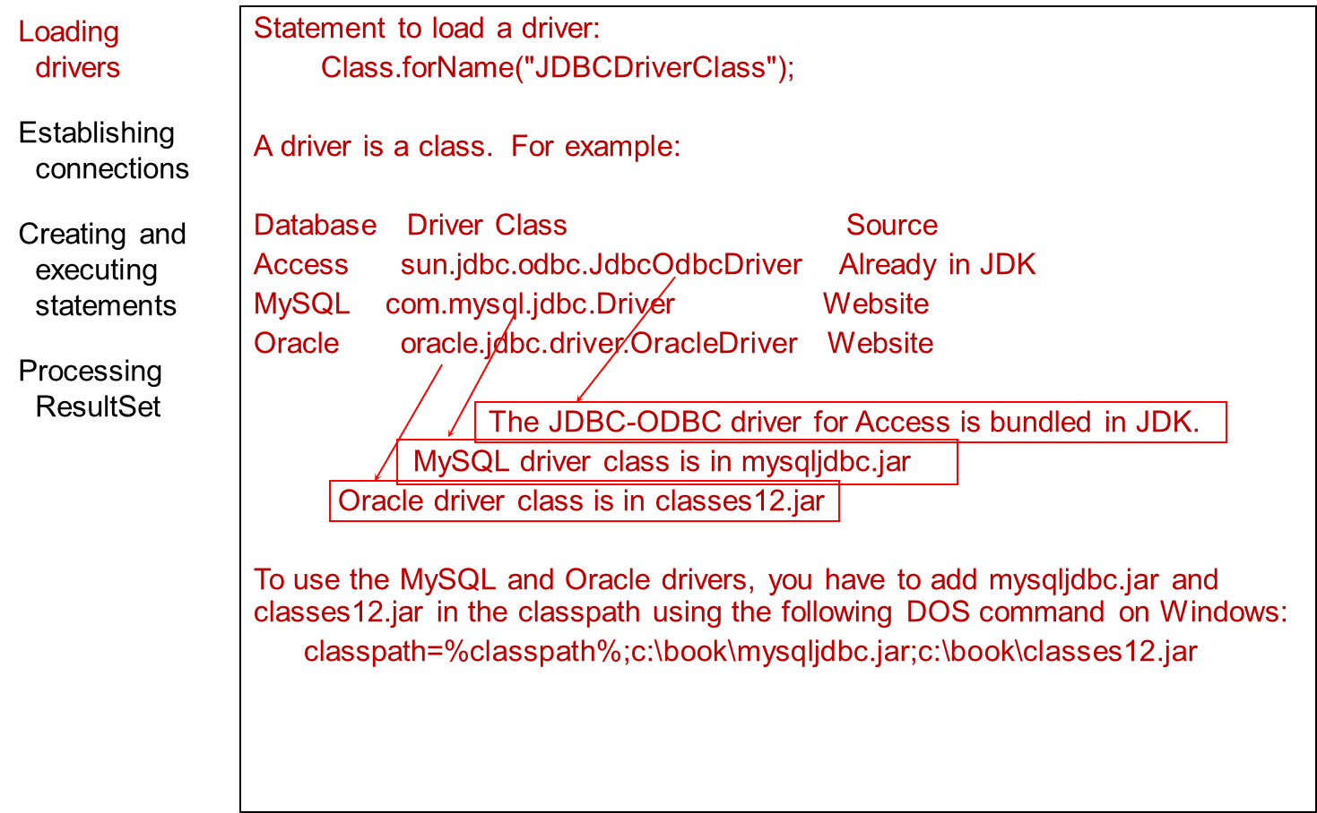
Developing J D B C Programs (1 of 4)
Notes:
Class.forName left parenthesis start double quotation marks JDBCDriverClass end double quotation marks right parenthesis semi colon
The above block of code is labeled, loading drivers.
A driver is a class. For example colon. This line is labeled, Establishing connections.
Database, Driver, Class, Source
Access, sun.jdbc.odbc.JdbcOdbcDriver, Already in JDK
MySQL, com.mysql.jdbc.Driver, Website
Oracle, oracle.jdbc.driver.OracleDriver, Website
The above block of codes is labeled, Creating and executing statements.
The JDBC-ODBC driver for Access is bundled in JDK.
MySQL driver class is in mysqljdbc.jar
Oracle driver class is in classes12.jar
The above block of codes is labeled, Processing ResultSet.
To use the MySQL and Oracle drivers, you have to add mysqljdbc.jar and classes12.jar in the classpath using the following DOS command on Windows colon
classpath=%classpath% semi colon c colon backslash book backslash mysqljdbc.jar semi colon c colon backslash book backslash classes12.jar.
A line connects the code sun.jdbc.odbc.JdbcOdbcDriver to JDBC-ODBC driver for Access is bundled in JDK. A line connects the code com.mysql.jdbc.Driver to MySQL driver class is in mysqljdbc.jar. A line connects the code oracle.jdbc.driver.OracleDriver to Oracle driver class is in classes12.jar.

Slide 42
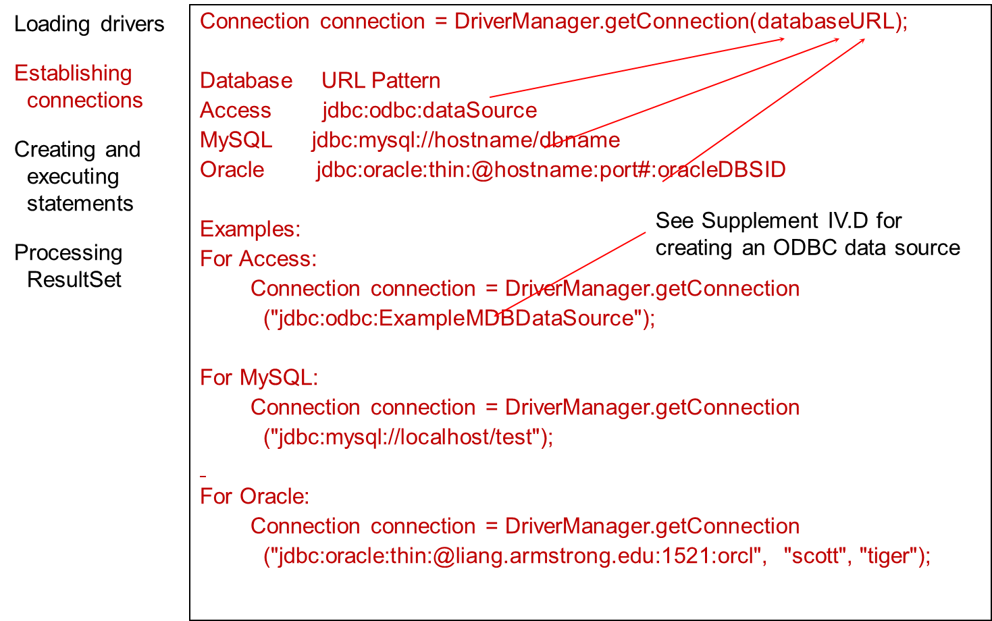
Developing J D B C Programs (2 of 4)
Notes:
Database URL Pattern
Access jdbc colon odbc colon dataSource
MySQL jdbc colon mysql colon forward slash forward slash hostname forward slash dbname
Oracle jdbc colon oracle colon thin colon @hostname colon port# colon oracleDBSID
The above code is labeled, establishing connections.
Examples colon
For Access colon
These two lines are labeled, creating and executing statements.
Connection connection = DriverManager.getConnection
left parenthesis start double quotation marks jdbc colon odbc colon ExampleMDBDataSource end double quotation marks right parenthesis semi colon
The above code block is labeled, Processing ResultSet.
For MySQL colon
Connection connection = DriverManager.getConnection
left parenthesis start double quotation marks jdbc colon mysql colon forward slash forward slash localhost forward slash test end double quotation marks right parenthesis ;
For Oracle colon
Connection connection = DriverManager.getConnection
left parenthesis start double quotation marks jdbc colon oracle colon thin colon at liang.armstrong.edu colon 1521 colon orcl end double quotation marks , start double quotation marks scott end double quotation marks , end double quotation marks tiger end double quotation marks right parenthesis ;
An arrow each from Access, MySQL, and Oracle points to databaseURL. The code line left parenthesis start double quotation marks jdbc colon odbc colon ExampleMDBDataSource end double quotation marks right parenthesis semi colon is labeled, see Supplement IV.D for creating an ODBC data source.

Slide 43
Developing J D B C Programs (3 of 4)
Loading drivers
Establishing connections
Creating and executing statements*
Processing ResultSet
*Creating statement:
Statement statement = connection.createStatement();
Executing statement (for update, delete, insert):
statement.executeUpdate
("create table Temp (col1 char(5), col2 char(5))");
Executing statement (for select):
// Select the columns from the Student table
ResultSet resultSet = statement.executeQuery
("select firstName, mi, lastName from Student where lastName "
+ " = 'Smith'");

Slide 44
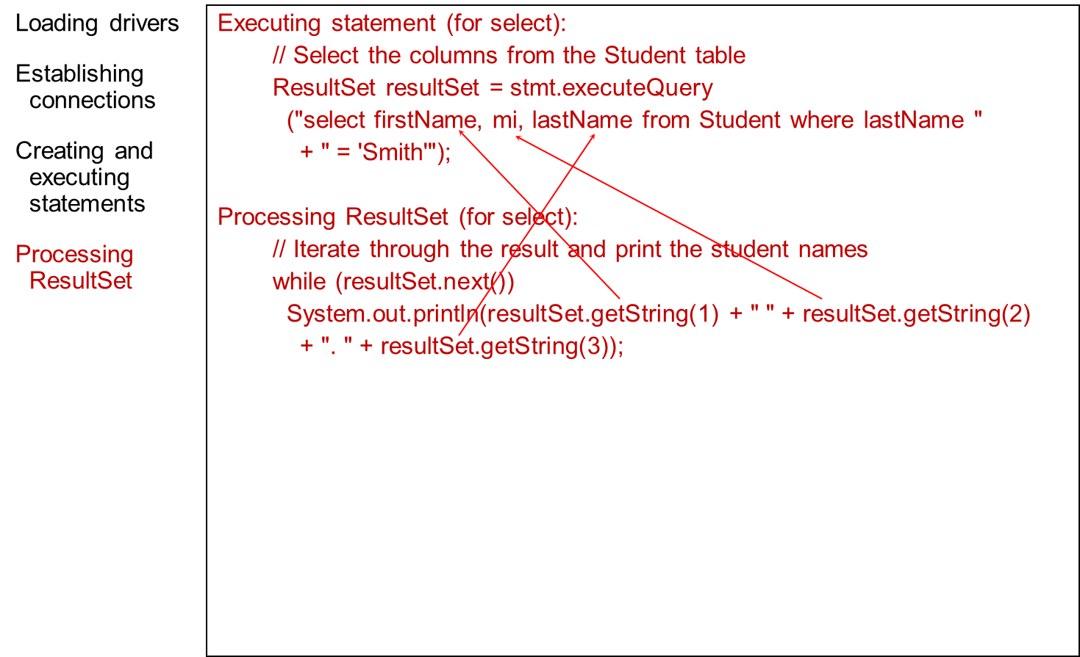
Developing J D B C Programs (4 of 4)
Notes:
forward slash forward slash Select the columns from the Student table
ResultSet resultSet = stmt.executeQuery
left parenthesis start double quotation marks select firstName, mi, lastName from Student where lastName end double quotation marks
+ start double quotation marks = Smith end double quotation marks right parenthesis semi colon
Processing ResultSet left parenthesis for select right parenthesis colon
forward slash forward slash Iterate through the result and print the student names
while left parenthesis resultSet.next left parenthesis right parenthesis right parenthesis
System.out.println left parenthesis resultSet.getString left parenthesis 1 right parenthesis + start double quotation marks end double quotation marks + resultSet.getString left parenthesis 2 right parenthesis
+ start double quotation marks . end double quotation marks + resultSet.getString left parenthesis 3 right parenthesis right parenthesis semi colon
The code blocks are labeled, loading drivers, establishing connections, creating and executing statements, and processing ResultSet,
An arrow from resultSet.getString left parenthesis 1 right parenthesis points to firstname, an arrow from resultSet.getString left parenthesis 2 right parenthesis points to mi, and an arrow from resultSet.getString left parenthesis 3 right parenthesis points to lastname.

Slide 45
Simple J D B C Example (1 of 2)
import java.sql.*;
public class SimpleJdbc {
public static void main(String[] args)
throws SQLException, ClassNotFoundException {
// Load the JDBC driver
Class.forName("com.mysql.jdbc.Driver");
System.out.println("Driver loaded");
// Establish a connection
Connection connection = DriverManager.getConnection
("jdbc:mysql://localhost/test");
System.out.println("Database connected");
// Create a statement
Statement statement = connection.createStatement();

Slide 46
Simple J D B C Example (2 of 2)
// Execute a statement
ResultSet resultSet = statement.executeQuery
("select firstName, mi, lastName from Student where lastName "
+ " = 'Smith'");
// Iterate through the result and print the student names
while (resultSet.next())
System.out.println(resultSet.getString(1) + "\t" +
resultSet.getString(2) + "\t" + resultSet.getString(3));
// Close the connection
connection.close();
}
}
SimpleJdbc
Notes:
SimpleJdbc: https://liveexample.pearsoncmg.com/html/SimpleJdbc.html

Slide 47
Creating O D B C Data Source
Please follow the steps in Supplement on the Companion Website to create an O D B C data source on Windows.

Slide 48
Example: Accessing Database from Java F X
This example demonstrates connecting to a database from a Java applet. The applet lets the user enter the S S N and the course I D to find a student’s grade.
FindGrade
Notes:
FindGrade: https://liveexample.pearsoncmg.com/html/FindGrade.html

Slide 49
Processing Statements
Once a connection to a particular database is established, it can be used to send S Q L statements from your program to the database. J D B C provides the Statement, PreparedStatement, and CallableStatement interfaces to facilitate sending statements to a database for execution and receiving execution results from the database.

Slide 50
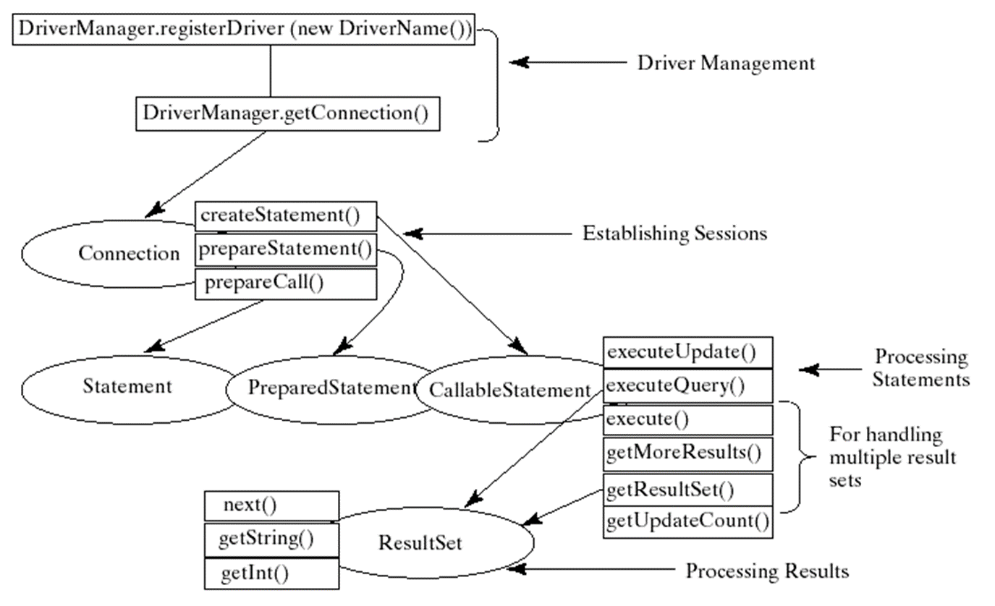
Processing Statements Diagram
Notes:
DriverManager.registerDriver (new DriverName left parenthesis right parenthesis
DriverManager.getConnection left parenthesis right parenthesis
These two line are labeled, Driver Management.
An arrow from the second line points to the following.
Connection, createStatement left parenthesis right parenthesis, prepareStatement left parenthesis right parenthesis, and prepareCall left parenthesis right parenthesis. There lines are labeled, establishing sessions.
An arrow from createStatement points to CallableStatement, from prepare statement points to prepare statement, and from prepareCall points to Statement. The processing statements are as follows.
executeUpdate left parenthesis right parenthesis
executeQuery left parenthesis right parenthesis
execute left parenthesis right parenthesis
getMoreResult left parenthesis right parenthesis
getResultSet left parenthesis right parenthesis
getUpdateCount left parenthesis right parenthesis
The third and fourth statements are labeled, for handing multiple result sets.
The processing Results, ResultSet has following code lines.
Next left parenthesis right parenthesis
getString left parenthesis right parenthesis
getInt left parenthesis right parenthesis

Slide 51
The execute, executeQuery, and executeUpdate Methods (1 of 2)
The methods for executing S Q L statements are execute, executeQuery, and executeUpdate, each of which accepts a string containing a S Q L statement as an argument. This string is passed to the database for execution. The execute method should be used if the execution produces multiple result sets, multiple update counts, or a combination of result sets and update counts.

Slide 52
The execute, executeQuery, and executeUpdate Methods (2 of 2)
The executeQuery method should be used if the execution produces a single result set, such as the S Q L select statement. The executeUpdate method should be used if the statement results in a single update count or no update count, such as a S Q L INSERT, DELETE, UPDATE, or D D L statement.

Slide 53
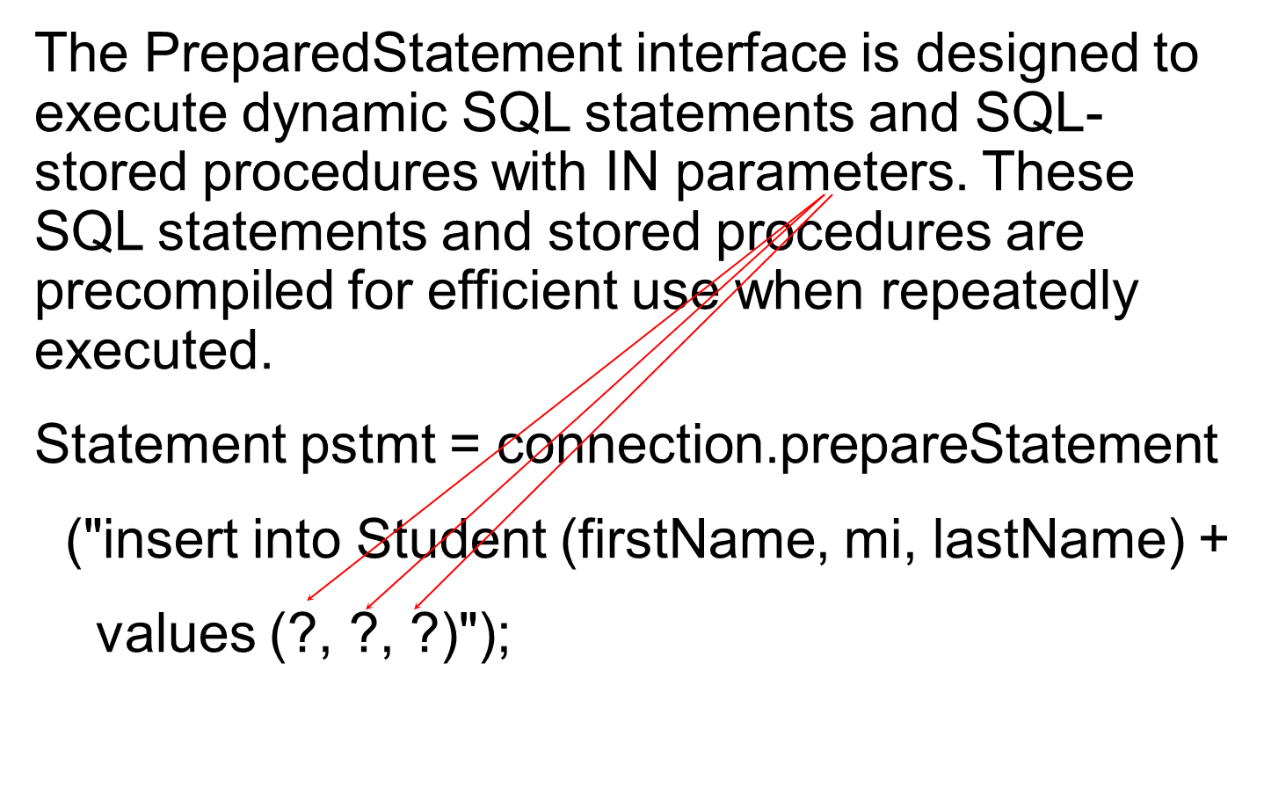
PreparedStatement
Notes:
These SQL statements and stored procedures are precompiled for efficient use when repeatedly executed.
Statement pstmt = connection.prepareStatement
Left parenthesis start double quotation marks insert into Student left parenthesis firstName, mi, lastName right parenthesis +
values left parenthesis question mark, question mark, question mark right parenthesis end double quotation marks right parenthesis semi colon.
An arrow from each of the above question marks points to parameters.

Slide 54
Example: Using PreparedStatement to Execute Dynamic SQL Statements
This example rewrites the preceding example using PreparedStatement.
FindGradeUsingPreparedStatement
Notes:
FindGradeUsingPreparedStatement: https://liveexample.pearsoncmg.com/html/FindGradeUsingPreparedStatement.html

Slide 55
Retrieving Database Metadata
Database metadata is the information that describes database itself. J D B C provides the DatabaseMetaData interface for obtaining database wide information and the ResultSetMetaData interface for obtaining the information on the specific ResultSet.

Slide 56
DatabaseMetadata
The DatabaseMetaData interface provides more than 100 methods for getting database metadata concerning the database as a whole. These methods can be divided into three groups: for retrieving general information, for finding database capabilities, and for getting object descriptions.

Slide 57
General Information
The general information includes the U R L, username, product name, product version, driver name, driver version, available functions, available data types and so on.

Slide 58
Obtaining Database Capabilities
The examples of the database capabilities are whether the database supports the GROUP BY operator, the ALTER TABLE command with add column option, supports entry-level or full A N S I92 S Q L grammar.

Slide 59
Obtaining Object Descriptions
the examples of the database objects are tables, views, and procedures.

Slide 60
Examples (1 of 2)
DatabaseMetaData dbMetaData = connection.getMetaData();
System.out.println("database URL: " + dbMetaData.getURL());
System.out.println("database username: " +
dbMetaData.getUserName());
System.out.println("database product name: " +
dbMetaData.getDatabaseProductName());
System.out.println("database product version: " +
dbMetaData.getDatabaseProductVersion());
System.out.println("JDBC driver name: " +
dbMetaData.getDriverName());
System.out.println("JDBC driver version: " +
dbMetaData.getDriverVersion());
System.out.println("JDBC driver major version: " +

Slide 61
Examples (2 of 2)
new Integer(dbMetaData.getDriverMajorVersion()));
System.out.println("JDBC driver minor version: " +
new Integer(dbMetaData.getDriverMinorVersion()));
System.out.println("Max number of connections: " +
new Integer(dbMetaData.getMaxConnections()));
System.out.println("MaxTableNameLentgh: " +
new Integer(dbMetaData.getMaxTableNameLength()));
System.out.println("MaxColumnsInTable: " +
new Integer(dbMetaData.getMaxColumnsInTable()));
connection.close();
Sample run on next slide

Slide 62
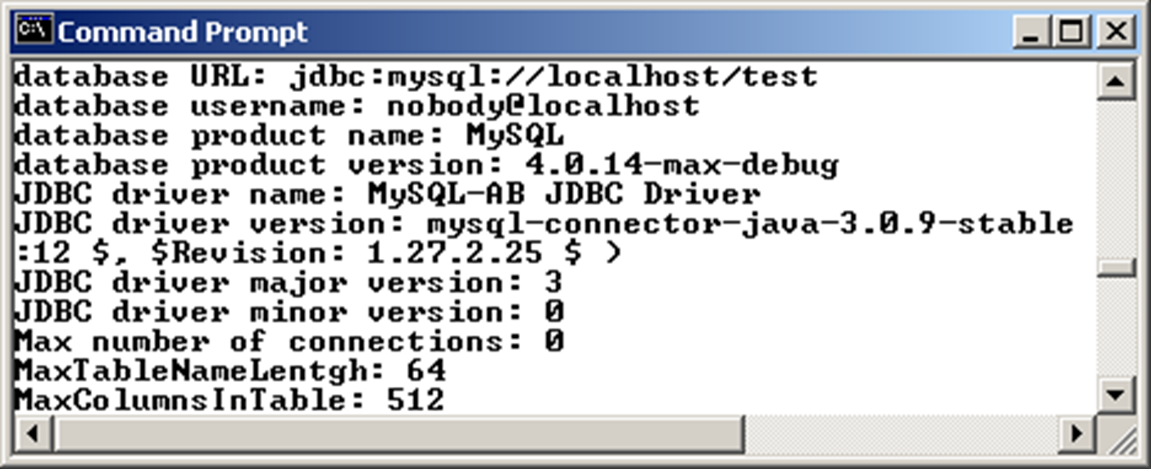
Sample Run
Notes:
database URL colon jdbc colon mysql colon forward slash forward slash localbost forward slash test database username colon nobodyelocalhost database product name colon MySQL database product version colon 4.0.14-max-debug JDBC driver name colon MySQL-AB JDBC Driver JDBC driver version colon mysql-connector-java-3.0.9-stable colon 12 $, $Revision colon 1.27.2.25 $ ) JDBC driver major version colon 3 JDBC driver minor version colon 0 Max number of connections colon 0 MaxTableNameLentgh colon 64 MaxColumnsInTable colon 512.

Slide 63

Copyright
This work is protected by United States copyright laws and is provided solely for the use of instructors in teaching their courses and assessing student learning. Dissemination or sale of any part of this work (including on the World Wide Web) will destroy the integrity of the work and is not permitted. The work and materials from it should never be made available to students except by instructors using the accompanying text in their classes. All recipients of this work are expected to abide by these restrictions and to honor the intended pedagogical purposes and the needs of other instructors who rely on these materials.

