Slide 1
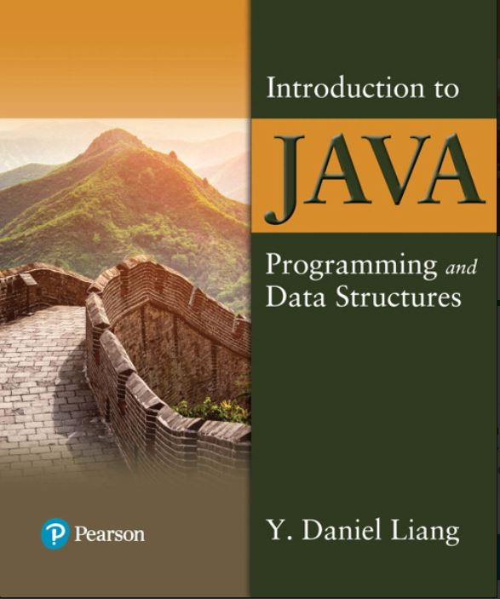

Introduction to Java Programming and Data Structures
Twelfth Edition
Chapter 36
Internationalization
Copyright © 2020 Pearson Education, Inc. All Rights Reserved
Notes:
If this PowerPoint presentation contains mathematical equations, you may need to check that your computer has the following installed:
1) MathType Plugin
2) Math Player (free versions available)
3) NVDA Reader (free versions available)
Slides in this presentation contain hyperlinks. JAWS users should be able to get a list of links by using INSERT+F7

Slide 2
Objectives
36.1 To describe Java's internationalization features (§36.1).
36.2 To construct a locale with language, country, and variant (§36.2).
36.3 To display date and time based on locale (§36.3).
36.4 To display numbers, currencies, and percentages based on locale (§36.4).
36.5 To develop applications for international audiences using resource bundles (§36.5).
36.6 To specify encoding schemes for text I/O (§36.6).

Slide 3
Java’s International Support
Use Unicode
Provide the Locale class to encapsulate information about a specific locale. A Locale object determines how locale-sensitive information, such as date, time, and number, is displayed, and how locale-sensitive operations, such as sorting strings, are performed.
Use the ResourceBundle class to separate locale-specific information such as status messages and the G U I component labels from the program. The information is stored outside the source code and can be accessed and loaded dynamically at runtime from a ResourceBundle, rather than hard-coded into the program.

Slide 4
The Locale Class
A Locale object represents a specific geographical, political, or cultural region. An operation that requires a Locale to perform its task is called locale-sensitive. You can use Locale to tailor information to the user.
Notes:
+Locale left parenthesis language colon String right parenthesis. Constructs a locale from a language code.
+Locale left parenthesis language colon String, country colon String right parenthesis. Constructs a locale from language and country codes.
+Locale left parenthesis language colon String, country colon String, variant colon String right parenthesis. Construct a locale from language, country, and variant codes.
+getCountry left parenthesis right parenthesis colon String. Returns the country/region code for this locale.
+getLanguage left parenthesis right parenthesis colon String. Returns the language code for this locale.
+getVariant left parenthesis right parenthesis colon String. Returns the variant code for this locale.
+getDefault left parenthesis right parenthesis colon Locale. Gets the default locale on the machine.
+getDisplayCountry left parenthesis right parenthesis colon String. Returns the name of the country as expressed in the current locale.
+getDisplayLanguage left parenthesis right parenthesis colon String. Returns the name of the language as expressed in the current locale.
+getDisplayName left parenthesis right parenthesis colon String. Returns the name for the locale. For example, the name is Chinese (China) for the locale Locale.CHINA.
+getDisplayVariant left parenthesis right parenthesis colon String. Returns the name for the locale’s variant if exists.

Slide 5
Creating a Locale
To create a Locale object, you can use the following constructor in Locale class:
Locale(String language, String country)
Locale(String language, String country, String variant)
Example:
new Locale(“en”, “US”);
new Locale(“fr”, “CA”);
Locale.CANADA
Locale.CANADA_FRENCH

Slide 6
The Locale-Sensitive Operations
An operation that requires a Locale to perform its task is called locale-sensitive. Displaying a number as a date or time, for example, is a locale-sensitive operation; the number should be formatted according to the customs and conventions of the user's locale.
Several classes in the Java class libraries contain locale-sensitive methods. Date, Calendar, DateFormat, and NumberFormat, for example, are locale-sensitive. All the locale-sensitive classes contain a static method, getAvailableLocales(), which returns an array of the locales they support. For example,
Locale[] availableLocales = Calendar.getAvailableLocales();
returns all the locales for which calendars are installed.

Slide 7
Processing Date and Time
java.util.Date
Introduced in Chapter 9.
java.util.Calendar and java.util.GregorianCalendar
Introduced in Chapter 13.
Different locales have different conventions for displaying date and time. Should the year, month, or day be displayed first? Should slashes, periods, or colons be used to separate fields of the date? What are the names of the months in the language? The java.text.DateFormat class can be used to format date and time in a locale-sensitive way for display to the user.

Slide 8
The TimeZone Class
TimeZone represents a time zone offset and also figures out daylight savings. To get a TimeZone object for a specified time zone ID, use TimeZone.getTimeZone(id). To set a time zone in a Calendar object, use the setTimeZone method with a time zone ID. For example, cal.setTimeZone(TimeZone.getTimeZone("CST")) sets the time zone to Central Standard Time. To find all the available time zones supported in Java, use the static method getAvailableIDs() in the TimeZone class. In general, the international time zone ID is a string in the form of continent/city like Europe/Berlin, Asia/Taipei, and America/Washington. You can also use the static method getDefault() in the TimeZone class to obtain the default time zone on the host machine.

Slide 9
Creating a TimeZone
You can also get a TimeZone object by using the class method getTimeZone(), along with a time zone I D. For example, the time zone I D for central standard time is CST. Therefore, you can get a C S T TimeZone object with the following:
TimeZone tz = TimeZone.getTimeZone("CST");

Slide 10
The DateFormat Class
The DateFormat class is an abstract class that provides many class methods for obtaining default date and time formatters based on the default or a given locale and a number of formatting styles, including FULL, LONG, MEDIUM, and SHORT.
Notes:
+format left parenthesis date colon Date right parenthesis colon String. Formats a Date into a date/time string.
+getDateInstance left parenthesis right parenthesis colon DateFormat. Gets the date formatter with the default formatting style for the default locale.
+getDateInstance left parenthesis dateStyle colon int right parenthesis colon DateFormat. Gets the date formatter with the given formatting style for the default locale.
+getDateInstance left parenthesis dateStyle colon int, aLocale colon Locale right parenthesis colon DateFormat. Gets the date formatter with the given formatting style for the given locale.
+getDateTimeInstance left parenthesis right parenthesis colon DateFormat. Gets the date and time formatter with the default formatting style for the default locale.
+getDateTimeInstance left parenthesis dateStyle colon int, timeStyle colon int right parenthesis colon DateFormat. Gets the date and time formatter with the given date and time formatting styles for the default locale.
+getDateTimeInstance left parenthesis dateStyle colon int, timeStyle colon int, aLocale colon Locale right parenthesis colon DateFormat. Gets the date and time formatter with the given formatting styles for the given locale.
+getInstance left parenthesis right parenthesis colon DateFormat. Get a default date and time formatter that uses the SHORT style for both the date and the time.

Slide 11
DateFormat Formats
SHORT is completely numeric, such as 12.13.52 or 3:30pm
MEDIUM is longer, such as Jan 12, 1952
LONG is even longer, such as January 12, 1952 or 3:30:32pm
FULL is completely specified, such as Tuesday, April 12, 1952 AD or 3:30:42pm PST

Slide 12
Creating a DateFormat
You can use the getDateTimeInstance() method to obtain a DateFormat object:
public static final DateFormat getDateTimeInstance(int dateStyle, int timeStyle, Locale aLocale)
This gets the date and time formatter with the given formatting styles for the given locale.

Slide 13
The SimpleDateFormat Class
The date and time formatting subclass, such as SimpleDateFormat, enables you to choose any user-defined patterns for date and time formatting. To specify the time format, use a time pattern string:
formatter = new SimpleDateFormat("yyyy.MM.dd G 'at' hh:mm:ss Z");
1997.11.12 AD at 04:10:18 PST

Slide 14
Example: Displaying an International Clock
Objective: Write a program that displays a clock to show the current time based on the specified locale and time zone. The locale and time zone are selected from the combo boxes that contain the available locales and time zones in the system.

Slide 15
Example (1 of 4)
Notes:
The first window shows a drop down button for Locale with Greek (Greece) el GR selected and a drop down menu for Time Zone with Europe slash Athens selected. A clock shows the time as 12, 40, 46. The second window shows a drop down button for Locale with Chinese (Hong Kong) zh HK selected and a drop down menu for Time Zone with Asia slash Hong Kong selected. A clock shows the time as 6, 40, 49.

Slide 16
Example (2 of 4)
WorldClock
WorldClockControl
WorldClockApp
Notes:
BorderPane, WorldClockControl leading to javafx.scene.layout.BorderPane, and WorldClockApp leading to javafx.application.Application. A line connects WorldClock to WorldClockControl with 1 near each end. A shaded rhombus is attached to WorldClockControl on the left. Another line connects WorldClockControl to WorldClockApp with 1 near each end. A shaded rhombus is attached to WorldClockApp on the left. The codes are as follows.
WorldClock.
Hyphen timeZone colon TimeZone
Hyphen locale colon Locale
Hyphen clock colon ClockPane
Hyphen lblDigitTime colon Label
+WorldClock left parenthesis right parenthesis
+setTimeZone left parenthesis timeZone colon
TimeZone right parenthesis colon void
+setLocale left parenthesis locale colon Locale right parenthesis colon void
Hyphen setCurrentTime left parenthesis right parenthesis colon void.
WorldClockControl.
Hyphen clock colon WorldClock
Hyphen cboLocales colon ComboBox less than symbol String greater than symbol
Hyphen cboTimeZones colon ComboBox less than symbol String greater than symbol
Hyphen availableLocales colon Locale left bracket right bracket
Hyphen availableTimeZones colon String left bracket right bracket
+WorldClockControl left parenthesis right parenthesis
Hyphen setAvailableLocales left parenthesis right parenthesis colon void
Hyphen setAvailableTimeZones left parenthesis right parenthesis colon void.
WorldClockApp.
+start left parenthesis primaryStage colon Stage right parenthesis colon void
+main left parenthesis args colon String left bracket right bracket right parenthesis colon void.
WorldClock: https://liveexample.pearsoncmg.com/html/WorldClock.html
WorldClockControl: https://liveexample.pearsoncmg.com/html/WorldClockControl.html
WorldClockApp: https://liveexample.pearsoncmg.com/html/WorldClockApp.html

Slide 17
Example: Displaying a Calendar
Objective: Display the calendar based on the specified locale. The user can specify a locale from a combo box that consists of a list of all the available locales supported by the system.

Slide 18
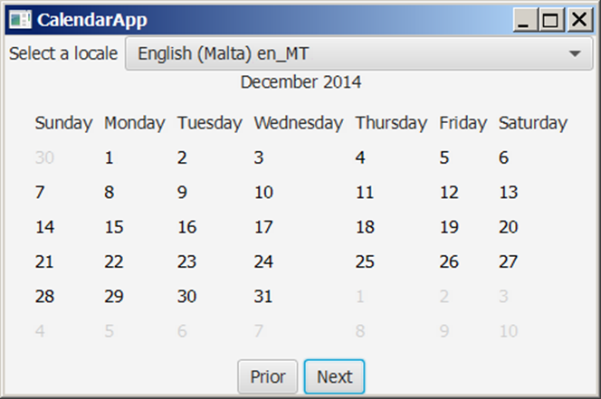
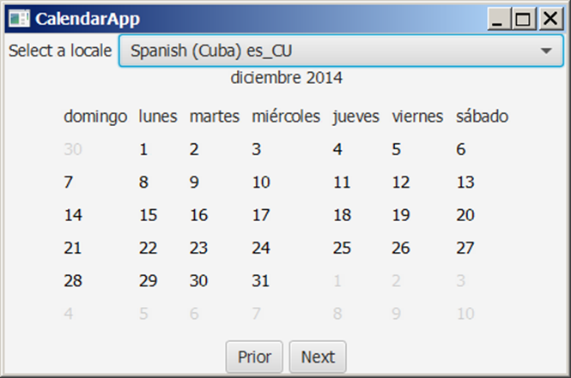
Example (3 of 4)
CalendarApp
Notes:
CalendarApp: https://liveexample.pearsoncmg.com/html/CalendarApp.html

Slide 19
Example (4 of 4)
CalendarPane
CalendarApp
Notes:
BorderPane and CalendarApp leading to javafx.application.application. A line connect CalendarPane CalendarApp with 1 near each end. A shaded rhombus is attached to the CalendarApp on the left. The codes are as follows.
CalendarPane
Hyphen month colon int
Hyphen year colon int
Hyphen calendar colon java.util.Calendar
Hyphen locale colon Locale
+getMonth left parenthesis right parenthesis colon int
+setMonth left parenthesis newMonth colon int right parenthesis colon void
+getYear left parenthesis right parenthesis colon int
+setYear left parenthesis newYear colon int right parenthesis colon void
+setLocale left parenthesis newLocale colon Locale right parenthesis colon void
+showHeader left parenthesis right parenthesis colon void
+showDayNames left parenthesis right parenthesis colon void
+showDays left parenthesis right parenthesis colon void. javafx.application.Application
CalendarApp
Hyphen calendarPane colon CalendarPane
Hyphen cboLocale colon ComboBox less than symbol String greater than symbol
Hyphen btPrior colon Button
Hyphen btNext colon Button
Hyphen locales colon java.util.Locale left bracket right bracket
+start left parenthesis primaryStage colon Stage right parenthesis colon void
+main left parenthesis args colon String left bracket right bracket right parenthesis colon void.
CalendarPane: https://liveexample.pearsoncmg.com/html/CalendarPane.html
CalendarApp: https://liveexample.pearsoncmg.com/html/CalendarApp.html

Slide 20
Formatting Numbers
Formatting numbers as currency or percentages is highly locale dependent.
For example, number 5000.50 is displayed as $5,000.50 in the US currency, but the same number is displayed as 5 000,50 F in the French currency.

Slide 21
The NumberFormat Class (1 of 3)
Notes:
+getInstance left parenthesis right parenthesis colon NumberFormat. Returns the default number format for the current default locale.
+getInstance left parenthesis locale colon Locale right parenthesis colon NumberFormat. Returns the default number format for the specified locale.
+getIntegerInstance left parenthesis right parenthesis colon NumberFormat. Returns an integer number format for the current default locale.
+getIntegerInstance left parenthesis locale colon Locale right parenthesis colon NumberFormat. Returns an integer number format for the specified locale.
+getCurrencyInstance left parenthesis right parenthesis colon NumberFormat. Returns a currency format for the current default locale.
+getNumberInstance left parenthesis right parenthesis colon NumberFormat. Returns a general purpose number format for the current default locale.
+getNumberInstance left parenthesis locale colon Locale right parenthesis colon NumberFormat. Returns a percentage format for the current default locale.
+getPercentInstance left parenthesis right parenthesis colon NumberFormat. Returns a percentage format for the specified locale.
+getPercentInstance left parenthesis locale colon Locale right parenthesis colon NumberFormat. Formats a floating-point number.
+format left parenthesis number colon double right parenthesis colon String. Formats an integer.
+format left parenthesis number colon long right parenthesis colon String. Returns the maximum number of allowed fraction digits.
+getMaximumFractionDigits left parenthesis right parenthesis colon int. Sets the maximum number of allowed fraction digits.
+setMaximumFractionDigits left parenthesis newValue colon int right parenthesis colon void. Returns the minimum number of allowed fraction digits.
+getMinimumFractionDigits left parenthesis right parenthesis colon int. Sets the minimum number of allowed fraction digits.
+setMinimumFractionDigits left parenthesis newValue colon int right parenthesis colon void. Returns the maximum number of allowed integer digits in a fraction number.
+getMaximumIntegerDigits left parenthesis right parenthesis colon int. Sets the maximum number of allowed integer digits in a fraction number.
+setMaximumIntegerDigits left parenthesis newValue colon int right parenthesis colon void. Returns the minimum number of allowed integer digits in a fraction number.
+getMinimumIntegerDigits left parenthesis right parenthesis colon int. Sets the minimum number of allowed integer digits in a fraction number.
+setMinimumIntegerDigits left parenthesis newValue colon int right parenthesis colon void. Returns true if grouping is used in this format. For example, in the English locale, with grouping on, the number 1234567 might be formatted as start double quotation marks 1,234,567 end double quotation marks.
+isGroupingUsed left parenthesis right parenthesis colon Boolean. Set whether or not grouping will be used in this format.
+setGroupingUsed left parenthesis newValue colon boolean right parenthesis colon void. Set whether or not grouping will be used in this format.
+parse left parenthesis String source right parenthesis colon Number. Parses string into a number.
+getAvailableLocales left parenthesis right parenthesis colon Locale left bracket right bracket. Gets the set of Locales for which NumberFormats are installed.

Slide 22
The NumberFormat Class (2 of 3)
use one of the factory class methods to get a formatter.
Use getInstance() or getNumberInstance() to get the normal number format.
Use getCurrencyInstance() to get the currency number format.
Use getPercentInstance() to get a format for displaying percentages. With this format, a fraction like 0.53 is displayed as 53%.

Slide 23
The NumberFormat Class (3 of 3)
For example, to display a number in percentages, you can use the following code to create a formatter for the given locale.
NumberFormat percForm
NumberFormat.getPercentInstance(locale);
You can then use percForm to format a number into a string like this:
String s = percForm.format(0.075);

Slide 24
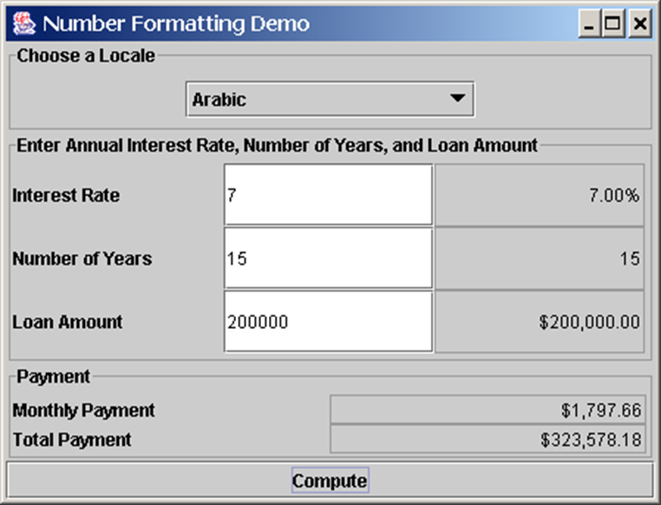
Example: Formatting Numbers
Objective: This example creates a loan calculator similar to the one in Listing 15.6. This new loan calculator allows the user to choose locales, and displays numbers in locale-sensitive format.
NumberFormatDemo
Notes:
The dialog box has three sections. The top section is for choose a locale with Arabic selected in a drop down button. The next section is for enter annual interest rate, number of years, and loan amount. The text box for interest rate has 7 entered in it with output displayed as 7.00%. The text box for number of years has 15 entered in it with output displayed as 15. The text box for interest rate has 200000 entered in it with output displayed as 200,000,00. The bottom section is for payment and shows value of monthly payment as $1,797.66 and total payment as $323,578.18. The button for compute is at the bottom.
NumberFormatDemo: https://liveexample.pearsoncmg.com/html/NumberFormatDemo.html

Slide 25
Resource Bundles (Optional)
A resource bundle is a Java class file or a text file that provides locale-specific information. This information can be accessed by Java programs dynamically.
When your program needs a locale-specific resource, a message string for example, your program can load the string from the resource bundle that is appropriate for the desired locale. In this way, you can write program code that is largely independent of the user's locale isolating most, if not all, of the locale-specific information in resource bundles.

Slide 26
Example: Using Resource Bundles
Objective: This example modifies the NumberFormattingDemo program in the preceding example to display messages, title, and button labels in English, Chinese, and French languages.

Slide 27
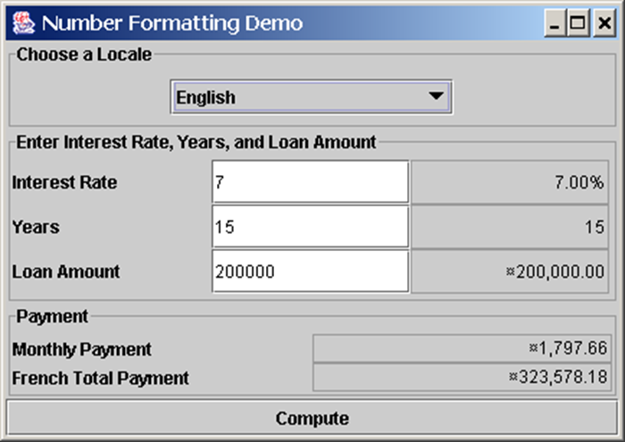
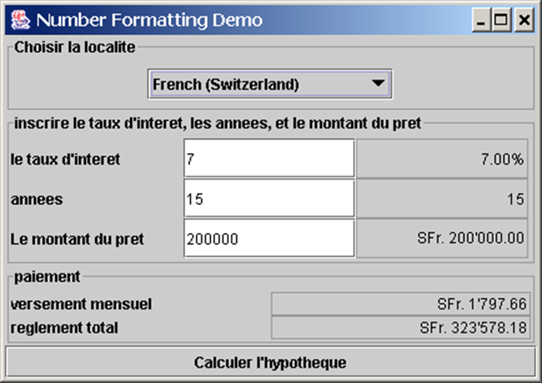
Example (1 of 2)
ResourceBundleDemo
Notes:
ResourceBundleDemo: https://liveexample.pearsoncmg.com/html/ResourceBundleDemo.html

Slide 28

Copyright
This work is protected by United States copyright laws and is provided solely for the use of instructors in teaching their courses and assessing student learning. Dissemination or sale of any part of this work (including on the World Wide Web) will destroy the integrity of the work and is not permitted. The work and materials from it should never be made available to students except by instructors using the accompanying text in their classes. All recipients of this work are expected to abide by these restrictions and to honor the intended pedagogical purposes and the needs of other instructors who rely on these materials.

