Slide 1

Data Analyst
James B
September 2025

Slide 2



OUTLINE
Executive Summary
Introduction
Methodology
Results
Visualization – Charts
Dashboard
Discussion
Findings & Implications
Conclusion
Appendix

Slide 3

EXECUTIVE SUMMARY
Coding trends according to StackOverflow
Visualizations will show findings from data analysis
Findings and implications are summarized
Dashboards show aggregate visualized information
Conclusion

Slide 4

INTRODUCTION
This presentation highlights trends in technology according to StackOverflow
Focus on programming languages and types
Many further data points are available
Age
Experience
Location
Salary
Etc
This is intended for job seekers, employees, employers, and other stakeholders in the tech industry

Slide 5

METHODOLOGY
Data Cleaning
Data Exploring
Data Analysis
Python, Jupyter, SQL
Pandas, Matplotlib, Sqlite3, Numpy
Visualization
Charts
Dashboards

Slide 6
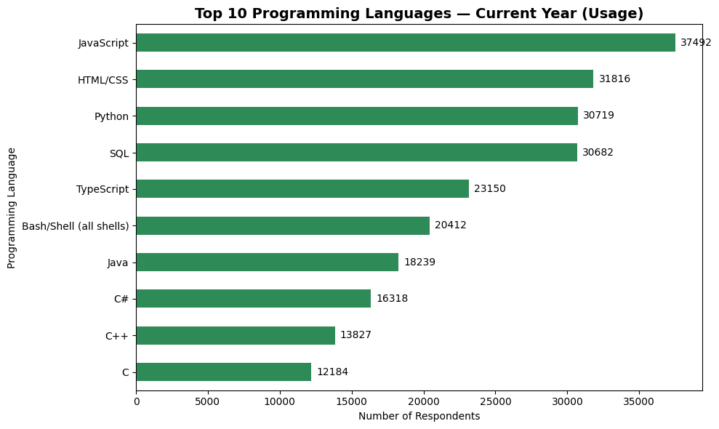
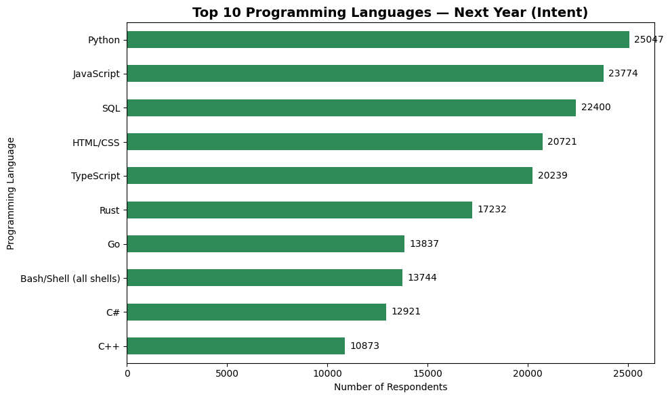
PROGRAMMING LANGUAGE TRENDS

Slide 7
PROGRAMMING LANGUAGE TRENDS - FINDINGS & IMPLICATIONS
Findings
The top five retain top five positions
Python moves from 3rd to 1st place
Rust and Go appear on the top ten
Implications
The most popular languages are steady
Python is dominating with ubiquity
Rust and Go are trending strongly

Slide 8
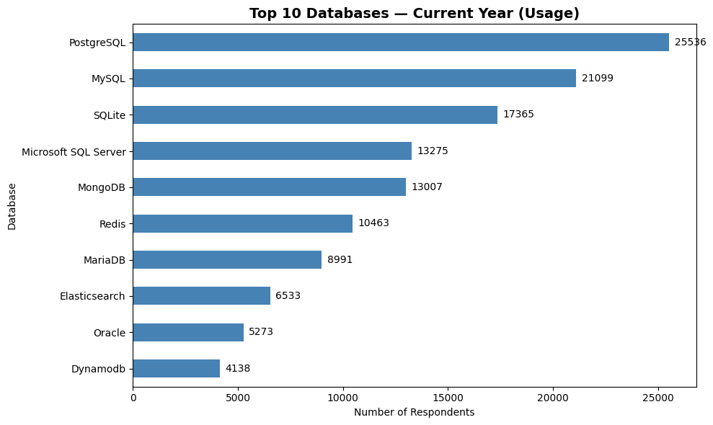
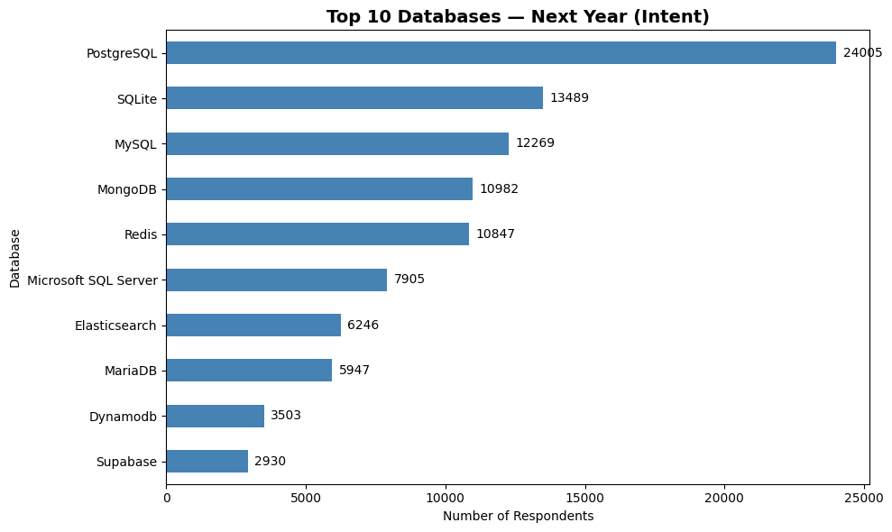
DATABASE TRENDS

Slide 9
DATABASE TRENDS - FINDINGS & IMPLICATIONS
Findings
PostgreSQL remains most popular
SQLite overtakes MySQL for second place
4 of 5 of the top 5 remain in top 5
Implications
PostgreSQL declines and may lose first place in subsequent years
SQLite is increasingly used for education and training
The top database languages are steady, MS SQL Server dropped to 6th place

Slide 10

DASHBOARD
<Please present your dashboard in the following slides.>

Slide 11
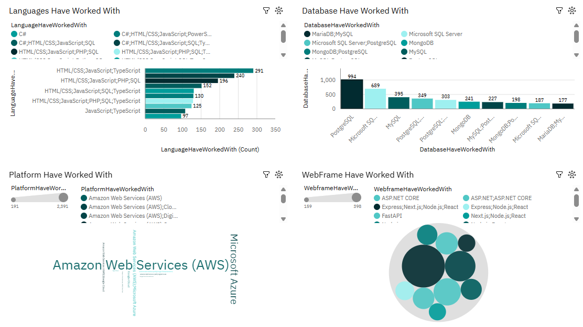
DASHBOARD TAB 1

Slide 12
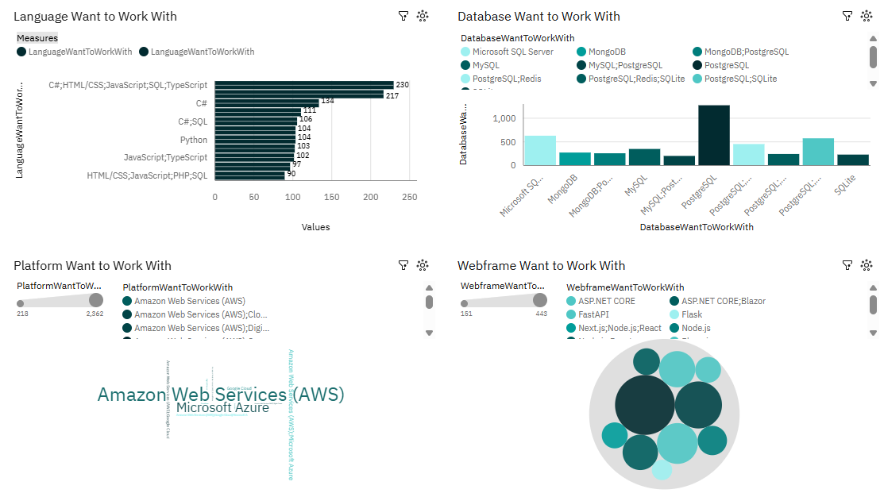
DASHBOARD TAB 2

Slide 13
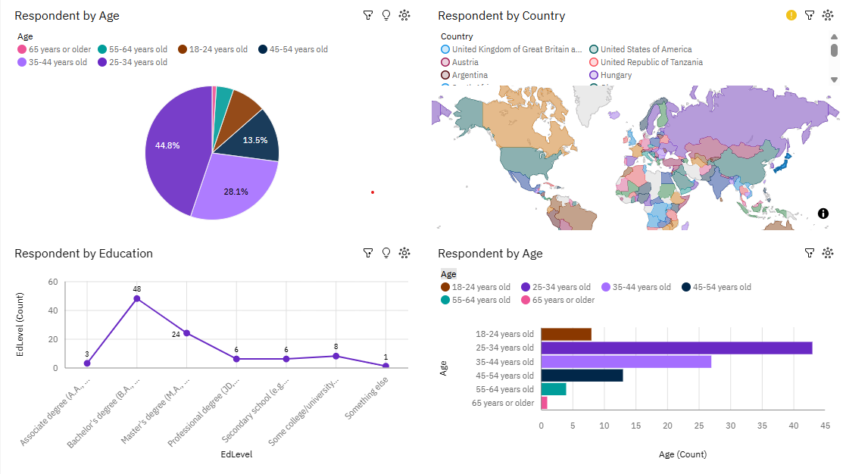
DASHBOARD TAB 3

Slide 14
DISCUSSION
This data comes from StackOverflow
How would these results compare to analysis from different sources?
Non-English sources?

Slide 15
OVERALL FINDINGS & IMPLICATIONS
Findings
Tech jobs are strongest in the US
The preferred languages are fluctuating
Salaries are good
Implications
Substack is mostly used for US jobs
New languages are competing for space occupied by popular languages
Coding will continue to be a reliable job sector in the future

Slide 16

CONCLUSION
Learning programming is worthwhile
The job market and salary are promising
Coding is increasingly in demand across industries
New languages are replacing some languages while other languages are remaining strong

Slide 17

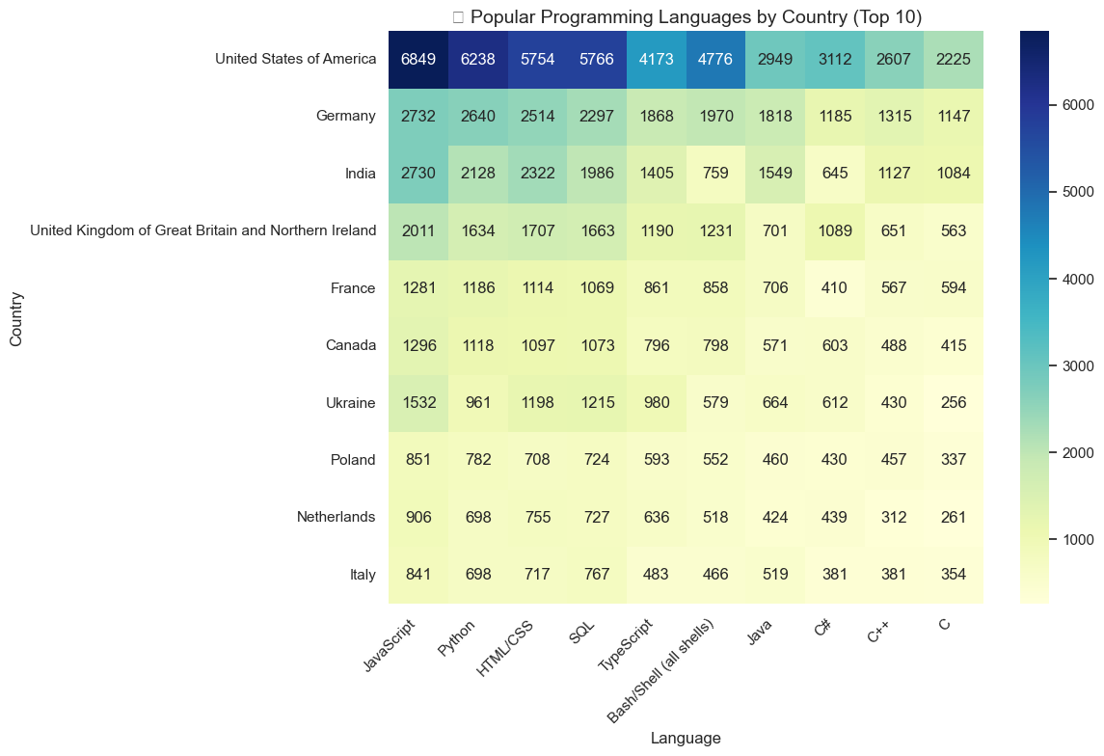
APPENDIX

Slide 18
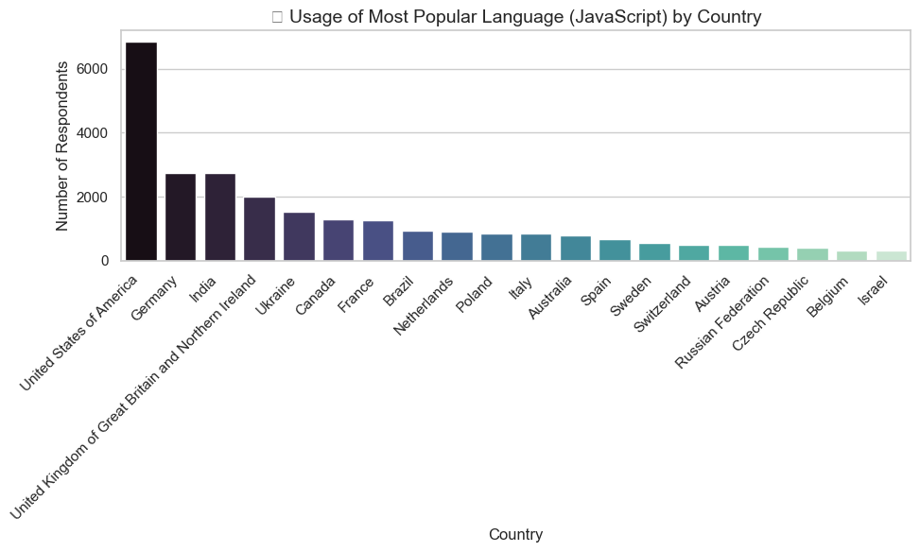
APPENDIX

Slide 19
JOB POSTINGS

Slide 20
POPULAR LANGUAGES

