Slide 1


Slide 2
Cloud Computing

Slide 3
What is the cloud computing?
Cloud computing is a platform that allows on-demand availability and delivery of virtual IT resources for personal or business use.
Cloud infrastructure or services mean that customers do not physically own the infrastructure and instead rent it from the provider.
All cloud services can be accessed over the internet, making it easy for customers to use and operate.

Slide 4
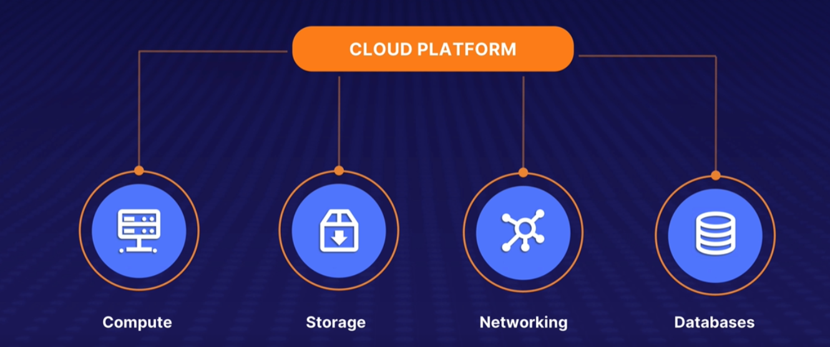
Cloud Services
Cloud services include compute, storage, networking, and database services.
These services can be used for setting up an entire network, software testing, or data analytics.

Slide 5
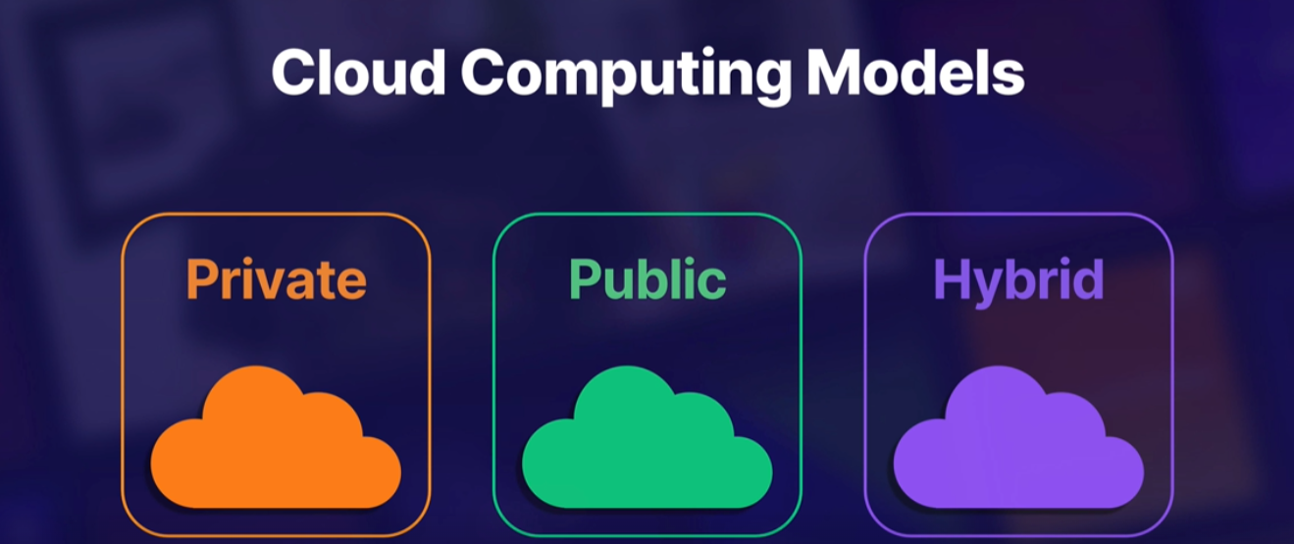
Cloud Models
Cloud operates on three different models: private, public, and hybrid.
Private cloud is for organizations operating on a private network.
Public cloud is owned by providers like Amazon, Google, or Microsoft and provides cloud computing infrastructure for individuals and businesses.
Hybrid cloud is a combination of both private and public cloud offerings.

Slide 6
Origins of Cloud Computing
Cloud computing comes from the term virtualization.
Virtualization is a process of running a virtual instance of a computer system in a layer abstracted from the actual hardware.

Slide 7
History
In 1963, the Defense Advanced Research Project Agency funded $2 million for a project, which included developing a technology that allowed a computer to be used by 2 or more persons simultaneously.
In 1969, Joseph Carl Robnett Licklider built the concept called the Intergalactic Computer Network, which connected people and data from anywhere at any time.
In 1999, Salesforce delivered software over the internet to their customers using the cloud computing model.
In 2002, Amazon used this model to provide capacity for their own infrastructure and in 2006, they launched Amazon Web Services (AWS).
Cloud computing has a rich history that dates back to the 1960s.
The concept of the cloud has evolved over time, and today it is a crucial part of our daily lives.
Understanding the origins of cloud computing is important to have a comfortable conversation about it.

Slide 8
Why we use cloud
One great reason to use cloud computing is speed to market.
Cloud computing allows for quick updates, high availability, fault tolerance, and unlimited storage.
-On-Prem Network
An on-prem network is a network that serves an application to its users using servers located on-site.
If a server goes down, it can take weeks to replace it and get it back up and running.
-Cloud Network
In the cloud, if a server goes down, another server can be up within seconds with all of the software and dependencies already installed and ready to go.
This dramatically decreases downtime and impact to the customer.
-Other Benefits of Cloud Computing
Cloud computing allows for quick updates and integration of products, services, and software.
It provides high availability and fault tolerance, ensuring that services stay available to end users without downtime.
It also provides unlimited storage for any files, no matter the size.

Slide 9
Why should I care about the Cloud?
Cloud computing is easy to use and doesn't require a technical background.
Cloud computing can save you money on logistics, staffing, and infrastructure design.
Cloud computing provides access to collaboration tools like Zoom, Microsoft Teams, and Google Meet at a cheaper cost.
These tools allow you to collaborate with anyone across the globe.
Cloud computing provides a guaranteed uptime of services.
Cloud service providers offer service-level agreements that guarantee availability of services.
Cloud computing is an important technology that provides many benefits, including ease of use, cost savings, and guaranteed uptime.

Slide 10
Isn’t the cloud just Storage?
Cloud computing offers services for computing needs, networking, database solutions, and file storage.
Collaboration tools like Microsoft 365, Google Workspace, and QuickBooks are examples of cloud-based tools.
Cloud computing is more than just storage and offers a range of services to meet various needs.
Collaboration tools like Microsoft 365, Google Workspace, and QuickBooks are examples of cloud-based tools that provide a range of features and services to users.
This course will provide a deeper understanding of cloud computing and its many applications.

Slide 11
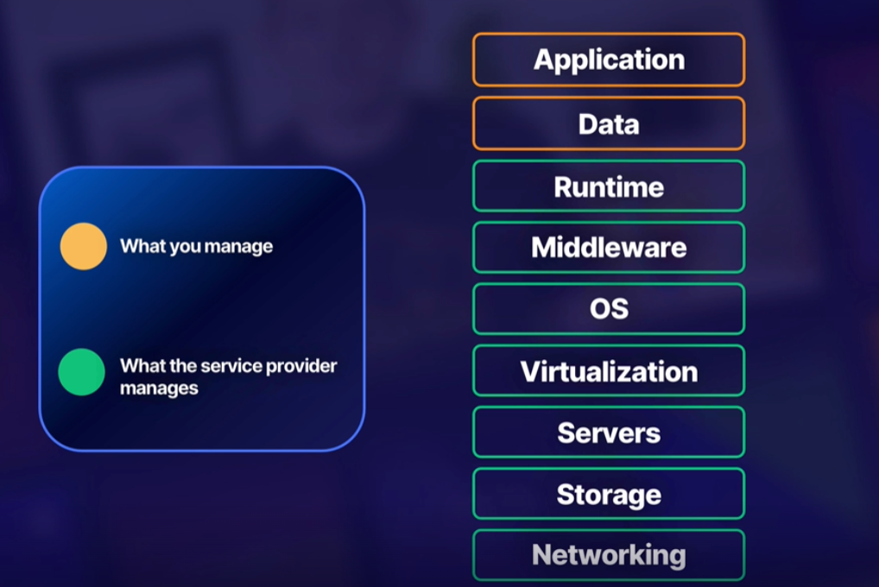
What is PaaS
PaaS stands for Platform as a Service.
It offers a complete development and deployment environment for the cloud.
With PaaS, the service provider manages the underlying infrastructure, while the customer manages the application and data.

Slide 12
PaaS Example
Elastic Beanstalk is an orchestration service offered by Amazon Web Services for deploying applications.
Google App Engine is a cloud computing Platform as a Service for developing and hosting web applications in Google-managed data centers.
Heroku is a cloud Platform as a Service that supports several programming languages.

Slide 13
What is SaaS
SaaS stands for Software as a Service.
It is a way companies deliver applications or software over the internet to the end user.
Everything is managed by the service provider.
The service provider manages everything from the application, data, runtime, middleware, operating system, virtualization, servers, storage, and networking.
The end user only needs to show up and use the software or application.

Slide 14
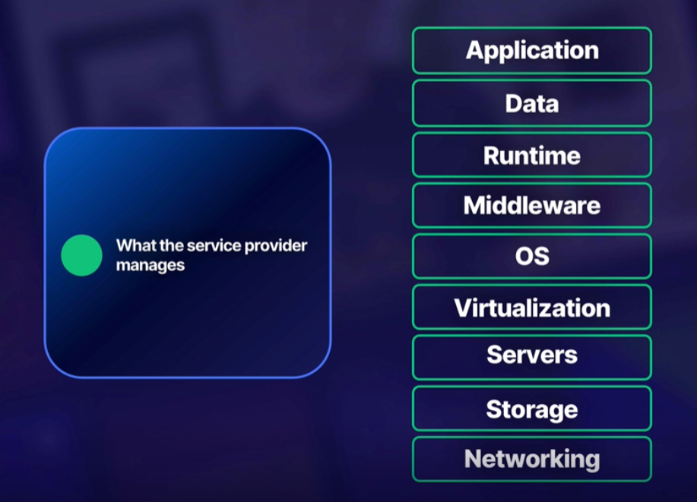
SaaS Examples
Office 365
Gmail
Webex

Slide 15
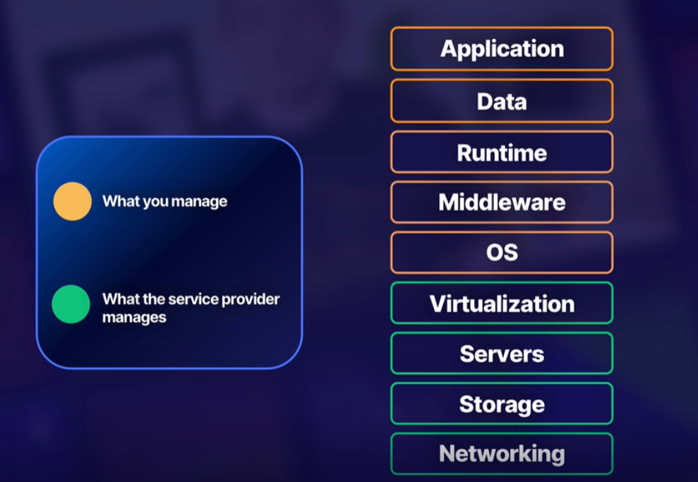
What is IaaS
IaaS stands for Infrastructure as a Service
It is a form of cloud computing that provides virtualized computing services over the internet to its users
Virtualization uses software to create an abstract layer over computer hardware, allowing its elements to be divided and offered to users as multiple computers

Slide 16
What is FaaS
FaaS stands for Function as a Service
It is a cloud computing service that allows code to be executed in response to events
Uses the serverless framework
Focus on writing code, not infrastructure
Pay only for the time the code runs
Scalability and flexibility

Slide 17
How FaaS works
Function takes data, processes it, responds or returns a result
With FaaS, you manage only the application while the service provider manages everything else from data to the network
Examples
AWS Lambda, Google Cloud Functions, and Azure Functions are examples of FaaS

Slide 18
What is a Server
A server is a computer or device that provides programmable service to another computer or its user.
There are different types of servers, including database servers, app servers, and web servers.
These servers work together to accomplish one goal: providing the best experience for the user.
By learning about servers, you can understand how cloud technology works and how servers are used in various applications.
Servers can be provisioned in the cloud with a specific CSP like AWS, Azure, or Google Cloud.
When you connect to a service like Hulu, you're actually connecting to a Hulu server provisioned in the cloud with a specific cloud service provider.

Slide 19
What is Serverless
Serverless is a cloud computing execution model in which the cloud service provider allocates machine resources on demand.
This model is also known as Function as a Service (FaaS), where the user creates the code that will allocate resources in response to certain event dependencies within that code.
With serverless, the user does not have to manage any resources as the provider will allocate everything needed in response to the activity within the user's code or function.
This allows for greater flexibility and scalability as the provider can adjust resources as needed to match the demand of the user's code.
Serverless is a powerful tool that allows developers to focus on writing code without worrying about infrastructure management.

