Slide 1


Slide 2
AWS Cloud Computing

Slide 3
What is the aws?
AWS is the world's leading cloud computing platform, offering a wide range of services and benefits
Owned by Amazon.com, Inc.
Provides a wide range of cloud-based services
Your choice in cloud provider depends on your needs, preferences, and organization's requirements

Slide 4
AWS Services Overview
Compute services: Amazon EC2, AWS Lambda, Amazon Lightsail
Storage services: Amazon S3, Amazon EBS, Amazon Glacier
Database services: Amazon RDS, Amazon DynamoDB, Amazon Aurora
Networking and content delivery: Amazon VPC, Amazon CloudFront, AWS Direct Connect
Security and identity: AWS IAM, Amazon Cognito, AWS Shield

Slide 5
AWS Market Share and Competitors
AWS holds 32% of the cloud computing market share
Major competitors: Microsoft Azure (19%), Google Cloud (7%)
AWS is the preferred choice for many startups, enterprises, and government agencies

Slide 6
AWS Regions and Availability Zones
AWS Regions: Physical locations with data centers hosting AWS services
AWS Availability Zones: Multiple isolated and physically separate zones within a region

Slide 7
AWS Regions Around the World
North America: Ohio, Oregon, North California, North Virginia, GovCloud West, GovCloud East
South America: Sao Paulo
Europe: Frankfurt, London, Paris, Ireland, Milan, Stockholm
Middle East: Bahrain
Africa: Cape Town
Asia Pacific: Singapore, Beijing, Sydney, Tokyo, Seoul, Ningxia, Osaka, Mumbai, Hong Kong
New Region Announced: Melbourne, Australia

Slide 8
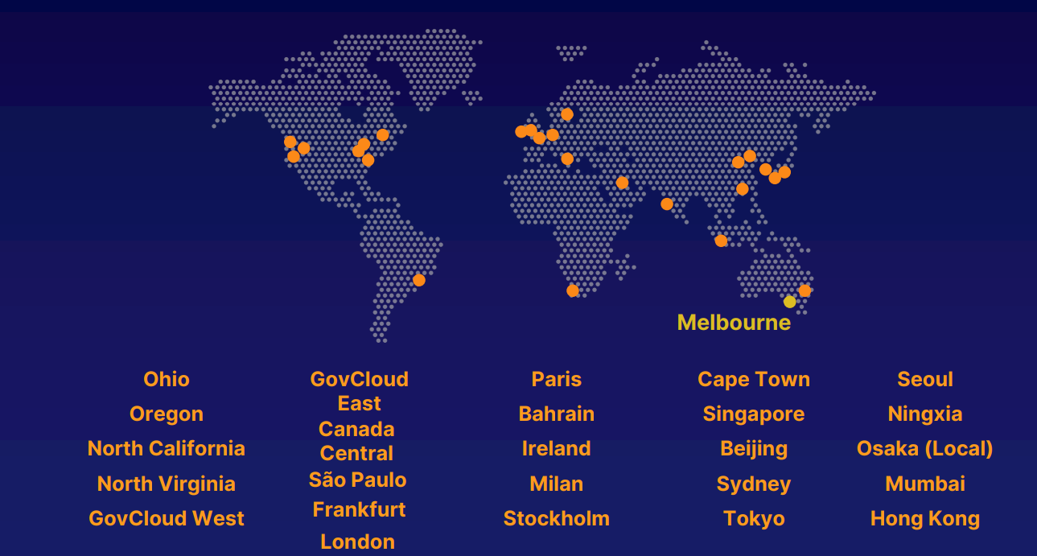
AWS Region

Slide 9
AWS Availability Zones
Each region has multiple availability zones
Independent power, cooling, and physical security
Connected via redundant, ultra-high-speed, low-latency networks

Slide 10
Purpose of Availability Zones
Redundancy: Protects workloads from issues in a single data center
Ensures high availability and fault tolerance

Slide 11
AWS Security and Identity
Ensuring data and infrastructure protection
Managing access and identity
AWS offers various solutions for security and identity management

Slide 12
Data Protection Services
Amazon Macie: Discover and protect sensitive data
AWS Key Management Service: Store and manage encryption keys
AWS CloudHSM: Hardware-based key storage and regulatory compliance
AWS Certificate Manager: Provision, manage, and deploy SSL/TLS certificates
AWS Secrets Manager: Rotate, manage, and retrieve secrets

Slide 13
Infrastructure Protection Services
AWS Shield: Denial of service protection
AWS Web Application Firewall (WAF): Filter malicious website traffic
AWS Firewall Manager: Centrally manage firewall rules

Slide 14
Threat Detection Services
Amazon GuardDuty: Automatically detect threats
Amazon Inspector: Analyze application security
AWS Config: Record and evaluate configurations of AWS resources
AWS CloudTrail: Track user activity and API usage

Slide 15
Identity Management Services
AWS Identity and Access Management (IAM): Securely manage access to AWS accounts, services, and resources
AWS Single Sign-On: Implement cloud single sign-on
Amazon Cognito: Manage identity inside applications
AWS Directory Service: Implement and manage Microsoft Active Directory
AWS Organizations: Centrally govern and manage multiple AWS accounts

Slide 16
Introduction to AWS Compute
Compute for any workload
Instances, Containers, and Serverless Computing
Processing of data and hosting applications

Slide 17
Instances (Virtual Machines)
Amazon EC2: Secure and resizable virtual machines in the cloud
Amazon EC2 Spot: Run fault-tolerant workloads for a reduced cost
Amazon EC2 Auto Scaling: Automatically adjust computing capacity
Amazon LightSail: Easy-to-use cloud platform for applications and websites

Slide 18
Containers
Amazon ECS: Run secure, reliable, and scalable containers
Amazon ECR: Store, manage, and deploy container images
Amazon EKS: Fully managed Kubernetes service

Slide 19
Containers
Solve dependency and versioning issues
Package program, libraries, and dependencies into a self-contained unit
Package program with specific versions of libraries and dependencies
Ensure consistent execution on any computer

Slide 20
Serverless
AWS Lambda: Run code without servers

Slide 21
AWS Lambda
AWS Lambda: A serverless compute service
Executes code in response to events
Simplifies management and reduces cost

Slide 22
How Lambda Works
Write code in supported languages (e.g., Python, Node.js, Java)
Create a Lambda function
Define the event source (e.g., API Gateway, S3, CloudWatch)
AWS manages the underlying infrastructure

Slide 23
Benefits of AWS Lambda
No need to manage servers
Automatic scaling based on demand
Pay only for compute time consumed
Supports multiple languages and runtimes

Slide 24
Use Cases for Lambda
Data processing: Stream processing, ETL jobs, real-time analytics
Web applications: Backend APIs, microservices
Automation: Scheduled tasks, infrastructure management
Event-driven tasks: Notifications, image processing

Slide 25
Introduction to AWS Storage
Cloud storage: Store and access data using cloud services
Types of storage: File-based, Block, Object
AWS offers a range of storage services

Slide 26
File-Based Storage
Traditional storage type, used by home computers
Organize files in folders and directories
AWS Services: Amazon Elastic File System (EFS), Amazon FSx for Windows File Server

Slide 27
Block Storage
Files split into equal-sized chunks
Commonly used by server-based operating systems and databases
AWS Service: Amazon Elastic Block Store (EBS)

Slide 28
Object Storage
Files stored as objects with unique identifiers
Flat memory model for easy retrieval
AWS Service: Amazon Simple Storage Service (S3)

Slide 29
Backup and Data Migration
AWS Backup: Centrally manage and automate backups across AWS services
AWS Storage Gateway: Hybrid cloud storage with on-premise access
AWS Data Sync: Faster data transfer to and from AWS

Slide 30
AWS Database
Databases store organized collections of data.
AWS offers a variety of managed database services.

Slide 31
AWS Database types
Relational Databases:
Amazon Aurora
Amazon RDS
Amazon Redshift
NoSQL Databases:
Amazon DynamoDB
In-Memory Databases:
Amazon ElastiCache
Document Databases:
Amazon DocumentDB

Slide 32
UseCases of Database
Traditional applications
Web applications
Analytics and data warehousing
Content management systems
Caching and session management

Slide 33
AWS Networking Basics and the Internet
Networking involves connecting computers using technologies and services.
The internet is a global network that connects computers worldwide.
AWS provides essential technologies and services for the internet to function effectively.

Slide 34
Network Services on AWS
-Amazon VPC (Virtual Private Cloud):
Defines and provisions isolated virtual networks for AWS resources.
Allows you to customize network configurations, including IP addressing, subnets, and routing tables.
Provides advanced security features such as network access control lists (ACLs) and security groups.
Supports VPN (Virtual Private Network) connections for secure communication with on-premises networks.
-AWS Transit Gateway:
Simplifies network connectivity by acting as a hub that connects multiple Amazon VPCs and on-premises networks.
Streamlines network management and reduces operational overhead by centralizing routing and security policies.
Enables scalable and efficient communication between VPCs and on-premises resources.
Supports advanced features like VPC peering, route propagation, and transit VPCs.

Slide 35
Network Services on AWS
-AWS Private Link:
Enables private and secure connectivity between Amazon VPCs and on-premises applications.
Allows you to expose services privately, eliminating the need for public IP addresses.
Offers a seamless and consistent user experience by keeping traffic within the AWS network.
Facilitates integration with AWS services, third-party SaaS applications, and partner solutions.
-Amazon Route 53:
Offers a scalable and highly available domain name system (DNS) web service.
Hosts managed DNS for your applications, translating domain names into IP addresses.
Provides features like routing policies, health checks, and traffic management to ensure efficient application delivery.
Supports domain registration, DNS failover, and global load balancing for improved availability.

Slide 36
Network Services on AWS
-Elastic Load Balancing:
Automatically distributes incoming network traffic across multiple resources (e.g., EC2 instances, containers, IP addresses).
Improves application availability and fault tolerance by evenly distributing traffic.
Supports different load balancing types, including Application Load Balancer, Network Load Balancer, and Classic Load Balancer.
Integrates with other AWS services like Auto Scaling for dynamic capacity adjustments.
Amazon CloudFront:
Content delivery network (CDN) service that securely delivers data, videos, and applications globally.
Caches content at edge locations for low-latency access and reduced network congestion.
Offers high transfer speeds through optimized data transfer protocols, such as HTTP/2 and TCP Fast Open.
Provides security features like HTTPS encryption, access control, and integration with AWS Web Application Firewall (WAF).

