Slide 1


Slide 2
Defining DevOps
DevOps – Dev (Development) + Ops (Operations
Different people define DevOps in a variety of different ways
The definition below from Wikipedia is a good starting point:
“DevOps is a software engineering cultural practice that aims at unifying software development (dev) and software operations (ops…
DevOps aims at shorter development cycles, increased deployment frequency, more dependable releases, in close alignment with business objectives.”
Wikipedia (Feb 2018)

Slide 3
DevOps Is
Devops is first a Culture of collaboration between developers and operations people
This culture has given rise a particular set of practices
DevOps is a grassroots movement by practitioners for practioners

Slide 4
DevOps Is Not
DevOps is not tools, but Tools are essential to success in DevOps
DevOps is not a product

Slide 5
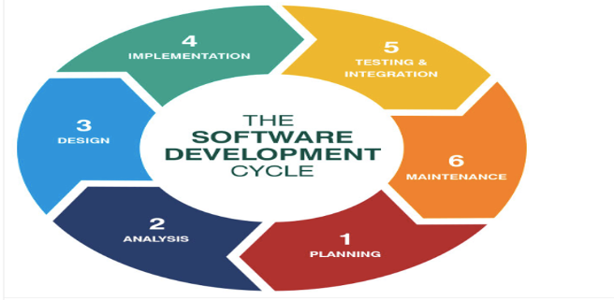
Software Development Lifecycle (SDLC)

Slide 6
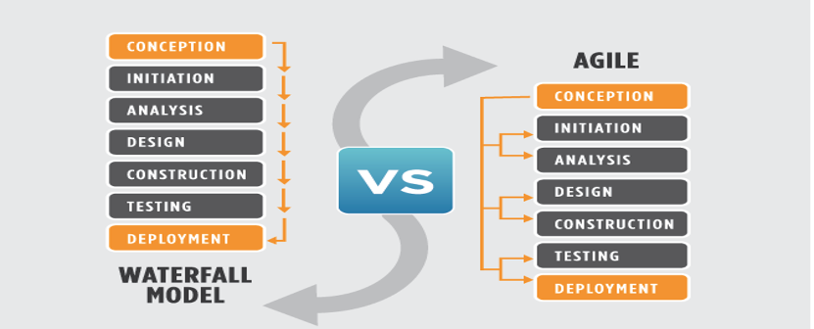
Waterfall Vs Agile

Slide 7
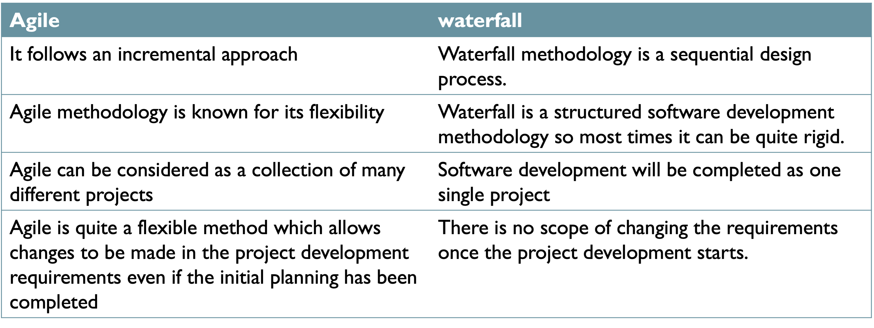
Waterfall vs Agile

Slide 8
Agile Software Development
DevOps grew out of the Agile software development movement
Agile seeks to develop software in small, frequent cycles in order to deliver functionality to customers quickly and quickly respond to changing business goals
DevOps and Agile often go hand-in-hand

Slide 9
Roles and Responsibilities of a DevOps Engineer
Almost all the duties of DevOps Engineer will revolve either Continuous Integration (CI) or Continuous Deployment (CD) or both
Many companies hire DevOps Engineer to work on their CICD pipeline
Based on the maturity level of the company ; a DevOps Engineer might work on whole pipeline or part of the pipeline
The job of a DevOps Engineer is to help build a steam lined process (CICD pipeline) by which companies can release & deploy their software faster

Slide 10
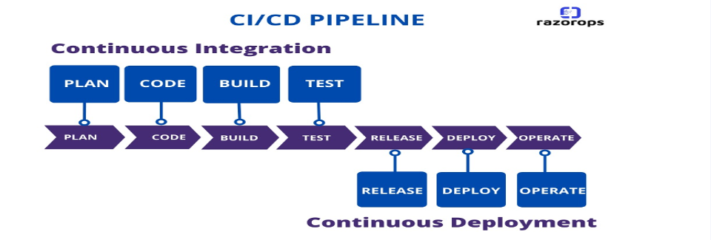
CICD Pipeline

Slide 11
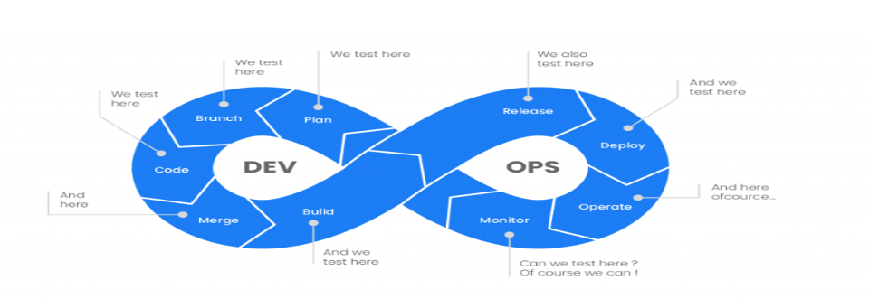
CICD………Continued

Slide 12
DevOps Culture
DevOps culture is about collaboration between dev and ops
Under the traditional separation between Dev and Ops, Dev and Ops have different and opposing goals
The goal of the development is to deliver feature in the hand of customer as quickly as possible- so their goal is speed
The goal of the operation team is to maintain the stability of the system and minimize downtime

Slide 13
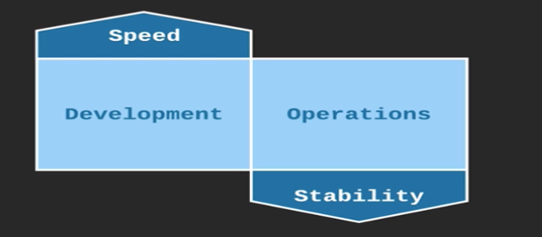
DevOps Culture….continued

Slide 14
DevOps Culture….Continued
These two goals end up becoming oppositions to one another because one of the worst thing for stability is changes. Every time you change a system you introduce a risk of instability.
So, while operations team is trying to maintain stability, development team is trying to deploy as many changes as possible. In order for them to deliver features in the hands of customers they have to deliver changes. And every one of them changes poses a risk for stability. So, these two goals are opposition to one another. And even if these teams want to cooperate because these opposing goals, they end up being opposition to one another. Development teams are often measured by the speed of their delivery. Operations team are measured by minimizing downtime. That's why Dev & Ops have a great incentive to fight against each other & be an opposition to each other.

Slide 15
DevOps Culture…..Continued
With DevOps, Dev and Ops work together and share the same goal.
In DevOps culture Developers and operation team are one group & they both share the same goals. And they are both measured according to those same goals. Both speed and stability are very important. What DevOps culture discovered is, when dev and ops together they are able to deliver both speed and stability to the organization.

Slide 16
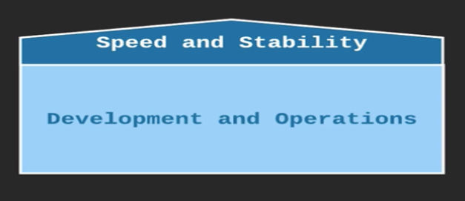
DevOps Culture…..Continued

Slide 17
Goals Of DevOps Culture
Dev and Ops are playing on the same team (in traditional culture Dev and Ops are in the opposing team, in order for one team to win the other team has to lose. In order for good speed of delivery stability has to compromise or in order to maintain good stability, speed has to be compromised)
Dev and Ops share the same goals (usually same measurement what means is that Developers are hold accountable for stability as much as they are hold accountable for delivering new features and operation engineers are hold accountable for speed of delivery just as much as they are hold accountable for stability)

Slide 18
Goals Of DevOps Culture….Continued
Fast time-to-market (TTM) (Time from code being finished and deployed to production and working, and faster the time to market is the most successful the organization will be)
Few Production failures
Immediate recovery from failures (in real world failures are going to happen, mistakes are going to be made, things are going to break any organization that doesn’t recognize that is deluding themselves. So, what you do? The best thing to do is ensure that you have a system in place when those things does happen you can recover quickly and immediately. The faster you can recover from problem the less impact they will have. Best case scenario is you can recover from a failure before customer can even notice. And engineers in DevOps culture will make that a possibility.)

Slide 19
Build Automation
What is Build Automation?
Build Automation is the automation of process of preparing code for deployment to a live environment
Depending on what languages are used, code needs to be compiled, linted, minified, transformed, unit tested etc
Build automation means taking these steps and doing them in a consistent, automated way using a script or tool
The tools of build automation often differ depending on what programming languages and frameworks are used, but they have one thing in common: automation!

Slide 20
What does Build Automation Looks Like?
Usually, build automation looks like running a command line tool that builds code using configuration files and/or scripts that are treated part of the source code.
Build automation tool is independent of IDE
Even if you can build within an IDE, it should be able to work same way outside of IDE
As much as possible, build automation should be agnostic of the configuration of the machine that it is built on
Your code should be able to build on someone else’s machine same way it builds on yours

Slide 21
Why do build automation?
Build automation is fast-automation handles task that would otherwise need to be done manually
Build automation is consistent - The build happens the same way every time, removing problems and confusions that can happen with manual builds.
Build automation is repeatable - The build can be done multiple times with the same result. Any version of the source code can always be transformed into deployable code in a consistent way
Build automation is portable - The build can be done same way on any machine. Anyone on the team can build on their machine, as well as on a shared build server. Building code doesn’t depend on specific people or machines.
Build automation is reliable – There will be fewer problems caused by bad builds

Slide 22
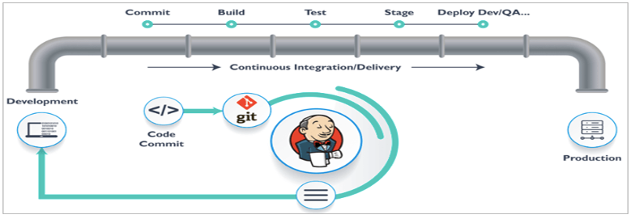
Build Automation

Slide 23
Continious Integration
Continious Integration (CI): the practice of frequently merging code changes done by developers.
Traditionally developers would work separately, perhaps for weeks at a time, and then merge all of their work together at the end in one large front.
Continious integration means merging consistently throughout the day, usually with the execution of automated tests to detect any problems caused by the merge
Merging all the time could be a lot of work, so to avoid that it should be automated

Slide 24
What Does Continious Integration looks like?
Continious integration usually done with the help of a CI server
When a developer commits a code change, the ci server sees the change and automatically performs a build, also executing automated tests
This occurs multiple times a day
If there is any problem with the build, the ci server immediately and automatically notifies the developer
If anyone commits the code that “breaks the build” they are responsible for fixing the problem or rolling back their changes immediately so that other developers can continue working

Slide 25
Why do Continious Integration?
Early detection of certain types of bugs- if code does not compile or an automated test fails, the developers are notified and can fix it immediately. The sooner those bugs are detected , the easier they are to fix!
Eliminate the scramble just before the big release- The code is constantly merged, so there is no need to do a big merge at the end.
Make frequent releases possible- Code is always in a state that can be deployed to production
Makes continuous testing possible- Since the code can always be run, QA testers can get their hands on all throughout the development process, not just at the end.
Encourages good coding practices- Frequent commits encourages simple, modular code

Slide 26
Continious Delivery and Continious Deployment
What is Continious Delivery?
Continuous Delivery (CD): the practice of continuously maintaining code in a deployable state
Regardless of whether or not the decision is made to deploy, the code is always in a state that is able to deploy
Some use the term continuous delivery and continuous deployment interchangeably or simply use the abbreviation CD

Slide 27
Continious Deployment
Continuous Deployment: the practice of frequently deploying small code changes to production
Continuous delivery is keeping the code in a deployable state. Continuous deployment is actually doing the deployment frequently.
Some companies that do continuous deployment, deploy to production multiple times a day
There is no standard for how often you should deploy, but in general the more often you deploy the better!
With continuous deployment, deployment to production are routine and commonplace. They are not a big scary event

Slide 28
What does Continious Delivery and Deployment look like?
Each version of the code goes through a series of stages such as automated build, automated testing, and manual acceptance testing. The result of this process is an artifact or package that is able to be deployed.
When the decision is made to deploy, the deployment is automated. What the automated deployment looks like depends on the architecture, but no matter what the architecture is, the deployment is automated.
If a deployment cause a problem, it is quickly and reliable rolled back using an automated process (hopefully before customer even notices the problem)
Rollbacks aren’t a big deal because the developers can redeploy a fixed version as soon as they have one available.
No one grips their desks in fear during a deployment, even if the deployment does cause a problem

Slide 29
Why do Continious Delivery and Continious Deployment?
Faster time to market - Get features into the hands of customers more quickly rather than waiting for a lengthy deployment process that doesn’t happen often
Fewer problems caused by the deployment process- Since the deployment process is frequently used, any problems with the process are more easily discovered.
Lower Risk - The more changes are deployed at once the higher the risk. Frequent deployments of only a few are changes are less risky
Reliable rollbacks- Robust automation means rollbacks are a reliable way to ensure stability for customers, and rollbacks don’t hurt developers because they can roll forward with a fix as soon as they have one.
Fearless Deployments- Robust automation plus the ability to rollback quickly means deployments are commonplace, everyday events rather than big scary events.

Slide 30
Infrastructure as Code (IaC)
What is Infrastructure as Code?
IaC: manage and provision infrastructure through code and automation.
With infrastructure as code, instead of doing thins manually, you use automation and code to create and change:
Servers
Instances
Environments
Containers
Other infrastructure

Slide 31
What Does Infrastructure as Code look like?
Without infrastructure as code, you might:
SSH into a host
issue a series of commands to perform the change
With infrastructure as code:
Change some code or configuration files that can be used with an automation tool to perform changes
Commit them to source control
Use an automation tool to enact the changes defined in the code and/or configuration files
With IAC provisioning new resources and changing existing resources are both done through automation

Slide 32
Why do Infrastructure as Code?
Consistency in creation and management of resources- The same automation will run the same way every time.
Reusability- Code can be used to make the same change consistently across multiple hosts and can be used again in the future.
Scalability- Need a new instance? You can have the one configured exactly the same way as the existing instances in minutes (or seconds).
Self-documenting- With IaC, changes to infrastructure document themselves to a degree. The way a server is configured can be viewed in source control, rather than being a matter of who logged in to the server and did something.
Simplify and complexity- Complex infrastructure can be stood up quickly once they are defined as code. A group of several independent servers can be provisioned on demand.

Slide 33
Configuration Management
What is configuration management?
Configuration management: maintaining and changing the state of pieces of infrastructure in a consistent, maintainable, and stable way.
Changes always need to happen- Configuration management is about doing them in a maintainable way.
Configuration management allows you to minimize configuration drift- the small changes that accumulate over time and make systems different from one another and harder to manage.
Infrastructure as code is very beneficial for configuration management.

Slide 34
What does configuration management looks like?
Here is an example
You need to upgrade a software package on a bunch of servers
Without good configuration management, you log into each server and perform the upgrade. However, this can lead to a lot of problems. Perhaps one server was missed due to poor documentation, or perhaps something doesn’t work while the versions are temporarily mismatched between servers, causing a lot of downtime while you do the upgrade.
With good configuration management you define the new version of the software package in a configuration file or tool and automatically roll out the changes to all of the servers.
Configuration management is about managing your configuration somewhere outside of the server themselves.

Slide 35
Why do Configuration Management?
Save time- It takes less time to change the configuration
Insight- With good configuration management, you can know about the state of all pieces of a large and complex infrastructure
Maintainability- A more maintainable infrastructure is easier to change in a stable way.
Less configuration drift- It is easier to keep a standard configuration across a multiple of hosts.

Slide 36
Orchestration
What is Orchestration?
Orchestration: automation that supports processes and workflows, such as provisioning resources.
With orchestration, managing a complex is less like being a builder and more like conducting an orchestra
Instead of going out and creating a piece of infrastructure, the conductor simply signals what needs to be done and the orchestration performs it
The conductor does not need to control every detail.
The musicians (automation) are able to perform their piece only a little bit of guidance

Slide 37
What does Orchestration looks like?
Here is an example:
A customer requests more resources for a web service that is about to see a heavy increase in usage due to a planned marketing effort.
Instead of manually standing up new nodes, operations engineer use an orchestration tool to request five more nodes to support the service.
A few moments later, the tool has five new nodes up & running.
A much cooler example:
A monitoring tool detects an increased load on the service
An orchestration tool responds to this by spinning up additional resource to handle the loa
When the load decreases again, the tool spins the additional resources back down, freeing them up to be used by something else
All of this happens when the engineer is getting coffee. This is how Netflix does their resource provisioning

Slide 38
Why do Orchestration?
Scalability- Resources can be quickly increased or decreased to meet changing needs
Stability- Automation tools can automatically respond to fix problems before users see them
Save Time- Certain tasks and workflows can be automated, freeing up engineer’s time
Self-service- Orchestration can be used to offer resources to customers in self-service fashion. (Example- amazon web services)
Granular insight into resource usage- Orchestration tool give greater into how many resources are being used by what software, services or customers

Slide 39
Monitoring
What is monitoring?
Monitoring: The collection and presentation of data about the performance and stability of services and infrastructure.
Monitoring tools collect data over things such as:
Usage of memory
Cpu
Disk I/o
Other resources over time
Application logs
Network traffic
The collected data is presented in various forms, such as charts and graphs, or in the form of real-time notifications about problems

Slide 40
What does monitoring looks like?
Real time notifications:
Performance on the website beginning to slow down
A monitoring tool detects that response times are growing
An administrator is immediately notified and is able to intervene before downtime occurs

Slide 41
What does monitoring looks like?
Postmortem analysis:
Something went wrong in production last night
It is working now, but we don’t know what caused It
Luckily monitoring tools collected a lot of data during the outage
With that data, developers and operations engineers are able to determine the root cause ( a poorly performing sql query) and fix it.

Slide 42
Why do Monitoring?
Fast recovery: The sooner a problem is detected, the sooner it can be fixed. You want to know about a problem before your customer does
Better root cause analysis: The more data you have, the easier it is to determine the root cause of a problem
Visibility across teams- Good monitoring tools give useful data to both developers and operations people about the performance of code in production
Automated response: Monitoring data can be used alongside orchestration to provide automated responses to events such as automated recovery from failures

Slide 43
Microservices
What are Microservices?
Microservices: A micro service architecture breaks an application up into collection of small, loosely-coupled services
Traditionally, apps used a monolithic architecture . In monolithic architecture, all features and services are part of one large application
Microservices are small: each microservice implements only a small piece of an application’s overall functionality
Microservices are loosely coupled: Different microservices interact with each other using stable and well-defined APIs. This means they are independent of one another

Slide 44
What do Microservices look like?
There are many different ways to structure and organize a microservice architecture.
For example, a pet shop application might have:
A pet inventory service
A customer details service
An authentication service
A pet adoption request service
A payment processing service
Each of these is its own codebase and a separate running processes (or processes). They can all be be built, deployed, and scaled separately.

Slide 45
Why use Microservices?
Modularity - Microservices encourage modularity. In monolithic apps, individual pieces become tightly coupled, and complexity grows. Eventually, it is very hard to change anything without breaking something.
Technological flexibility: You don’t need to use the same language and technologies for every part of the app. You can use the best tool for each job.
Optimized scalability: You can scale individual parts of the app based upon resource usage and load. With a monolith, you have to scale up the entire application, even if only aspect of the service actually needs to be scaled.
Microservices aren’t always the best choice. For smaller, simpler apps a monolith might be easier to manage

Slide 46
DevOps Tools
Introduction to DevOps Tools
The roles of Tools in DevOps
DevOps is not set of tools
But how can we achieve high speed of delivery while maintaining stability? TOOLS
The DevOps community has created wide range of powerful tools
Part of doing DevOps Is identifying the tools you need and learning how to use them

Slide 47
Build Automation Tools
Build Automation- Automated processing of code in preparation for deployment
What tool you use for build automation usually depends on programming languages and frameworks
A few examples:
Java: ant, maven, cradle
Javascript: nom, grunt, gulp
Make: widely used in linux based system
Packer: build machine images and container

Slide 48
Continious Integration Tools
Continuous integration tools
Jenkins:
Open source - fork of Hudson
Widely used
Java servlet-based
Travis CI
Open source
Build around GitHub integration
Executes build in clean vms
Bamboo
Enterprise product by Atlassian
Out of-the-box integration with other Atlassian products like Jira and Confluence

Slide 49
Configuration Management Tools
Ansible:
Open source
Declarative configuration
YAML configuration files
No control server needed- but sensible tower is available
No agents needed, just python and ssh

