Slide 1


Slide 2
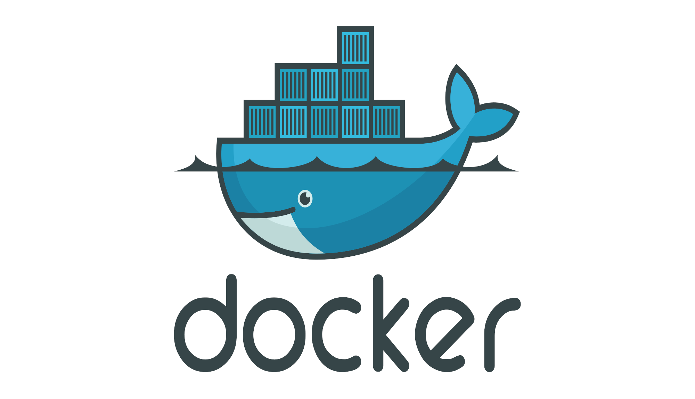
Docker History
Docker didn’t invent containers, but it made containers easier to work with.

Slide 3
What is a Container
A container is a standard unit of software that can run a particular application and its associated processes.
A container is portable and contains the software dependencies for a given application.
It is common to run several containers at once in a single host machine.

Slide 4
Docker Container Benefits
Containers are self-contained and do not alter the host system they are running on.
Docker is lightweight.
Containers provide reproducible and consistent environments. If it works in development, it will work in production.
Containers have a smaller footprint than virtual machines.
Using containers can reduce the number of servers required.
Orchestrators can be used to manage multiple containers.
Docker provides an easy-to-use way to create, store and run container images.

Slide 5
Virtual Machines vs Containers
Containers are used for a single process or task, while virtual machines may run multiple processes or tasks.
Container boot times are much quicker than virtual machines.

Slide 6
Docker Basics
Docker uses containers to run single process or a small group of process to provide a service.
A container image is required to start a container and these images can be held in an online library, called an image registry.
To create a docker image you need a Dockerfile.

Slide 7
Base Images and Layering
A base image is a tiny, but functional Operating system.
Docker uses a layered filesystem so that you can add to a base image.
FROM debian:stable
Changes made to the base image are actually stored in a new layer and do not alter the base image.

Slide 8
Microservices
Microservices is an architectural style that structures an application as a collection of loosely coupled services.
Microservices are easier to fix and test
Each microservices can be deployed without the need to deploy the whole application.
Docker containers are ideal for microservices.

Slide 9
Summary
A container is a standard unit of software that can run a particular application and its associated processes.
It is common to run several containers at once in a single host machine.
Containers have a smaller footprint than virtual machines.
A container image is required to start a container and these images can be held in an online library, called an image registry.
To create a docker image you need a Dockerfile.
Docker uses a layered filesystem so that you can add to the base image.

