Slide 1
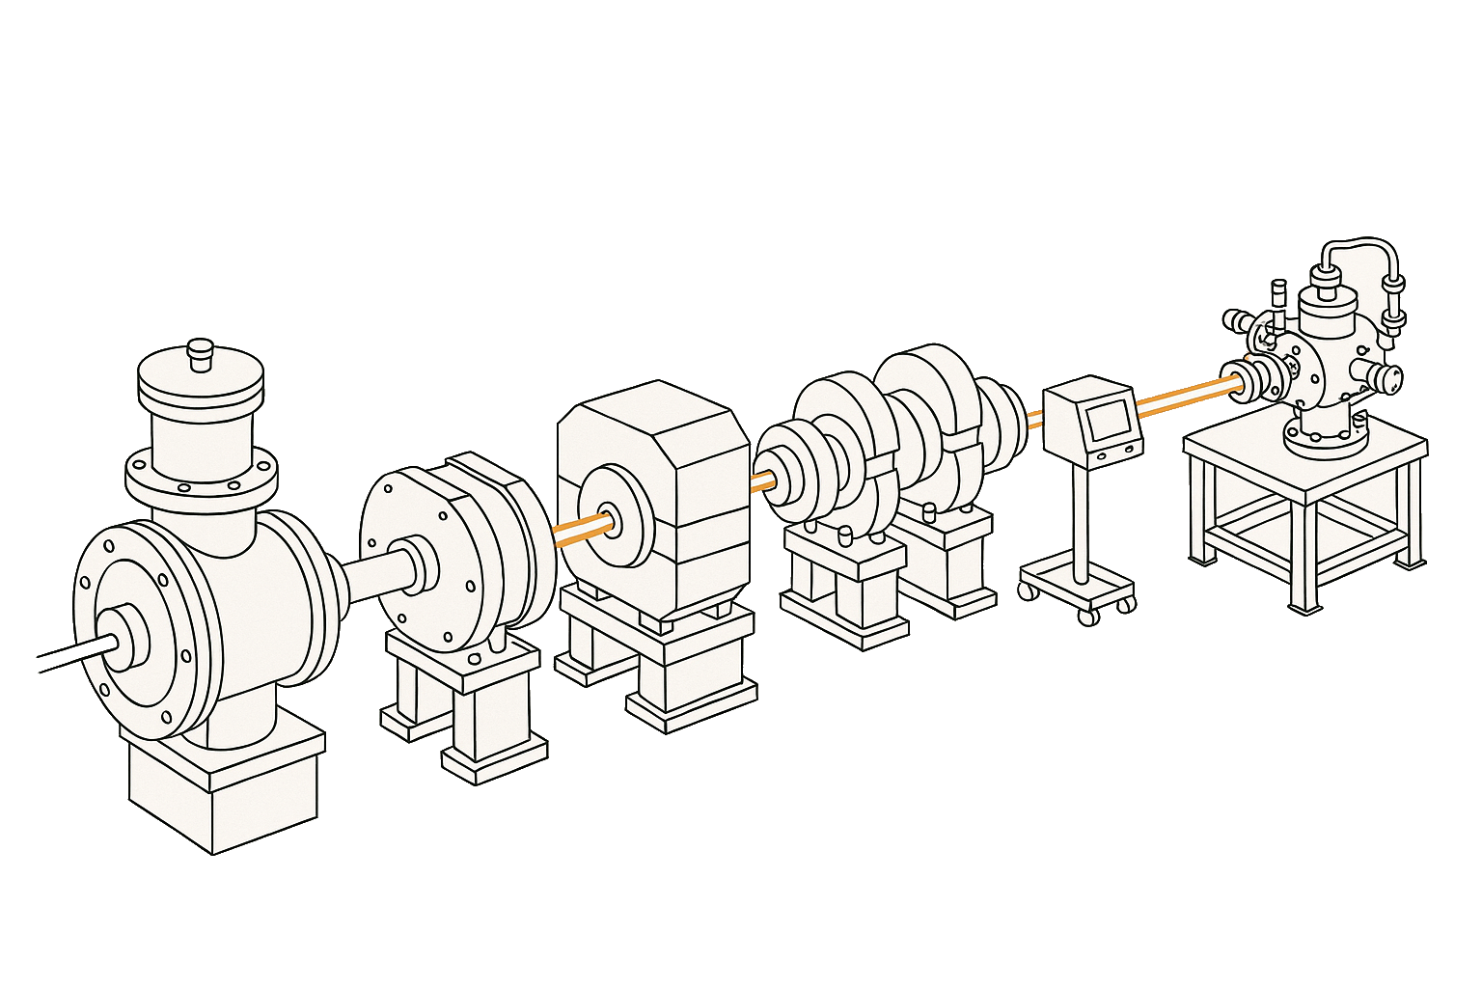
Stream miner operator
Event source
Sink
Event filter

