Slide 1
Cli Tool User Guide
2018.01.19

Slide 2
Cli install setup in Amlogic Platform
檢查 wifi interface 是否正常
需確認開機前先全完斷電，否則可能造成下次USB interface無法重新認卡，可能會造成wifi interface無法帶起
第一次使用adb 時，需讓amlogic platform去信任NB/PC主機(透過GUI)
如果利用USB port來進行adb command，USB port type 需為 OTG
-請參閱Pag 3 & Page4
Non-adb 時的cli install setup
-請參閱Pag 5
在進行RF tool前，需確認無wireless連線,並確認硬體架構設定
-請參閱Pag 6 & Page 7

Slide 3
adb install & adb command
Install adb command (如果電腦上沒有adb-tool就必須安裝)
http://bernaerts.dyndns.org/linux/74-ubuntu/328-ubuntu-trusty-android-adb-fastboot-qtadb
備註:adb➔Ubuntu 14.04 - Install Android Tools
Amlogic platform adb command
adb root
adb remount
adb shell

Slide 4
rf & cli install (adb)
Push rf and cli to device(Amlogic)
adb push rf /system/bin/rf
adb push cli /system/bin/cli(更改執行權)
Change rf and cli mode
adb shell
chmod 777 /system/bin/rf
chmod 777 /system/bin/cli

Slide 5
rf & cli install (non-adb)
Console command
mkdir /data/temp
mount –o rw,remount /system
[change filesystem /system to read/write]
mount –t vfat /dev/block/sda1 /data/temp
[mount usb storage to /data/temp]
cp /data/temp/rf /system/bin/rf
cp /data/temp/cli /system/bin/cli
chmod 777 /system/bin/rf
chmod 777 /system/bin/cli
umount /data/temp

Slide 6
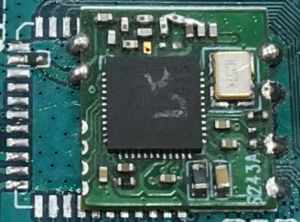
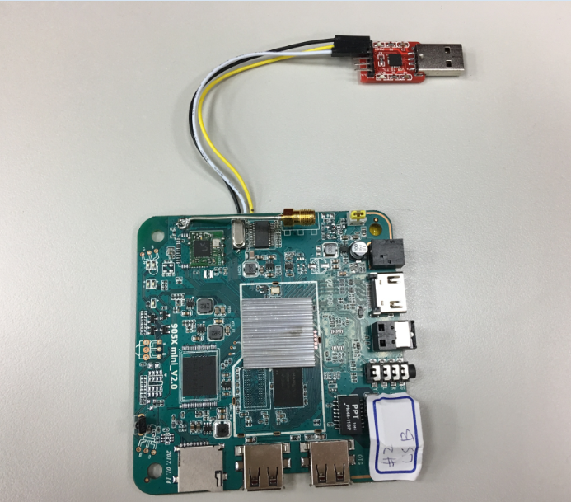

Hardware Setup
SSV6266P
25MHz晶振
UART
Ant端
GND/RX/TX
HDMI
amlogic platform S905
OTG Port

Slide 7
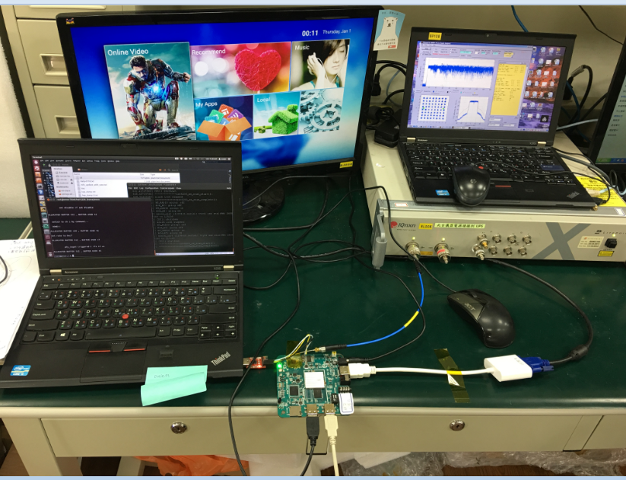
Hardware Setup
在進行RF tool前，需確認無wireless連線
amlogic platform S905
Non-adb時須利用UART來操作
如果利用USB port來進行adb command，USB port type 需為 OTG

Slide 8
rf command
rf [tx|rx|stop|rate|count|reset|ifs|freq|rfreq|rssi|sar|ch]
tx command
Set rf block mode
Disable ack policy
Set channel 1 bandwidth 20, rate HT20, MCS7
Tx packet generate (default ifs 15us)
rx command
Set rf block mode
Set channel 1, bandwith20
Disable ack policy
Mib reset

Slide 9
rf command
rf [tx|rx|stop|rate|count|reset|ifs|freq|rfreq|rssi|sar|ch]
stop
Rf unblock mode
rate [rate index]
Set rate index
count [0|1]
Get phy mib, 0 => 11b mib, 1 => 11gn mib
reset
Mib reset
ifs [value]
Set txgen packet ifs value

Slide 10
rf command
rf [tx|rx|stop|rate|count|reset|ifs|freq|rfreq|rssi|temperature|ch]
freq [value]
Set xtal frequency offset
rfreq
Get xtal frequency offset
rssi
get ofdm/b mode rssi of last packet
temperature
Ic temperature
ch [channel value] [bw40]
Set channel

Slide 11
Change channel command
rf ch [ch_value] [bw40]
Manual command to change channel
Ex:rf_tool ch 3: change channel to 3 ht20.
rf_tool ch 3 bw40: change channel to 3 bandwith 40
chan3 bw 40 = chan 1 HT40PLUS
= chan 5 HT40MINUS

Slide 12
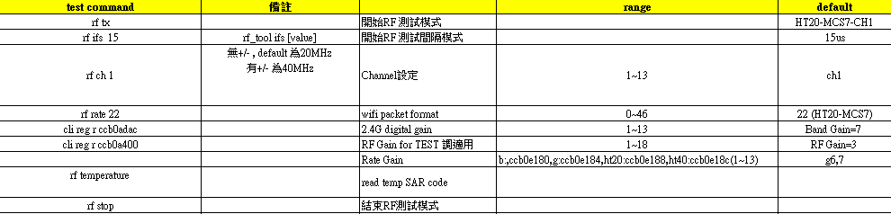
TX_Cli_command
TX test Cli_command
rf tx
rf rate 22
rf ch 1

Slide 13
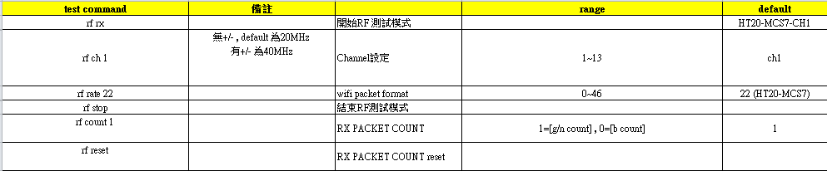
RX_Cli_command
RX test Cli_command
rf rx
rf ch 1
rf reset
rf count [1|0]
]

Slide 14
Set RF tool tx rate
rf rate [rateidx]
rateidx | description | rateidx | description | rateidx | description | rateidx | description
0 | 11b, 1M | 7 | 11g, 6M | 14 | 11g, 54M | 21 | Ht20, MCS6, LGI
1 | 11b, 2M | 8 | 11g, 9M | 15 | Ht20, MCS0, LGI | 22 | Ht20, MCS7, LGI
2 | 11b, 5.5M | 9 | 11g, 12M | 16 | Ht20, MCS1, LGI | 23 | Ht20, MCS0, SGI
3 | 11b, 11M | 10 | 11g, 18M | 17 | Ht20, MCS2, LGI | 24 | Ht20, MCS1, SGI
4 | None | 11 | 11g, 24M | 18 | Ht20, MCS3, LGI | 25 | Ht20, MCS2, SGI
5 | 11b, 5.5M Short Preamble | 12 | 11g, 36M | 19 | Ht20, MCS4, LGI | 26 | Ht20, MCS3, SGI
6 | 11b, 11M Short Preamble | 13 | 11g, 48M | 20 | Ht20, MCS5, LGI | 27 | Ht20, MCS4, SGI

Slide 15
Set RF tool tx rate
rf rate [rateidx]
rateidx | description | rateidx | description | rateidx | description
28 | Ht20, MCS5, SGI | 35 | Ht40, MCS4, LGI | 42 | Ht40, MCS3, SGI
29 | Ht20, MCS6, SGI | 36 | Ht40, MCS5, LGI | 43 | Ht40, MCS4, SGI
30 | Ht20, MCS7, SGI | 37 | Ht40, MCS6, LGI | 44 | Ht40, MCS5, SGI
31 | Ht40, MCS0, LGI | 38 | Ht40, MCS7, LGI | 45 | Ht40, MCS6, SGI
32 | Ht40, MCS1, LGI | 39 | Ht40, MCS0, LGI | 46 | Ht40, MCS7, SGI
33 | Ht40, MCS2, LGI | 40 | Ht40, MCS1, SGI
34 | Ht40, MCS3, LGI | 41 | Ht40, MCS2, SGI

Slide 16
CLI CALIBRATION
cli cali do|show|dpd
cli cali do: re-do calibration.
cli cali show: show current calibration result.
cli cali dpd do|show|enable|disable
cli cali dpd do: re-do padpd for current channel
cli cali dpd show: show dpd result for all band.
cli cali dpd enable: enable dpd
cli cali dpd disable: disable dpd.

