Slide 1
Efuse User Guide
2018.01.22

Slide 2
Cli install setup in Amlogic Platform
檢查 wifi interface 是否正常
需確認開機前先全完斷電，否則可能造成下次USB interface無法重新認卡，可能會造成wifi interface無法帶起
第一次使用adb 時，需讓amlogic platform去信任NB/PC主機(透過GUI)
如果利用USB port來進行adb command，USB port type 需為 OTG
-請參閱Pag 3 & Page4
Non-adb 時的cli install setup
-請參閱Pag 5
在進行RF tool前，需確認無wireless連線,並確認硬體架構設定
-請參閱Pag 6 & Page 7

Slide 3
adb install & adb command
Install adb command (如果電腦上沒有adb-tool就必須安裝)
http://bernaerts.dyndns.org/linux/74-ubuntu/328-ubuntu-trusty-android-adb-fastboot-qtadb
備註:adb➔Ubuntu 14.04 - Install Android Tools
Amlogic platform adb command
adb root
adb remount
adb shell

Slide 4
cli install (adb)
Push cli to device(Amlogic)
adb push cli /system/bin/cli(更改執行權)
Change cli mode
adb shell
chmod 777 /system/bin/cli

Slide 5
cli install (non-adb)
Console command
mkdir /data/temp
mount –o rw,remount /system
[change filesystem /system to read/write]
mount –t vfat /dev/block/sda1 /data/temp
[mount usb storage to /data/temp]
cp /data/temp/cli /system/bin/cli
chmod 777 /system/bin/cli
umount /data/temp

Slide 6
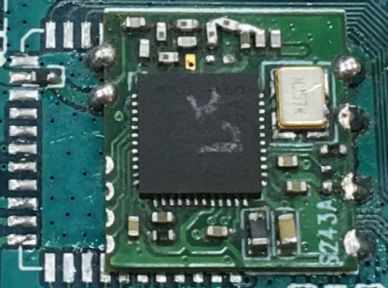
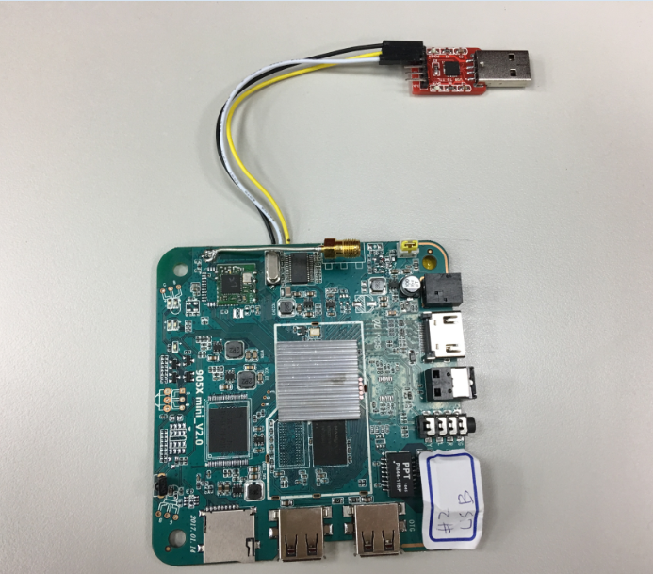
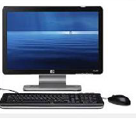
Hardware Setup
SSV6266P
25MHz晶振
UART
Ant端
GND/RX/TX
HDMI
amlogic platform S905
OTG Port

Slide 7
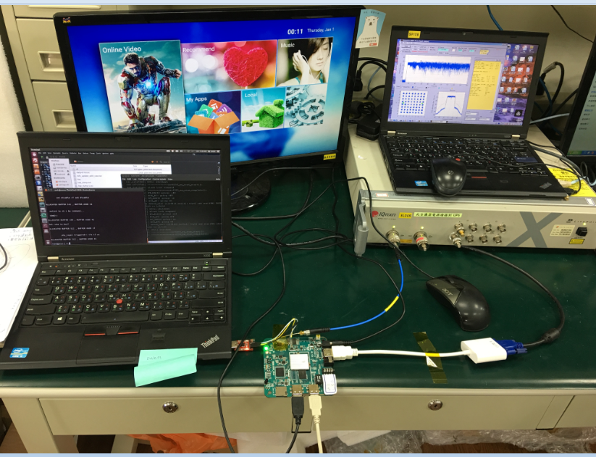
Hardware Setup
在進行RF tool前，需確認無wireless連線
amlogic platform S905
Non-adb時須利用UART來操作
如果利用USB port來進行adb command，USB port type 需為 OTG

Slide 8
Efuse command
cli efuse [r|w] [category] [value]
cli efuse r freq
Read xtal frequency offset from efuse
cli efuse r txpower1
Read txpower1 from efuse
cli efuse r txpower2
Read txpower2 from efuse
cli efuse r mac
Read mac address from efuse
cli efuse r ht40rate
Read ht40rate from efuse

Slide 9
Efuse command
cli efuse [r|w] [category] [value]
cli efuse w freq [value]
write xtal frequency offset to efuse
cli efuse w txpower1 [value]
write txpower1 to efuse
cli efuse w txpower2 [value]
write txpower2 to efuse
cli efuse w mac [value]
write mac address to efuse
cli efuse w ht40rate
write ht40rate to efuse

