Slide 1
JIRA Training

Slide 2

Key Terms to Remember
JIRA vs Jira
JIRA refers to the entire Atlassian suite of software
Jira is the singular software, Jira for Testing System Lifecycle Management
Issues
A single work item of any type and size, that is trackable
Feature being developed
To-do item
Bug fix
Projects
A collection of issues that have a common purpose or context

Slide 3

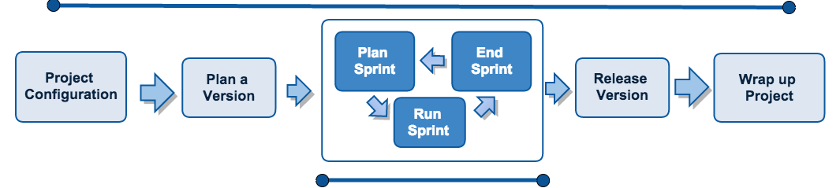
The Jira Workflow and You!
Managers
Users

Slide 4
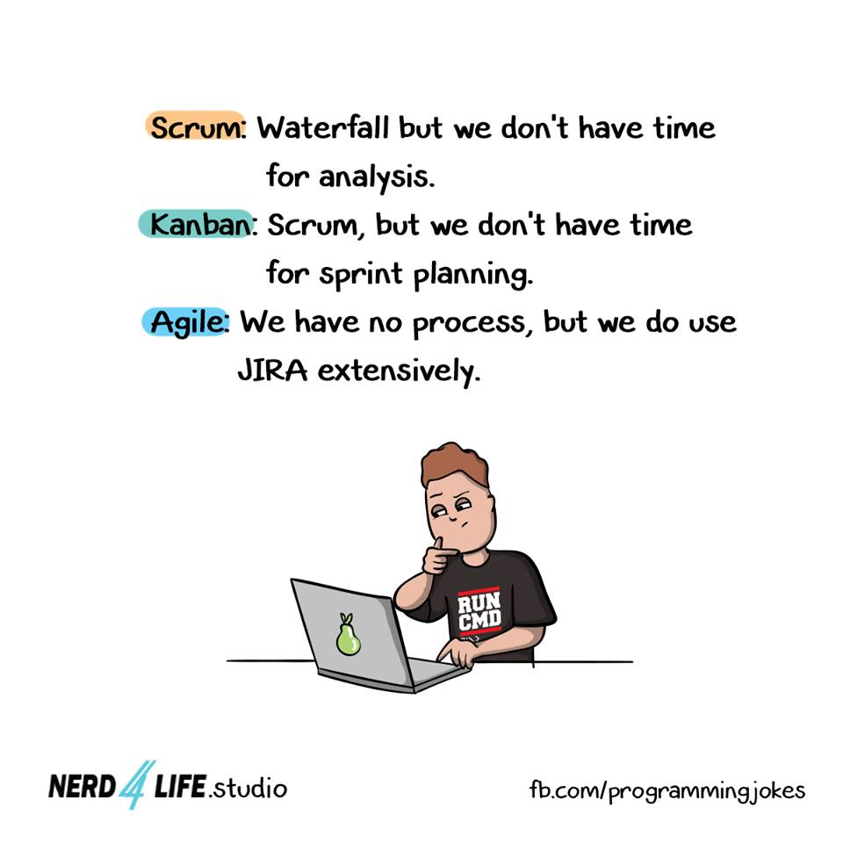
Roles and Responsibilities
Jira Software Managers
Access to all features in Jira
Create and update projects
Add and remove Users
Start and end sprints
Jira Software User
Create and manage issues
Check code review status
Create branches
Notes:
Switch to website view only

Slide 5
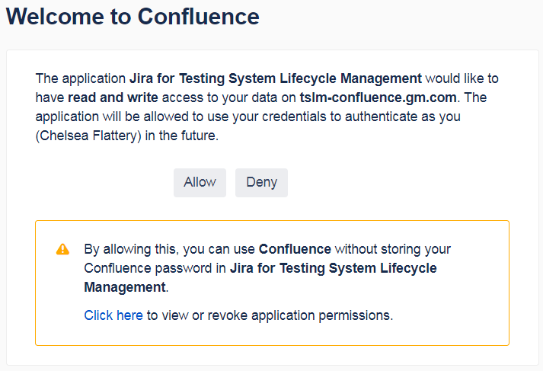
Authentication in JIRA
Navigate to https://tslm-jira.gm.com/secure/Dashboard.jspa
Click the user icon and select Profile
In the Activity Stream, click to Authenticate any applications
Click Allow
Notice the link
Notes:
Open the Jira webpage and navigate to Profile
Authenticate the Activity Stream if the option is available. It if isn’t it’s because authentication has already been completed. Discuss features of the Profile after authenticating the Activity Stream

Slide 6
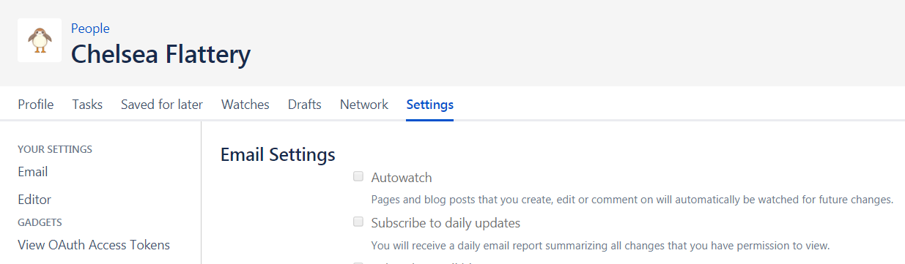
Turn off Autowatch
From the Profile:
Click Settings
In Email Settings
Click Edit
Uncheck Autowatch
Thank me later

Slide 7

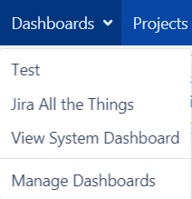
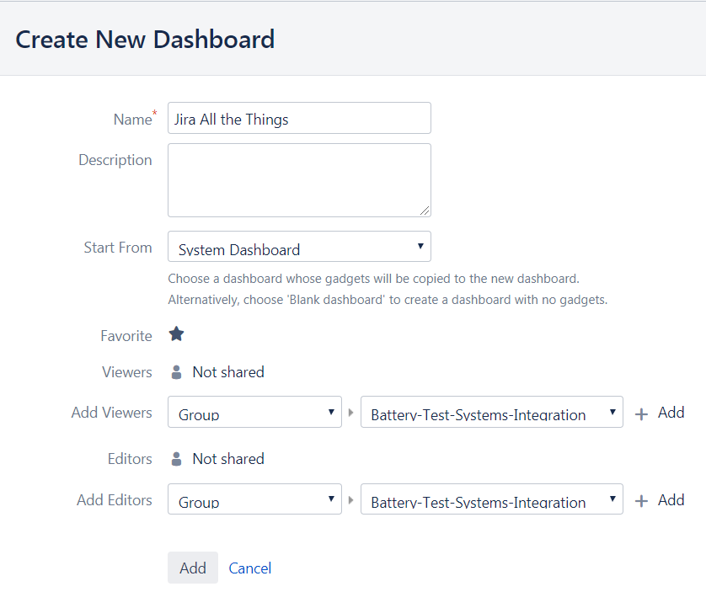
Create a New Dashboard
Click Dashboards
Select Manage Dashboards
Click Create New Dashboard
Name that Dashboard
Select System Dashboard from the Start From menu
Click Favorite
Click Add
Notes:
At the top toolbar, the dashboards menu will serve as a hub for information about Jira projects and your involvement in the system.

Slide 8
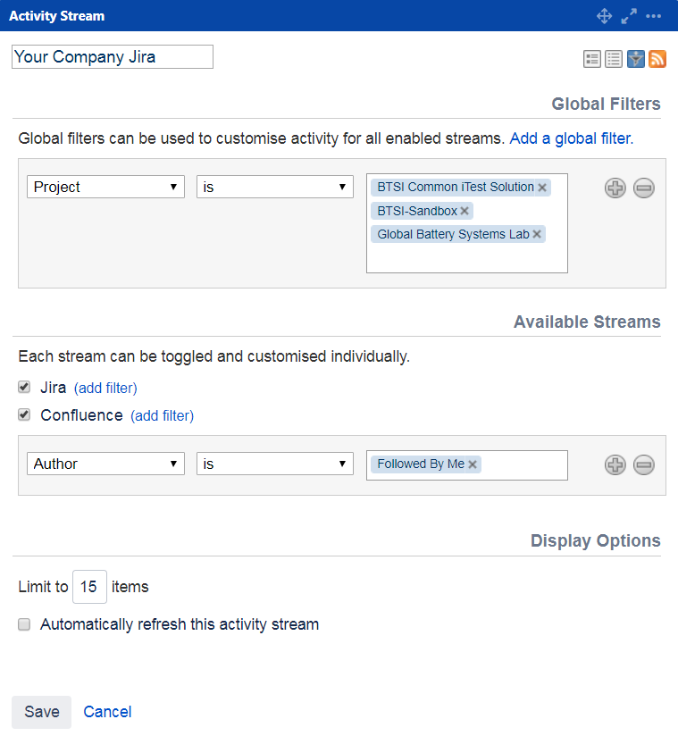
Filter the Activity Stream
Click the icon on the Activity Stream
Change the Name
Add a Global Filter
Project is
BTSI Common iTest Solution, Global Battery Systems Lab, and any additional Project you are in
Add a Confluence Filter
Author is
Followed By Me
Change the display limit
Click Save

Slide 9
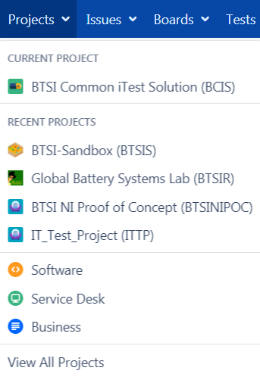
Projects
A Project is like a container for Issues
Current Project is the default space entered when you click the Projects tab
Recent Projects shows all Projects you have visited
The Software, Service Desk, and Business icons are Project filters
Click View All Projects if the BTSI-Sandbox (BTSIS) doesn’t display

Slide 10
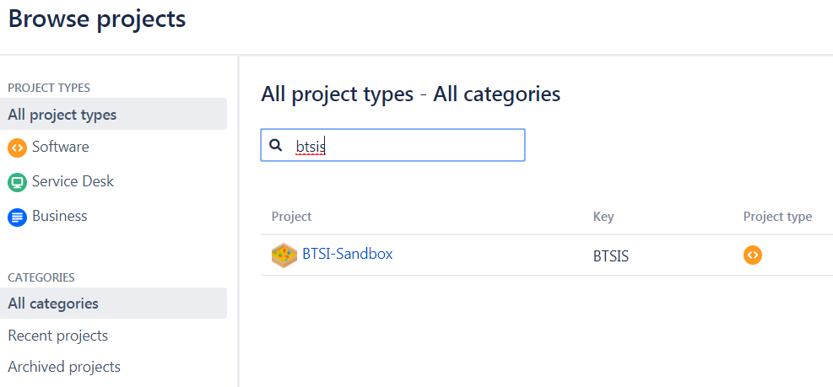
Projects
If the BTSI-Sandbox (BTSIS) doesn’t display:
Click View All Projects
Click BTSI-Sandbox (BTSIS) or search BTSIS

Slide 11
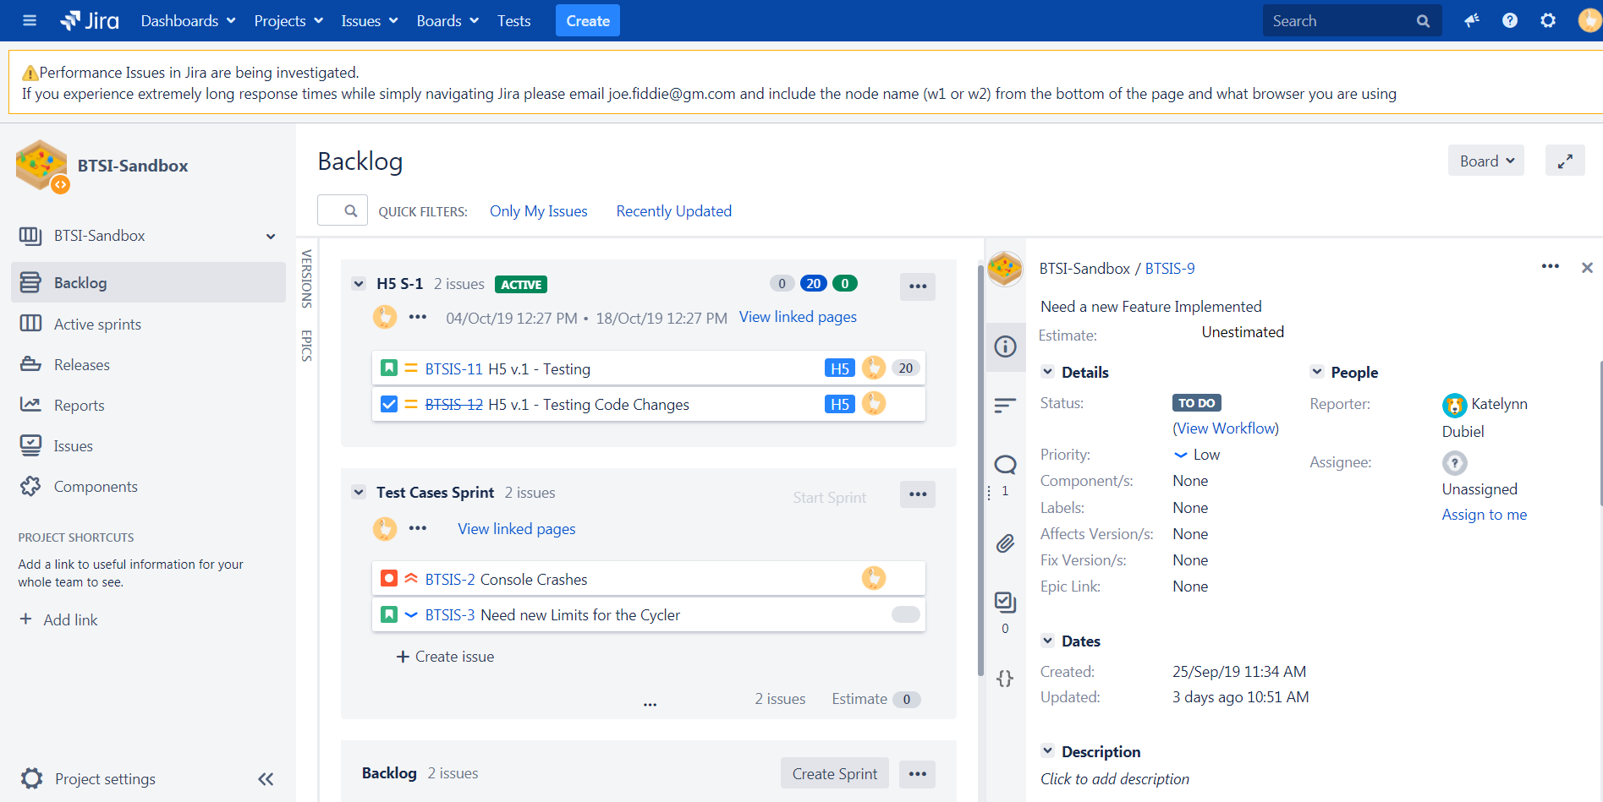
The Project Page
Notes:
The project page typically defaults to the Backlog.
This displays all sprint activity:
The active sprint,
Any upcoming sprints,
And the backlog of issues that can be added to a sprint
There is a search bar and quick filter options for finding issues in a Project
And filters to view by Version or Epic, if that is implemented
The Issue pane shows the last issue worked on within the project and gives access to change the status, assignment, or add information.
Finally the side bar allows you to navigate through the Project, between the active sprint, releases, and issues.

Slide 12
Issue Types
Regular Issues
Bug – A problem which impairs or prevents the functions of the product
New Feature – A new feature that has yet to be developed
Task – A task that needs to be done
Improvement – An improvement or enhancement to an existing feature or task
Incident – For system outages or incidents, created by Service Desk
Service Request – An issue created by the Jira Service Desk
Service Request with Approvals – Requests that require approval, created by Service Desk
Change – Created by Service Desk
Problem – Track underlying causes of incidents
Initiative – The type used to indicate that the issue is part of an Initiative, a large body of work spanning multiple epics
Story – Created by Jira Software, this issue type is used for user stories
Approval – Used to record an approval, like UAT testing approvals
Epic – Created by Jira Software, this issue type is used for big user stories that need to be broken down
Sub-task – The sub-task of an issue

Slide 13
Issue Types
Regular Issues
Bug – A problem which impairs or prevents the functions of the product
New Feature – A new feature that has yet to be developed
Task – A task that needs to be done
Improvement – An improvement or enhancement to an existing feature or task
Incident – For system outages or incidents, created by Service Desk
Service Request – An issue created by the Jira Service Desk
Service Request with Approvals – Requests that require approval, created by Service Desk
Change – Created by Service Desk
Problem – Track underlying causes of incidents
Initiative – The type used to indicate that the issue is part of an Initiative, a large body of work spanning multiple epics
Story – Created by Jira Software, this issue type is used for user stories
Approval – Used to record an approval, like UAT testing approvals
Epic – Created by Jira Software, this issue type is used for big user stories that need to be broken down
Sub-task – The sub-task of an issue

Slide 14


Slide 15
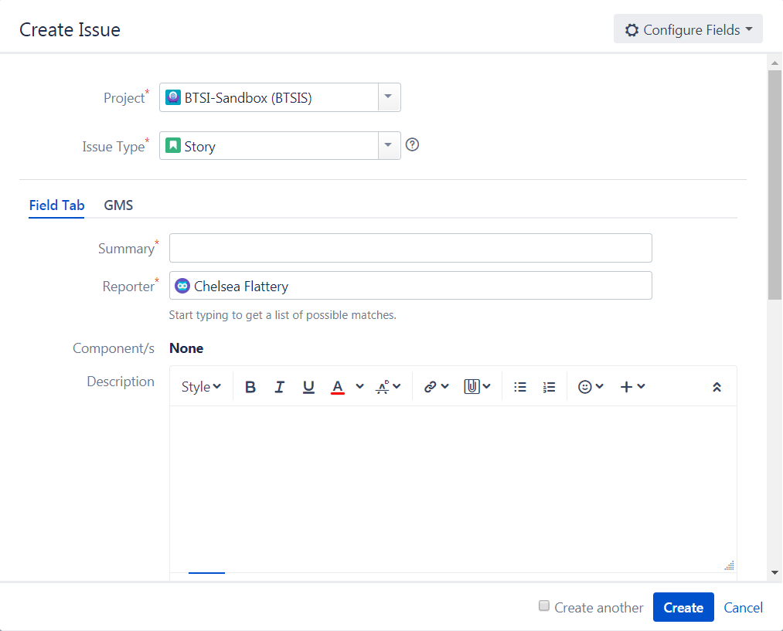
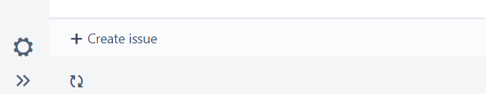
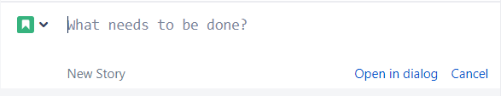
Create an Issue
Click Create Issue from the bottom of the issue bar
Click Open in dialog
Project needs to be BTSI-Sandbox (BTSIS)
Select any Issue Type
Enter in a mock Summary
Choose a Component or two
Add a Description
Click Create

Slide 16
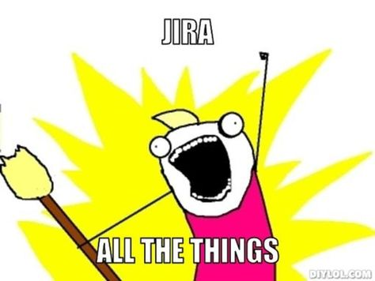







Priority Levels
Highest – This problem will block progress
High – Serious problem that could block progress
Medium – Has the potential to affect progress
Low – Minor problem or easily worked around
Lowest – Trivial problem with little or no impact on progress
Blocker – The problem will block progress and needs to be addressed before the issue it is blocking can be completed
Minor – Trivial problem with little to no impact on progress

Slide 17
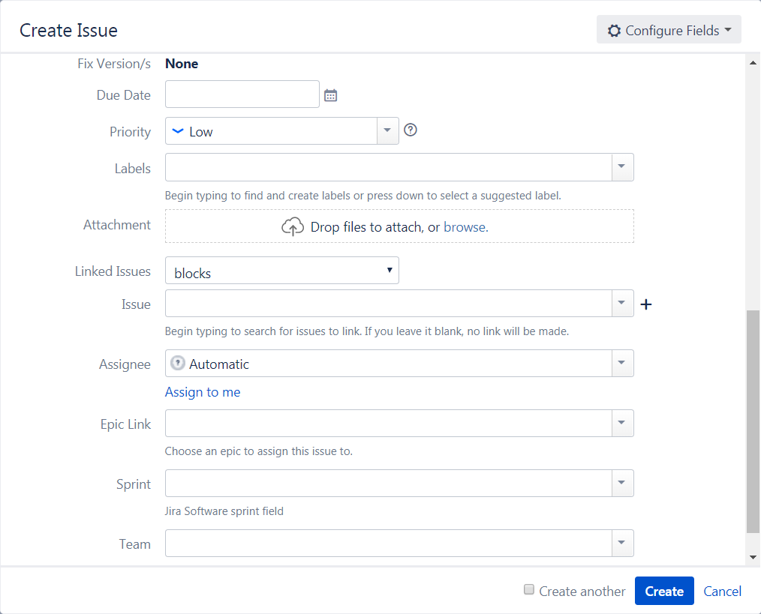
Create an Issue
Add a Due Date
Select the Priority
Select a Linked Issues option
Choose 2 Issues by clicking the
Choose the Assignee by selecting the person to your left (choose Assign to Me if there’s no one to your left)
Click Create

Slide 18
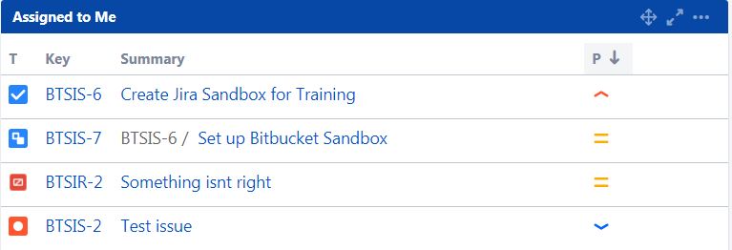

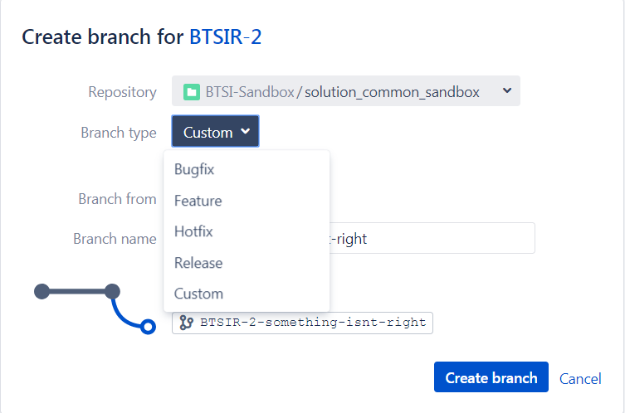
Creating a Branch in Bitbucket
Click on the Jira Dashboards link
Select the dashboard you created
Choose an issue from the Assigned to me pane
Scroll down to Development
Click Create branch
Select the BTSI-Sandbox/solution_common_sandbox Repo
Click the Branch type drop down

Slide 19
Bitbucket Branch Types
Bugfix – Typically used for fixing bugs against a release branch
Feature – Used for specific feature work. This branch typically branches from and merges back into develop
Hotfix – Typically used to quickly fix the production (master) branch
Release – Used for release tasks and long-term maintenance. Typically branches from develop and changes are merged back into develop

Slide 20
Creating a Branch in Bitbucket cont.
Pick a Branch type
Branch from develop
Click Create branch

Slide 21


Bitbucket Navigation
Clone – Get the HTTP address and a button to Clone the repo to SourceTree
Create branch – Opens the Create branch window
Create pull request – Make a pull request (merge request)
Compare – Launches the Diff, Commits, and Blame tools for selected branches, tags, or commits
Source – Shows files within a selected Project
Commits – Shows the list of Commits for the selected branch
Branches – Displays all branches in a selected Project, indicates Behind and Ahead statuses
Pull requests – View pull requests (merge requests)

Slide 22
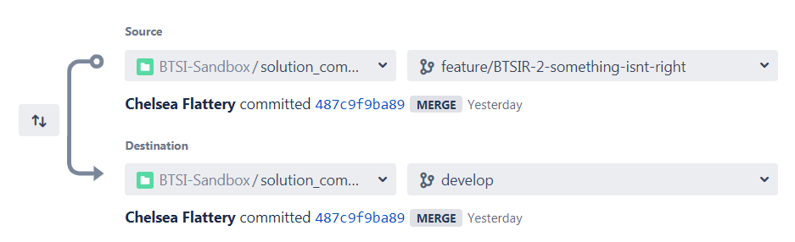
Create a Pull Request
Click the Branches icon
Select your Branch
Change Destination to develop
Click Create pull request

Slide 23
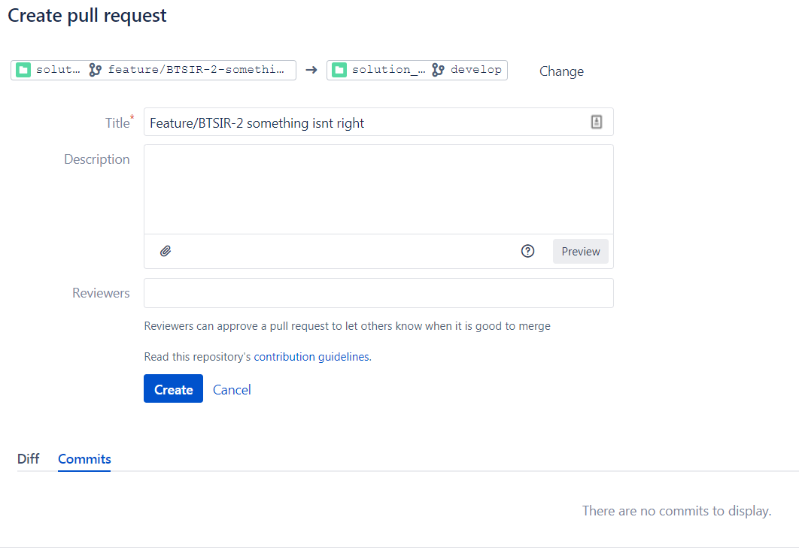
Create a Pull Request Cont.
Create a Description
Add the person to your right as the Reviewer
Click Create

Slide 24
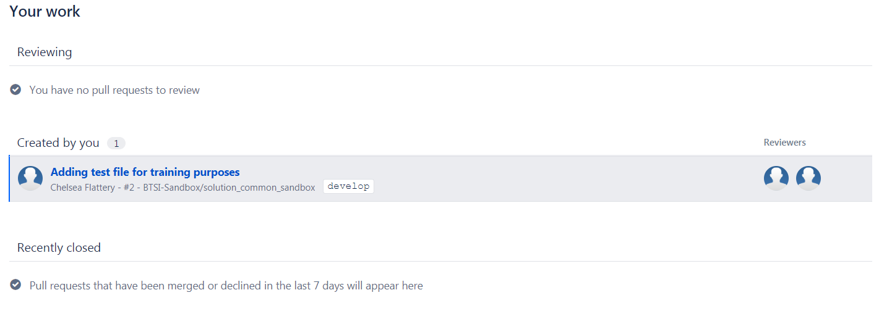
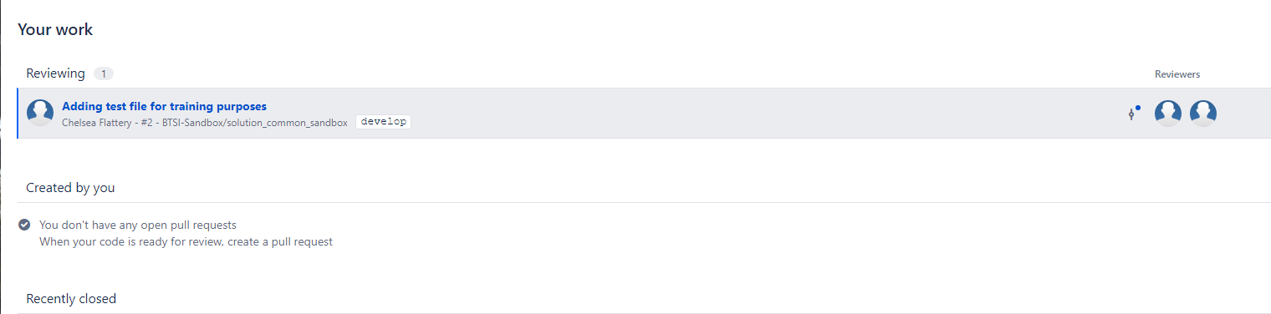
Pull Requests Creator vs Reviewer

Slide 25
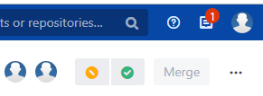

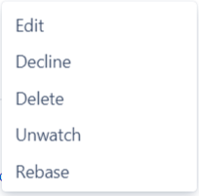
Reviewer Functions
Reviewers have Needs Work and Approve quick buttons
If you are not a Reviewer but want to be, click the
Click Edit
Add yourself as a Reviewer

Slide 26
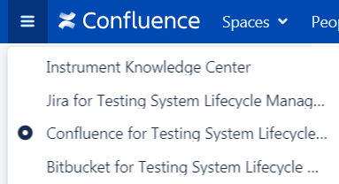
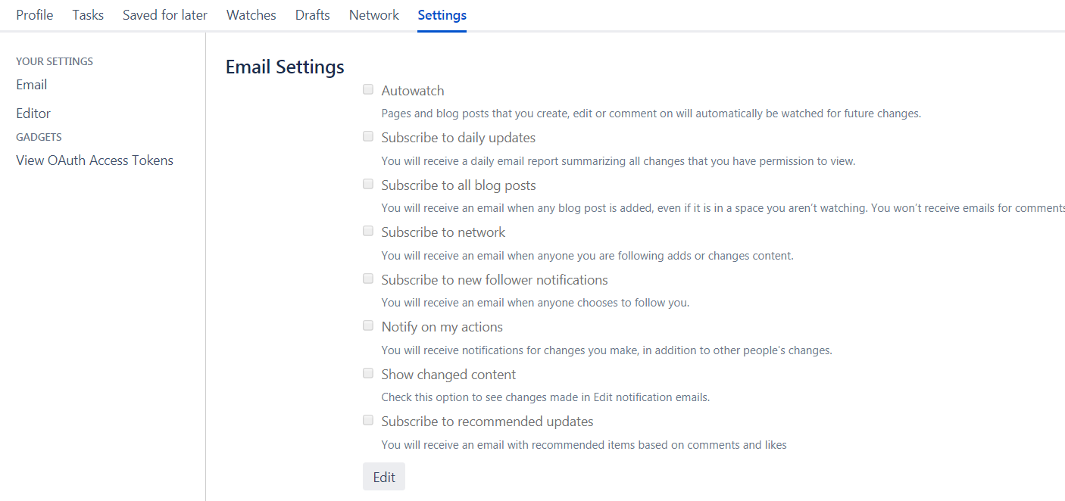

Confluence
Use the hamburger menu to open Confluence
Click the User Icon
Click Setting
Click Email
Click the Edit button
Uncheck Autowatch
Use the icon instead of autowatch on pages you want email alerts for

Slide 27
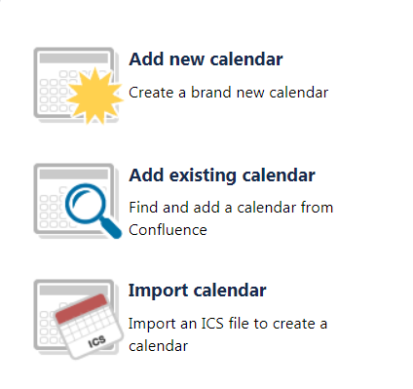

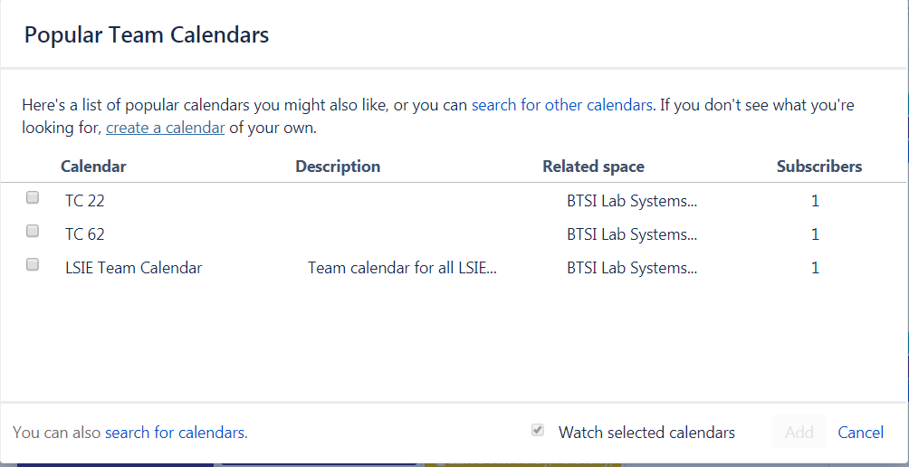
Calendars
Navigate to the user calendar by clicking on Calendars
Click the button
Click add existing calendar
Add the LSIE Team Calendar and any TC calendars
Click watch selected calendars
Click Add
If a TC calendar is missing:
Add existing calendar
Click search for calendars
Type “TC”
Select and click Add

Slide 28
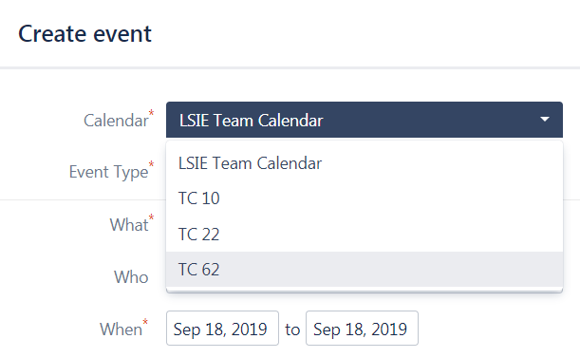
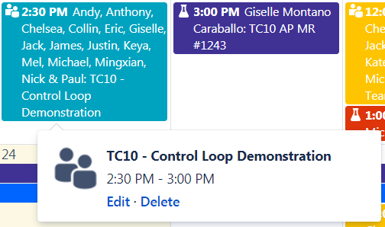
Adding Calendar Events
Select Calendars from the header:
Click Add Event
Click the Calendar drop down
Select the appropriate Calendar
Complete the details
If you make a mistake:
Click the Event once
Click Edit

Slide 29
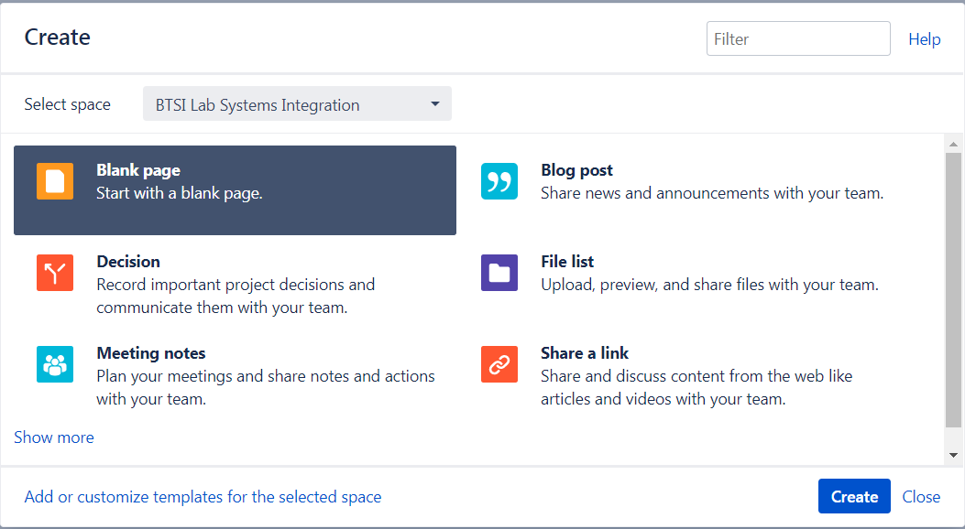

Adding Files for Version Control
Select from the header:
Select the Space
Select the Template
Click Create or Next
Available Templates include:
Blank page
Decision
Meeting notes
Blog post
File list
Share a link

Slide 30
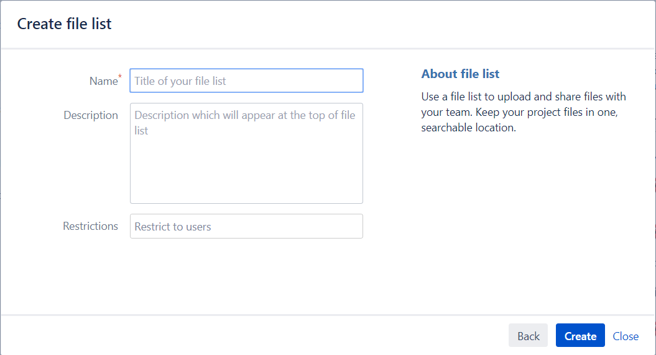
Creating a File List
Name the file list
Add usernames to restrict file sharing, if applicable
Click Create

Slide 31
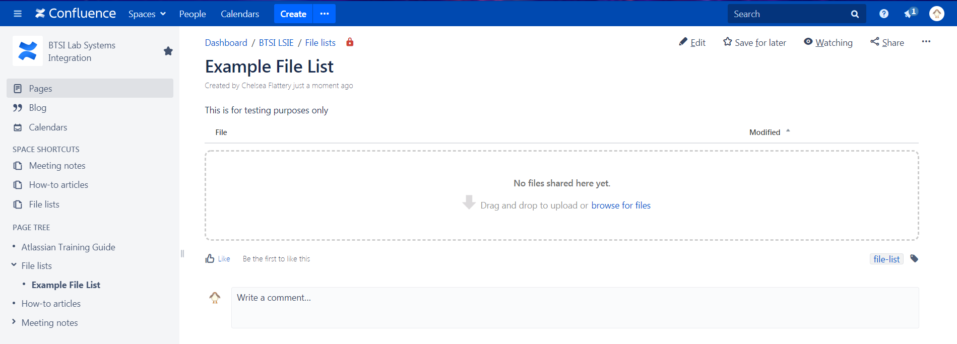
Managing and Editing the File List
The red lock indicates there are restrictions
Tags can be added for helpful searching
Drag and drop or browse for files
The File list shows up in the sidebar

Slide 32
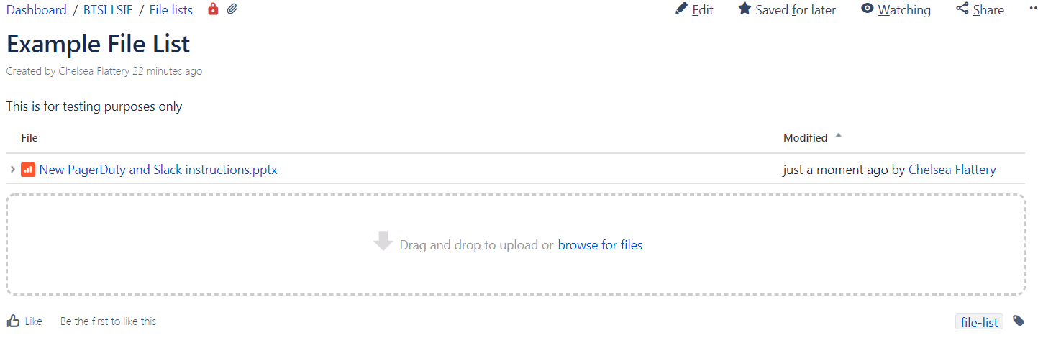
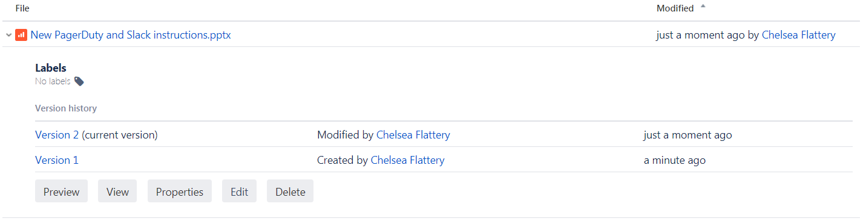
Version Control
The Version history is displayed with links to open each version
The example PowerPoint shows when and by whom a file was modified
Files, Pages, and Work added to Confluence all have version control and change tracking
Click the drop down for more information

Slide 33
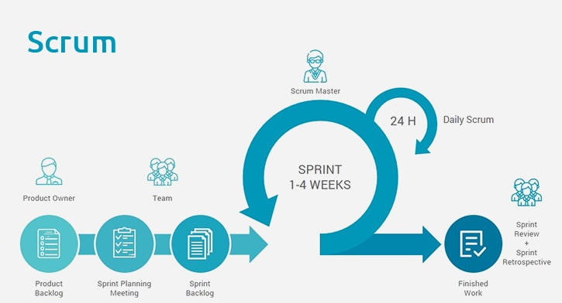
Agile and Scrum

Slide 34
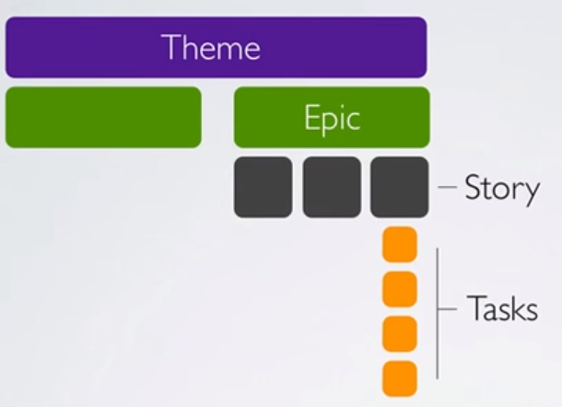
Agile and Scrum
Theme – The over-arching idea
Epic – A collection of functionalities
Story – The functionality the user notices
Task – What development needs to be done to achieve the story

Slide 35
Agile and Scrum
Theme
i.e. User Interface and Usability Updates
Epic
Release
Program
H5 Planning
H5 Testing
H5 Development
H5 Issues
H5 Code Review
Story
Debugging
Testing that it works
Meetings
Research
Training
Blockers
Coding
Theme – The over-arching idea
Epic – A collection of functionalities
Story – The functionality the user notices
Task – What development needs to be done to achieve the story
Task

Slide 36
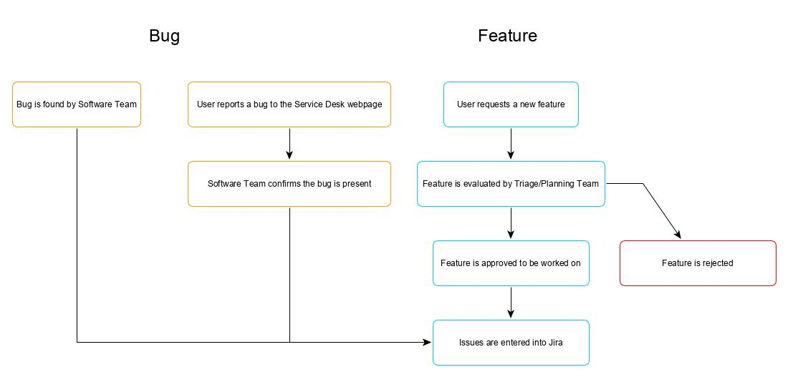
Proposed wORKFLOW – Bugs and Feature Requests

Slide 37
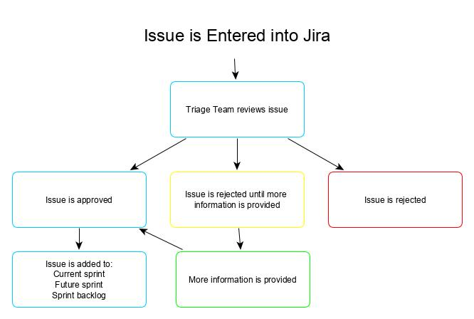
Proposed wORKFLOW – Issues

Slide 38
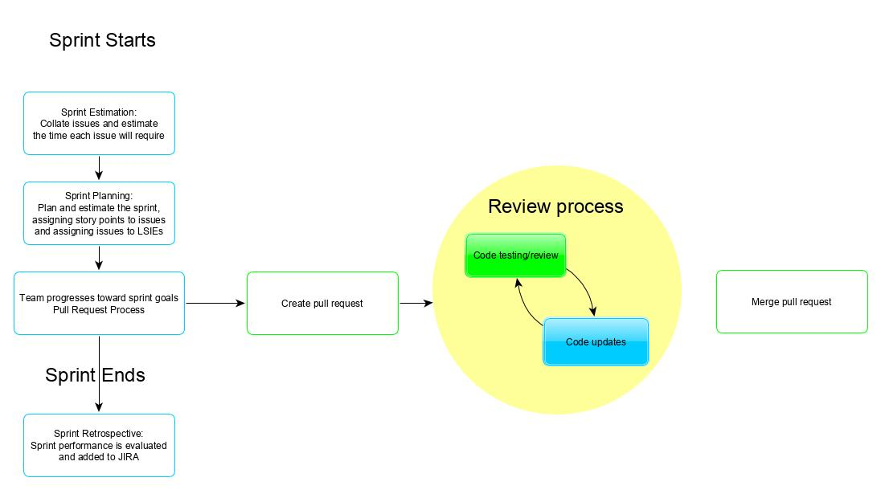
Proposed wORKFLOW – Sprints

