Slide 1
Transition from GitLab to JiRA
What does this mean for your workflow?

Slide 2
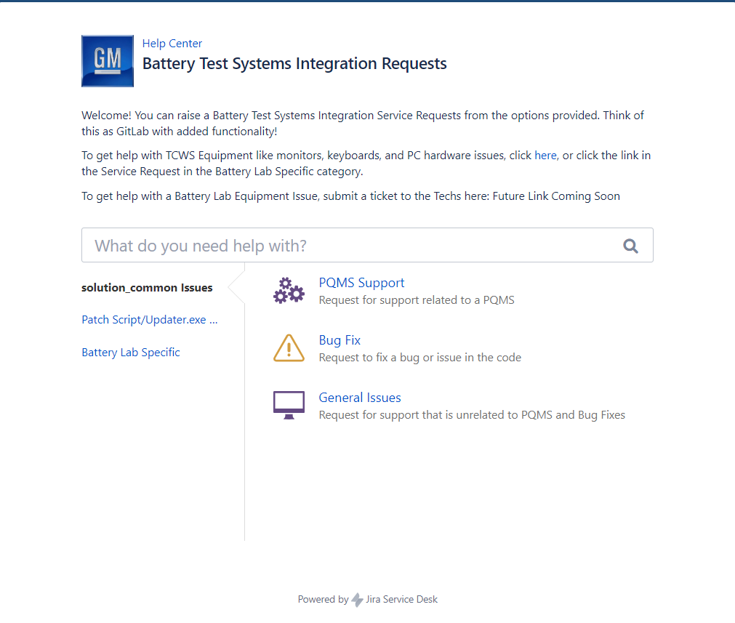

GitLab is Read-only, now what?
Welcome to the Battery Test Systems Integration (BTSI) Service Desk
It is Trackable
Issues = Service Requests
Get help with the Knowledge Base
It is linked on the Desktop, you’ll need to log in

Slide 3
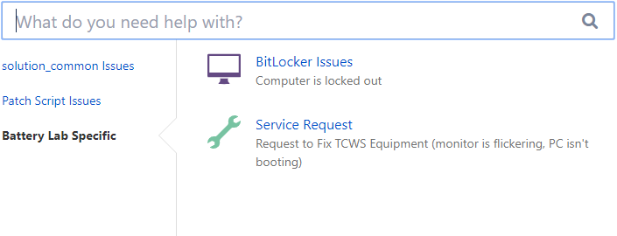
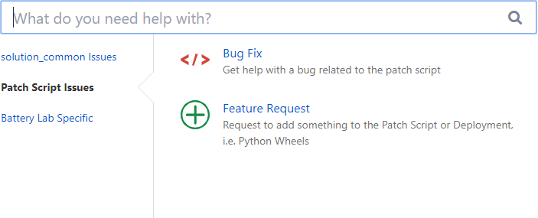
There are Multiple Features Available
For TCWS equipment issues (monitors, keyboards, PC hardware) click the link
Search the knowledge base
Submit PQMS Support, bug fix, and general service requests for solution_common
Submit bug fix and feature request service request for the Updater.exe patch script
Submit a service request to onsite IT for BitLocker and PC hardware issues

Slide 4
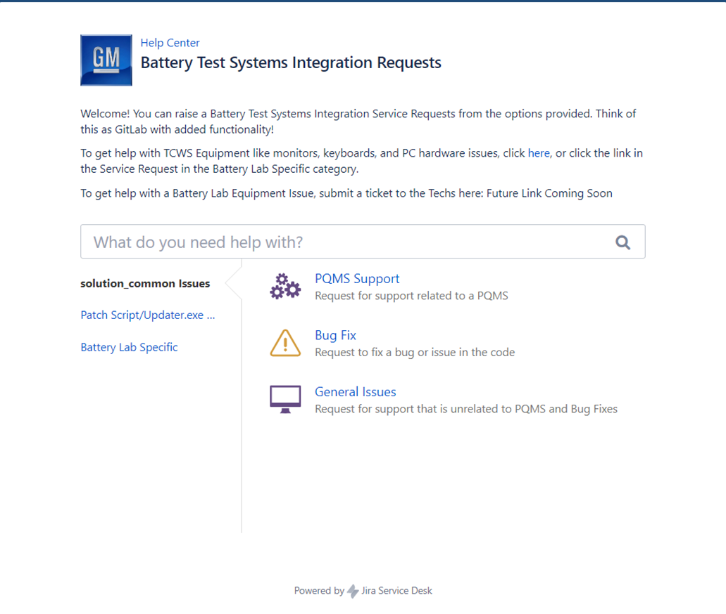
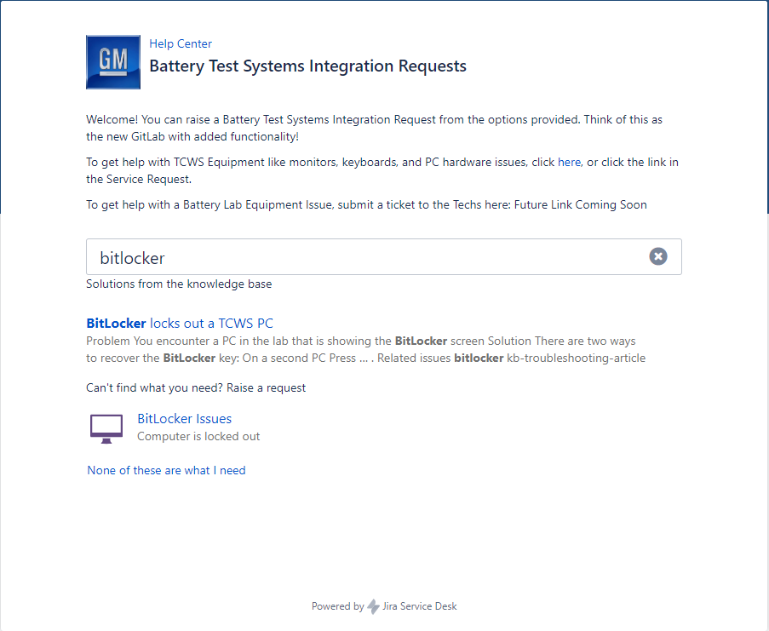
How to Search the knowledge base
In the search bar, type a single word related to your issue
If there is a knowledge base article available, it appears
Relevant service requests will display
The last link returns you to the main Help Desk page

Slide 5
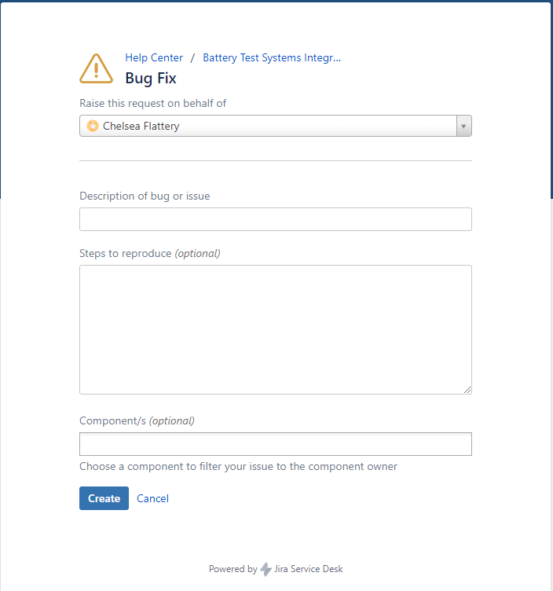
How to Submit an Issue
To fill out a service request, select from the two categories
Pick the service request type
Click the drop-down and type your name
Fill out the description and steps to reproduce (if applicable)
Select impacted components from the menu (if applicable)
Click Create

Slide 6
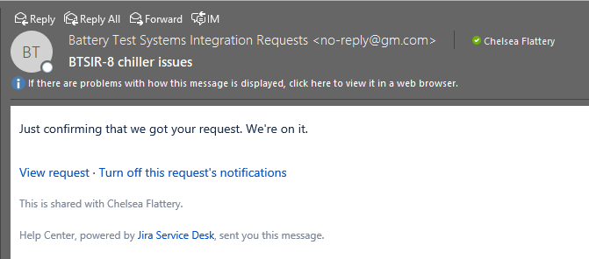
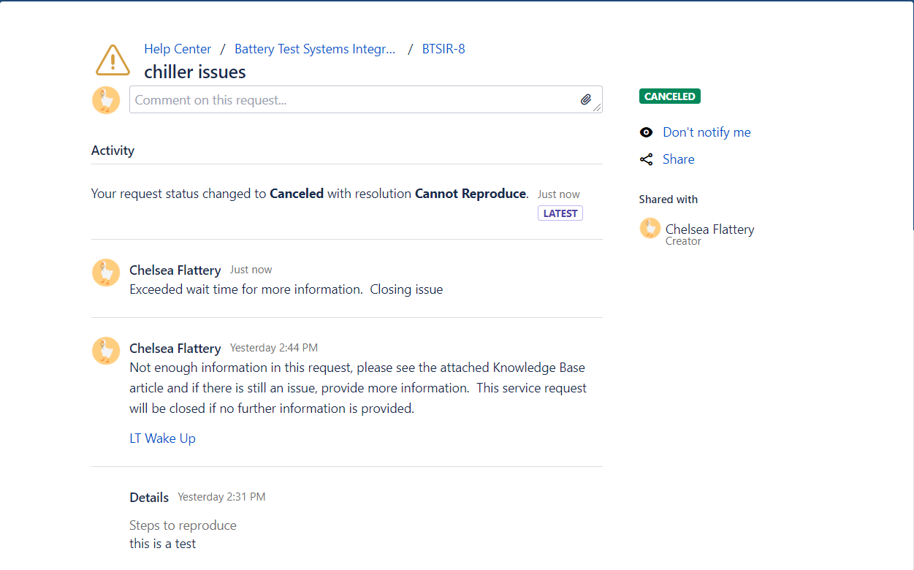
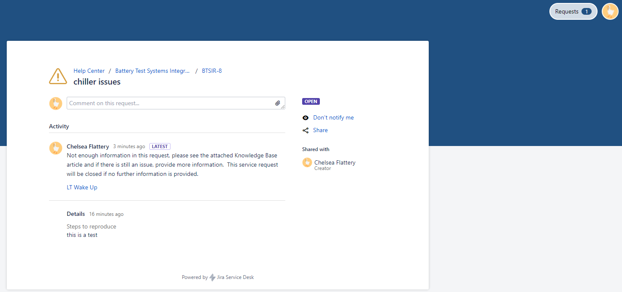
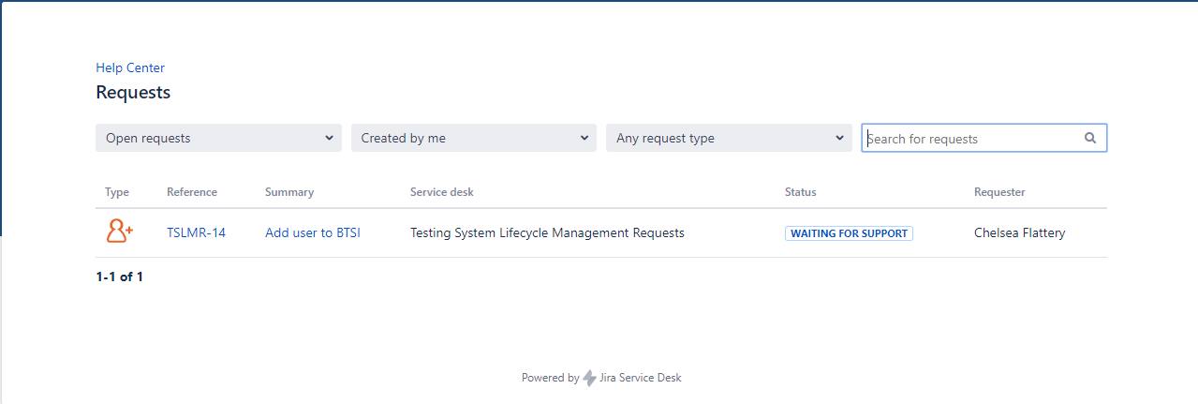
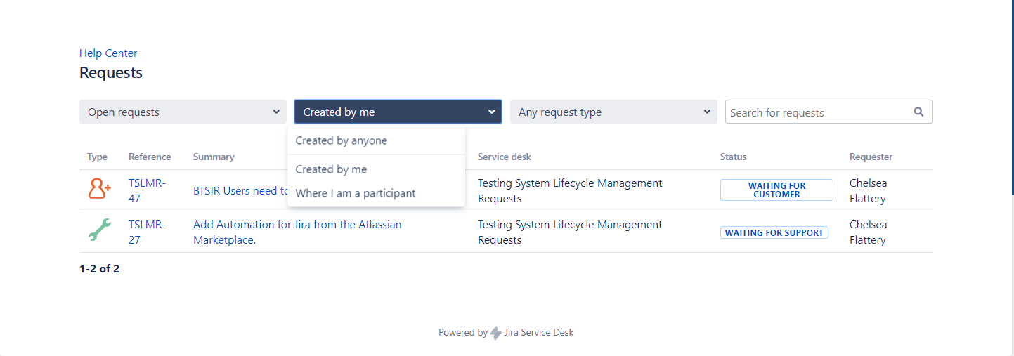
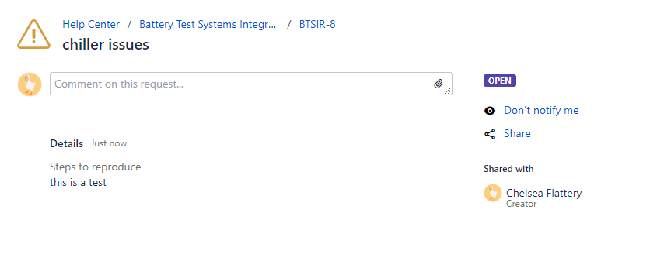
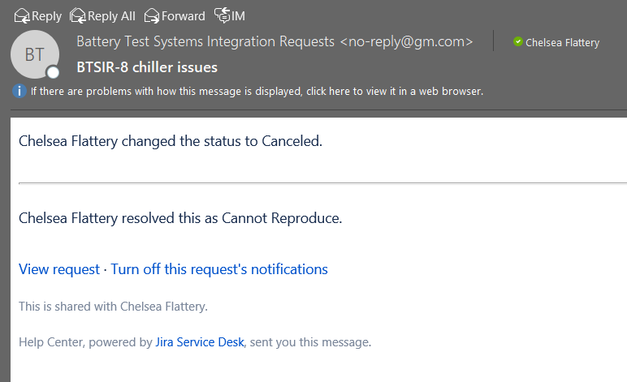
Then what?
An email is sent to confirm receipt
Comments and attachments can be added to the request
The Software Team will review the service request
Any responses will appear on the service request
View your open requests by clicking the Request button
Requests can be filtered and searched from the Requests link
If an issue was shared with you, change the Created by me drop down to Where I am a participant
Status update will be sent via email

Slide 7
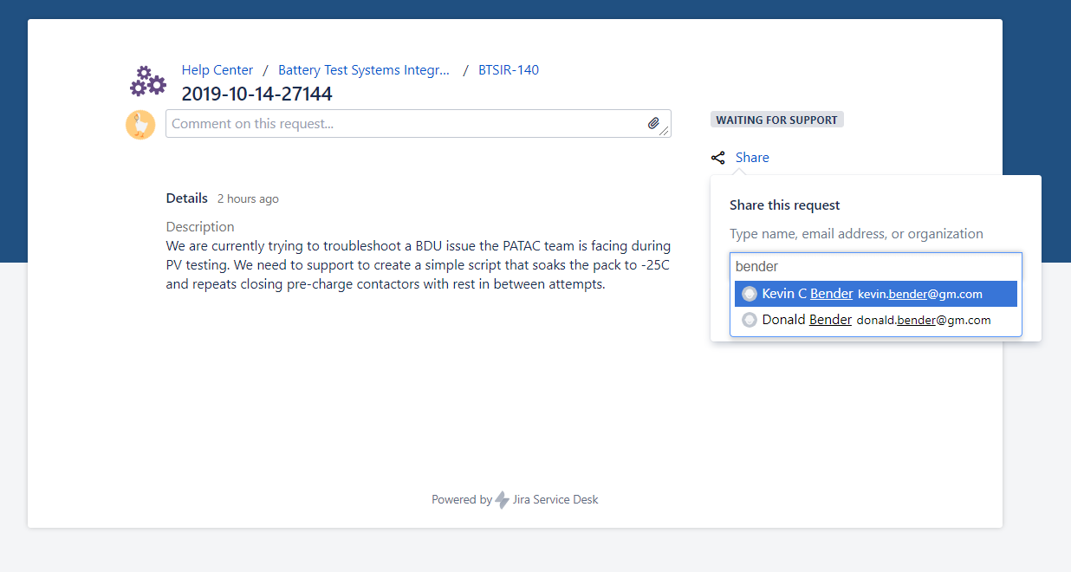
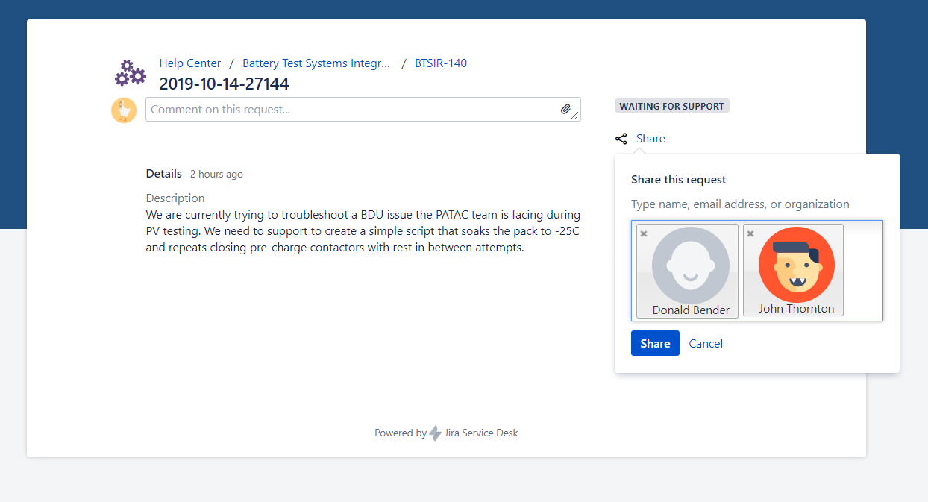
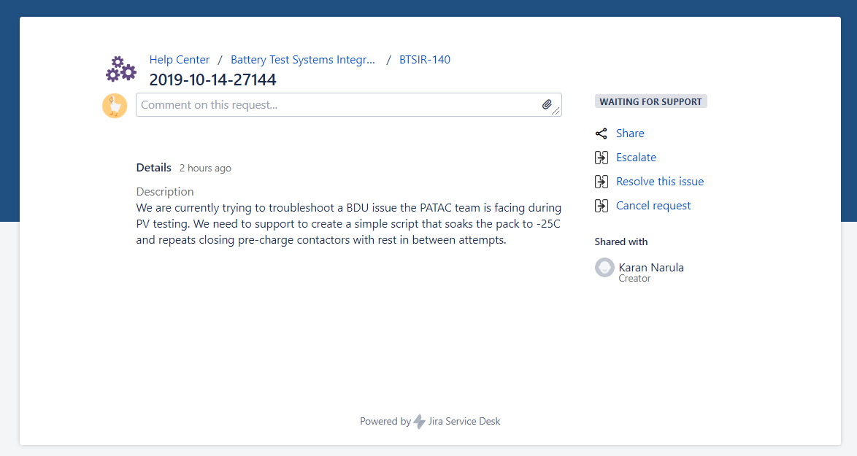
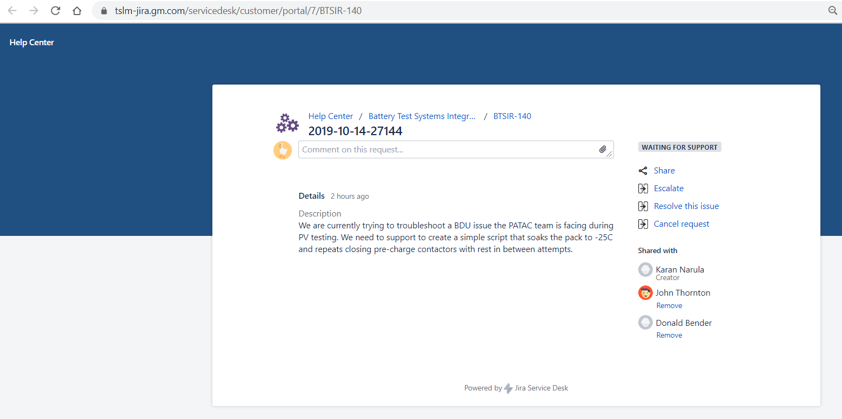
Sharing your Request with Other Users
To share your request with other users, click Share
Type their name and click to add them to the Share field and click Share
This must be completed by either the service request reporter (who entered the request) or a member of the LSIE Team
Once added, share the full servicedesk/customer/portal/7 URL and the added user will be able to view the Service Request

