Slide 1
Version 2.2
Upgrades, Enhancements, and Changes

Slide 2
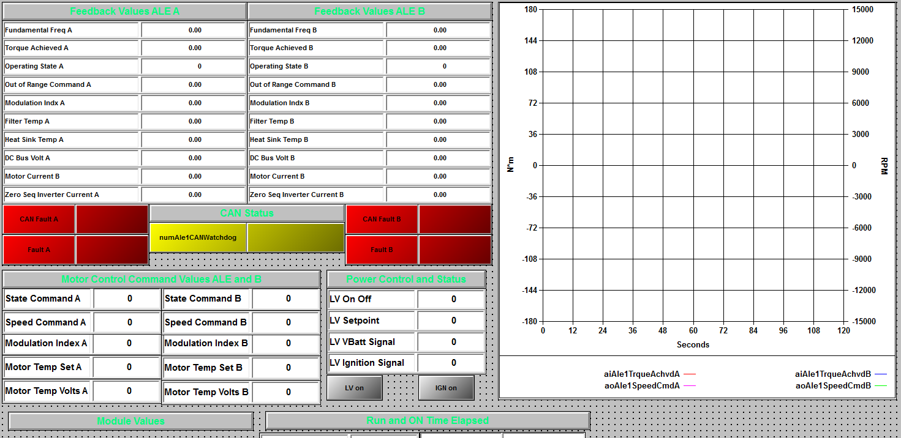
ALE integration
ALE Module was integrated
This emulates a 3 phase AC motor
Issue 1166/549, MR 665
Solved integration with non-ALE tests
Issue 1573, MR 776

Slide 3
Global B integration
iTest can now communicate with multiple ECUs on a CAN bus
Core CAN procedures are now in the folder “BLINC1CAN_Core”
Global B procedures are in the folder “BLINC1CANGB”
Issue 1172, MR 697

Slide 4
Safety Thermocouple Changes
Using V2.2, it is no longer necessary to use a dummy TC
Eliminate TC Pull callout if there is no pack. (Issue 1574, MR 778)
Enforce a per program minimum TC count. (Issue 1179, MR 759)

Slide 5
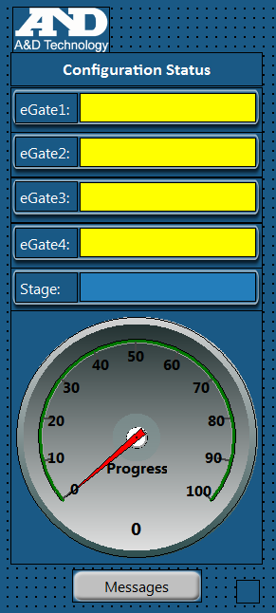
EGate Initialization Enhancement
Made the EGate initialization more robust
Provides a new GUI to track initialization progress
Issue 1269/1082, MR 711

Slide 6
Misc Changes
Restructure active cell balancing (Issue 1294/976/128, MR 672)
Enhance FrostD1 to allow mid-cycle resume (Issue 1252, MR 763)
Notify user if GoToNominal takes too long (Issue 1248/1134, MR 714)
Fix possibilities of Npt getting stuck at end (Issue 1234/1164/1163, MR 695/676)
Migrated GoToSOC from Sequence to Procedure (Issue 1151, MR 708)
Enforce “continuous” battery cell limits (Issue 1108, MR 655)
Wait during weld check for “tacked” contactor (Issue 1218/1214, MR 710)
Consolidate contactor closure logs (Issue 1213, MR 710)
Add flow/pressure sensor to chiller display (Issue 930, MR 516)

Slide 7
Misc Changes (2)
Add OCV mode to Ship1 test (Issue 1159, MR 729)
Add display relevant fields on several tests (Issue 172, MR 764)
Sanitizer improvements (Issue 1493/1223, MR 768/685)
Fix iTest running on software team laptops (Issue 1320, MR 1320)
Improve “git” contribution statistics (Issue 1305, MR 730)
Remove remnants of test stand 25 (Issue 1292, MR 732)
Remove obsolete option (Pulse Type) from HPPC (Issue 1281, MR 716)
Remove duplicate channels from Maintrans.LOL (Issue 1262, MR 707)
Fix “offsite” mode (Issue 1253, MR 719)
Fix SysLogOperatorNotes during SysLimitAction (Issue 1197, MR 675)

Slide 8
Misc Changes (3)
Standardize names of Batt1 procedures (Issue 1142, MR 728)
Refactor test start battery controller diagnostics (Issue 1106/1282, MR 1095/721)
Remove unused VICM channels (Issue 809, MR 673)
Rename chiller PID loop (Issue 162, MR 755)
Rvibe misc improvements (Issue 1321/1240/284/1322, MR 737)
Improve chamber control from channels other than A (Issue 1291, MR 771)
Updated Powertek.ini for 3.7 compatibility (Issue 1638, MR 786)

